Slide 1
Chapter 5
Evolution of Biodiversity
Friedland and Relyea Environmental Science for AP®, second edition ©2015 W.H. Freeman and Company/BFW
AP® is a trademark registered and/or owned by the College Board®, which was not involved in the production of, and does not endorse, this product.

Slide 2
Module 14 The Biodiversity of Earth
After reading this module you should be able to
understand how we estimate the number of species living on Earth.
quantify biodiversity.
describe patterns of relatedness among species using a phylogeny.

Slide 3
It is difficult to estimate the number of species on Earth
The number of species in any given place is a common measure of biodiversity, but estimating the total number of species on Earth is a challenge.
Scientists have named approximately 2 million species, which means the total must be larger.

Slide 4
We can measure biodiversity in terms of species richness and evenness
Species richness The number of species in a given area.
Species evenness The relative proportion of individuals within the different species in a given area.
Knowing the species richness or evenness of an ecosystem gives environmental scientists a baseline they can use to determine how much an ecosystem has changed.

Slide 5
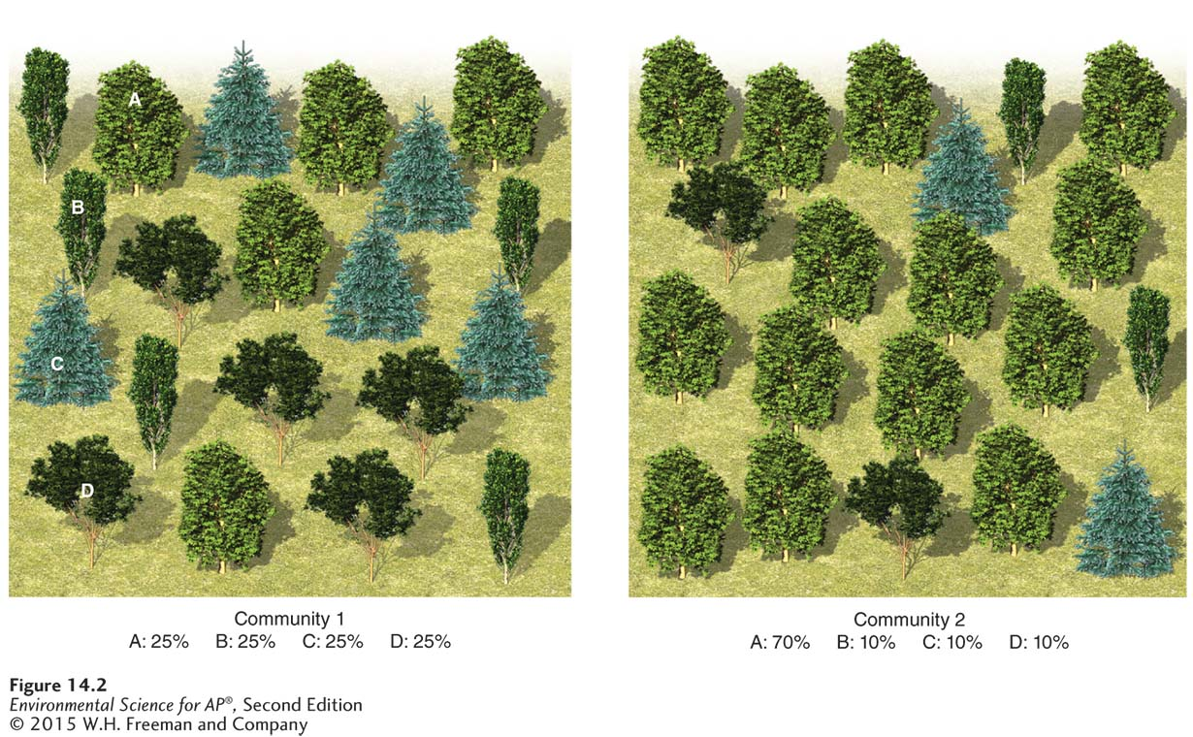
Measuring Biodiversity
Measures of species diversity. Species richness and species evenness are two different measures of species diversity. Although both communities contain the same number of species, community 1 has a more even distribution of species and is therefore more diverse than community 2.

Slide 6
The evolutionary relationship among species can be illustrated using a phylogeny
Phylogeny The branching pattern of evolutionary relationships.
The more similar the traits of two species, the more closely related the two species are assumed to be.

Slide 7
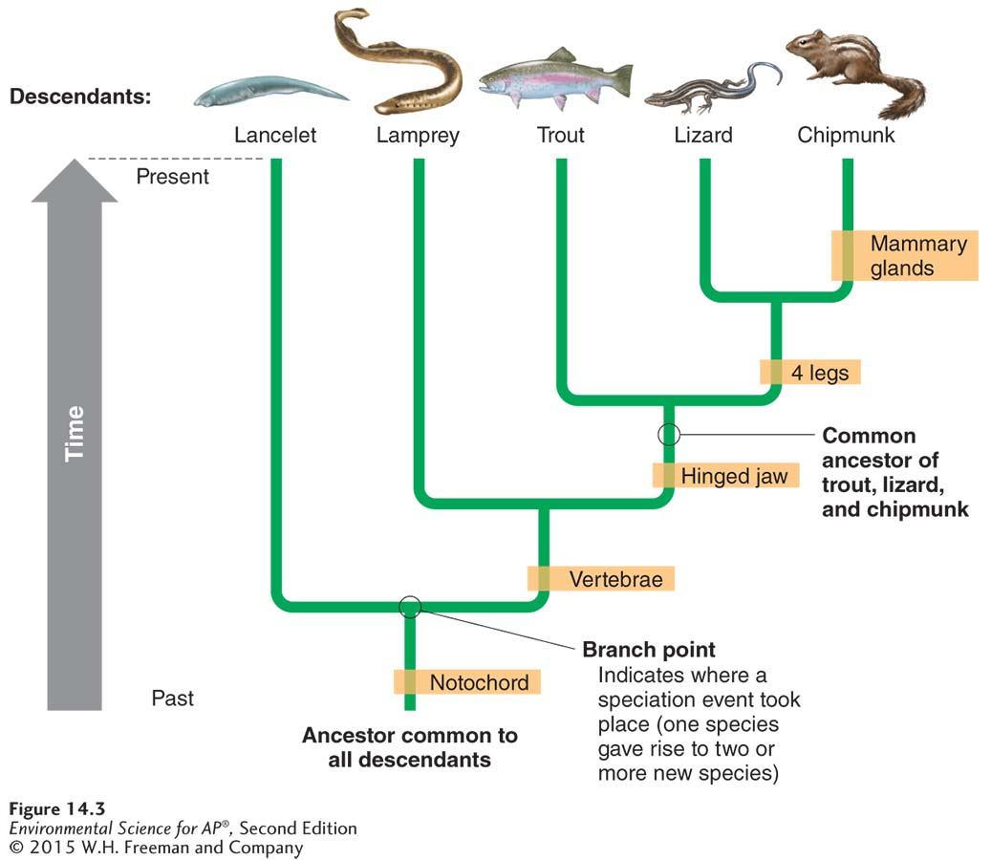
Phylogeny
A phylogenetic tree. Phylogenies are based on the similarity of traits among species. Scientists can assemble phylogenetic trees that indicate how different groups of organisms are related and show where speciation events have occurred. The brown boxes indicate when major morphological changes evolved over evolutionary time.

Slide 8
Module 15 How Evolution Creates Biodiversity
After reading this module you should be able to
identify the processes that cause genetic diversity.
explain how evolution can occur through artificial selection.
explain how evolution can occur through natural selection.
explain how evolution can occur through random processes.

Slide 9
Genetic diversity is created through mutation and recombination
Evolution A change in the genetic composition of a population over time.
Microevolution Evolution below the species level.
Macroevolution Evolution that gives rise to new species, genera, families, classes, or phyla.
Gene A physical location on the chromosomes within each cell of an organism.

Slide 10
Genotypes versus phenotypes
Genotype The complete set of genes in an individual.
Phenotype A set of traits expressed by an individual.
Genotypes help determine the traits of individuals

Slide 11
Mutation
Mutation A random change in the genetic code produced by a mistake in the copying process.
When mutations occur in cells responsible for reproduction those mutations can be passed on to the next generation.
Sometimes a mutation improves an organism’s chances of survival or reproduction. If such a mutation is passed along to the next generation, it adds new genetic diversity to the population.

Slide 12
Recombination
Recombination The genetic process by which one chromosome breaks off and attaches to another chromosome during reproductive cell division.
This process does not create new genes, but brings together new combinations of alleles on a chromosome, producing new traits.
For example, the human immune system must battle a large variety of viruses and bacteria that regularly attempt to invade the body. Recombination allows new allele combinations to come together, which provides new immune defenses.

Slide 13
Evolution can occur through artificial selection
Evolution by artificial selection The process in which humans determine which individuals breed, typically with a preconceived set of traits in mind.
Artificial selection has produced numerous breeds of livestock and pets.
Most modern agricultural crops are the result of many years of careful breeding.
Artificial selection can also produce a unintended results such as herbicide resistance.

Slide 14
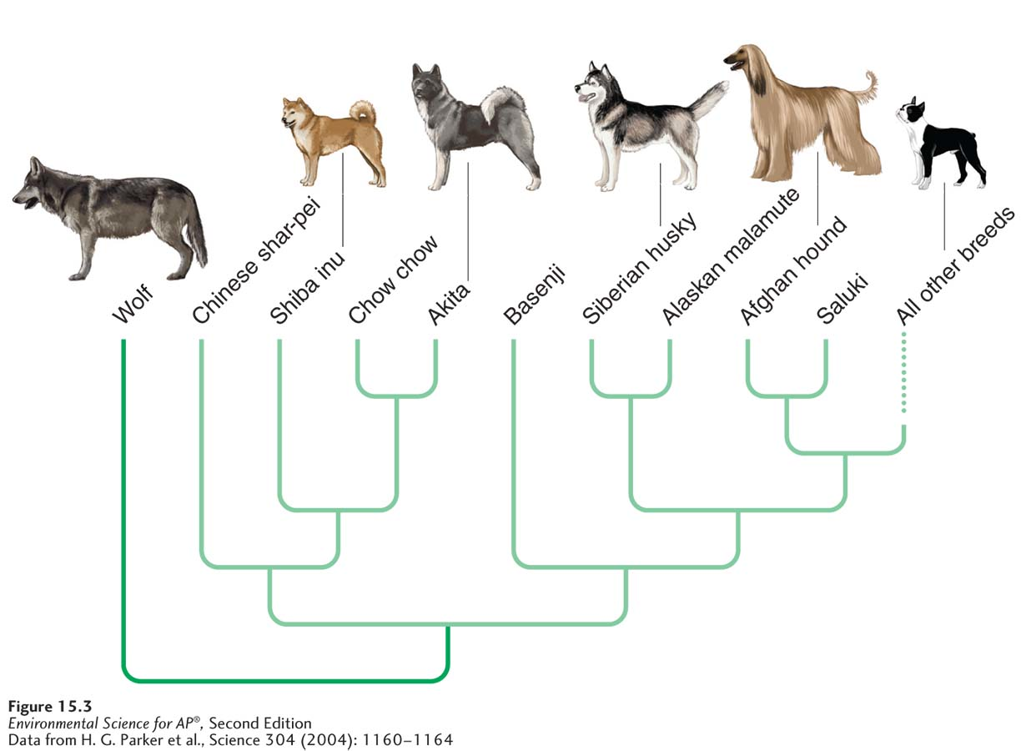
Artificial Selection
Artificial selection on animals. The diversity of domesticated dog breeds is the result of artificial selection on wolves. The wolf is the ancestor of the various breeds of dogs. It is illustrated at the same level as the dogs in this phylogeny because it is a species that is still alive today.

Slide 15
Evolution can occur through natural selection
Evolution by natural selection The process in which the environment determines which individuals survive and reproduce.
Key ideas of the theory of evolution:
Individuals produce an excess of offspring.
Not all offspring can survive.
Individuals differ in their traits.
Differences in traits can be passed on from parents to offspring.
Differences in traits are associated with differences in the ability to survive and reproduce.

Slide 16
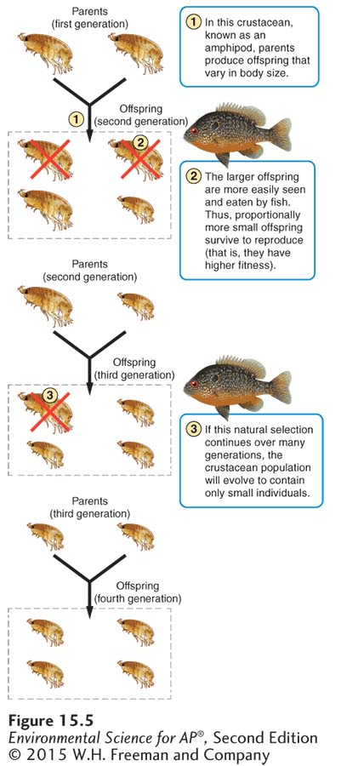
Natural Selection
Natural selection. All species produce an excess number of offspring. Only those offspring with the fittest genotypes will pass on their genes to the next generation.

Slide 17
Natural Selection
Natural selection favors any combination of traits that improves an individual’s fitness.
Fitness An individual’s ability to survive and reproduce.
Adaptation A trait that improves an individual’s fitness.

Slide 18
Evolution can also occur through random processes
There are five random processes through which evolution occurs:
Mutation
Gene flow
Genetic drift
Bottleneck effects
Founder effects

Slide 19
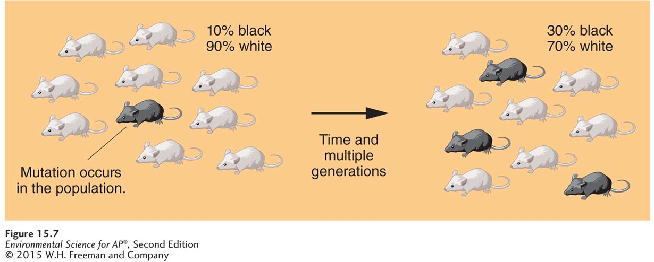
Mutation
As the number of mutations accumulates in a population over time, evolution occurs.
Evolution by mutation. A mutation can arise in a population and if it is not lost
it may increase in frequency over time.

Slide 20
Gene Flow
Gene flow The process by which individuals move from one population to another and thereby alter the genetic composition of both populations.
The arrival of individuals from adjacent populations alters the frequency of alleles in the population.
In a population that is experiencing natural or artificial selection, high gene flow from outside can prevent the population from responding to selection.
Gene flow can be helpful in bringing in genetic variation to a population that lacks it.

Slide 21
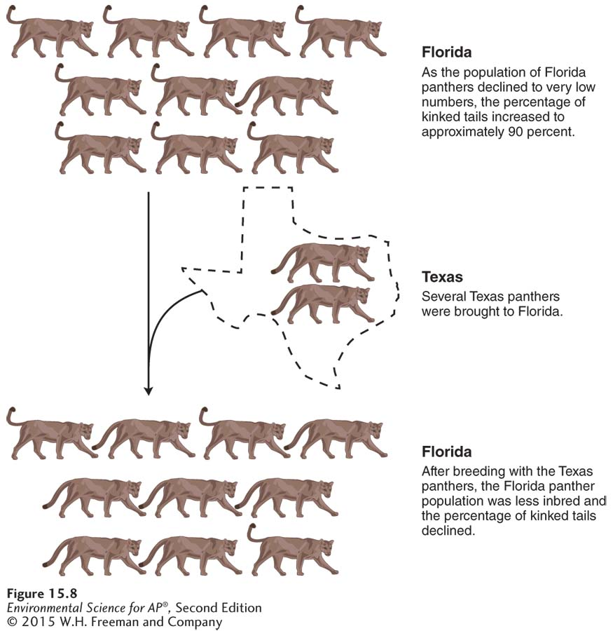
Gene Flow
Evolution by gene flow. As the Florida panther declined in population
size, the animals experienced low genetic variation and showed signs of inbreeding, which lead to kinky tails, heart defects, and low sperm counts. With the introduction of eight
panthers from Texas, the Florida population experienced a decline
in the prevalence of defects and a growth in population from 30 to 160
individuals.

Slide 22
Genetic Drift
Genetic drift A change in the genetic composition of a population over time as a result of random mating.
Like mutation and gene flow, genetic drift is a nonadaptive, random process.
Can be particularly important role in altering the genetic composition of small populations.

Slide 23
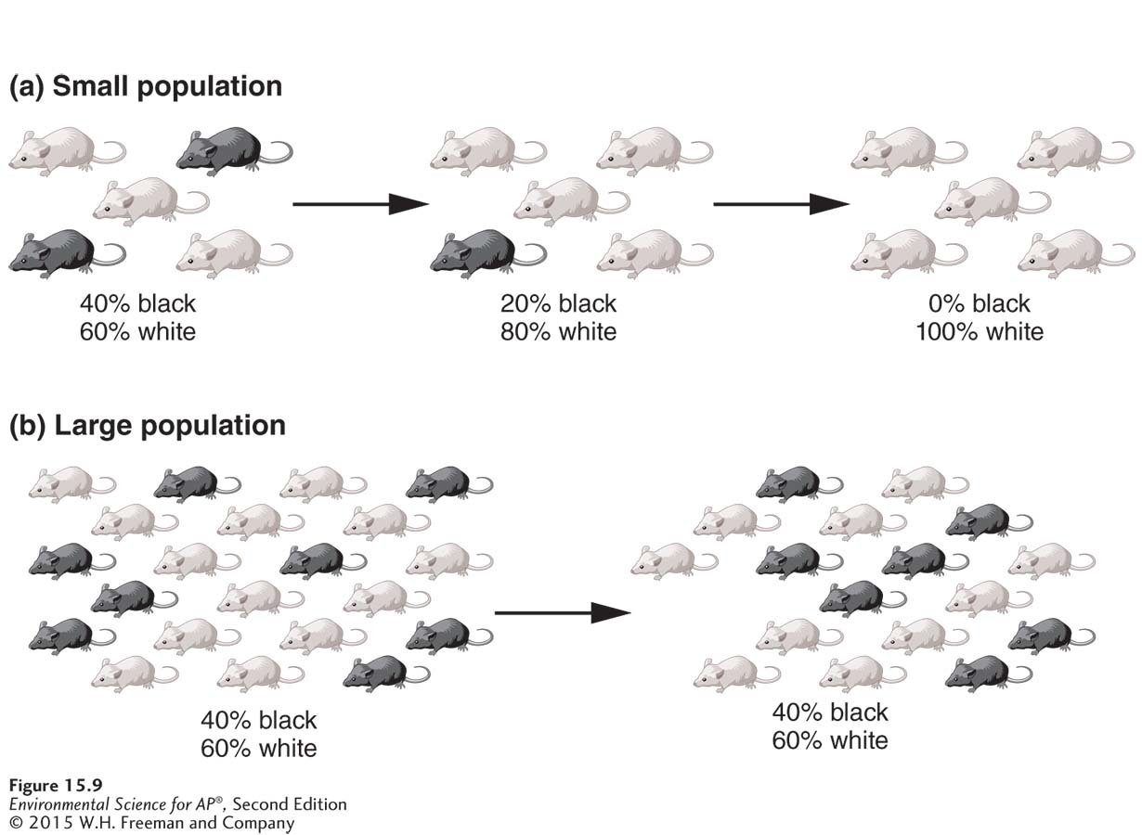
Genetic Drift
Evolution by genetic drift. (a) In a small population, some less-common genotypes can be lost by chance as random mating among a small number of individuals can result in the less-common genotype not mating. As a result, the genetic composition can change over time. (b) In a large population, it is more difficult for the less-common genotypes to be lost by chance because the absolute number of these individuals is large. As a result, the genetic composition tends to remain the same over time in larger populations.

Slide 24
Bottleneck Effect
Bottleneck effect A reduction in the genetic diversity of a population caused by a reduction in its size.
Reduced population numbers means reduced genetic variation.
Low genetic variation in a population can cause increased risk of disease and low fertility.
The bottleneck effect means species are less able to adapt to future environmental changes.
Resulting low diversity can lead to decline and extinction.
Extinction The death of the last member of a species.

Slide 25
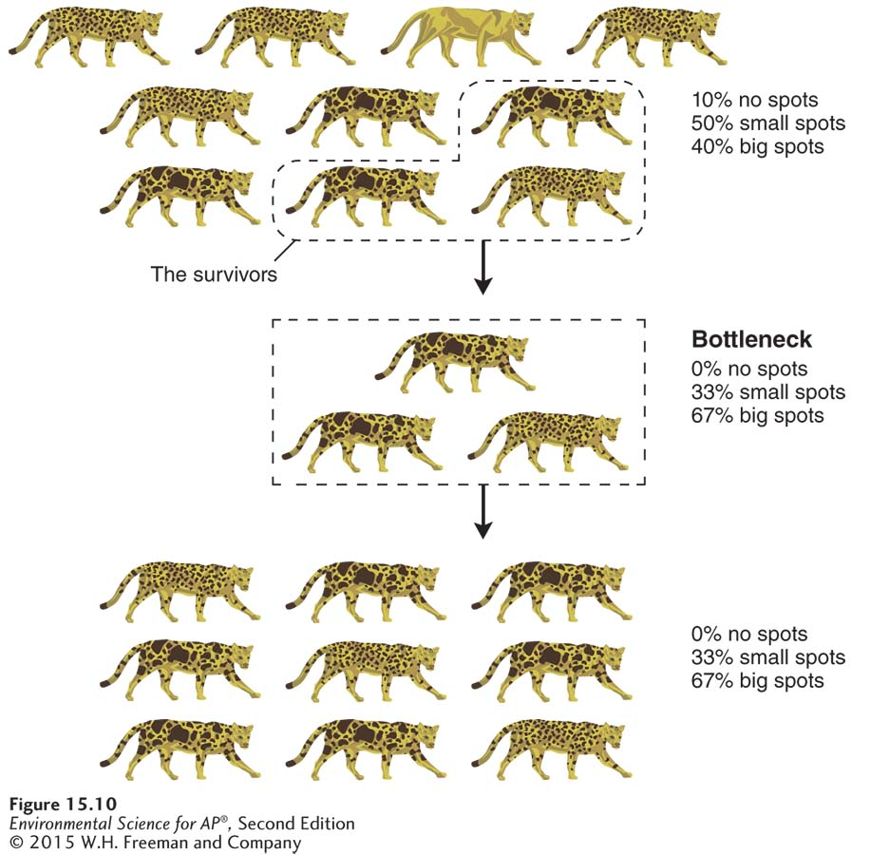
Bottleneck Effect
Evolution by the bottleneck effect. If a population experiences a drastic decrease in size (goes through a “bottleneck”), some genotypes will be lost, and the genetic composition of the survivors will differ from the composition of the original group.

Slide 26
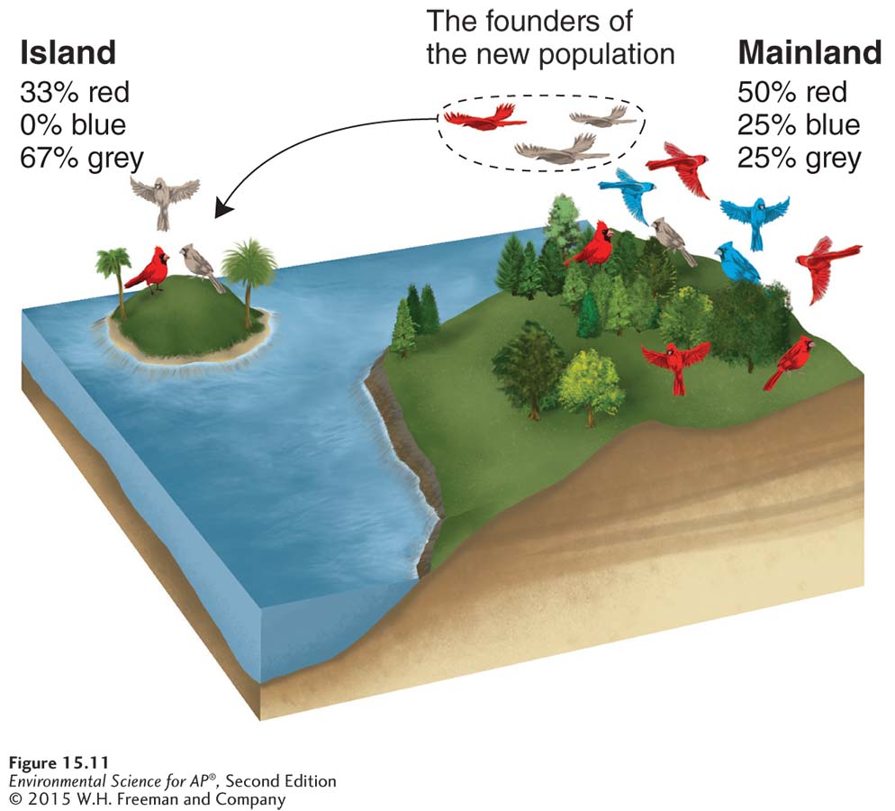
Founder Effect
Founder effect A change in the genetic composition of a population as a result of descending from a small number of colonizing individuals.
Evolution by the founder effect. If a few individuals from a mainland population colonize an island, the genotypes on the island will represent only a subset of the genotypes present in the
mainland population. As with the bottleneck effect, some genotypes will not be present in the new population.

Slide 27
Module 16 Speciation and the Pace of Evolution
After reading this module you should be able to
explain the processes of allopatric and sympatric speciation.
understand the factors that affect the pace of evolution.

Slide 28
Speciation can be allopatric or sympatric
New species commonly evolve through two processes:
Allopatric speciation The process of speciation that occurs with geographic isolation.
Sympatric speciation The evolution of one species into two, without geographic isolation.

Slide 29
Allopatric Speciation
Geographic isolation Physical separation of a group of individuals from others of the same species.
Reproductive isolation The result of two populations within a species evolving separately to the point that they can no longer interbreed and produce viable offspring.

Slide 30
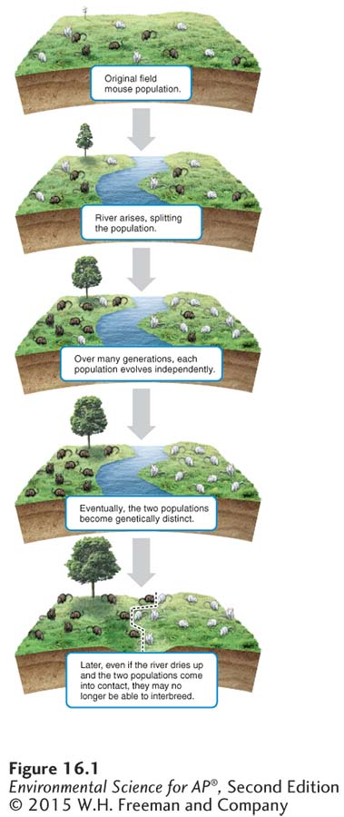
Allopatric Speciation
Allopatric speciation. Geographic barriers can split populations. Natural selection may favor different traits in
the environment of each isolated population, resulting in different adaptations. Over time, the two populations may become so genetically
distinct that they are no longer capable of interbreeding.
Notes:
Decided to make this a new slide

Slide 31
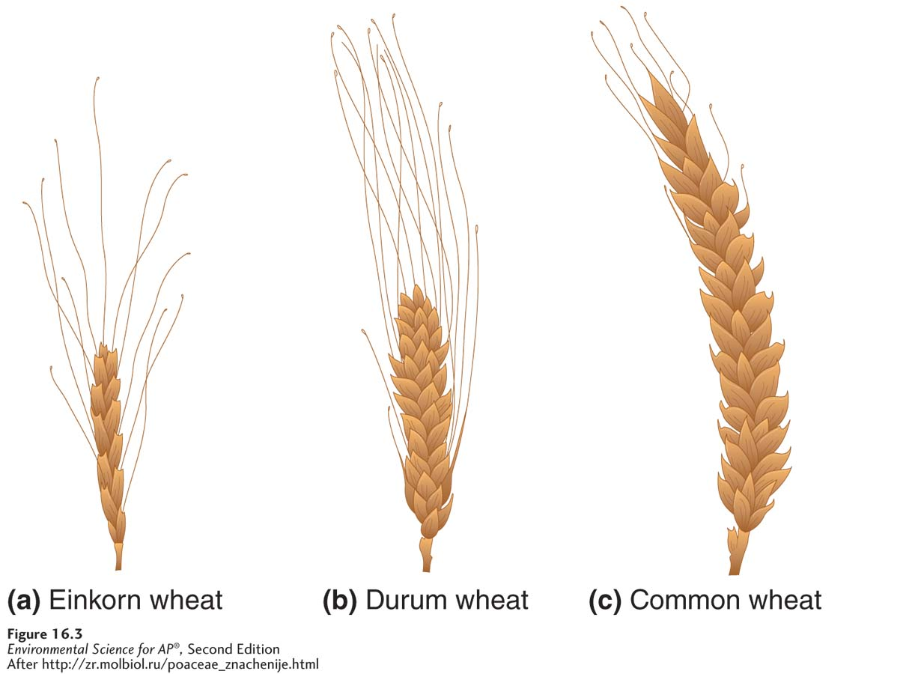
Sympatric Speciation
Usually happens through polyploidy
Sympatric speciation. Flowering plants such as wheat commonly form new species through the process of polyploidy, an increase in the number of sets of chromosomes beyond the normal two sets. (a) The ancestral einkorn wheat (Triticum boeoticum) has two sets of chromosomes and produces small seeds. (b) Durum wheat (Triticum durum), which is used to make pasta, was bred to have four sets of chromosomes and produces medium-sized seeds. (c) Common wheat (Triticum aestivum), which is used mostly for bread, was bred to have six sets of chromosomes and produces the largest seeds.

Slide 32
The pace of evolution depends on several factors
A species can survive an environmental change if it can quickly evolve adaptations to new conditions.
Slow rates of evolution occur when a population has long generation times or contains low genetic variation.
Evolution by artificial selection can be very rapid.
Genetically modified organism (GMO) An organism produced by copying genes from a species with a desirable trait and inserting them into another species.

Slide 33
Module 17 Evolution of Niches and Species Distributions
After reading this module you should be able to
explain the difference between a fundamental and a realized niche.
describe how environmental change can alter species distributions.
discuss how environmental change can cause species extinctions.

Slide 34
Every species has a niche
Range of tolerance The limits to the abiotic conditions that a species can tolerate.
Fundamental niche The suite of abiotic conditions under which a species can survive, grow, and reproduce.
Realized niche The range of abiotic and biotic conditions under which a species actually lives.
Distribution Areas of the world in which a species lives.

Slide 35
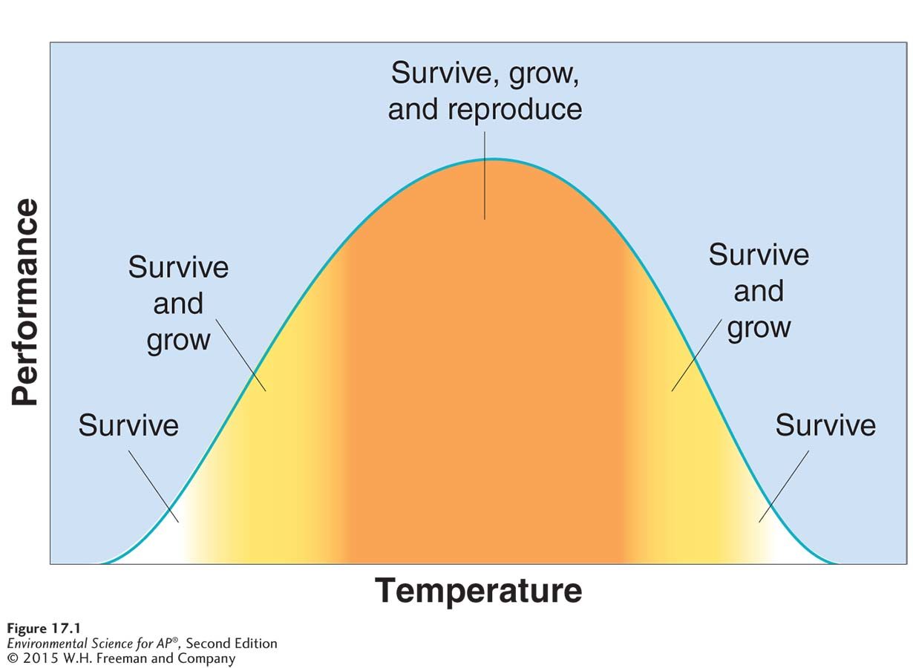
Species Niches
Every species has an optimal environment in which it performs particularly well.
Range of tolerance. All species have an ideal range of abiotic conditions, such as temperature, under which their members can survive, grow, and reproduce. Under more extreme
conditions, their ability to perform these essential functions declines.

Slide 36
Species Niches
Niche generalist A species that can live under a wide range of abiotic or biotic conditions.
Niche specialist A species that is specialized to live in a specific habitat or to feed on a small group of species.
Niche specialists do well when environmental conditions remain relatively constant; however loss of a favored habitat or food source leaves them with few alternatives for survival.
Niche generalists fare better under changing conditions because they have a number of alternative habitats and food sources available.

Slide 37
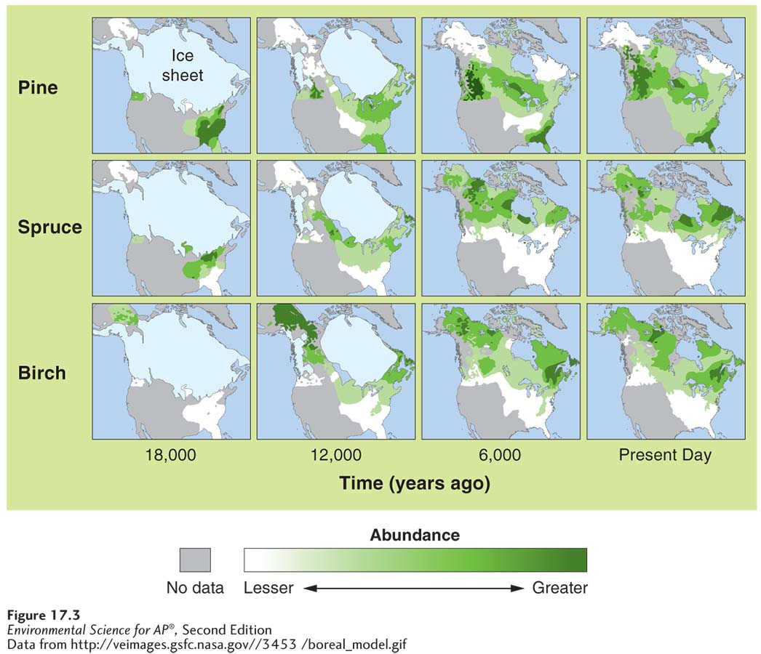
Environmental change can alter the distribution of species
Changes in tree species distributions
over time. Pollen recovered
from lake sediments indicates
that plant species moved north as temperatures warmed following the retreat of the glaciers, beginning about 12,000 years ago. Areas shown in color or white were sampled for pollen, whereas areas shown in gray were not sampled.

Slide 38
Environmental change can cause species extinctions
If environmental conditions change, species that cannot adapt to the changes or move to more favorable environments will eventually go extinct.
The average life span of a species appears to be only about 1 million to 10 million years; 99 percent of the species that have ever lived on Earth are now extinct.
Mass extinction A large extinction of species in a relatively short period of time.

Slide 39
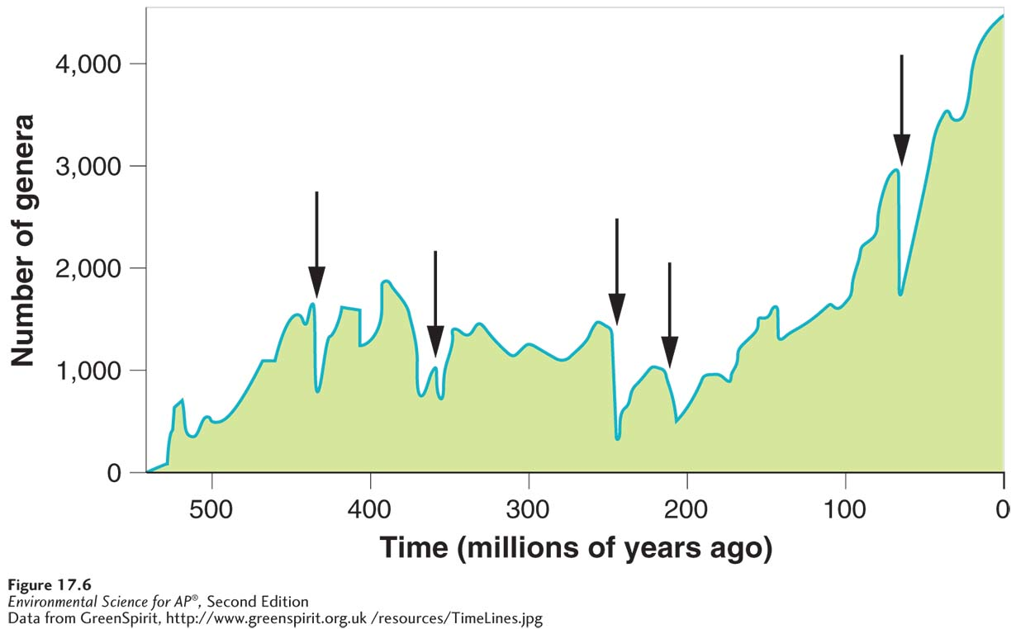
Five Global Mass Extinctions
Mass extinctions. Five global mass extinction events have occurred since the
evolution of complex life roughly 500 million years ago.

