Slide 1
Chapter 6
Population and Community Ecology
Friedland and Relyea Environmental Science for AP®, second edition ©2015 W.H. Freeman and Company/BFW
AP® is a trademark registered and/or owned by the College Board®, which was not involved in the production of, and does not endorse, this product.

Slide 2
Module 18 The Abundance and Distribution of Populations
After reading this module you should be able to
explain how nature exists at several levels of complexity.
discuss the characteristics of populations.
contrast the effects of density-dependent and density-independent factors on population growth.

Slide 3
Nature exists at several levels of complexity
Population The individuals that belong to the same species and live in a given area at a particular time.
Community All of the populations of organisms within a given area.
Population ecology The study of factors that cause populations to increase or decrease.

Slide 4
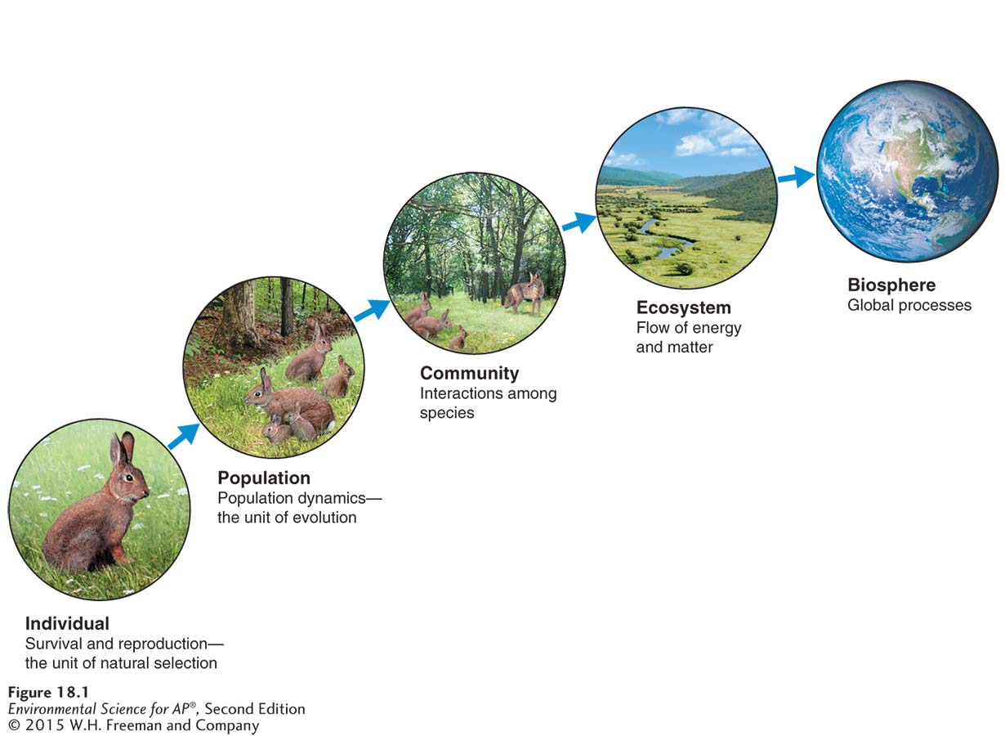
Levels of Complexity
Levels of complexity. Environmental scientists study nature at several different levels of complexity, ranging from the individual organism to the biosphere. At each level, scientists focus on different processes.

Slide 5
Populations have distinctive characteristics
There are 5 basic characteristics of a population:
Population size (N) The total number of individuals within a defined area at a given time.
Population density The number of individuals per unit area at a given time.
Population distribution A description of how individuals are distributed with respect to one another.
Sex ratio The ratio of males to females in a population.
Age structure A description of how many individuals fit into particular age categories in a population.

Slide 6
Population size is affected by density-dependent and density-independent factors
Factors that influence population size are either density-dependent or density-independent.
Density-dependent factor A factor that influences an individual’s probability of survival and reproduction in a manner that depends on the size of the population.
Density-independent factor A factor that has the same effect on an individual’s probability of survival and the amount of reproduction at any population size.

Slide 7
Module 19 Population Growth Models
After reading this module you should be able to
explain the exponential growth model of populations, which produces a J-shaped curve.
describe how the logistic growth model incorporates a carrying capacity and produces an S-shaped curve.
compare the reproductive strategies and survivorship curves of different species.
explain the dynamics that occur in metapopulations.

Slide 8
The exponential growth model describes populations that continuously increase
Population growth models Mathematical equations that can be used to predict population size at any moment in time.
Population growth rate The number of offspring an individual can produce in a given time period, minus the deaths of the individual or its offspring during the same period.
Intrinsic growth rate (r) The maximum potential for growth of a population under ideal conditions with unlimited resources.
Exponential growth model (N_{t} = N₀e^{rt} ) A growth model that estimates a population’s future size (N_{t} ) after a period of time (t), based on the intrinsic growth rate (r) and the number of reproducing individuals currently in the population (N₀).
J-shaped curve The curve of the exponential growth model when graphed.

Slide 9
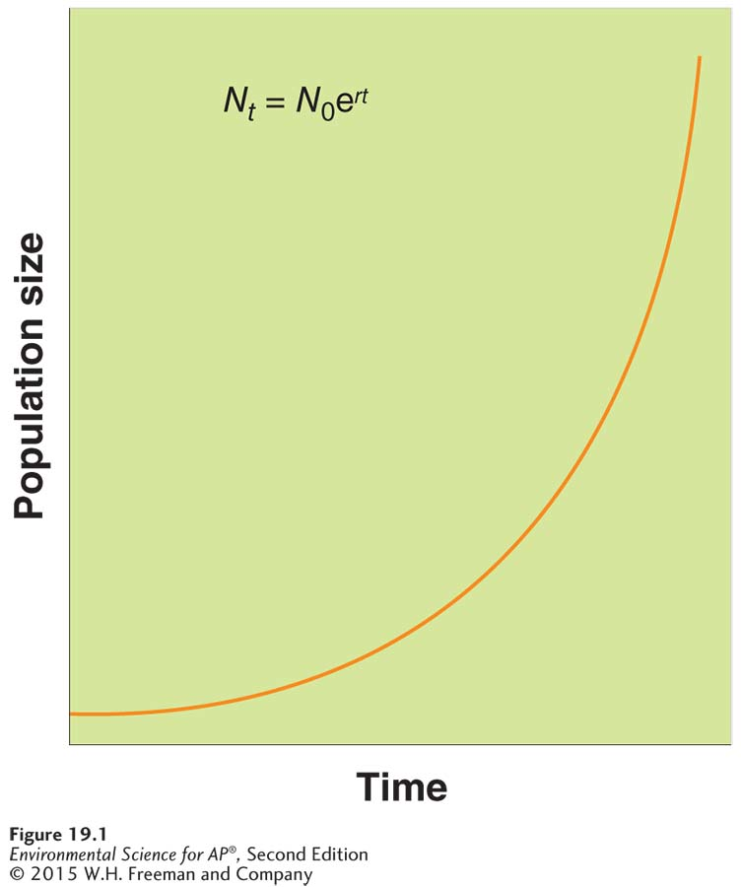
The Exponential Growth Model
The exponential growth model. When populations are not limited by resources, their growth can be very rapid. More births occur with each step in time, creating a J-shaped growth curve.

Slide 10
The logistic growth model describes populations that experience a carrying capacity
Populations do not typically experience exponential growth indefinitely. They are limited by resources and carrying capacity.
Limiting resource A resource that a population cannot live without and that occurs in quantities lower than the population would require to increase in size.
Carrying capacity (K) The limit of how many individuals in a population the environment can sustain.
The logistic growth model is more realistic because it incorporates environmental limits.
Logistic growth model A growth model that describes a population whose growth is initially exponential, but slows as the population approaches the carrying capacity of the environment.
S-shaped curve The shape of the logistic growth model when graphed.

Slide 11
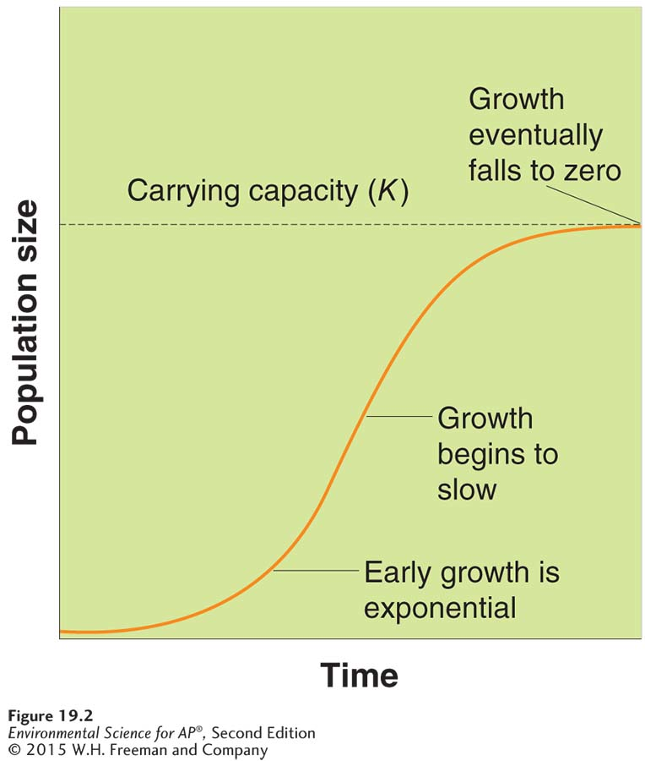
The Logistic Growth Model
The logistic growth model.
A small population initially experiences exponential growth. As the population becomes larger, however, resources become scarcer, and the growth rate slows. When the population size reaches the carrying capacity of the
environment, growth stops. As a result, the pattern of population growth follows an S-shaped curve.

Slide 12
The Logistic Growth Model
If food becomes scarce or other conditions change, a population can experience fluctuations.
Overshoot When a population becomes larger than the environment’s carrying capacity.
Die-off A rapid decline in a population due to death.

Slide 13
Species have different reproductive strategies and distinct survivorship curves
K-selected species A species with a low intrinsic growth rate that causes the population to increase slowly until it reaches carrying capacity.
r-selected species A species that has a high intrinsic growth rate, which often leads to population overshoots and die-offs.

Slide 14
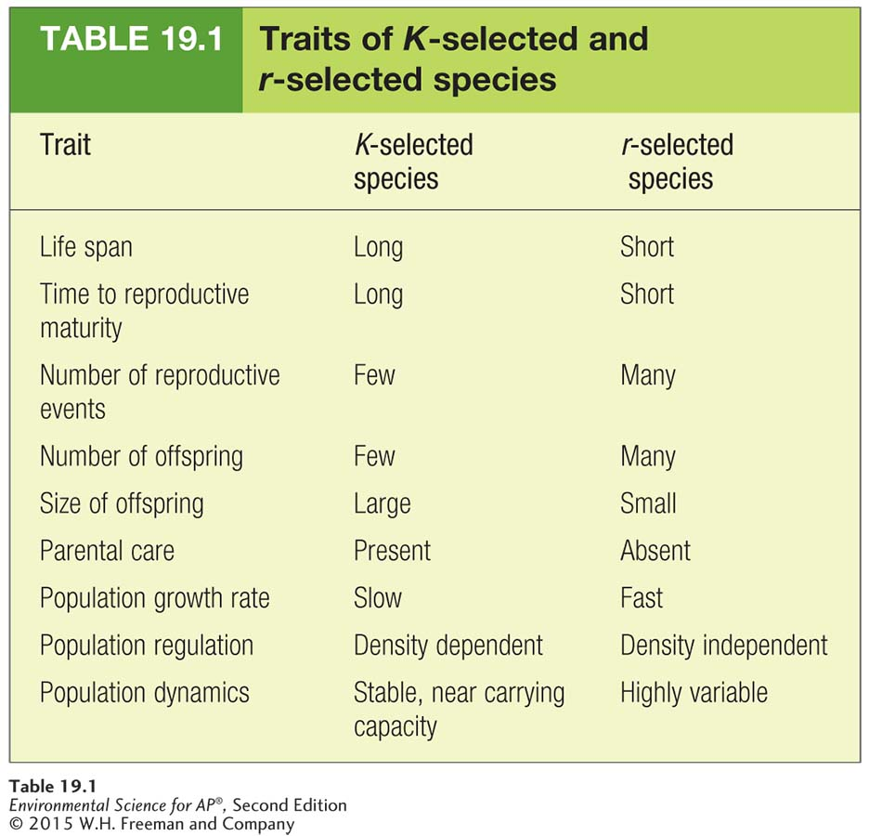
Reproductive Strategies

Slide 15
Survivorship Curves
Survivorship curve A graph that represents the distinct patterns of species survival as a function of age.
There are three types of survivorship curves:
Type I survivorship curve A pattern of survival over time in which there is high survival throughout most of the life span, but then individuals start to die in large numbers as they approach old age.
Type II survivorship curve A pattern of survival over time in which there is a relatively constant decline in survivorship throughout most of the life span.
Type III survivorship curve A pattern of survival over time in which there is low survivorship early in life with few individuals reaching adulthood.

Slide 16
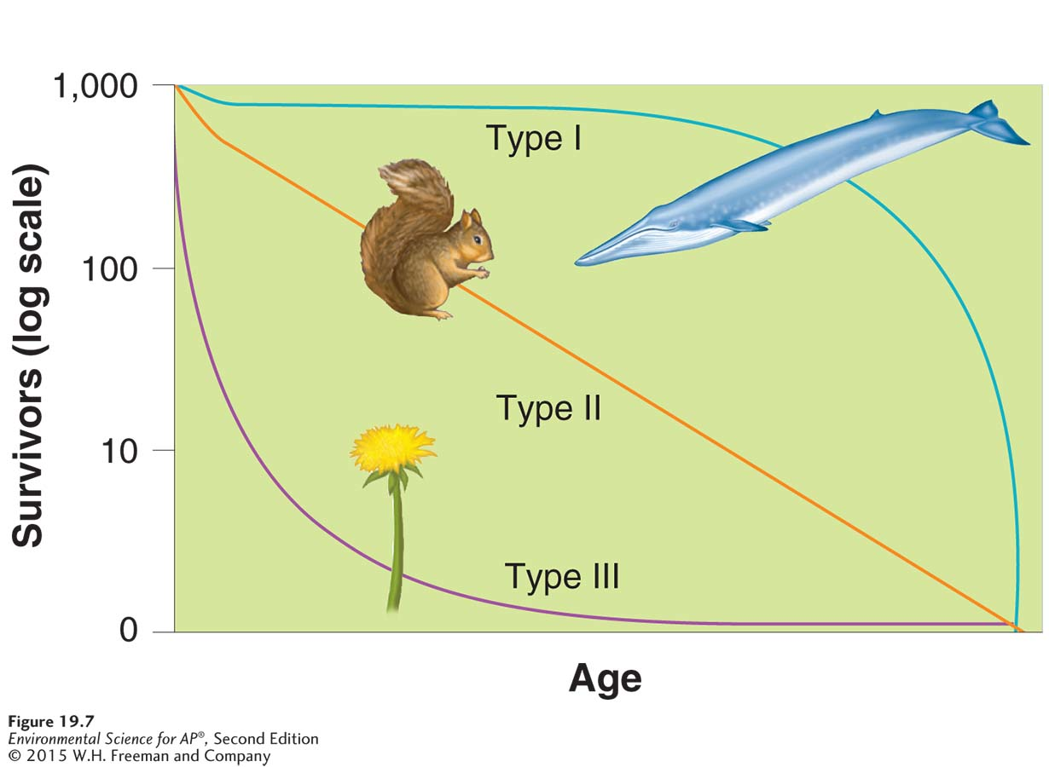
Survivorship Curves
Survivorship curves. Different species have distinct patterns of survivorship over the life span. Species range from exhibiting excellent survivorship until old age (type I curve) to exhibiting a relatively constant decline in survivorship over time (type II curve) to having very low rates of survivorship early in life (type III curve). K-selected species tend to exhibit type I curves, whereas r-selected species tend to exhibit type III curves.

Slide 17
Interconnected populations form metapopulations
Corridor Strips of natural habitat that connect populations.
Metapopulation A group of spatially distinct populations that are connected by occasional movements of individuals between them.
Inbreeding depression When individuals with similar genotypes—typically relatives—breed with each other and produce offspring that have an impaired ability to survive and reproduce.

Slide 18
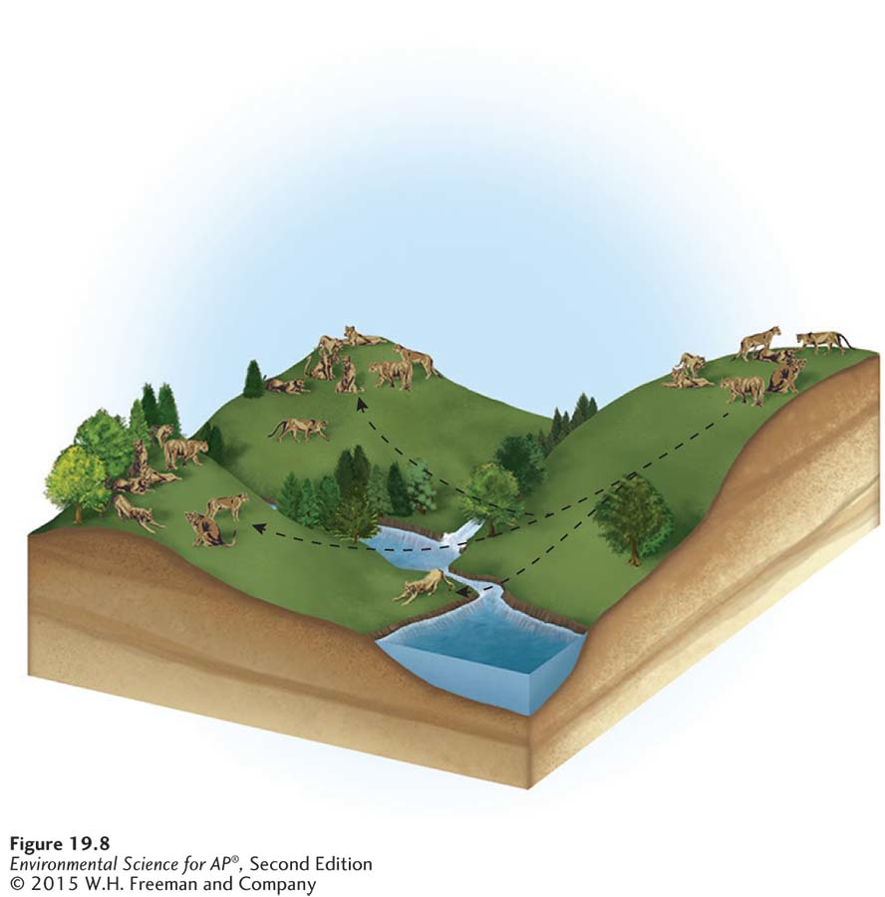
Metapopulations
A cougar metapopulation. Populations of cougars
live in separate mountain ranges in New Mexico. Occasionally, however, individuals move between mountain ranges. These
movements can recolonize mountain ranges with extinct populations and add individuals and genetic diversity to existing populations.

Slide 19
Module 20 Community Ecology
After reading this module you should be able to
identify species interactions that cause negative effects on one or both species.
discuss species interactions that cause neutral or positive effects on both species.
explain the role of keystone species.

Slide 20
Some species interactions cause negative effects on one or both of the species
Community ecology The study of interactions between species.
Throughout the world, species have symbiotic relationships.
Symbiotic relationship The relationship between two species that live in close association with each other.
Negative species interactions include:
Competition
Predation
Parasitism
Herbivory

Slide 21
Competition
Competition The struggle of individuals to obtain a shared limiting resource.
Competitive exclusion principle The principle stating that two species competing for the same limiting resource cannot coexist.
When two species have the same realized niche, one species will perform better and drive the other to extinction.

Slide 22
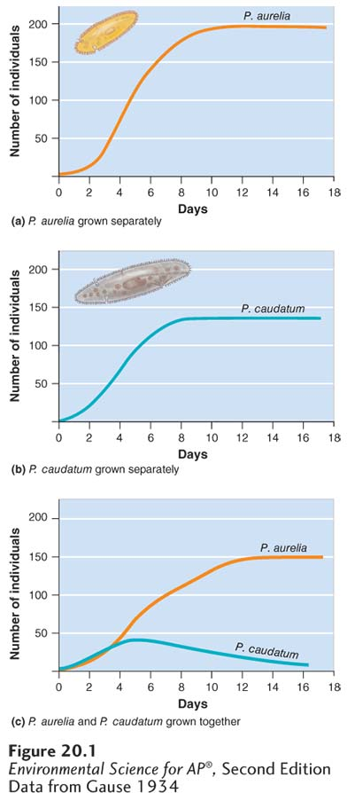
Competition
Competition for a limiting resource. When Gause grew two species of Paramecium separately, both achieved large population sizes. However, when the two species were grown together, P. aurelia continued to grow well, while P. caudatum declined to extinction. These experiments demonstrated that two species competing for the same limiting resource cannot coexist.

Slide 23
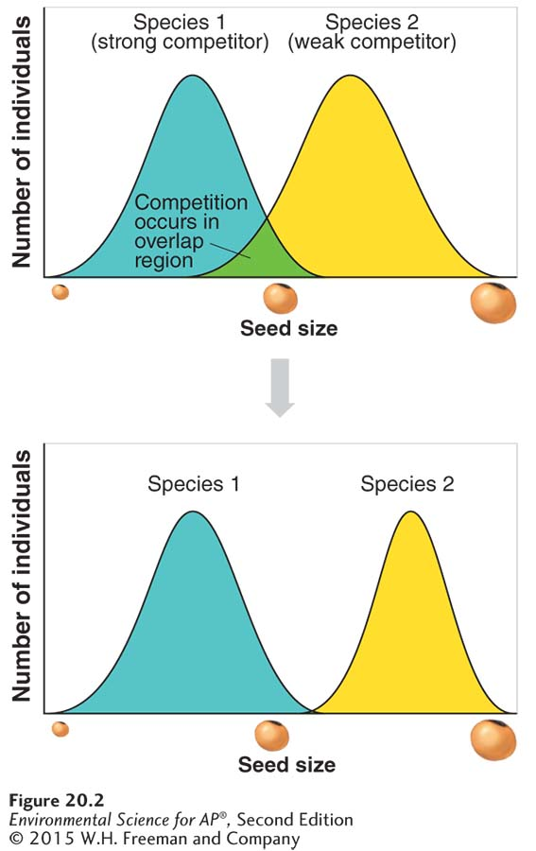
Competition
Resource partitioning When two species divide a resource based on differences in their behavior or morphology.
The evolution of resource partitioning.
(a) When two species overlap in their use of a limiting resource, selection
favors those individuals of each species whose use of the resource overlaps the least with that of the other species. (b) Over many generations, the two species can evolve to reduce their overlap and thereby partition their use of the limiting resource.

Slide 24
Predation
Predation An interaction in which one animal typically kills and consumes another animal.
Parasitoid A specialized type of predator that lays eggs inside other organisms—referred to as its host.
To avoid being eaten or harmed by predators, many prey species have evolved defenses.

Slide 25
Parasitism
Parasitism An interaction in which one organism lives on or in another organism.
Pathogen A parasite that causes disease in its host.
A single parasite rarely causes the death of its host.

Slide 26
Herbivory
Herbivory An interaction in which an animal consumes a producer.
When herbivores become abundant they can have dramatic effects on producers.
Many species of producers have evolved defenses against herbivores.

Slide 27
Other species interactions can cause neutral or positive effects on one or both species.
Mutualism An interaction between two species that increases the chances of survival or reproduction for both species.
Commensalism A relationship between species in which one species benefits and the other species is neither harmed nor helped.

Slide 28
Species Interactions

Slide 29
Keystone species have large effects on communities
Some species that are not abundant can still have very large effects on a community.
Keystone species A species that plays a far more important in its community than its relative abundance might suggest.
Ecosystem engineer A keystone species that creates or maintains habitat for other species.

Slide 30
Module 21 Community Succession
After reading this module you should be able to
explain the process of primary succession.
explain the process of secondary succession.
explain the process of aquatic succession.
describe the factors that determine the species richness of a community.

Slide 31
Primary succession starts with no soil.
Virtually every community experiences ecological succession.
Ecological succession The predictable replacement of one group of species by another group of species over time.

Slide 32
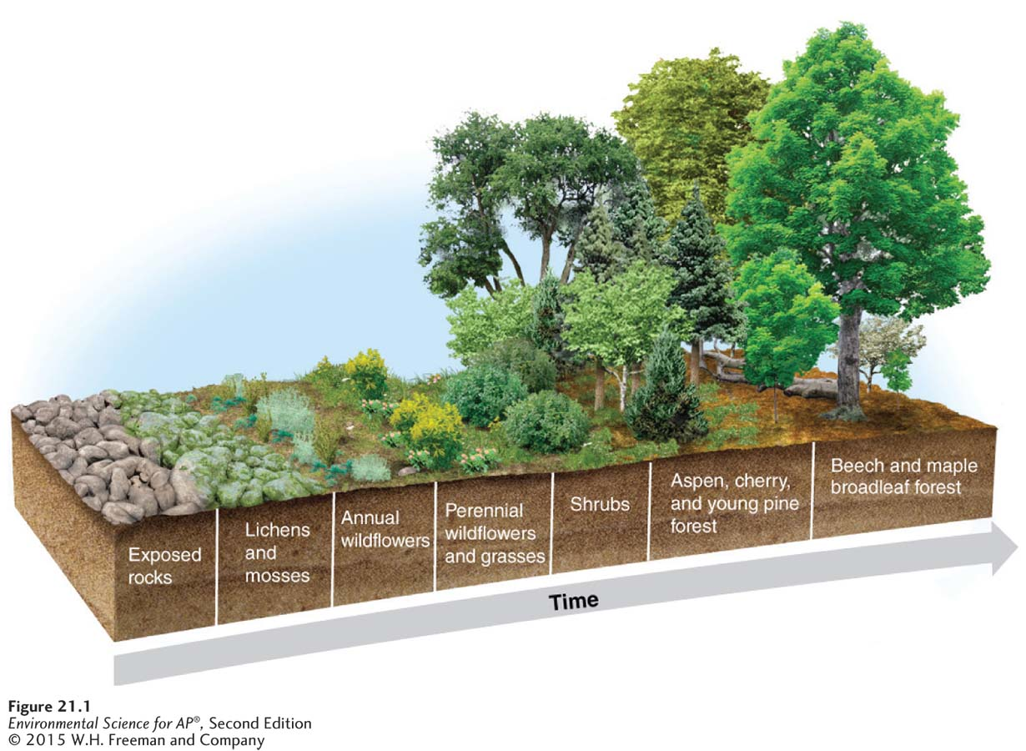
Primary Succession
Primary succession Ecological succession occurring on surfaces that are initially devoid of soil.
Primary succession. Primary succession occurs in areas devoid of soil. Early-arriving plants and algae can colonize bare rock and begin to form soil, making the site more hospitable for other species to colonize later. Over time, a series of distinct communities develops. In this illustration, representing an area in New England, bare rock is initially colonized by lichens and mosses and later by grasses, shrubs, and trees.

Slide 33
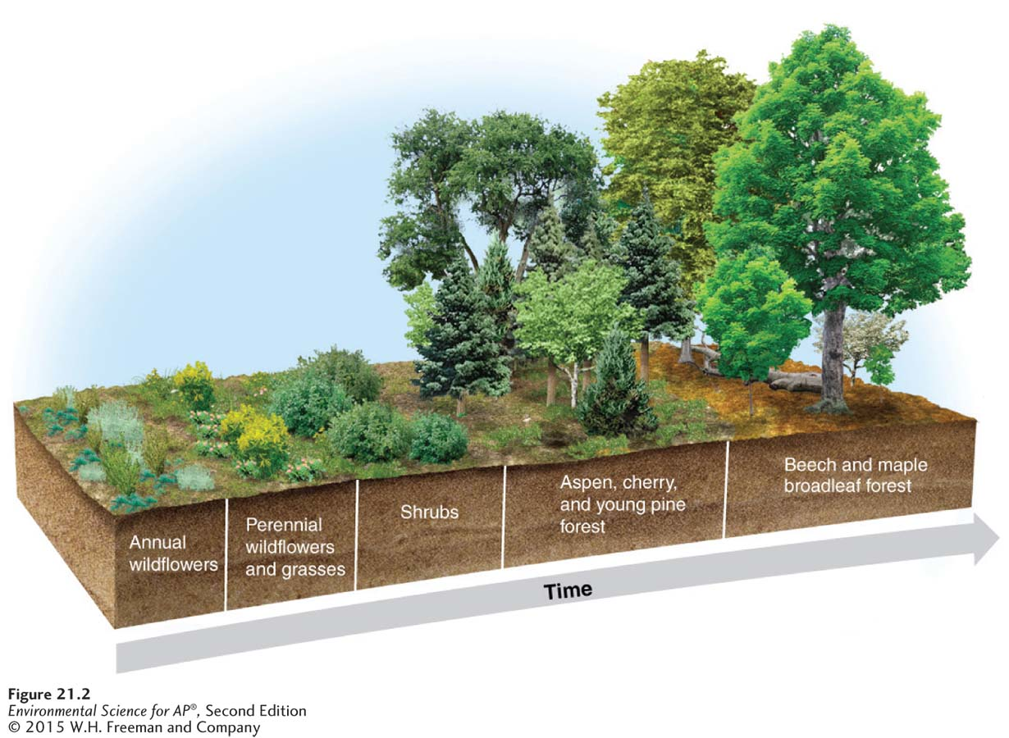
Secondary succession starts with soil
Secondary succession The succession of plant life that occurs in areas that have been disturbed but have not lost their soil.
Secondary succession. Secondary succession occurs where soil is present, but all plants have been removed. Early-arriving plants set these areas on a path of secondary succession. Secondary
succession in a New England forest begins with grasses and wildflowers, which are later replaced by trees.

Slide 34
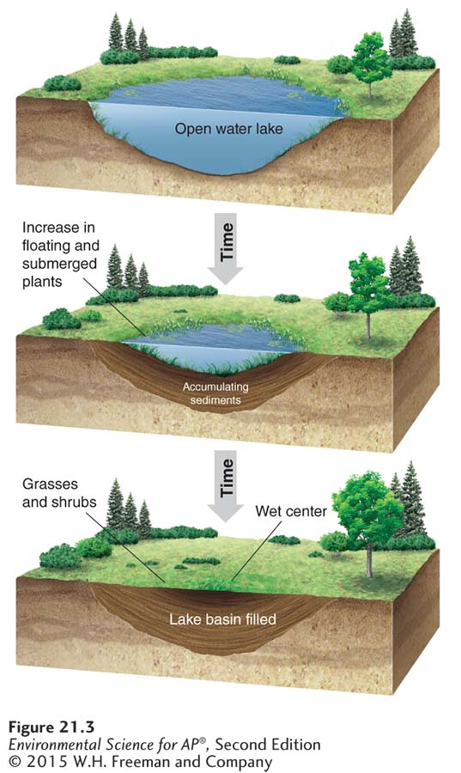
Succession occurs in a variety of aquatic ecosystems
Succession in lakes.
Over a time span of hundreds to thousands of years, lakes are filled with sediments and slowly become terrestrial habitats.

Slide 35
The species richness of a community is influenced by many factors
Species richness is influenced by:
latitude
time
habitat size
distance from other communities
Theory of island biogeography A theory that demonstrates the dual importance of habitat size and distance in determining species richness.

Slide 36
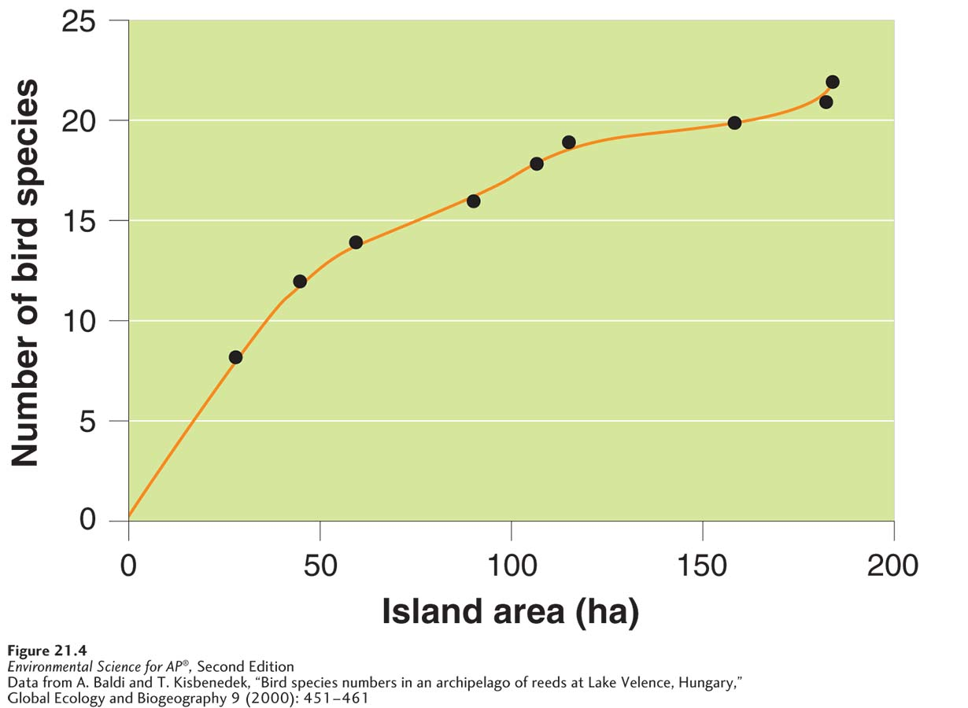
The Theory of Island Biogeography
Species richness increases as the size of the habitat increases.
Habitat size and species richness. Species richness
increases as the size of the habitat increases. In this example, researchers
counted the number of bird species that inhabited reed islands in Lake Velence, Hungary. As island area increased, the number of bird species initially rose quickly and then began to slow.

