Slide 1
Chapter 9
Water Resources
Friedland and Relyea Environmental Science for AP®, second edition ©2015 W.H. Freeman and Company/BFW
AP® is a trademark registered and/or owned by the College Board®, which was not involved in the production of, and does not endorse, this product.

Slide 2
Module 26 The Availability of Water
After reading this module you should be able to
describe the major sources of groundwater.
identify some of the largest sources of fresh surface water.
explain the effects of unusually high and low amounts of precipitation.

Slide 3
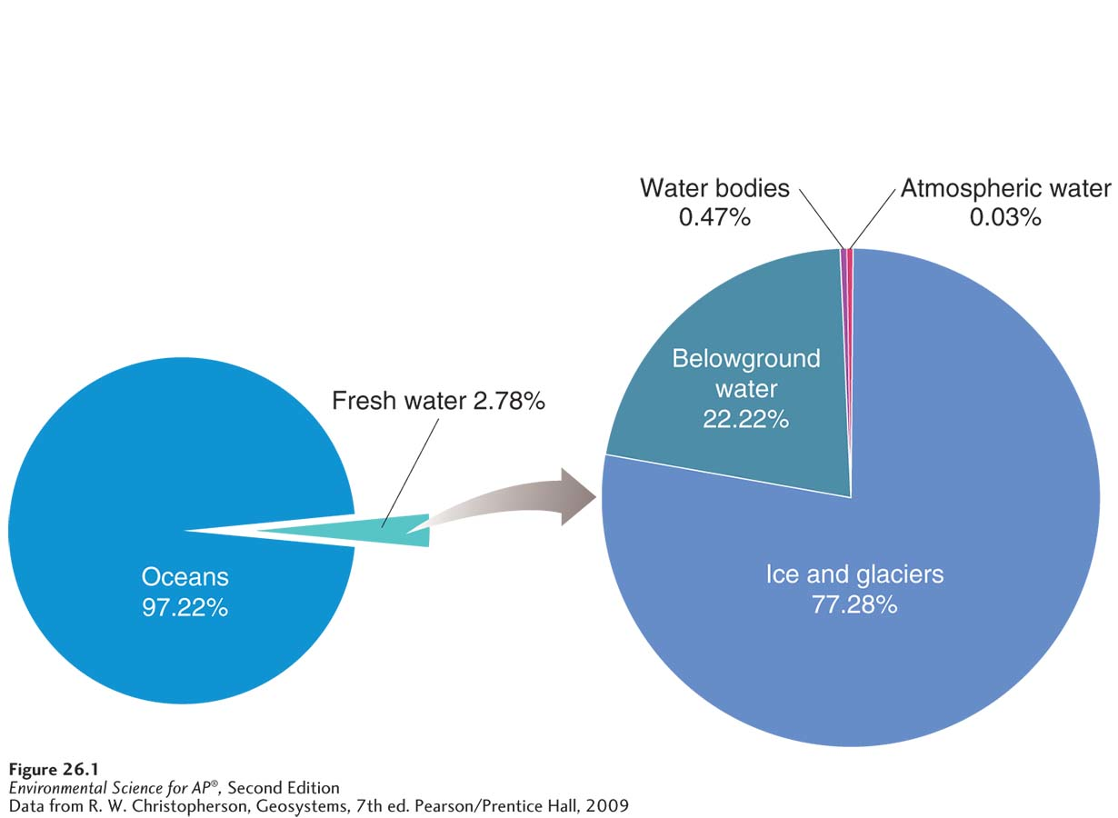
Groundwater can be extracted for human use
Distribution of water on Earth. Fresh water represents less than 3 percent of all water on Earth, and only about three-fourths of that fresh water is surface water. Most of that surface water is frozen as ice and in glaciers. Therefore, less than 1 percent of all water on the planet is accessible for use by humans.

Slide 4
Groundwater
Aquifer A permeable layer of rock and sediment that contains groundwater.
Unconfined aquifer An aquifer made of porous rock covered by soil out of which water can easily flow.
Confined aquifer An aquifer surrounded by a layer of impermeable rock or clay that impedes water flow.

Slide 5
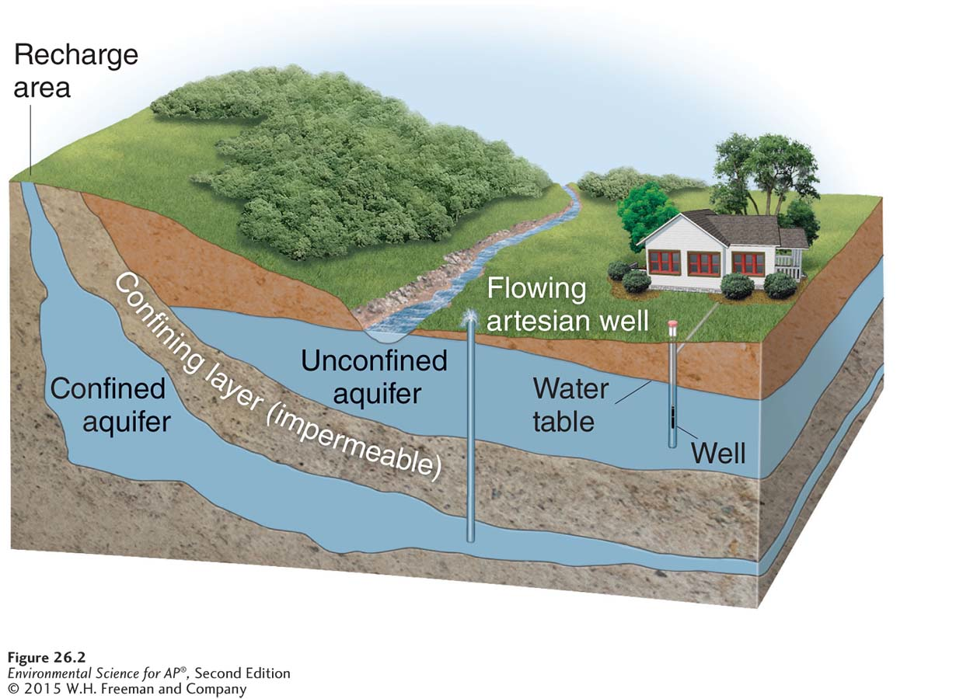
Groundwater
Aquifers. Aquifers are sources of usable groundwater. Unconfined aquifers are rapidly recharged by water that percolates downward from the land surface. Confined aquifers are capped by an impermeable layer of rock or clay, which can cause water pressure to build up underground. Artesian wells are formed when a well is drilled into a confined aquifer and the natural pressure causes water to rise toward the ground surface.

Slide 6
Groundwater
Water table The uppermost level at which the water in a given area fully saturates rock or soil.
Groundwater recharge A process by which water percolates through the soil and works its way into an aquifer.
Spring A natural source of water formed when water from an aquifer percolates up to the ground surface.
Artesian well A well created by drilling a hole into a confined aquifer.

Slide 7
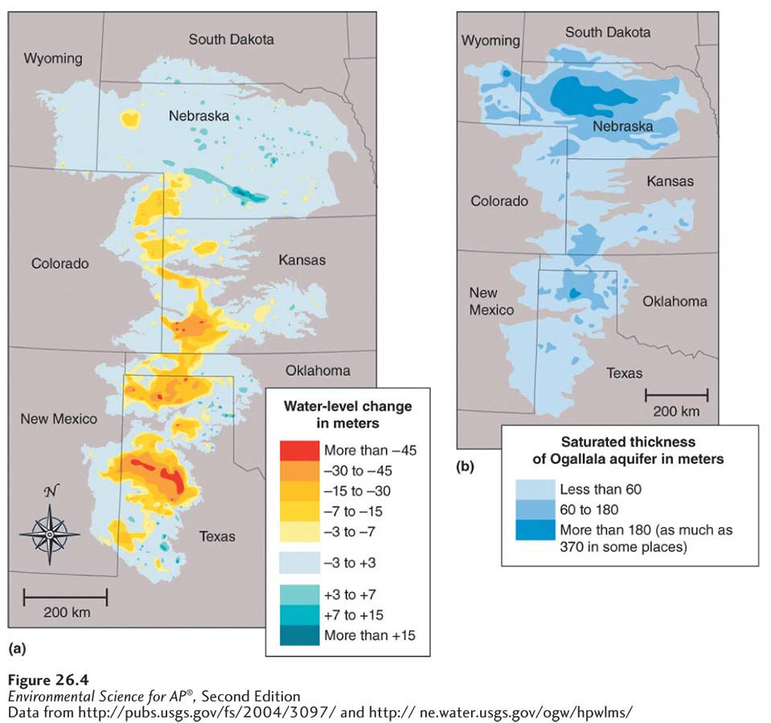
Groundwater
The Ogallala aquifer. The Ogallala aquifer, also called the High Plains aquifer, is the
largest in the United States, with a surface area of about 450,000 km² (174,000 miles²). (a) The change in
water level from 1950 to 2005, mostly due to withdrawals for irrigation that have exceeded the aquifer’s
rate of recharge. (b) The current thickness of the aquifer.

Slide 8
Groundwater
Cone of depression An area lacking groundwater due to rapid withdrawal by a well.
Saltwater intrusion An infiltration of salt water in an area where groundwater pressure has been reduced from extensive drilling of wells.

Slide 9
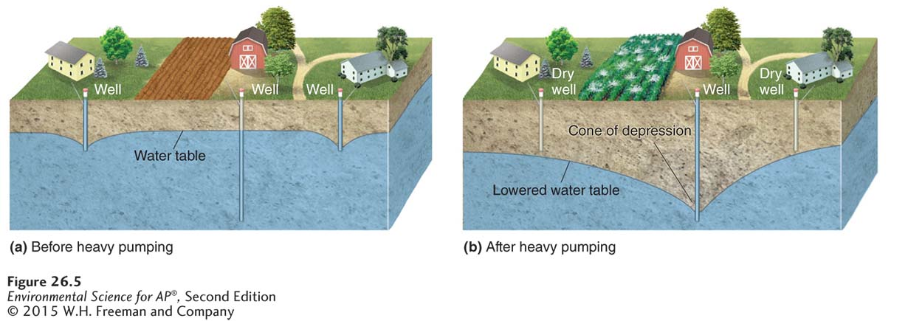
Groundwater
Cone of depression. (a) When a deep well is not heavily pumped, the recharge of the water table keeps up with the pumping. (b) In contrast, when a deep well pumps water from an aquifer more rapidly than it can be recharged, it can form a cone of depression in the water table and cause nearby shallow wells to go dry.

Slide 10
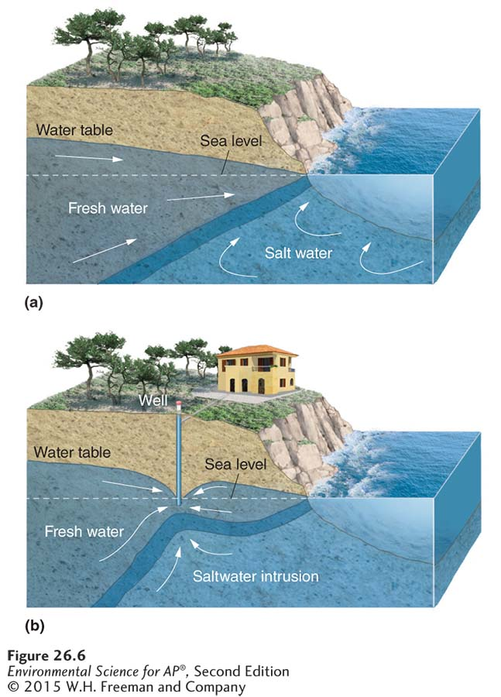
Groundwater
Saltwater intrusion. (a) When there are few wells along a coastline, the water table remains high and the
resulting pressure prevents salt water from intruding. (b) Rapid
pumping of wells drilled in aquifers along a coastline can lower the
water table. Lowering the water table reduces water pressure in the
aquifer, allowing the nearby salt water to move into the aquifer and
contaminate the well water with salt.

Slide 11
Surface water is the collection of aquatic biomes
Surface water is water that exists aboveground and includes steams, rivers, ponds, and wetlands.
Early human civilizations typically settled along major rivers.
Floodplain The land adjacent to a river.

Slide 12
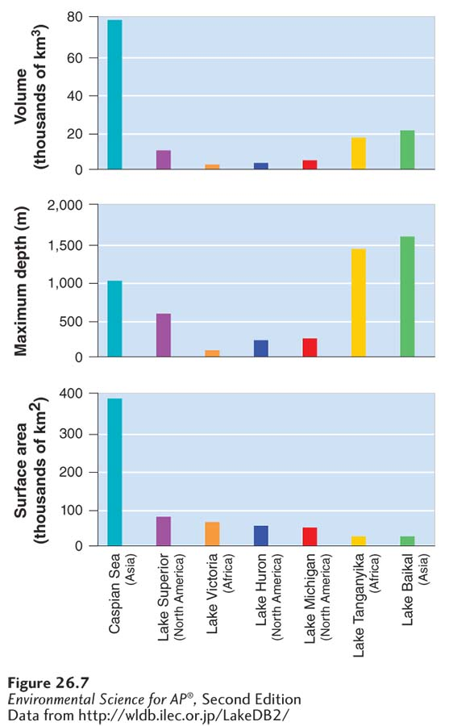
Surface Water
The world’s largest lakes. Measurements of
surface area, depth, and volume are shown for each lake.

Slide 13
Atmospheric water produces precipitation
Although the atmosphere contains only a very small percentage of the water on Earth, that atmospheric water is essential to global water distribution.
Impermeable surface Pavement or buildings that do not allow water penetration.

Slide 14
Module 27 Human Alteration of Water Availability
After reading this module you should be able to
compare and contrast the roles of levees and dikes.
explain the benefits and costs of building dams.
explain the benefits and costs of building aqueducts.
describe the processes used to convert salt water into fresh water.

Slide 15
Levees and dikes are built to prevent flooding
Levee An enlarged bank built up on each side of a river.
Dike A structure built to prevent ocean waters from flooding adjacent land.

Slide 16
Dams are built to restrict the flow of streams and rivers
Dam A barrier that runs across a river or stream to control the flow of water.
Reservoir The water body created by a damming a river or stream.
Fish ladder A stair-like structure that allows migrating fish to get around a dam.

Slide 17
Aqueducts carry water from one location to another
Aqueduct A canal or ditch used to carry water from one location to another.
In the United States, both Los Angeles and New York City depend on aqueducts to meet their daily water needs.
The consequences of water diversion can be severe.

Slide 18
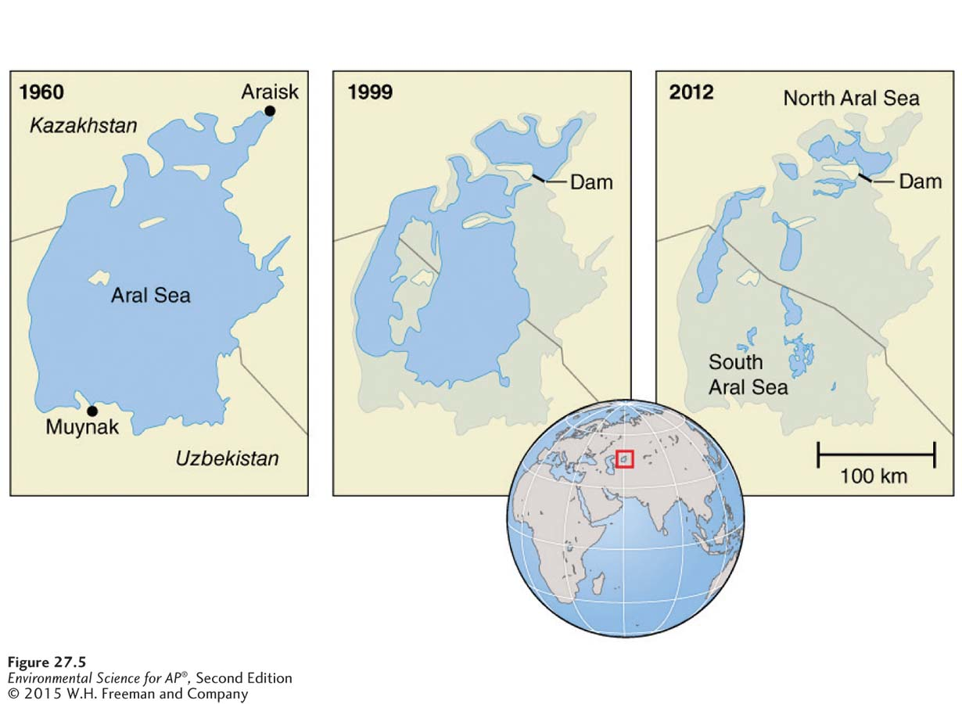
Aqueducts
Consequences of river diversion. Diverting river water can have devastating impacts downstream. The Aral Sea, on the border of Kazakhstan and Uzbekistan, was once the world’s fourth largest lake. Since the two rivers that fed the lake were diverted, its surface area has declined by 60 percent and the lake has split into two parts: the North and South Aral seas.

Slide 19
Desalination converts salt water into fresh water
Desalination The process of removing the salt from salt water. Also known as Desalinization.
Distillation A process of desalination in which water is boiled and the resulting steam is captured and condensed to yield pure water.
Reverse osmosis A process of desalination in which water is forced through a thin semipermeable membrane at high pressure.

Slide 20
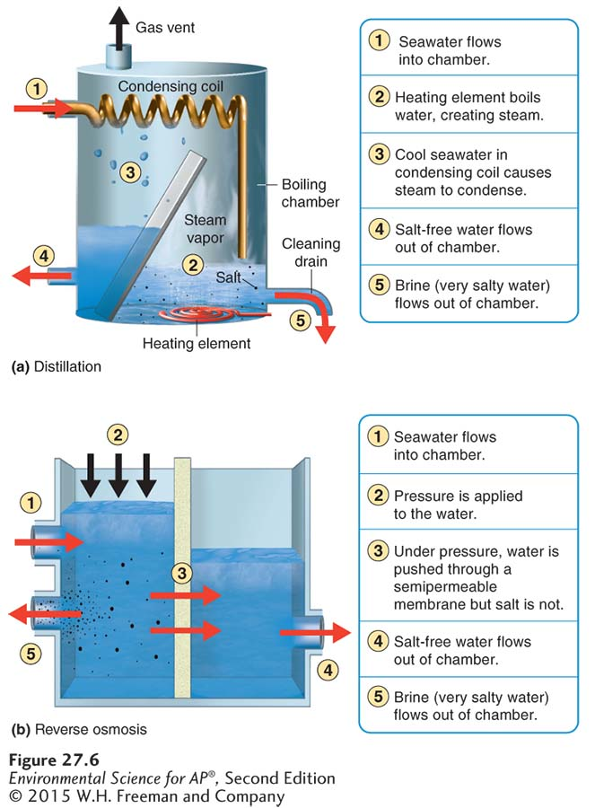
Desalination
Desalination technologies. Salt water can be converted into fresh water in one of two ways. (a) Distillation uses heat to convert pure water into steam that is later condensed, leaving the salt behind. (b) Reverse osmosis uses pressure to force pure water through a semipermeable membrane, leaving the salt behind.

Slide 21
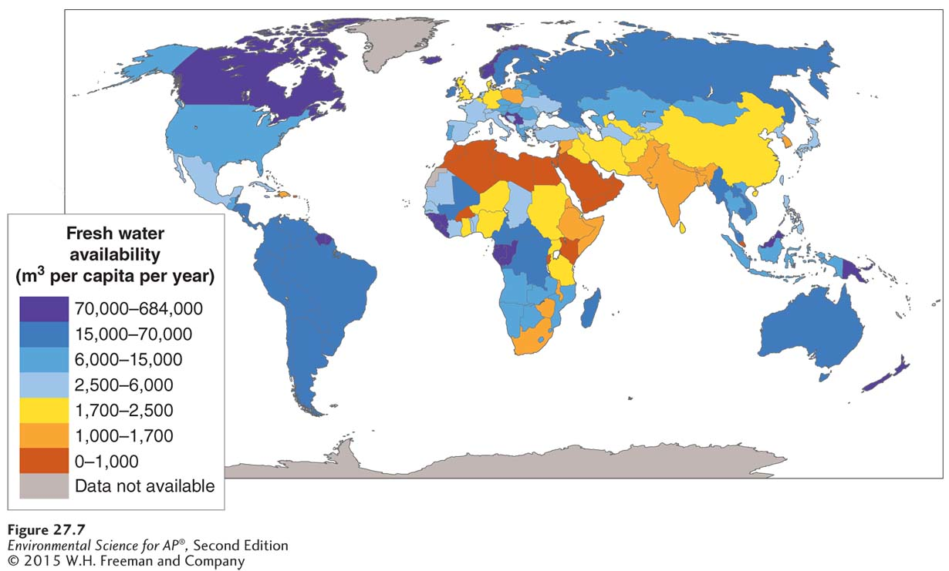
Water Availability
Water availability per capita. The amount of water available per person
varies tremendously around the world. North Africa and the Middle East are the regions with the lowest amounts of available fresh water.

Slide 22
Module 28 Human use of Water Now and in the Future
After reading this module you should be able to
compare and contrast the four methods of agricultural irrigation.
describe the major industrial and household uses of water.
discuss how water ownership and water conservation are important in determining future water availability.

Slide 23
Water is used for agriculture
Water footprint The total daily per capita use of fresh water.
Around the world, more water is used for agriculture than anything else.
The daily use of water per capita varies dramatically among the nations of the world.

Slide 24
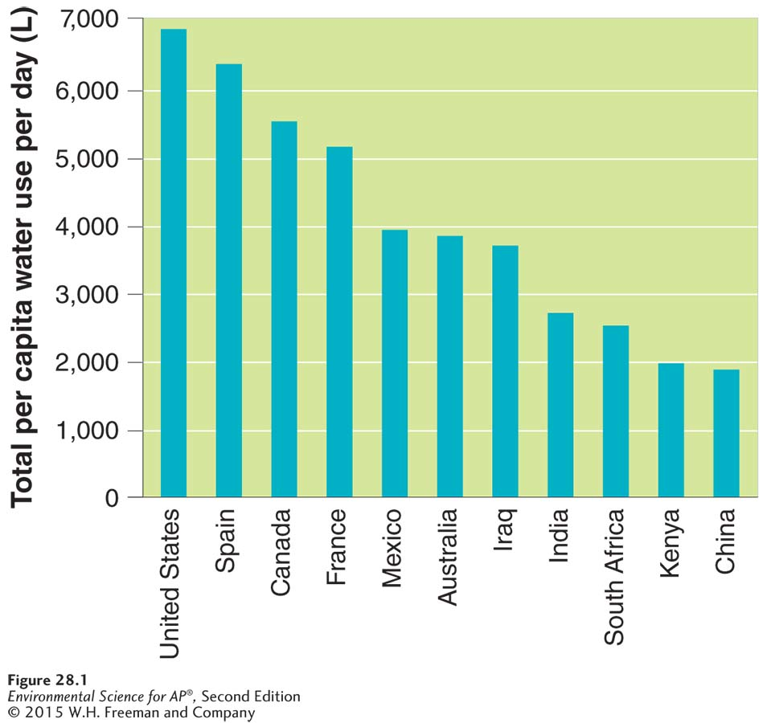
Water Footprint
Total per capita water use per day. The total water use per person for agriculture, industry, and households varies
tremendously by country.

Slide 25
Irrigation
Technological advances have made water use for crops more efficient.
There are four types of irrigation:
Furrow: a trench that is flooded with water
Flood: the entire field is flooded with water
Spray: an apparatus sprays water across a field
Drip: a slow dripping hose is laid on or buried beneath the soil

Slide 26
Hydroponic Agriculture
Hydroponic agriculture The cultivation of plants in greenhouse conditions by immersing roots in a nutrient-rich solution.
An alternative to irrigation, hydroponic agriculture is more expensive but has several advantages:
Requires little or no pesticide use.
Uses up to 95 percent less water than traditional irrigation.
Crops can be grown year-round.

Slide 27
Water is also used for industrial processes and households
After agriculture, the most common use of water is for industry and households.

Slide 28
Industrial Water Use
Water is required for many industrial purposes:
Generating electricity
Cooling machinery
Refining metals
Making paper

Slide 29
Household Water Use
Household water use accounts for 10 percent of all water used in the United States.
Per capita household water use varies dramatically among nations.

Slide 30
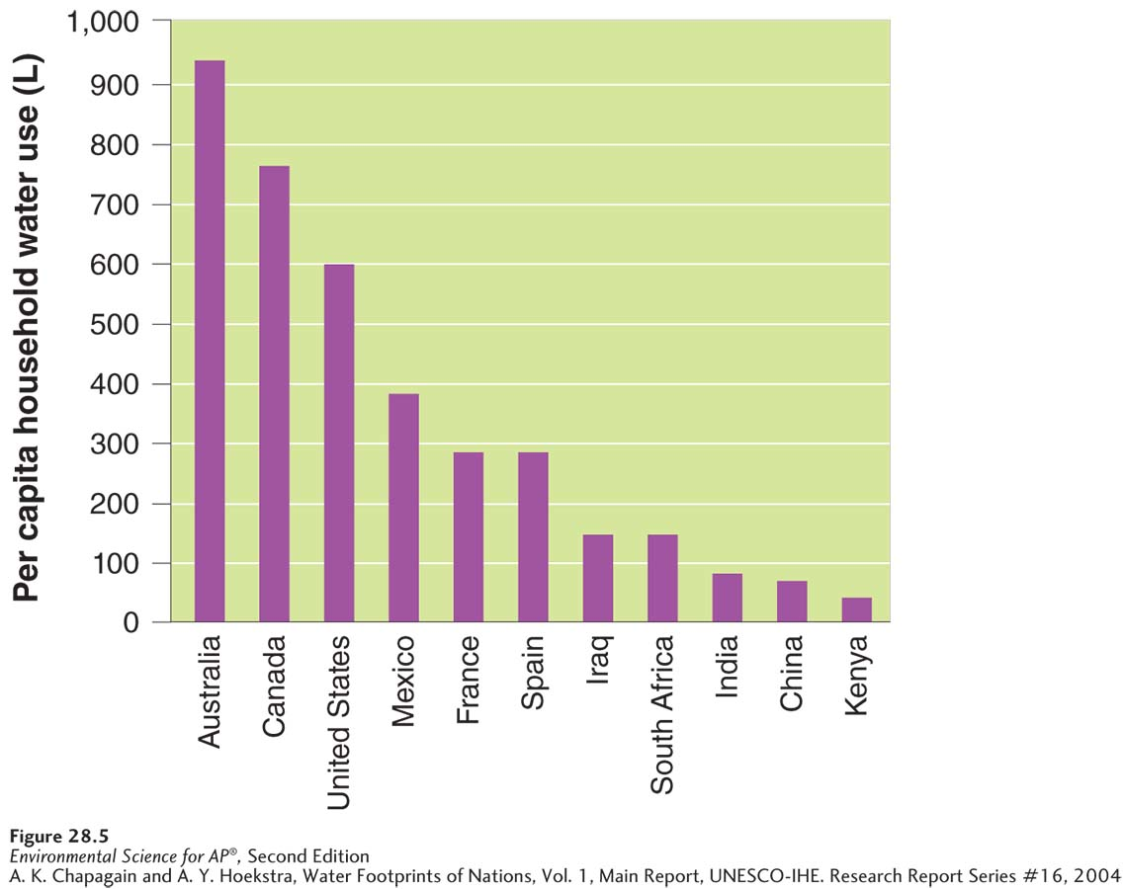
Household Water Use
Household per capita water use per day. The amount of household water use per capita is different from that of total water use.

Slide 31
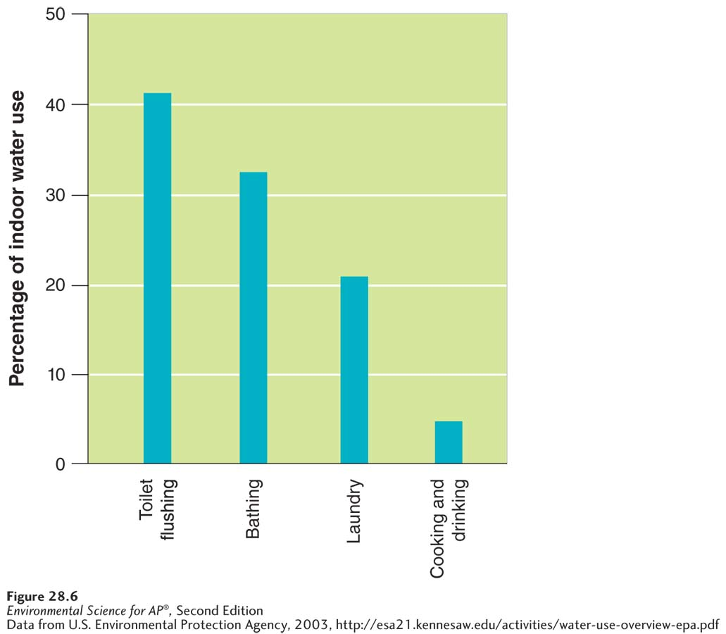
Household Water Use
Indoor household water use. Most water used indoors is used in the bathroom

Slide 32
The future availability of water depends on water ownership and water conservation
Throughout the world, issues of water ownership and water rights have created conflicts.
Many countries have found ways to conserve water through improved technology.
Gray water Wastewater from baths, showers, bathrooms, and washing machines.
Contaminated water Wastewater from toilets, kitchen sinks, and dishwashers.

