Slide 1
Chapter 10
Land, Public and Private
Friedland and Relyea Environmental Science for AP®, second edition
© 2015 W.H. Freeman and Company/BFW
AP® is a trademark registered and/or owned by the College Board®, which was not involved in the production of, and does not endorse, this product.

Slide 2
Module 29 Land Use Concepts and Classification
After reading this module, you should be able to
explain how human land use affects the environment.
describe the various categories of public land used globally and in the United States.

Slide 3
Human land use affects the environment in many ways
Every human use of land alters it in some way.
People do not always agree on land use and management priorities.
To understand land use and management issues, environmental scientists use 3 concepts:
Tragedy of the commons
Externalities
Maximum sustainable yield

Slide 4
Tragedy of the Commons
Tragedy of the commons The tendency of a shared, limited resource to become depleted because people act from self-interest for short-term gain.
When many people share a common resource without agreement on or regulation of its use, it is likely to become overused very quickly.

Slide 5
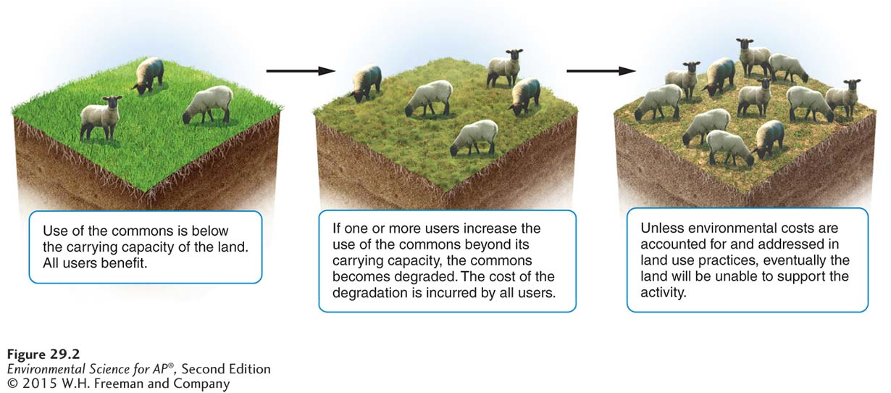
Tragedy of the Commons
The tragedy of the commons. If the use of common land is not regulated in some way—by the users or by a government agency—the land can easily be degraded to the point at which it can no longer support that use.

Slide 6
Externalities
Externality The cost or benefit of a good or service that is not included in the purchase price of that good or service.
Environmental scientists are concerned about negative externalities because of the environmental damage for which no one bears the cost.

Slide 7
Maximum Sustainable Yield
Maximum sustainable yield (MSY) The maximum amount of a renewable resource that can be harvested without compromising the future availability of that resource.
Maximum sustainable yield varies case by case.
In theory, harvesting the MSY should be sustainable. In reality it is very difficult to calculate MSY.
Even when we do calculate MSY, it can take months or years to determine whether a yield is truly sustainable.

Slide 8
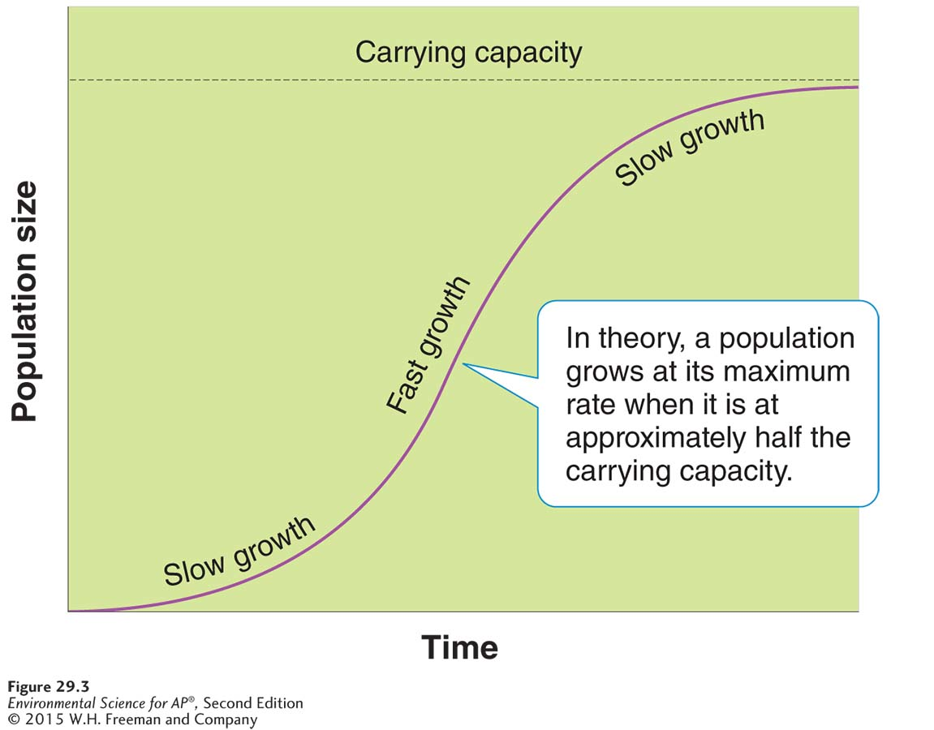
Maximum Sustainable Yield
Maximum sustainable yield. Every population has a point at which a maximum number of individuals can be harvested sustainably. That point is often reached when the population size is about one-half the carrying capacity.

Slide 9
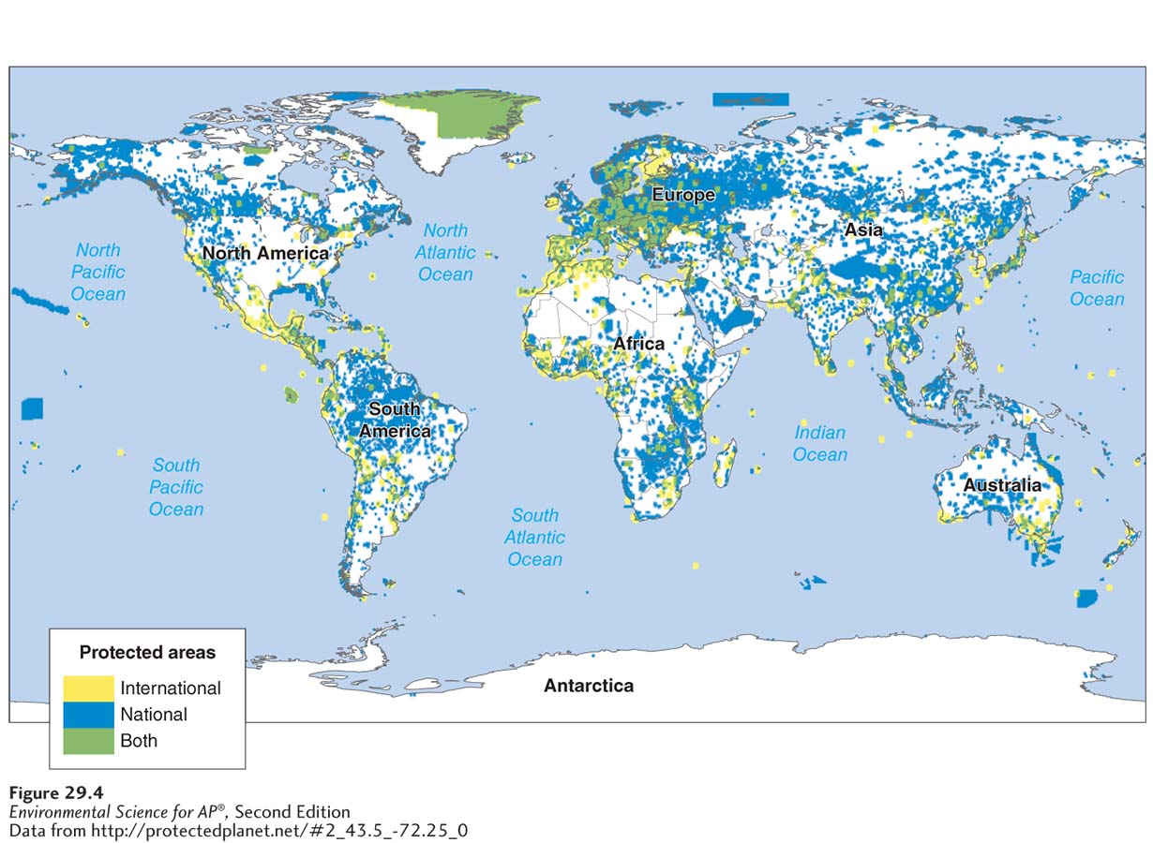
Public lands are classified according to their use
Protected land and marine areas of the world. Protected areas are distributed around the globe.

Slide 10
International Categories of Public Lands
The United Nations recognizes six categories of public lands:
National parks are managed for scientific, educational, and recreational use, and sometimes for their beauty or unique landforms.
Managed Resource Protected Areas are designated for the sustained use of biological, mineral, and recreational resources.
Habitat/Species Management Areas are actively managed to maintain biological communities.
Notes:
Fix spacing and size so the next slide and this match.

Slide 11
International Categories of Public Lands (Cont.)
Strict Nature Reserves and Wilderness Areas are set aside to protect species and ecosystems.
Protected Landscapes and Seascapes permit nondestructive use of natural resources while allowing for tourism and recreation.
National Monuments are designated to protect unique sites of special natural or cultural interests.

Slide 12
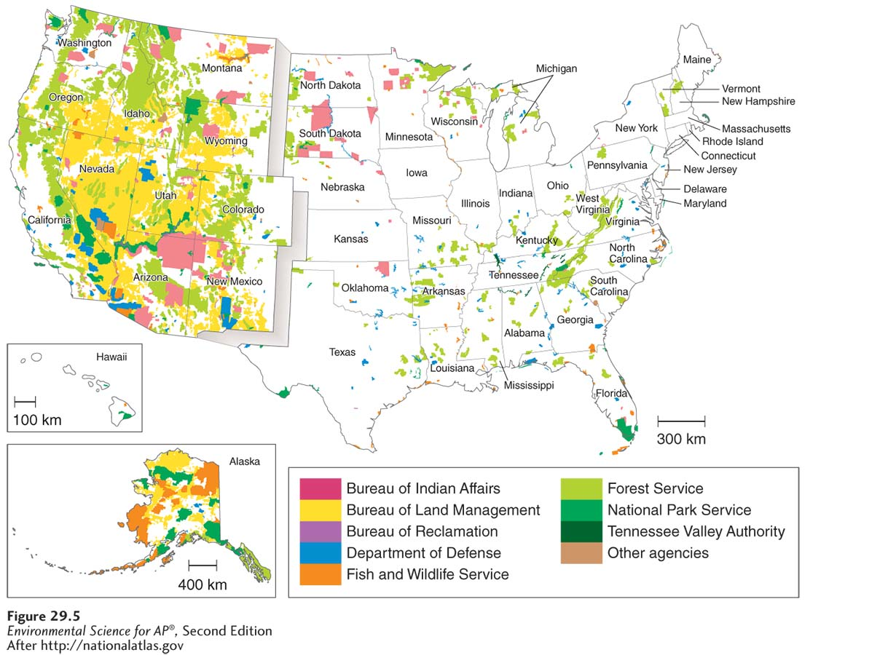
Public Lands in the United States
Federal lands in the United States. Approximately 42 percent of the land in the
United States is publicly owned, with 25 percent of the nation’s land owned by the federal government.

Slide 13
Public Lands in the United States
Resource conservation ethic The belief that people should maximize use of resources, based on the greatest good for everyone.
Multiple-use lands A U.S. classification used to designate lands that may be used for recreation, grazing, timber harvesting, and mineral extraction.

Slide 14
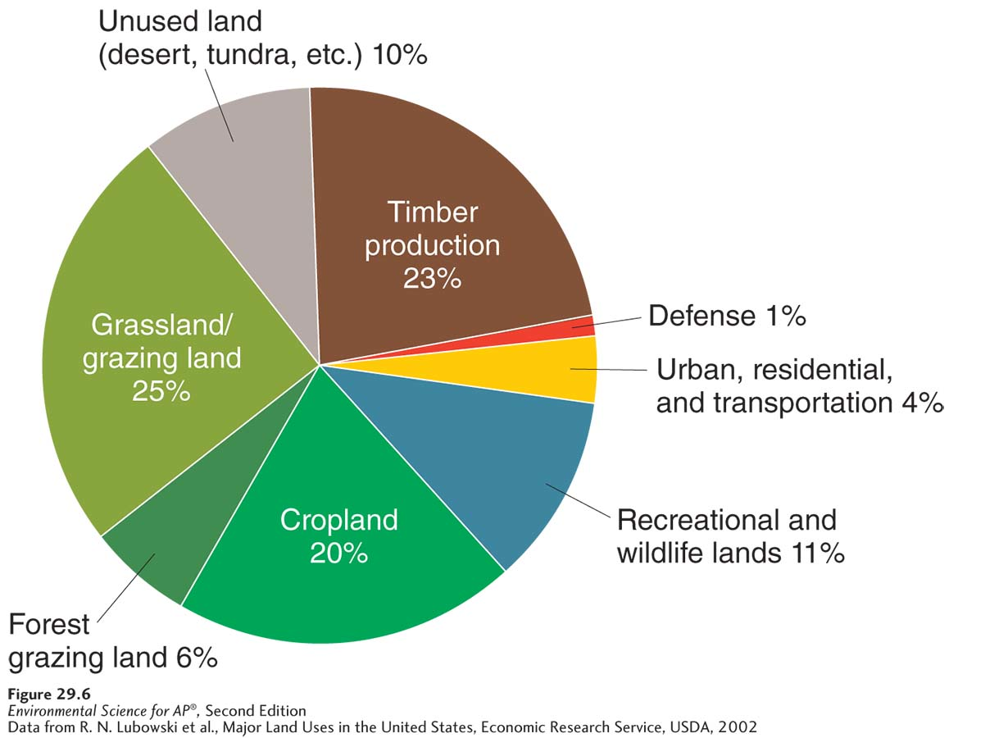
Public Lands in the United States
Land use in the United States. Public and private land in the United States is used for many purposes.

Slide 15
Public Lands in the United States
More than 95 percent of all federal lands are managed by four federal agencies.
Bureau of Land Management (BLM): grazing, mining, timber harvesting and recreation
U.S. Forest Service (USFS): timber harvesting, grazing, and recreation
National Park Service (NPS): recreation and conservation.
Fish and Wildlife Service (FWS): conservation, hunting, and recreation

Slide 16
Module 30 Land Management Practices
After reading this module, you should be able to
explain specific land management practices for rangelands and forests.
describe contemporary problems in residential land use and some potential solutions.

Slide 17
Land management practices vary according to land use
Management issues differ for rangelands, forests, and parks.

Slide 18
Rangelands
Rangeland A dry open grassland.
Grazing too many animals can quickly denude a region of vegetation. Loss of vegetation can lead to land exposed to wind and water erosion.

Slide 19
Forests
Forest Land dominated by trees and other woody vegetation and sometimes used for commercial logging.
Approximately 73 percent of the forests used for commercial timber operations in the U.S. are privately owned.
Timber harvest practices include clear-cutting and selective cutting
Clear-cutting A method of harvesting trees that removes all or almost all trees in an area.
Selective cutting The method of harvesting trees that involves removing single trees or a small number of trees from many in a forest.

Slide 20
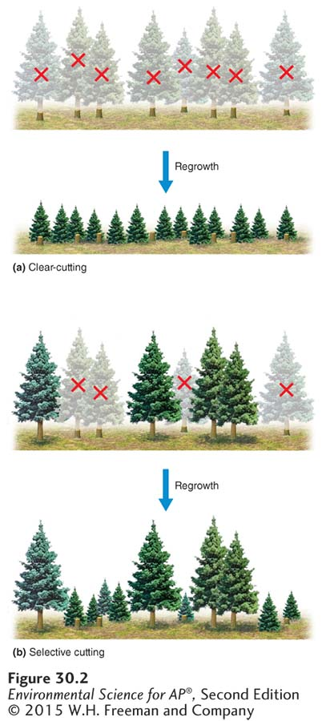
Timber Harvest Practices
Timber harvest practices.
(a) Clear-cutting removes most, if not all, trees from an area and is often coupled with replanting. The resulting trees are then all the same age. (b) In
selective cutting, single trees or small numbers of trees are harvested. The resulting forest consists of trees of varying ages.

Slide 21
Timber Harvest Practices
A third approach to logging—ecologically sustainable forestry—has a goal of maintaining both plants and animals in as close to a natural state as possible.
Ecologically sustainable forestry An approach to removing trees from forests in ways that do not unduly affect the viability of other trees.

Slide 22
Reforestation
Timber production presents ecological challenges.
All logging disrupts habitat.
Logging often replaces complex forest ecosystems with tree plantations.
Tree plantation A large area typically planted with a single rapidly growing tree species.

Slide 23
Fire Management
In many ecosystems fire is a natural process for recycling nutrients.
Humans have followed a number of fire management policies.
Prescribed burn A fire deliberately set under controlled conditions in order to reduce the accumulation of dead biomass on a forest floor.
Prescribed burns help reduce the risk of uncontrolled natural fires.

Slide 24
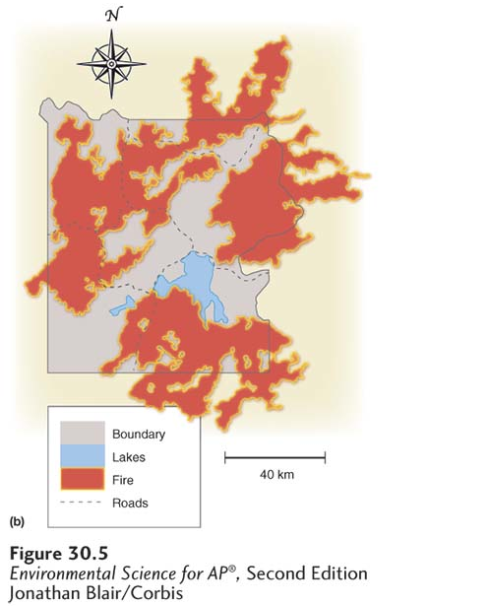
Fire Management
Yellowstone fires of 1988. As can be seen from the map, extensive areas of the park were burned in this exceptionally hot and dry year.

Slide 25
National Parks
National Parks are managed for scientific, educational, aesthetic, and recreational use.
Human overuse can harm the environmental features that attract visitors.

Slide 26
Wildlife Refuges and Wilderness Areas
National wildlife refuge A federal public land managed for the primary purpose of protecting wildlife.
National wilderness area An area set aside with the intent of preserving a large tract of intact ecosystem or a landscape.

Slide 27
Federal Regulation of Land Use
National Environmental Policy Act (NEPA) A 1969 U.S. federal act that mandates an environmental assessment of all projects involving federal money or federal permits.
Environmental impact statement (EIS) A document outlining the scope and purpose of a development project, describing the environmental context, suggesting alternative approaches to the project, and analyzing the environmental impact of each alternative.
Environmental mitigation plan A plan that outlines how a developer will address concerns raised by a project’s impact on the environment.
Endangered Species Act A 1973 U.S. act designed to protect species from extinction

Slide 28
Residential land use is expanding
Suburb An area surrounding a metropolitan center, with a comparatively low population density.
Exurb An area similar to a suburb, but unconnected to any central city or densely populated area.
Since 1950 more than 90 percent of the population growth in metropolitan areas has occurred in suburbs, and two out of three people now live in suburban or exurban communities.

Slide 29
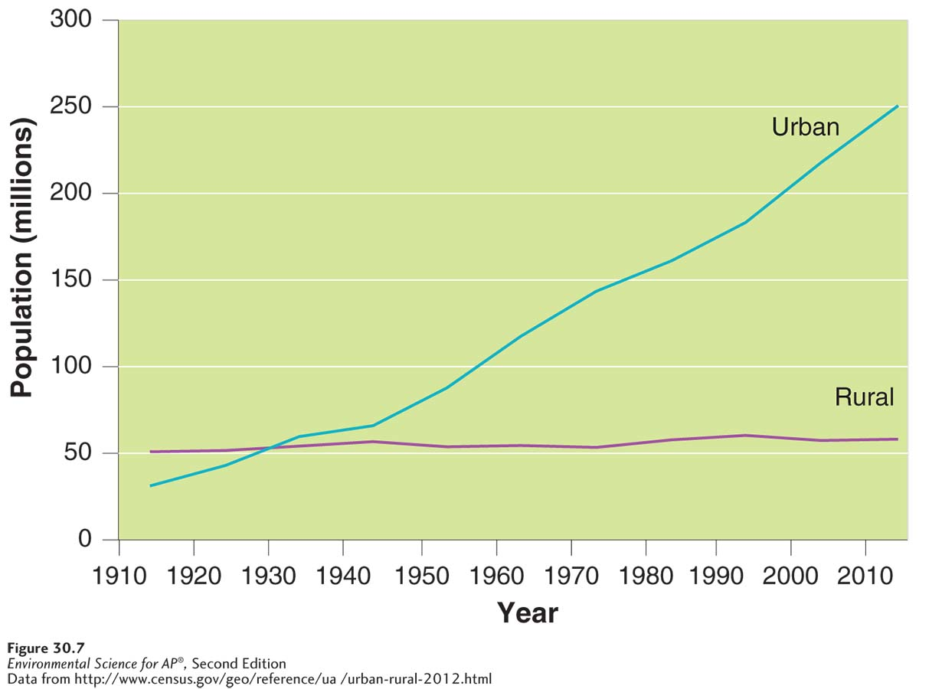
Residential Land Use
Distribution of urban and rural populations in the United States between 1910 and 2012. This graph shows a dramatic shift in the population from rural to urban areas.

Slide 30
Causes and Consequences of Urban Sprawl
Urban sprawl Urbanized areas that spread into rural areas, removing clear boundaries between the two.
Urban sprawl has four main sources:
Automobiles and highway construction
Living costs
Urban blight
Government policies
Urban blight The degradation of the built and social environments of the city that often accompanies and accelerates migration to the suburbs.

Slide 31
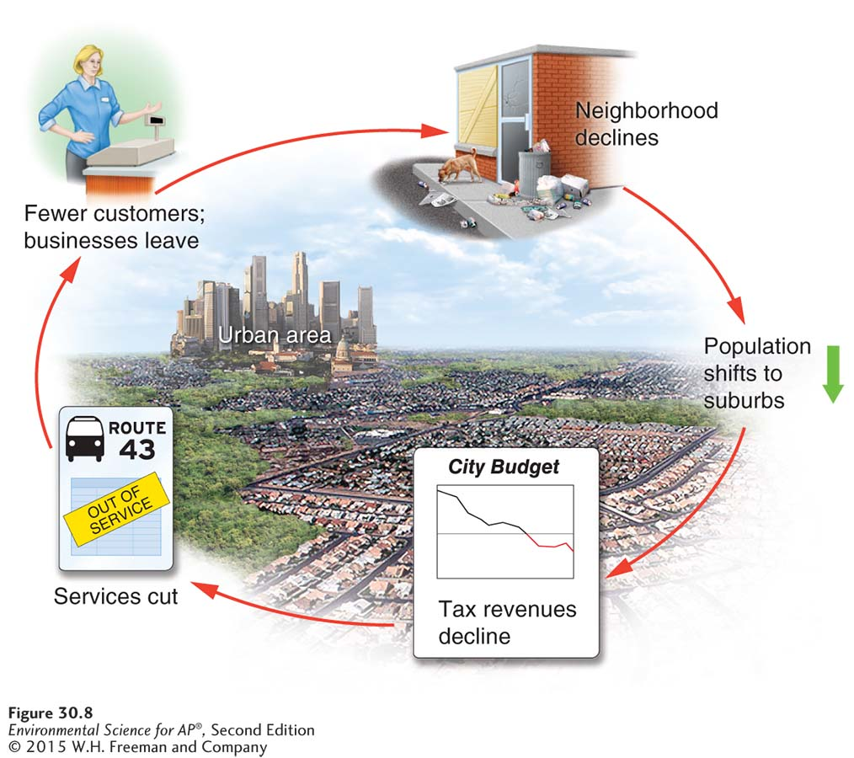
Urban Sprawl
Urban blight.
As people move away from a city to suburbs and exurbs, the city often
deteriorates, which causes yet more people to leave. This cycle is an example of a positive feedback
system. The green arrow indicates the starting point of the cycle.

Slide 32
Urban Sprawl
Urban sprawl has been enhanced by federal and local laws and policies:
Highway Trust Fund A U.S. federal fund that pays for the construction and maintenance of roads and highways.
Induced demand The phenomenon in which an increase in the supply of a good causes demand to grow.
Zoning A planning tool used to separate industry and business from residential neighborhoods.
Multi-use zoning A zoning classification that allows retail and high-density residential development to coexist in the same area.

Slide 33
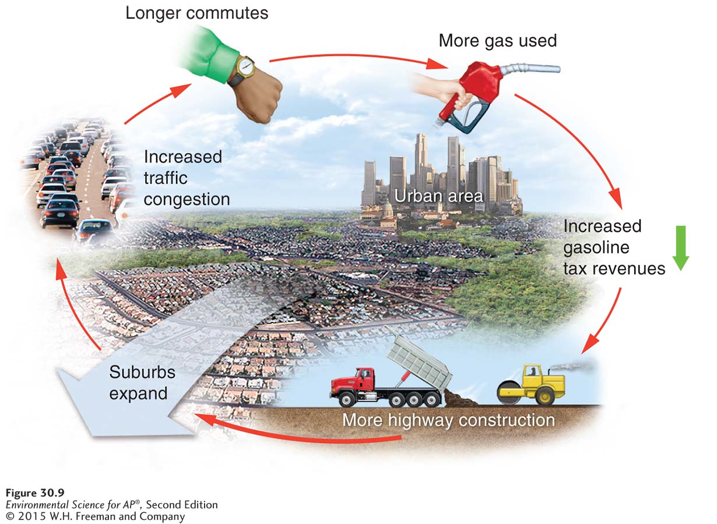
Urban Sprawl
Induced demand as a cause of traffic congestion and urban sprawl. The use of gasoline tax money to build highways leads to the development of suburbs and traffic congestion, at which point yet more money is spent on highways to alleviate the congestion. The green arrow indicates the starting point of the cycle.

Slide 34
Smart Growth
Smart growth A set of principles for community planning that focuses on strategies to encourage the development of sustainable, healthy communities.
Smart growth follows ten principles :
1. Create mixed land uses.
2. Create a range of housing opportunities and choices.
3. Create walkable neighborhoods.
4. Encourage community and stakeholder collaboration in development decisions.
Stakeholder A person or organization with an interest in a particular place or issue.
Notes:
Make this set into three slides and space out more.

Slide 35
Smart Growth
5. Take advantage of compact building design.
6. Foster distinctive, attractive communities with a strong sense of place.
Sense of place The feeling that an area has a distinct and meaningful character.
7. Preserve open space, farmland, natural beauty and critical environmental areas.

Slide 36
Smart Growth
8. Provide a variety of transportation choice.
Transit-oriented development (TOD) Development that attempts to focus dense residential and retail development around stops for public transportation, a component of smart growth.
9. Strengthen and direct development toward existing communities
Infill Development that fills in vacant lots within existing communities.
Urban growth boundary A restriction on development outside a designated area.
10. Make development decisions predictable, fair and cost-effective

