Slide 1
Chapter 11
Feeding the World
Friedland and Relyea Environmental Science for AP®, second edition
© 2015 W.H. Freeman and Company/BFW
AP® is a trademark registered and/or owned by the College Board®, which was not involved in the production of, and does not endorse, this product.

Slide 2
Module 31 Human Nutritional Needs
After reading this module, you should be able to
describe human nutritional requirements.
explain why nutritional requirements are not being met in various parts of the world.

Slide 3
Human nutritional requirements are not always satisfied
Undernutrition The condition in which not enough calories are ingested to maintain health.
Malnourished Having a diet that lacks the correct balance of proteins, carbohydrates, vitamins, and minerals.
Food security A condition in which people have access to sufficient, safe, and nutritious food that meets their dietary needs for an active and healthy life.
Food insecurity A condition in which people do not have adequate access to food.

Slide 4
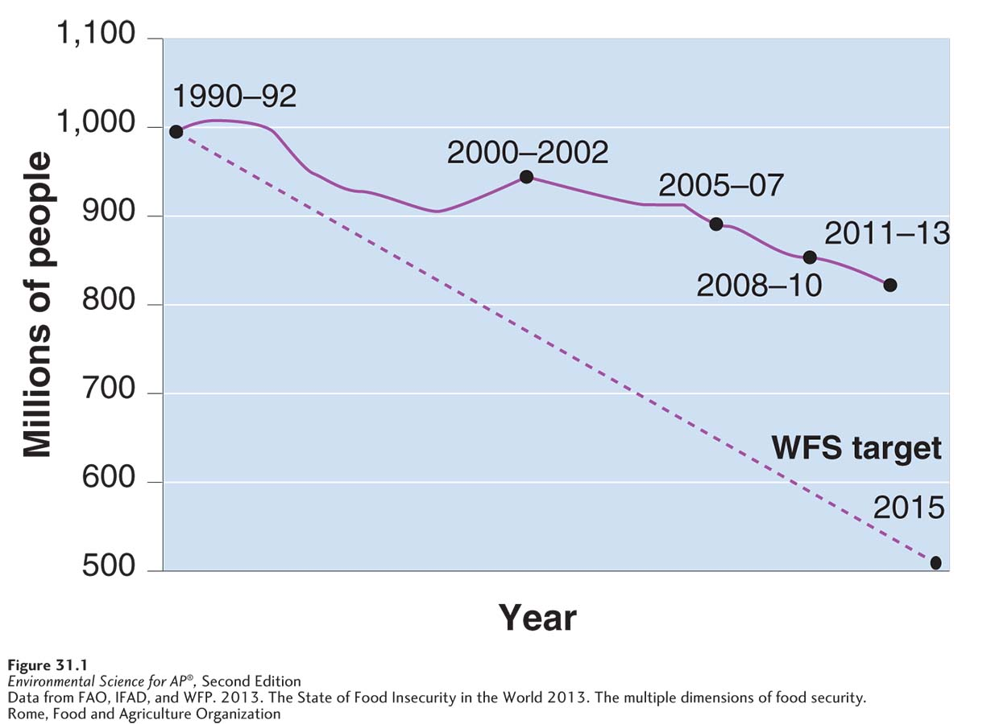
Human Nutritional Needs
Global undernutrition. The number of undernourished people in the world has declined from 1990 through the present (solid line), but is still greater than World Food Summit targets (dashed line).

Slide 5
Human Nutritional Needs
Famine The condition in which food insecurity is so extreme that large numbers of deaths occur in a given area over a relatively short period.
Anemia A deficiency of iron.
Overnutrition Ingestion of too many calories and a lack of balance of foods and nutrients.
Meat Livestock or poultry consumed as food.

Slide 6
Human Nutritional Needs
Humans eat a variety of foods, but grains (corn, rice, wheat) make up the largest portion of the human diet.
There are roughly 50,000 edible plants, but 3 species (corn, rice, wheat) constitute 60 percent of the human energy intake.
Meat, is the second largest component of the human diet.

Slide 7
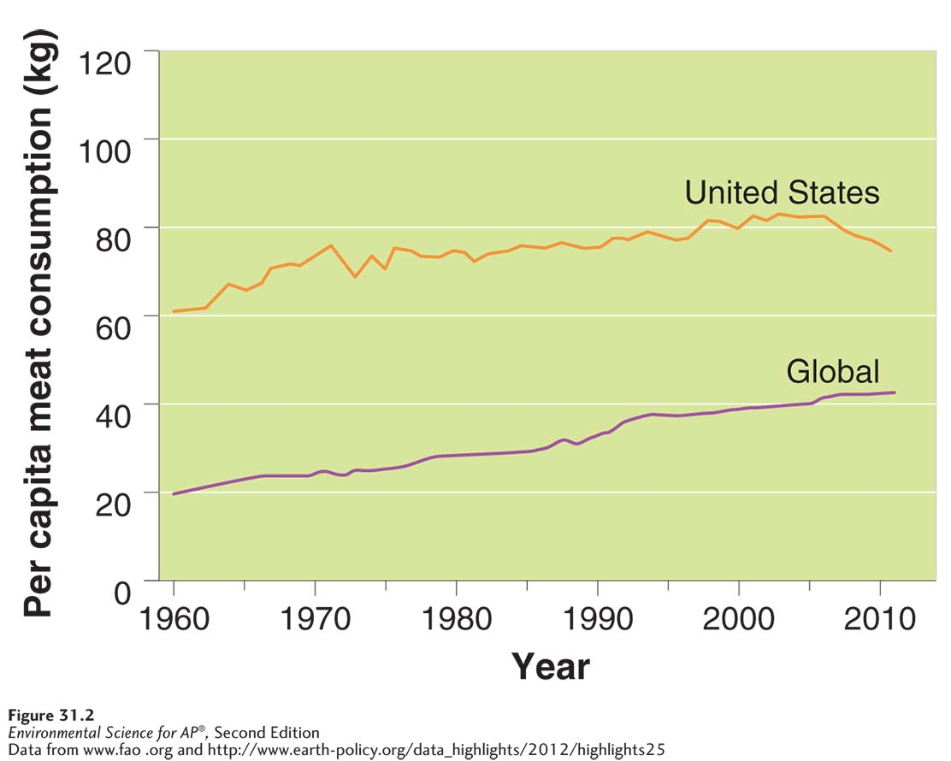
Human Nutritional Needs
Per capita meat consumption through 2012. Per capita meat consumption has begun to decrease in the United States. It has been steadily increasing worldwide.

Slide 8
Undernutrition and malnutrition occur primarily because of poverty
Several factors contribute to malnutrition:
Poverty
Political unrest
Poor governance
High food prices and other economic conditions

Slide 9
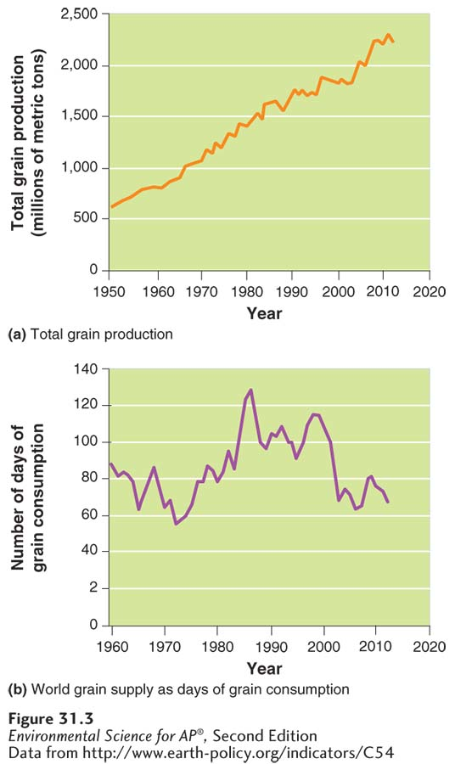
Reasons for Malnutrition
Global grain production, 1950–2012.
(a) Global grain production grew rapidly from 1950 through the
mid-1980s. Growth has continued since then, but per capita growth has slowed. (b) World grain supply (days of supply for everyone in the world) has been declining.

Slide 10
Module 32 Modern Large-Scale Farming Methods
After reading this module you should be able to
describe modern, large-scale agricultural methods.
explain the benefits and consequences of genetically modified organisms.
discuss the large-scale raising of meat and fish.

Slide 11
Modern industrial farming methods have transformed agriculture
Industrial agriculture Agriculture that applies the techniques of mechanization and standardization. Also known as agribusiness.
Energy subsidy The fossil fuel energy and human energy input per calorie of food produced.

Slide 12
The Energy Subsidy in Agriculture
It may take 20kg of grain to make 1kg of beef.
Most of the energy subsidies in modern agriculture are in the form of fossil fuels used to produce fertilizers and pesticides, and to harvest food and prepare it for transport.
Transporting food from farm to your plate is another large energy subsidy.

Slide 13
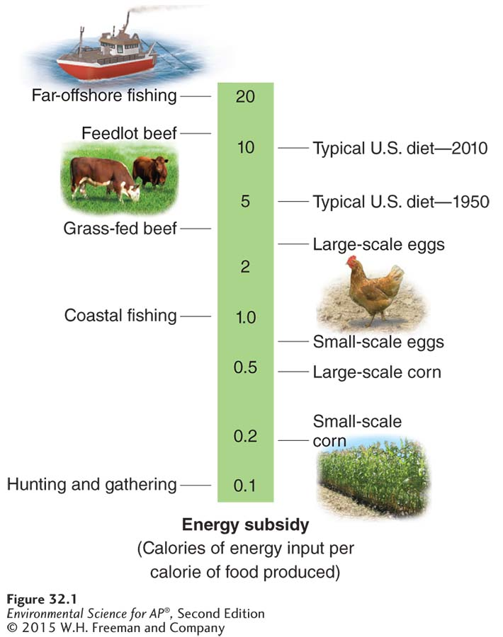
The Energy Subsidy in Agriculture
Energy subsidies for various methods of food production and diets. Energy input per calorie of food obtained is greater for modern agricultural practices than for traditional agriculture. Energy inputs for hunting and gathering and for small-scale food production are mostly in the form of human energy, whereas fossil
fuel energy is the primary energy subsidy for large-scale modern food production. All values are approximate, and for any given method there is a large range of values.

Slide 14
The Green Revolution
New management techniques and mechanization as well as fertilization, irrigation, and improved crop varieties has increased food production dramatically.
The abundance of food supplied by agriculture is one factor that has led to the exponential growth of the human population.
Green Revolution A shift in agricultural practices in the twentieth century that included new management techniques, mechanization, fertilization, irrigation, and improved crop varieties, and that resulted in increased food output.
Economies of scale The observation that average costs of production fall as output increases.

Slide 15
The Green Revolution: Irrigation
Irrigation creates certain problems including waterlogging and salinization.
Waterlogging A form of soil degradation that occurs when soil remains under water for prolonged periods.
Salinization A form of soil degradation that occurs when the small amount of salts in irrigation water becomes highly concentrated on the soil surface through evaporation.

Slide 16
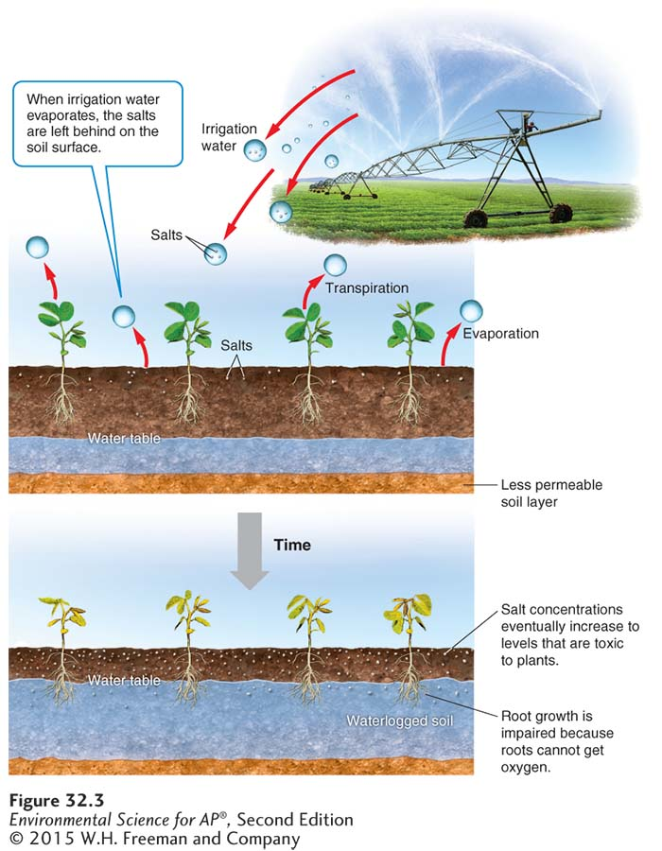
The Green Revolution: Irrigation
Irrigation-induced salinization and waterlogging. Over time, irrigation can degrade soil by leaving a layer of highly concentrated salts at the soil surface and waterlogged soil below.

Slide 17
The Green Revolution: Fertilizers
Fertilizers are either organic or synthetic (inorganic).
Organic fertilizer Fertilizer composed of organic matter from plants and animals.
Synthetic fertilizer Fertilizer produced commercially, normally with the use of fossil fuels. Also known as inorganic fertilizer.

Slide 18
The Green Revolution: Pesticides
Monocropping An agricultural method that utilizes large plantings of a single species or variety.
Pesticide A substance, either natural or synthetic, that kills or controls organisms that people consider pests.
Insecticide A pesticide that targets species of insects and other invertebrates that consume crops.
Herbicide A pesticide that targets plant species that compete with crops.

Slide 19
The Green Revolution: Pesticides
Broad-spectrum pesticide A pesticide that kills many different types of pest.
Selective pesticide A pesticide that targets a narrow range of organisms.
Persistent pesticide A pesticide that remains in the environment for a long time.
Nonpersistent pesticide A pesticide that breaks down rapidly, usually in weeks or months.

Slide 20
The Green Revolution: Pesticides
Pesticide resistance A trait possessed by certain individuals that are exposed to a pesticide and survive.
Pesticide treadmill A cycle of pesticide development, followed by pest resistance, followed by new pesticide development.

Slide 21
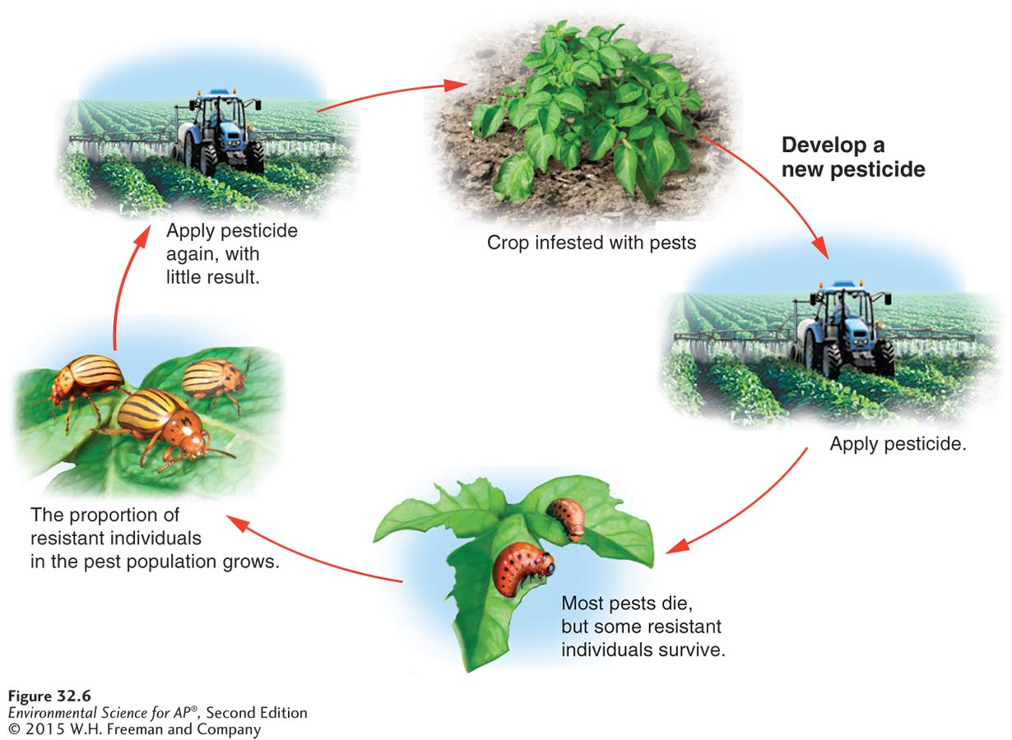
The Green Revolution: Pesticides
The pesticide treadmill. Over time, pest populations evolve resistance to pesticides,
which requires farmers to use higher doses or to develop new pesticides.

Slide 22
Genetic engineering is revolutionizing agriculture
Benefits of genetic engineering:
Greater yield
Greater food quality
Reductions in pesticide use
Reduction of world hunger by increased food production
Increased profits

Slide 23
Genetic Engineering
Concerns about genetic engineering:
Safety for human consumption
Effects on biodiversity
Regulation of genetically modified organisms

Slide 24
Modern agribusiness includes farming meat and fish
Concentrated animal feeding operation (CAFO) A large indoor or outdoor structure designed for maximum output.
Fishery A commercially harvestable population of fish within a particular ecological region.
Fishery collapse The decline of a fish population by 90 percent or more.
Bycatch The unintentional catch of nontarget species while fishing.

Slide 25
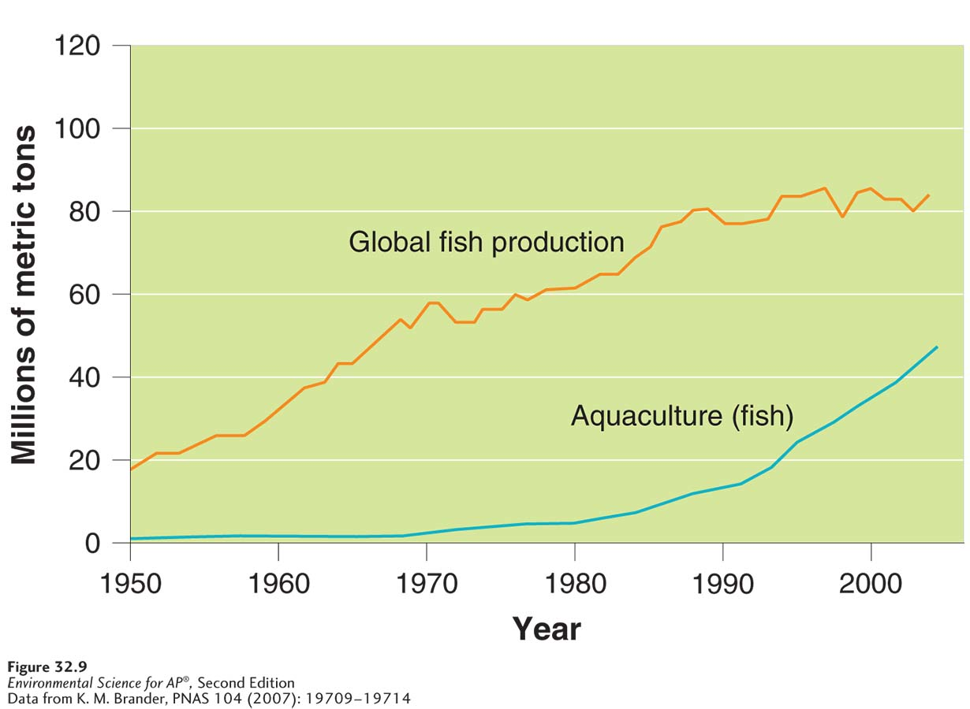
Harvesting Fish
Global fish production. Global fish production has increased by more than 30 percent since 1980, primarily as a result of the large increase in aquaculture. The graph shows data for aquaculture-raised fish (blue) and global fish production (orange), which includes both wild-caught fish and aquaculture-raised fish.

Slide 26
Module 33 Alternatives to Industrial Farming Methods
After reading this module, you should be able to
describe alternatives to conventional farming methods.
explain alternative techniques used in farming animals and in fishing and aquaculture.

Slide 27
Alternatives to industrial farming methods are gaining more attention
Industrial agriculture is now considered conventional.
When cost of labor is not the most important consideration, traditional farming techniques may be economically viable.

Slide 28
Shifting Agriculture and Nomadic Grazing
Shifting agriculture An agricultural method in which land is cleared and used for a few years until the soil is depleted of nutrients.
Desertification The transformation of arable, productive land to desert or unproductive land due to climate change or destructive land use.
Nomadic grazing The feeding of herds of animals by moving them to seasonally productive feeding grounds, often over long distances.

Slide 29
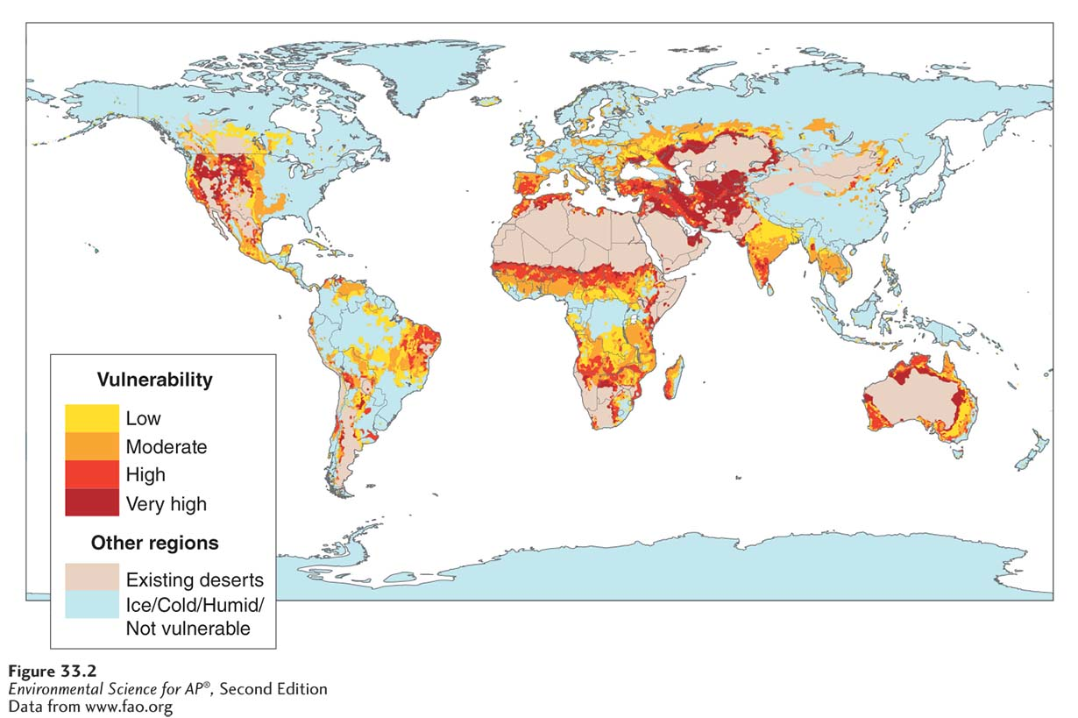
Shifting Agriculture and Nomadic Grazing
Vulnerability to desertification. Certain regions of the world are much more vulnerable to desertification than others.

Slide 30
Sustainable Agriculture
Sustainable agriculture Agriculture that fulfills the need for food and fiber while enhancing the quality of the soil, minimizing the use of nonrenewable resources, and allowing economic viability for the farmer.
Practices used in sustainable agriculture :
Intercropping An agricultural method in which two or more crop species are planted in the same field at the same time to promote a synergistic interaction.
Crop rotation An agricultural technique in which crop species in a field are rotated from season to season.
Agroforestry An agricultural technique in which trees and vegetables are intercropped.
Contour plowing An agricultural technique in which plowing and harvesting are done parallel to the topographic contours of the land.

Slide 31
No-Till Agriculture
Perennial plant A plant that lives for multiple years.
Annual plant A plant that lives only one season.
No-till agriculture An agricultural method in which farmers do not turn the soil between seasons as a means of reducing topsoil erosion.

Slide 32
Integrated Pest Management
Integrated pest management (IPM) An agricultural practice that uses a variety of techniques designed to minimize pesticide inputs.
Characteristics of IPM:
Crop rotation
Intercropping
Planting pest resistant crop varieties
Creating habitats for predators
Limited use of pesticides

Slide 33
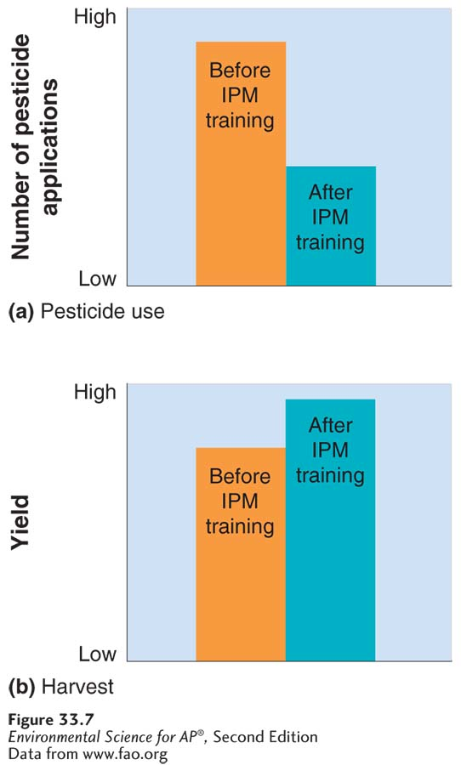
Integrated Pest Management
Effects of IPM training. (a) IPM training of farmers in Indonesia led to a significant reduction in pesticide
applications. (b) Yield improvements also occurred after the training
because of the additional attention the farmers gave to their crops.

Slide 34
Organic Agriculture
Organic agriculture Production of crops without the use of synthetic pesticides or fertilizers.
Principles of organic agriculture:
Use ecological principles and work with natural systems.
Keep as organic matter and nutrients in the soil and on the farm.
Avoid the use of synthetic fertilizers and synthetic pesticides.
Maintain soil by increasing soil mass, biological activity, and beneficial chemical properties.
Reduce the adverse environmental effects of agriculture.

Slide 35
Alternatives techniques for farming animals and fish are becoming more popular
Free-range beef and chicken are becoming increasingly popular.
Free-range meat is more likely to be sustainable.
Free range farming does not require treatment and disposal of massive quantities of manure.
Free-range animals are less likely to spread disease; the use of antibiotics and other medications can be reduced or eliminated.
Free range farming uses more land and cost is significantly higher than CAFOs.

Slide 36
More Sustainable Fishing
Many countries around the world have developed fishery management plans with international agreements.
The Sustainable Fisheries Act passed in 1996 shifted fisheries management from a focus on economic sustainability to a species-sustainability approach.
Individual transferable quota (ITQ) A fishery management program in which individual fishers are given a total allowable catch of fish in a season that they can either catch or sell.

Slide 37
Aquaculture
Aquaculture Farming aquatic organisms such as fish, shellfish, and seaweeds.
Aquaculture involves constructing an aquatic ecosystem. It usually requires keeping the organisms in enclosures.
Proponents of aquaculture believe it can alleviate some of the human-caused pressure on overexploited fisheries and provide protein for the more than 1 billion undernourished people in the world.
Critics of aquaculture point out that it can create many environmental problems.

