Slide 1
Chapter 13
Achieving Energy Sustainability
Friedland and Relyea Environmental Science for AP®, second edition
© 2015 W.H. Freeman and Company/BFW
AP® is a trademark registered and/or owned by the College Board®, which was not involved in the production of, and does not endorse, this product.

Slide 2
Module 37 Conservation, Efficiency, and Renewable Energy
After reading this module you should be able to
describe strategies to conserve energy and increase energy efficiency.
explain differences among the various renewable energy resources.

Slide 3
We can use less energy through conservation and increased efficiency
Energy conservation and energy efficiency are the least expensive and most environmentally sound options for maximizing our energy resources.
Energy conservation Finding and implementing ways to use less energy.
Tiered rate system A billing system used by some electric companies in which customers pay higher rates as their use goes up.
Peak demand The greatest quantity of energy used at any one time.

Slide 4
Sustainable Design
Sustainable design improves the efficiency of the buildings and communities in which we we live and work.

Slide 5
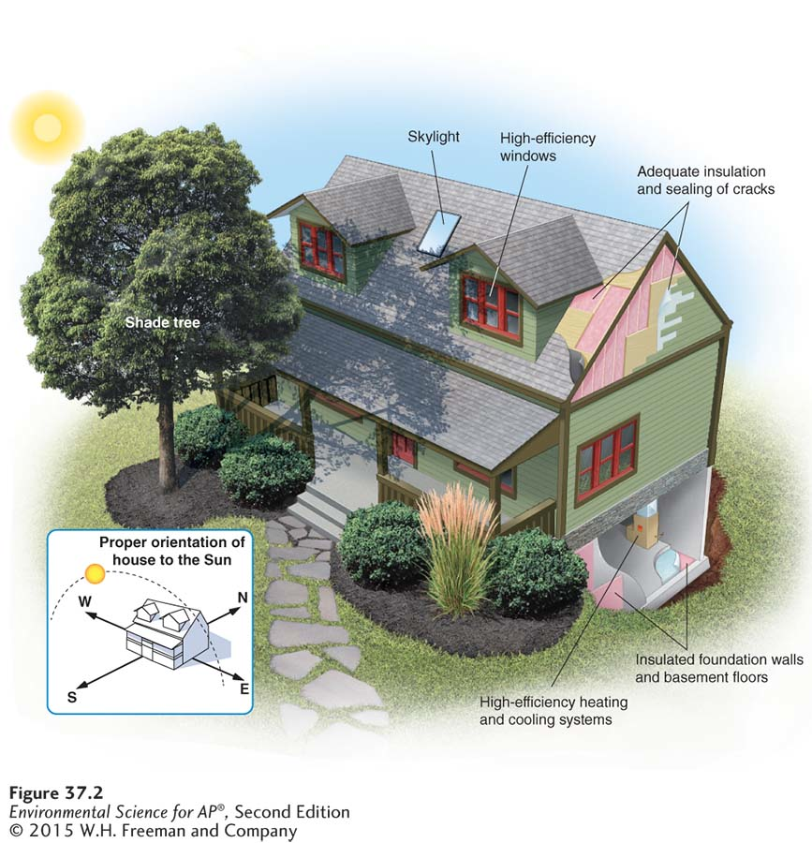
Sustainable Design
An energy-efficient home. A sustainable building design incorporates proper solar
orientation and landscaping as well as insulated windows, walls, and floors. In the Northern Hemisphere, a
southern exposure allows the house to receive more direct rays from the Sun in winter when the path of the
Sun is in the southern sky.

Slide 6
Sustainable Design
Passive solar design Construction designed to take advantage of solar radiation without active technology.
Thermal mass A property of a building material that allows it to maintain heat or cold.

Slide 7
Sustainable Design
Using passive solar energy can lower your electricity bill without the need for pumps or other mechanical devices.
Building the house with windows along a south-facing wall which allows the Sun’s rays to warm the house is an example of passive solar design.

Slide 8
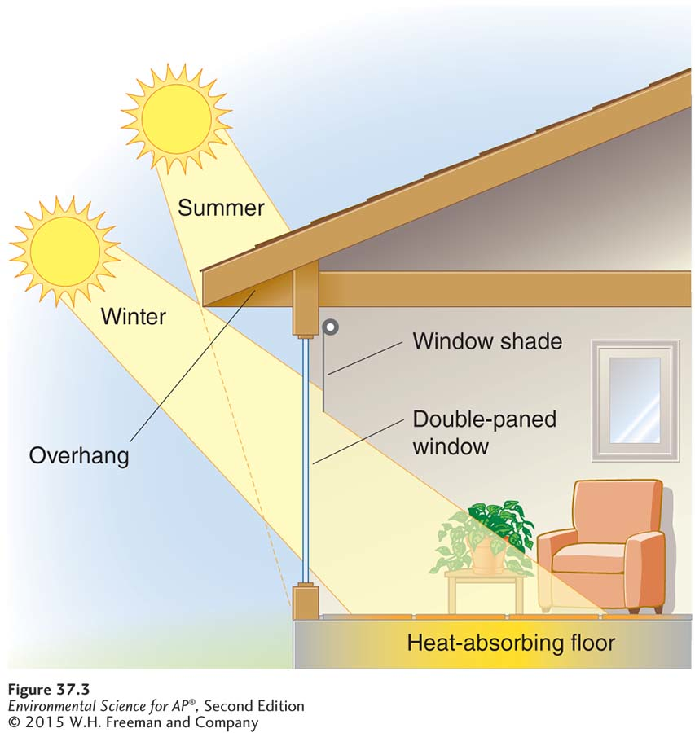
Sustainable Design
Passive solar design.
Passive solar design uses
solar radiation to maintain indoor temperature. Roof overhangs make
use of seasonal changes in the Sun’s position to reduce energy
demand for heating and cooling. In winter, when the Sun is low in
the sky, it shines directly into the window and heats the house. In
summer, when the Sun is higher in the sky, the overhang blocks
incoming sunlight and the room stays cool. High-efficiency windows
and building materials with high thermal inertia are also components
of passive solar design.

Slide 9
Renewable energy is either potentially renewable or nondepletable
Potentially renewable An energy source that can be regenerated indefinitely as long as it is not overharvested.
Nondepletable An energy source that cannot be used up.
Renewable In energy management, an energy source that is either potentially renewable or nondepletable.

Slide 10
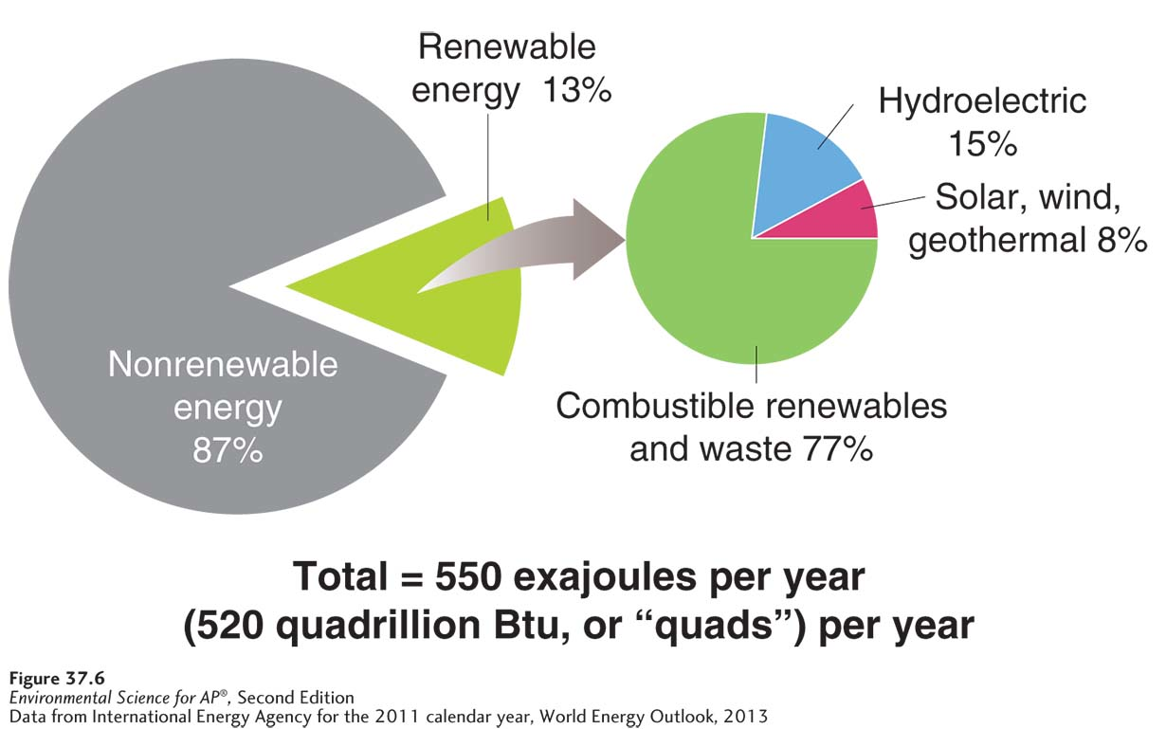
Renewable Energy
Global energy use. Renewable energy resources provide about 13 percent of energy worldwide

Slide 11
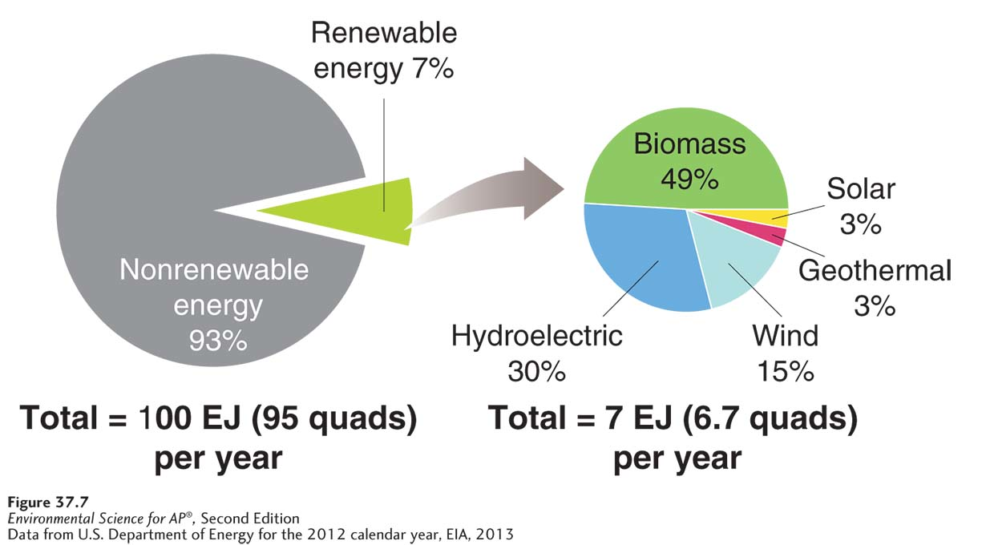
Renewable Energy
Energy Use in the United States. Only 7 percent of the energy used in the United States comes from renewable energy resources.

Slide 12
Module 38 Biomass and Water
After reading this module you should be able to
describe the various forms of biomass.
explain how energy is harnessed from water.

Slide 13
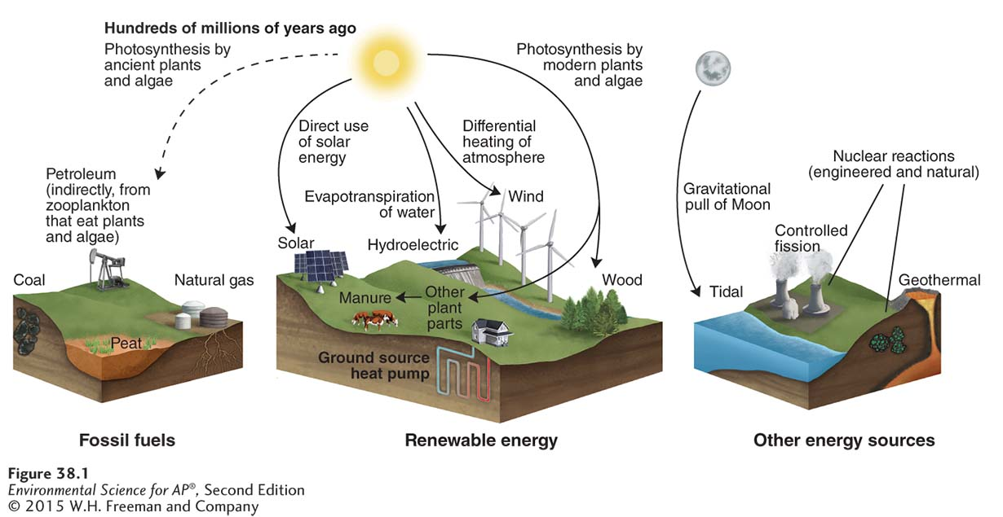
Biomass is energy from the Sun
Energy from the Sun. The Sun is the ultimate source of almost all types of energy.

Slide 14
Modern Carbon Versus Fossil Carbon
Biofuel Liquid fuel created from processed or refined biomass.
Modern carbon Carbon in biomass that was recently in the atmosphere.
Fossil carbon Carbon in fossil fuels.
Carbon neutral An activity that does not change atmospheric CO₂ concentrations.

Slide 15
Solid Biomass: Wood, Charcoal, and Manure
Wood, charcoal and manure are used to heat homes throughout the world.
In the developing world, people often cannot afford fossil fuels or do not have access to them.
Net removal The process of removing more than is replaced by growth, typically used when referring to carbon.

Slide 16
Solid Biomass
Use of wood is unsustainable if forest growth does not keep up with forest use.
Charcoal is lighter than wood and contains twice as much energy per unit of weight. It also produces less smoke.
In regions where wood is scarce, people often use dried animal manure as a fuel for indoor heating and cooking. Burning manure indoors creates indoor air pollution.

Slide 17
Biofuels: Ethanol and Biodiesel
Liquid biofuels can be used as a substitute for gasoline and diesel.
Ethanol Alcohol made by converting starches and sugars from plant material into alcohol and CO₂.
Biodiesel A diesel substitute produced by extracting and chemically altering oil from plants.
Flex-fuel vehicle A vehicle that runs on either gasoline or a gasoline/ethanol mixture.

Slide 18
The kinetic energy of water can generate electricity
Hydroelectricity Electricity generated by the kinetic energy of moving water.
Run-of-the-river Hydroelectricity generation in which water is retained behind a low dam or no dam.
Water impoundment The storage of water in a reservoir behind a dam.
Tidal energy Energy that comes from the movement of water driven by the gravitational pull of the Moon.

Slide 19
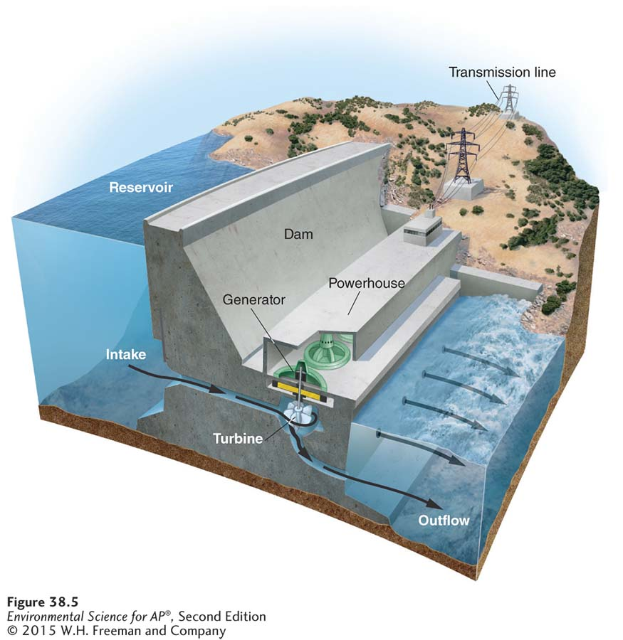
Hydroelectricity
A water impoundment hydroelectric dam.
Water impoundment, a
common method of hydroelectricity generation, allows for electricity
generation on demand. Dam operators control the rate of water flow by
opening and closing the gates. This determines the amount of electricity
generated. The arrows indicate the path of water flow.

Slide 20
Hydroelectricity and Sustainability
Hydroelectricity has many benefits:
Hydroelectric projects bring renewable energy to large numbers of rural residents worldwide.
Hydroelectricity does not create air pollution, waste products, or CO₂ emissions.
Electricity generated from hydroelectricity is less expensive.
Reservoirs create recreational opportunities.

Slide 21
Hydroelectricity and Sustainability
Hydroelectricity has some negative environmental consequences:
Creating the reservoir may flood agricultural land or places of archeological significance, and force people to relocate.
Impounding a river can interfere with organisms that depend on a free-flowing river.
Downstream ecosystems are affected.
Siltation The accumulation of sediments, primarily silt, on the bottom of a reservoir.

Slide 22
Module 39 Solar, Wind, Geothermal, and Hydrogen
After reading this module, you should be able to
list the different forms of solar energy and their application.
describe how wind energy is harnessed and its contemporary uses.
discuss the methods of harnessing the internal energy from Earth.
explain the advantages and disadvantages of energy from hydrogen.

Slide 23
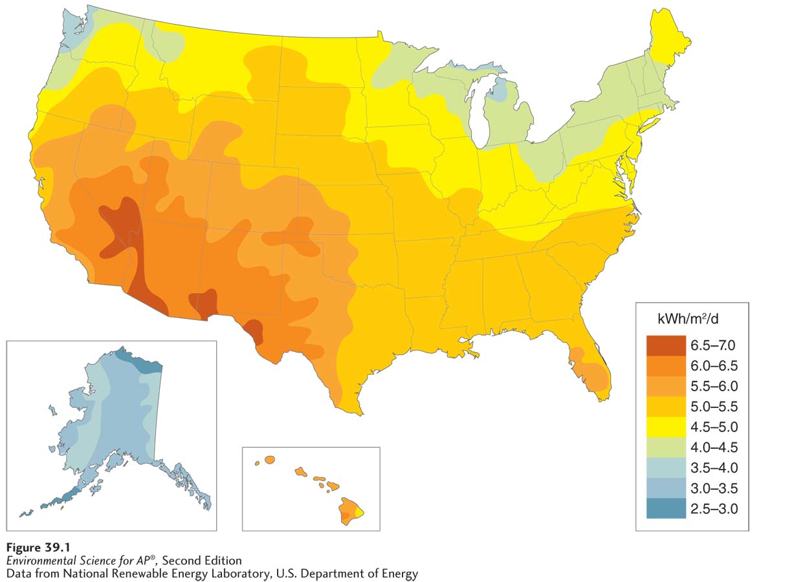
The energy of the Sun can be captured directly
Geographic variation in solar radiation in the United States. This map shows the
amount of solar energy available to a flat photovoltaic solar panel in kilowatt-hours per square meter per day, averaged over a year.

Slide 24
Active Solar Energy
Active solar energy Energy captured from sunlight with advanced technologies.
Technologies that employ active solar energy include:
Solar water heating systems
Photovoltaic systems
Photovoltaic solar cell A system of capturing energy from sunlight and converting it directly into electricity.
Large-scale concentrating solar thermal systems for electricity generation (CST)

Slide 25
Benefits and Drawbacks of Active Solar Energy Systems
Active solar energy systems offer many benefits:
Generating hot water or electricity without producing CO₂ or polluting the air or water during operation.
Producing electricity on hot, sunny days when demand for electricity is high.
Producing electricity during peak demand hours helps reduce the need to build new fossil fuel power plants.
A photovoltaic system may be less expensive than running electrical transmission lines to some home sites.

Slide 26
Benefits and Drawbacks of Active Solar Energy Systems
Drawbacks have inhibited the growth of solar energy use in the United States:
Photovoltaic solar panels are expensive to manufacture and install.
Manufacturing requires energy and water, and involves a variety of toxic metals and industrial chemicals.
There are environmental costs associated with the batteries for systems that use batteries for energy storage.
The end-of-life reclamation and recycling is another potential source of environmental contamination.

Slide 27
Wind energy is the most rapidly growing source of electricity
Wind energy Energy generated from the kinetic energy of moving air.
Wind energy is the fastest growing major source of electricity in the world.

Slide 28
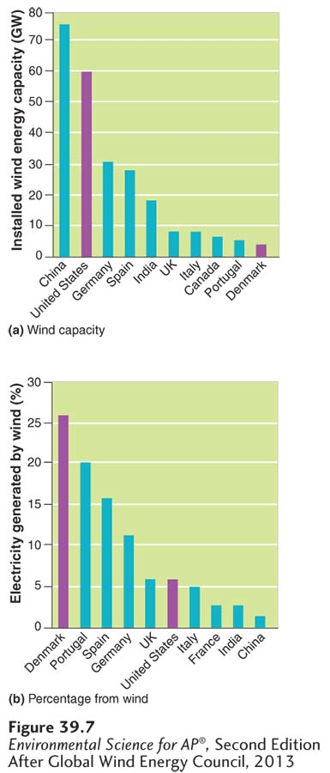
Wind Energy
Installed wind energy capacity by country.
(a) China generates more electricity from wind energy than any other country. (b) However, some relatively small countries,such as Denmark, generate a much higher percentage of their electricity from wind.

Slide 29
Generating Electricity from Wind
Wind turbine A turbine that converts wind energy into electricity.
The blades of the wind turbine transfer energy to the gear box that transfers energy to the generator.
Wind turbines on land are typically installed in rural locations, away from buildings and population centers.
Turbines are typically grouped into wind farms or wind parks.

Slide 30
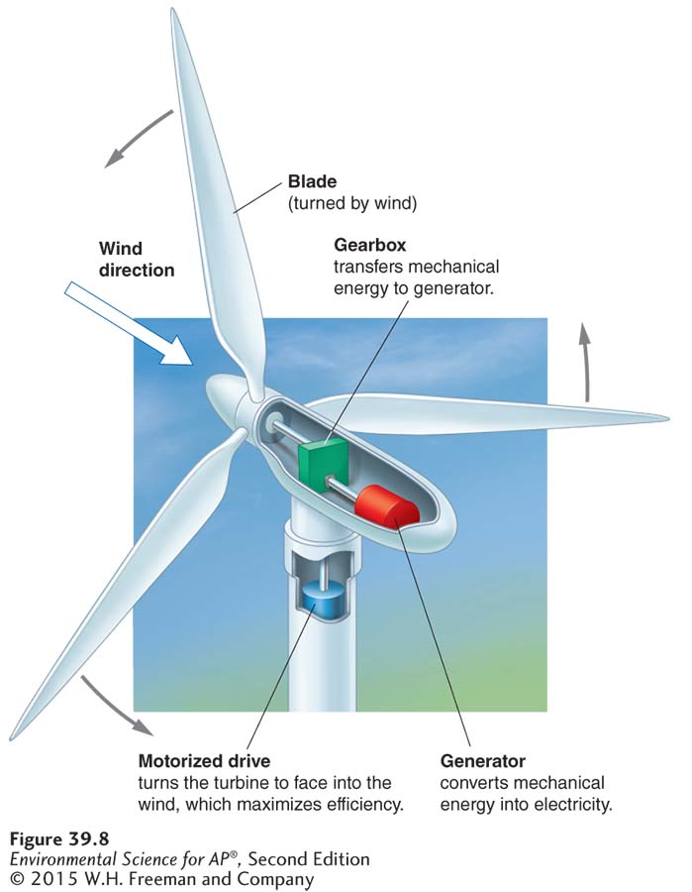
Generating Electricity from Wind
Generating electricity with a wind turbine.
The wind turns the blade, which is connected to the generator, which generates electricity.

Slide 31
Wind Energy
Advantages of wind energy include:
It is a nondepletable and free energy resource.
After manufacturing and installation, little energy input other than wind is required.
Wind-generated electricity produces no pollution and no greenhouse gases.
Wind farms can share the land with other uses.

Slide 32
Wind Energy
Disadvantages of wind energy include:
Most off-grid residential wind energy systems rely on batteries to store.
Wind turbines can be noisy and unattractive.
As many as 40,000 birds are killed by wind turbine blades in the United States each year.
Bats are also killed by wind turbines.

Slide 33
Earth’s internal heat is a source of nondepletable energy
Geothermal energy Heat energy that comes from the natural radioactive decay of elements deep within Earth.
Geothermal energy can be used directly as a source of heat.
Many countries obtain clean, renewable energy from geothermal resources.
The United States, China, and Iceland, all of which have substantial geothermal resources, are the largest geothermal energy producers.

Slide 34
Ground Source Heat Pumps
Ground source heat pump A technology that transfers heat from the ground to a building.
Although the heat tapped by ground source heat pumps is often informally referred to as “geothermal,” it comes from solar energy.

Slide 35
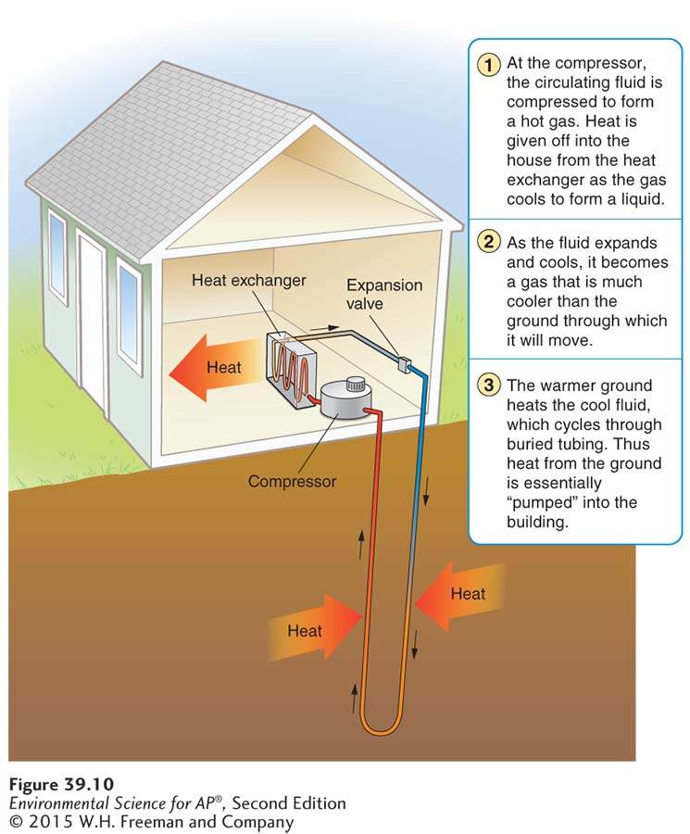
Ground Source Heat Pumps
Heating and cooling with a ground source heat pump.
By exchanging heat with the ground, a ground source heat pump can heat and cool a building using 30 to 70 percent
less energy than traditional furnaces and air conditioners.

Slide 36
Hydrogen fuel cells have many potential applications
Fuel cell An electrical-chemical device that converts fuel, such as hydrogen, into an electrical current.
Electrolysis The application of an electric current to water molecules to split them into hydrogen and oxygen.

Slide 37
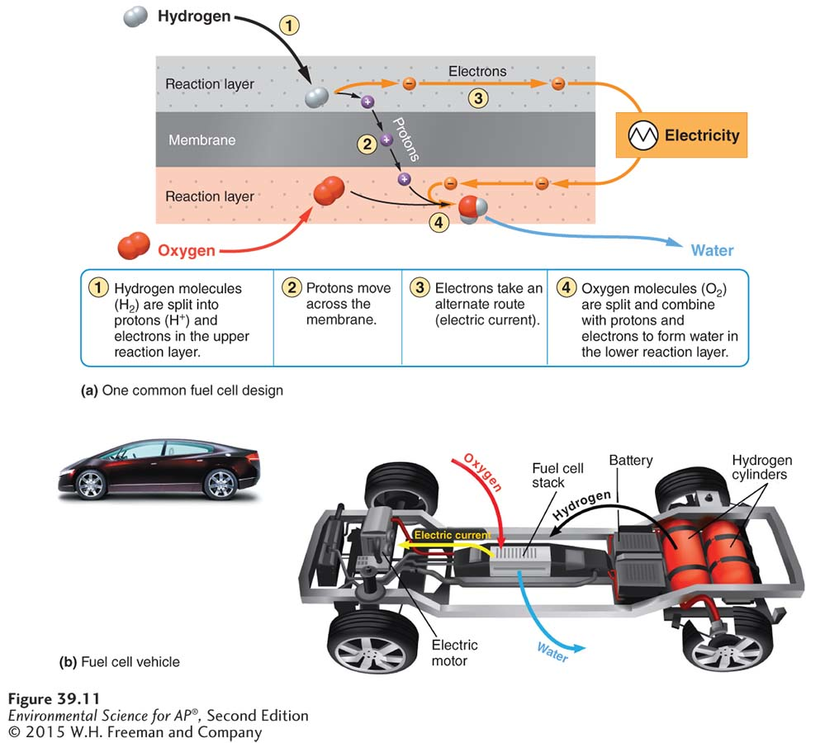
Hydrogen Fuel Cells
Power from a hydrogen fuel cell.
(a) Hydrogen gas enters the cell from an external
source. Protons from the hydrogen molecules pass through a membrane, while electrons flow around it,
producing an electric current. Water is the only waste product of the reaction.
(b) In a fuel cell vehicle,
hydrogen is the fuel that reacts with oxygen to provide electricity to run the motor.

Slide 38
Module 40 Planning Our Energy Future
After reading this module, you should be able to
discuss the environmental and economic options we must assess in planning our energy future.
consider the challenges of a renewable energy strategy.

Slide 39
Our energy future depends on efficiency, conservation, and the development of renewable and nonrenewable energy resources
No single energy can replace nonrenewable energy resources in a way that is completely renewable, nonpolluting, and free of impacts on the environment.
A sustainable energy strategy must combine:
Energy efficiency
Energy conservation
Development of renewable and nonrenewable energy resources

Slide 40
Our Energy Future
A sustainable energy strategy must consider the costs, benefits, and limitations of each energy source.
Convenience, reliability, and logistical considerations are also important.
Smart grid An efficient, self-regulating electricity distribution network that accepts any source of electricity and distributes it automatically to end users.

Slide 41
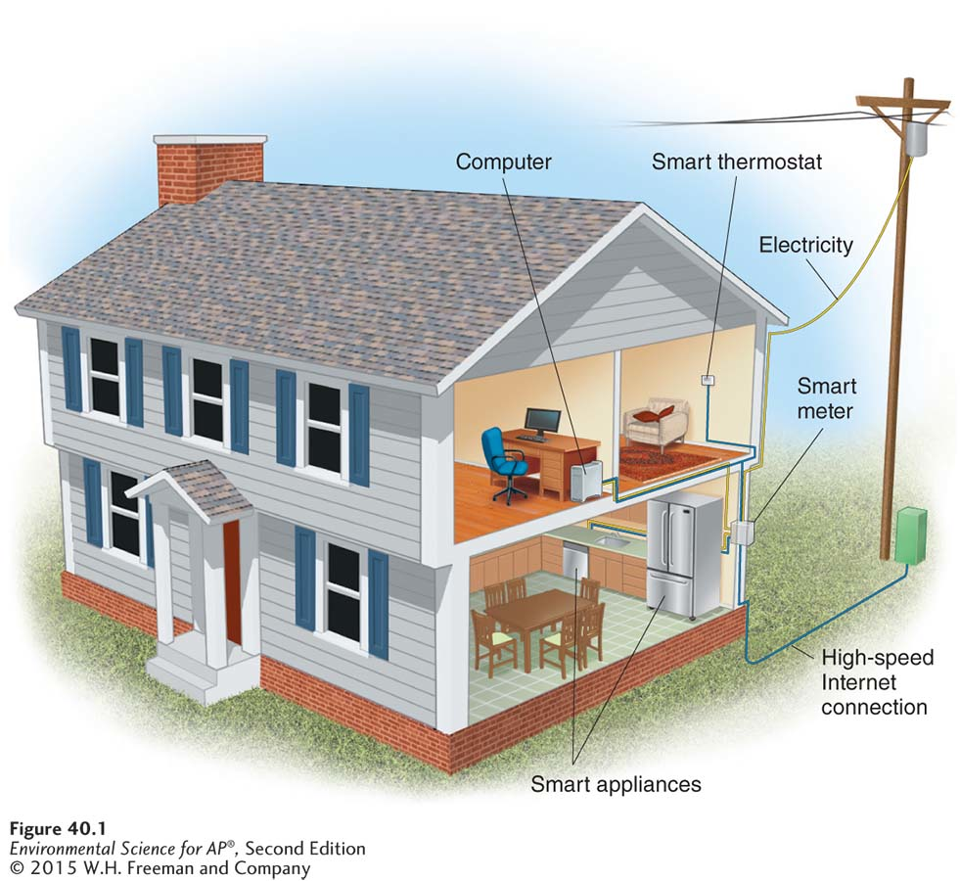
Our Energy Future
Using a smart grid. A smart grid optimizes the use of energy in a home by continuously coordinating energy use with energy availability.

