Slide 1
Chapter 14
Water Pollution
Friedland and Relyea Environmental Science for AP®, second edition
© 2015 W.H. Freeman and Company/BFW
AP® is a trademark registered and/or owned by the College Board®, which was not involved in the production of, and does not endorse, this product.

Slide 2
Module 41 Wastewater from Humans and Livestock
After reading this module you should be able to
discuss the three major problems caused by wastewater pollution.
explain the modern technologies used to treat wastewater.
Notes:
Added period

Slide 3
Wastewater from humans and livestock poses multiple problems
Water pollution The contamination of streams, rivers, lakes, oceans, or groundwater with substances produced through human activities. Wastewater Water produced by livestock operations and human activities, including human sewage from toilets and gray water from bathing and washing of clothes and dishes.
Point source A distinct location from which pollution is directly produced.
Nonpoint source A diffuse area that produces pollution.
Notes:
Fixed spacing

Slide 4
Wastewater from humans and livestock poses multiple problems
Problems from wastewater fall into three categories:
Oxygen demand
Nutrient release
Disease-causing organisms

Slide 5
Oxygen Demand
Biochemical oxygen demand (BOD) The amount of oxygen a quantity of water uses over a period of time at specific temperatures.
Dead zone In a body of water, an area with extremely low oxygen concentration and very little life.

Slide 6
Nutrient Release
Eutrophication A phenomenon in which a body of water becomes rich in nutrients.
Cultural eutrophication An increase in fertility in a body of water, the result of anthropogenic inputs of nutrients.
Eutrophication is caused by an increase in nutrients, such as fertilizers
Eutrophication can cause a rapid growth of algae which eventually dies, causing the microbes to increase the BOD.

Slide 7
Disease-Causing Organisms
Throughout the world people routinely use the same water source for drinking, bathing, and sewage.
Wastewater can carry a variety of pathogens.
Diseases that can be contracted by coming into contact with contaminated water include:
Cholera
Typhoid fever
Stomach flu
Diarrhea
Cholera
Hepatitis

Slide 8
Disease-Causing Organisms
Because of the risk that water-borne pathogens pose, we need a way to test for pathogens in our drinking water.
Indicator species A species that indicates whether or not disease-causing pathogens are likely to be present.
Fecal coliform bacteria A group of generally harmless microorganisms in human intestines that can serve as an indicator species for potentially harmful microorganisms associated with contaminated sewage.

Slide 9
We have technologies to treat wastewater
Treating wastewater properly reduces the risk of waterborne pathogens.
Two common ways to handle human wastewater:
Septic systems
Sewage treatment plants
Notes:
Fixed spacing on botom line

Slide 10
Septic Systems
Septic system A relatively small and simple sewage treatment system, made up of a septic tank and a leach field, often used for homes in rural areas.
Septic tank A large container that receives wastewater from a house as part of a septic system.
Sludge Solid waste material from wastewater.
Septage A layer of fairly clear water found in the middle of a septic tank.
Leach field A component of a septic system, made up of underground pipes laid out below the surface of the ground.

Slide 11
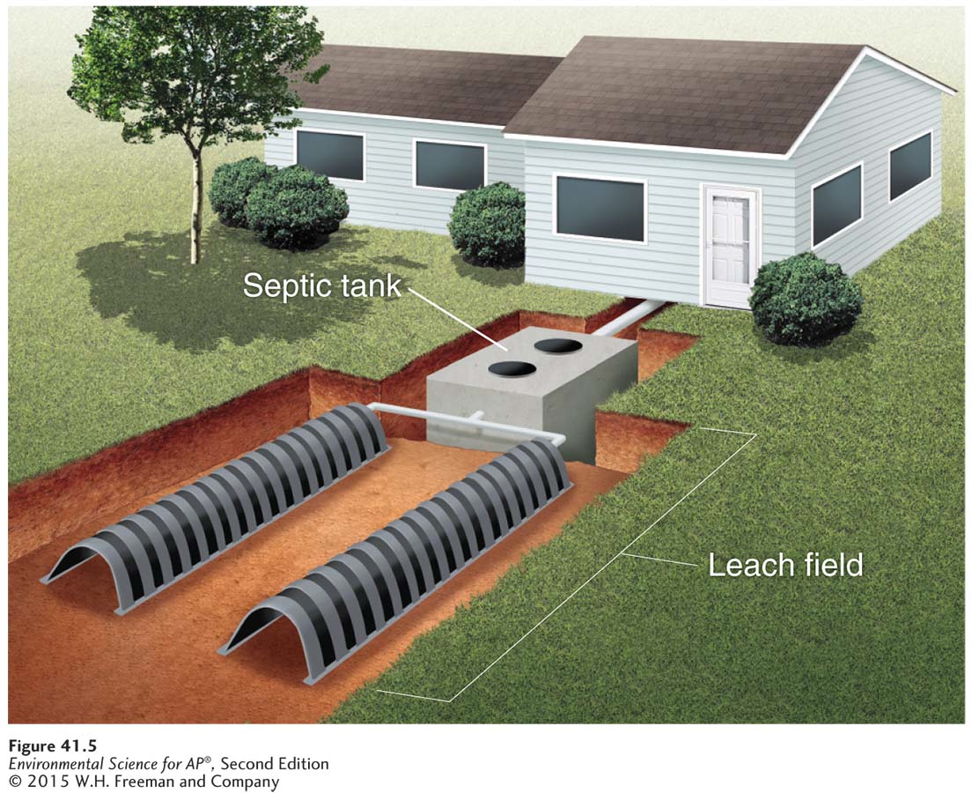
Septic Systems
A septic system. Wastewater from a house is held in a large septic tank where solids settle to the bottom and bacteria break down the sewage. The liquid moves through a pipe at the top of the tank and passes through perforated pipes that distribute the water through a leach field.

Slide 12
Sewage Treatment Plants
In developed countries, municipalities use centralized sewage treatment plant that receive wastewater from hundreds or even thousands of households.
In traditional waste treatment plants, there are two phases of treatment: primary and secondary.

Slide 13
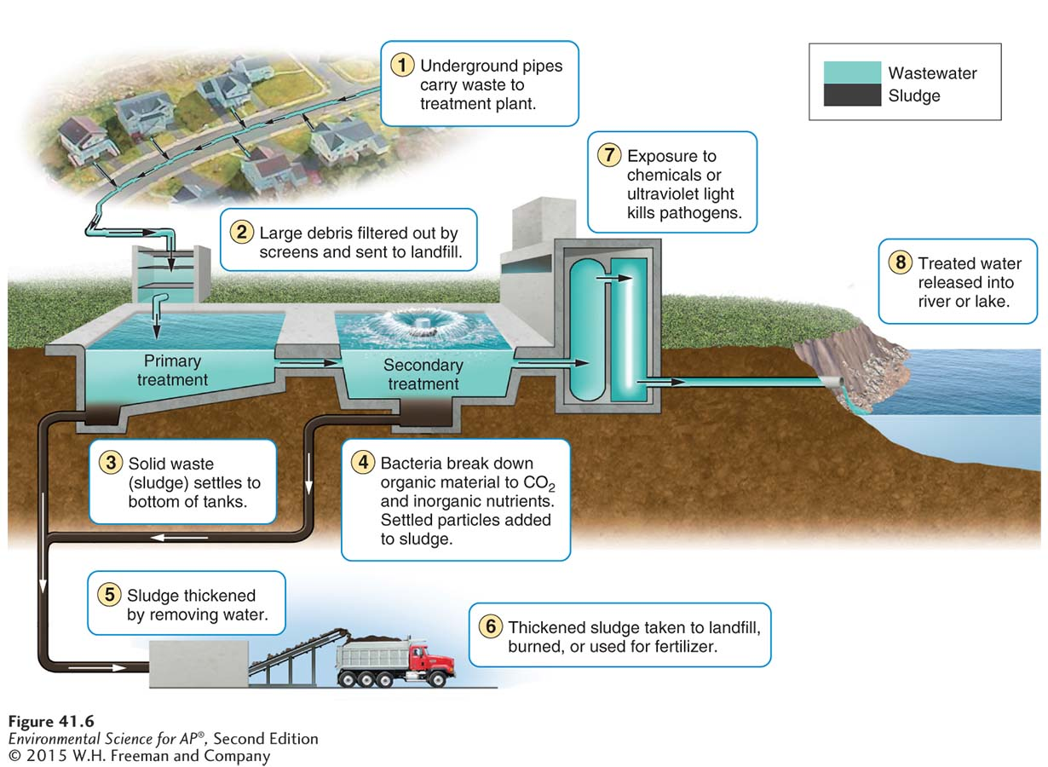
Sewage Treatment Plants
A sewage treatment plant. In large municipalities, great volumes of wastewater are
handled by separating the sludge from the water and then using bacteria to break down both components.

Slide 14
Animal Feed Lots and Manure Lagoons
Manure from concentrated animal feeding operations is a problem because of volume. It can also contain hormones and antibiotics that are given to the animals.
Manure lagoon Human-made pond lined with rubber built to handle large quantities of manure produced by livestock.
After the manure is broken down by bacteria, it is spread onto fields as fertilizers.

Slide 15
Module 42 Heavy Metals and Other Chemicals
After reading this module you should be able to
explain the sources of heavy metals and their effect on organisms.
discuss the sources and effects of acid deposition and acid mine drainage.
explain how synthetic organic compounds can affect aquatic organisms.

Slide 16
Heavy metals are highly toxic to organisms
Three heavy metals are of particular concern:
Lead: found in pipes and other materials in older construction.
Arsenic: occurs naturally and through human activity such as mining and industry.
Mercury: occurs naturally and through human activity, primarily burning coal.

Slide 17
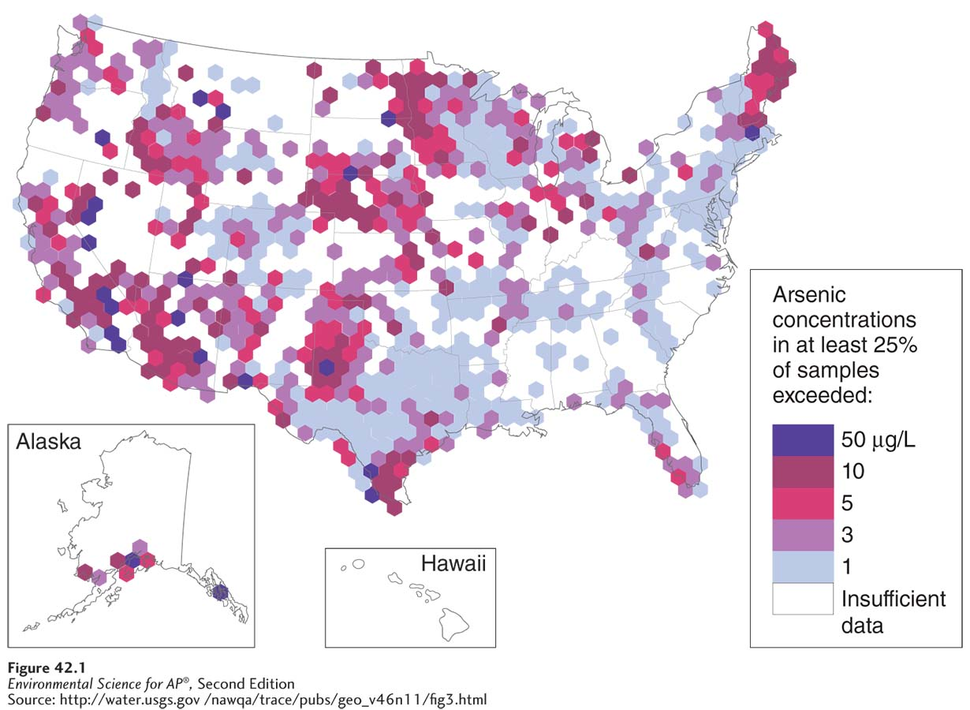
Arsenic
Arsenic in U.S. well water. The highest concentrations of arsenic are generally found in the upper Midwest and the West.

Slide 18
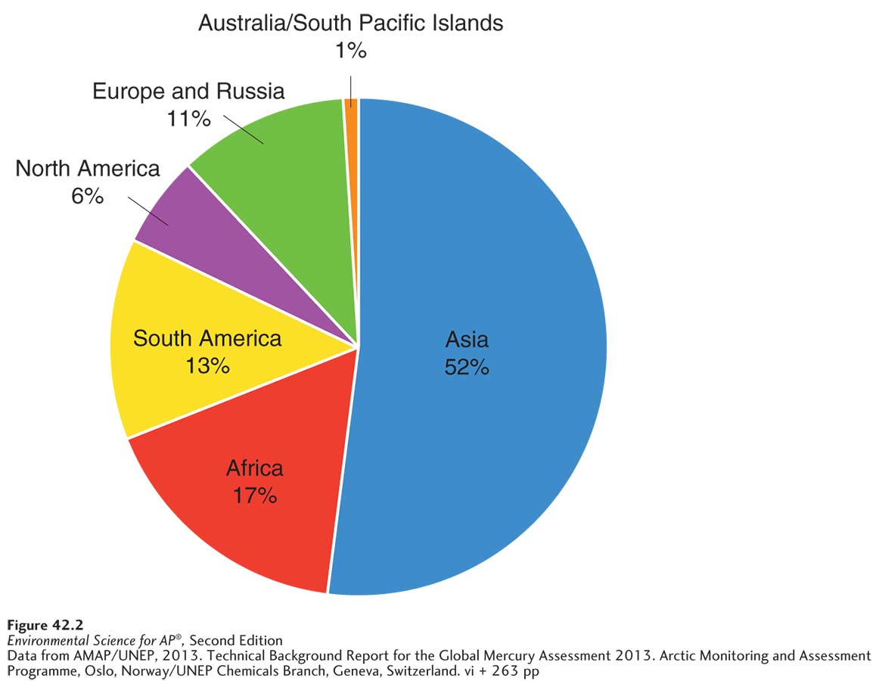
Mercury
World mercury emissions. Mercury emissions from human activities vary greatly among regions of the world.

Slide 19
Acid deposition and acid mine drainage affect terrestrial and aquatic ecosystems
Acid deposition Acids deposited on Earth as rain and snow or as gases and particles that attach to the surfaces of plants, soil, and water.
Acid deposition occurs when burning coal releases sulfur dioxide and nitrogen dioxide into the air.
In the atmosphere, these chemicals are converted to sulfuric acid and nitric acid, which fall back to Earth as acid deposition.
Acid deposition reduces the pH of water bodies to levels that are lethal to many organisms.
Many coal-burning facilities have installed coal scrubbers to combat this problem.

Slide 20
Synthetic organic compounds are human-produced chemicals
Synthetic compounds can enter the water supply from industrial point sources or from nonpoint sources when they are applied over large areas.
These compounds include pesticides, pharmaceuticals, military compounds, and industrial compounds.
Synthetic organic compounds can be toxic, cause genetic defects, and interfere with growth and sexual development.

Slide 21
Pesticides and Inert Ingredients
Pesticides serve an important role in helping to control pest organisms that pose a threat to crop production and human health.
However pesticides can have unintended impacts on other pests as well as on many nonpest species.
For example, DDT—designed to kill mosquitoes—can move up an aquatic food chain to birds that consume fish. Eagles that consumed DDT-contaminated fish produced eggs with thinner shells that broke too easily. After the United States DDT in 1972, the bald eagle and other birds of prey increased in numbers.

Slide 22
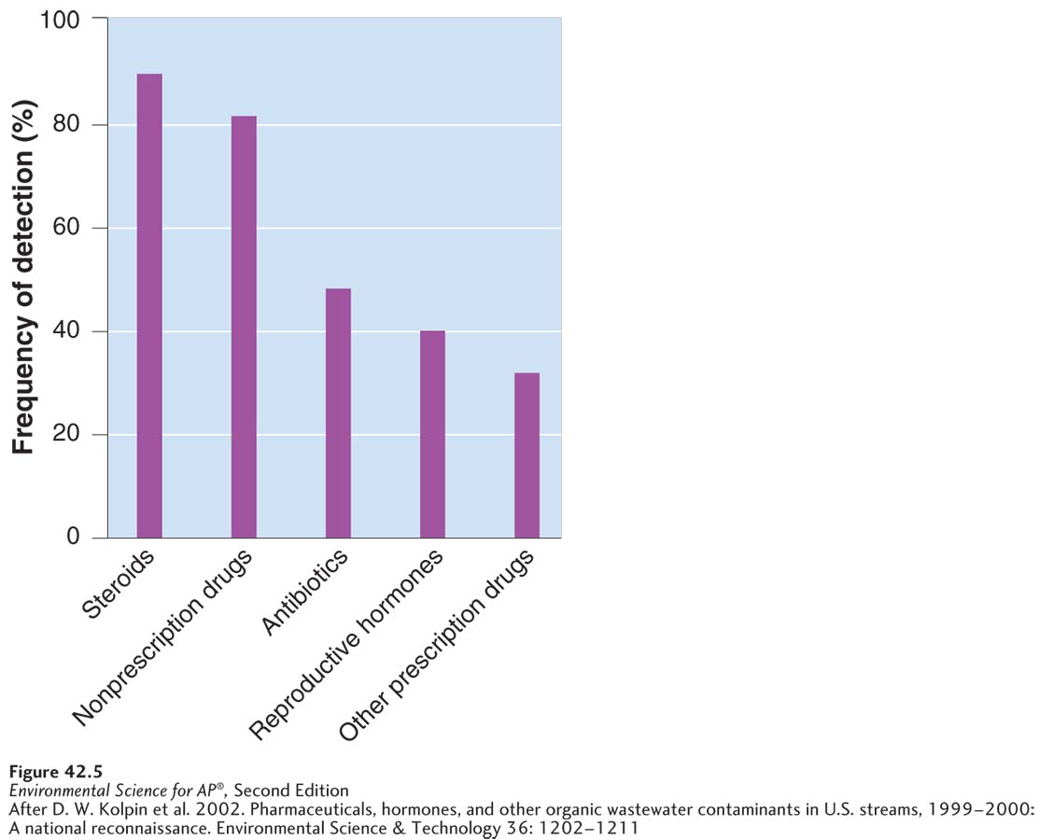
Pharmaceuticals and Hormones
Contaminants in streams. Streams contain a wide variety of chemicals including pharmaceutical drugs and hormones. These come from a combination of wastewater inputs, agriculture, forestry, and industry.

Slide 23
Military Compounds
Perchlorates A group of harmful chemicals used for rocket fuel.
Perchlorates sometimes contaminate the soil in regions of the world where military rockets are manufactured, tested, or dismantled.

Slide 24
Industrial Compounds
Industrial compounds: chemicals used in manufacturing.
It used to be common for manufacturers in the United States to dump industrial compounds directly into bodies of water.
Polychlorinated biphenyls (PCBs) A group of industrial compounds used to manufacture plastics and insulate electrical transformers, and responsible for many environmental problems.

Slide 25
Module 43 Oil Pollution
After reading this module you should be able to
identify the major sources of oil pollution.
explain some of the current methods to remediate oil pollution.

Slide 26
There are several sources of oil pollution
Petroleum products are highly toxic to many marine organisms, including birds, mammals, and fish, as well as to the algae and microorganisms that form the base of the aquatic food chain.
One source of oil in the water comes from drilling for undersea oil using offshore platforms.
Oil and other petroleum products can also enter the oceans as spills from oil tankers.
Oil pollution in the ocean also occurs naturally.

Slide 27
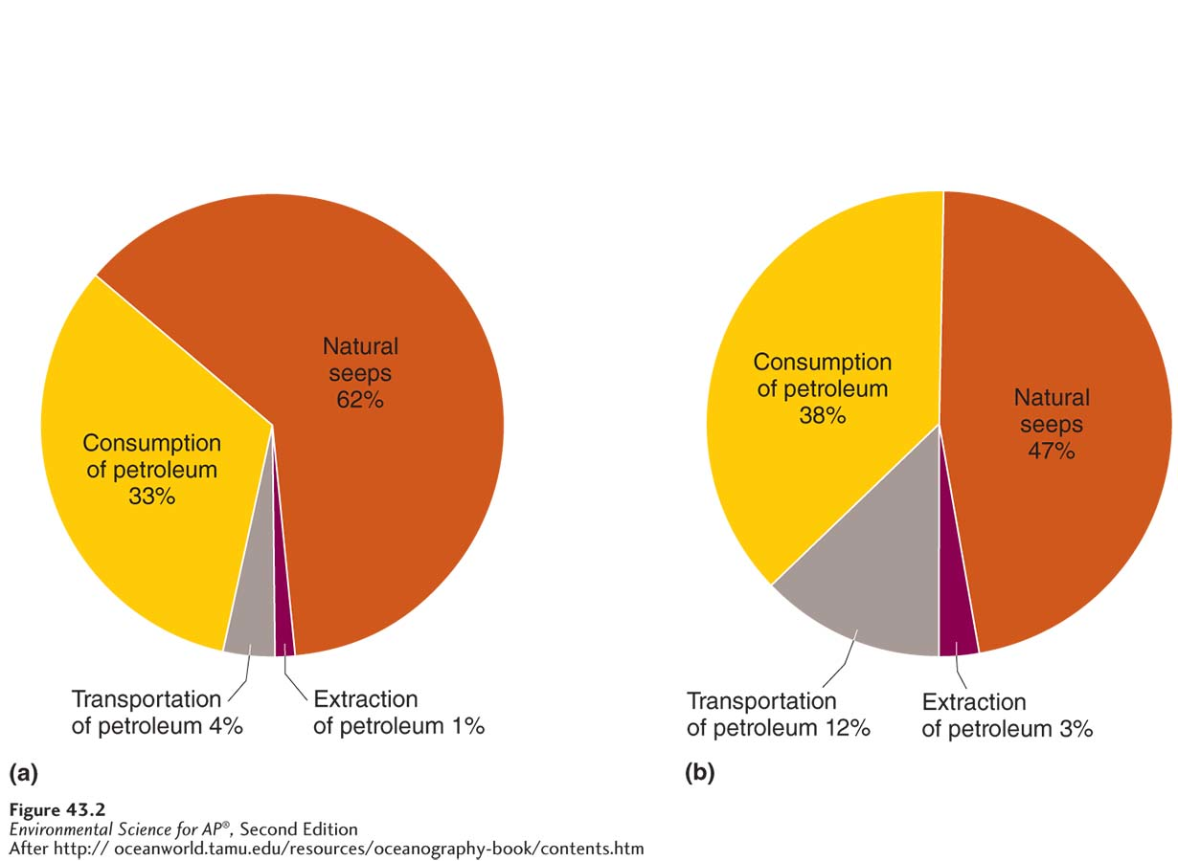
Oil Pollution
Sources of oil in the ocean. Oil contamination in the ocean, both (a) in North America and (b) worldwide, comes from a variety of sources including natural seeps, extraction of oil from underneath the ocean, transport of oil by tanker or pipeline, and consumption of petroleum-based products.

Slide 28
The are ways to remediate oil pollution
Containment: Booms keep the floating oil from spreading, then boats equipped with giant oil vacuums suck up as much oil as possible.
Chemicals: Chemicals break up the oil on the surface, making it disperse before it hits the shoreline.
Bacteria: A particular bacterium consumes oil; scientists are currently trying to genetically engineer the bacterium to consume oil even faster.

Slide 29
Module 44 Nonchemical Water Pollution
After reading this module you should be able to
identify the major sources of solid waste pollution.
explain the harmful effects of sediment pollution.
discuss the sources and consequences of thermal pollution.
understand the causes of noise pollution.

Slide 30
Solid waste includes garbage and sludge
Much solid waste is what we call garbage and the sludge produced by sewage treatment plants.
Garbage on beaches and in the ocean is dangerous to both marine organisms and people.
In the United States the practice of dumping garbage in the ocean was curtailed in the early 1980s.
The problem remains in many developing countries.

Slide 31
Sediment pollution consists of soil particles that are carried downstream
30 percent of all sediments in our waterways comes from natural sources while 70 percent comes from human activities.
Problems with sedimentation:
Suspension of soil particles cause waterways to become brown and cloudy.
Reduced infiltration of sunlight lowers productivity of aquatic plants and algae.
Sediments clog gills and prevent aquatic organisms from obtaining oxygen.

Slide 32
Thermal pollution causes change in water temperatures
Thermal pollution Nonchemical water pollution that occurs when human activities cause a substantial change in the temperature of water.
Thermal shock A dramatic change in water temperature that can kill organisms.
One common solution is cooling towers that release the excess heat into the atmosphere instead of into the water.

Slide 33
Noise pollution may interfere with animal communication
Sounds emitted by ships and submarines can interfere with animal communication.
Especially loud sonar can negatively affect species such as whales that rely on low-frequency, long-distance communication.
An increased awareness of noise pollution in the ocean has inspired some ship builders to design ships equipped with quieter propellers.

Slide 34
Module 45 Water Pollution Laws
After reading this module you should be able to
explain how the Clean Water Act protects against water pollution.
discuss the goals of the Safe Drinking Water Act.
understand how water pollution legislation is changing in developing countries.

Slide 35
The Clean Water Act protects water bodies
Clean Water Act Legislation that supports the “protection and propagation of fish, shellfish, and wildlife and recreation in and on the water” by maintaining and, when necessary, restoring the chemical, physical, and biological properties of surface waters.
The Clean water Act issued water quality standards that defined acceptable limits of various pollutants in U.S. waterways.

Slide 36
The Safe Drinking Water Act protects sources of drinking water
Safe Drinking Water Act Legislation that sets the national standards for safe drinking water.
The Safe Water Drinking Act establishes maximum contaminant levels (MCL) for 77 different elements or substances in both surface water and groundwater.
Maximum contaminant level (MCL) The standard for safe drinking water established by the EPA under the Safe Drinking Water Act.

Slide 37
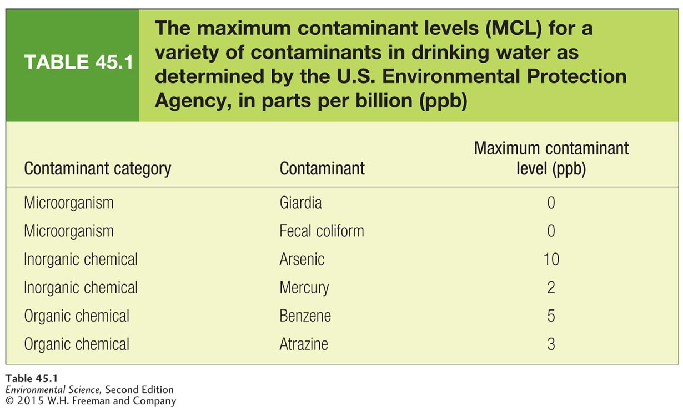
Safe Drinking Water Act

Slide 38
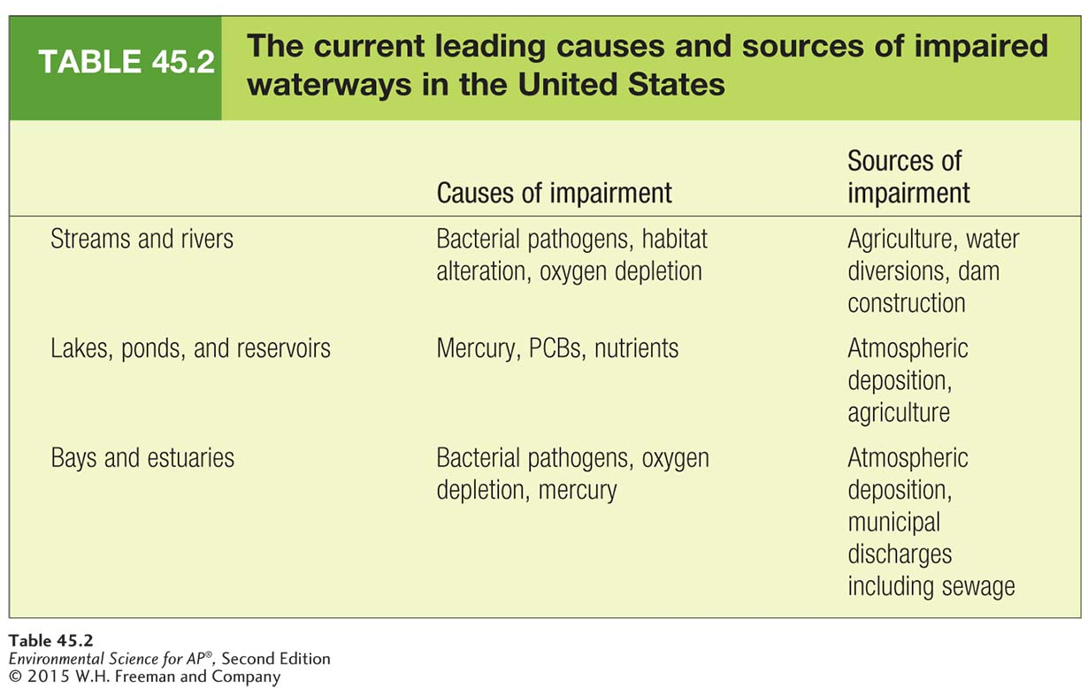
Safe Drinking Water Act

Slide 39
Water pollution legislation is becoming more common in the developing world
Developed countries have addressed the problems of pollution by cleaning up polluted areas and by passing legislation to prevent pollution in the future.
Developing countries are still in the process of industrializing and are less able to afford water-quality improvements
Developing countries suffer from the additional pollution, but also benefit economically from the additional jobs and industrial spending.
As a nation becomes more affluent, it has more resources available to address environmental issues.

