Slide 1
Chapter 15
Air Pollution and Stratospheric Ozone Depletion
Friedland and Relyea Environmental Science for AP®, second edition
© 2015 W.H. Freeman and Company/BFW
AP® is a trademark registered and/or owned by the College Board®, which was not involved in the production of, and does not endorse, this product.

Slide 2
Module 46 Major Air Pollutants and Their Sources
After reading this module, you should be able to
identify and describe the major air pollutants.
describe the sources of air pollution.

Slide 3
Air Pollution is a global system
Air pollution The introduction of chemicals, particulate matter, or microorganisms into the atmosphere at concentrations high enough to harm plants, animals, and materials such as buildings, or to alter ecosystems.
The air pollution system has many inputs and outputs.

Slide 4
Classifying Pollutants
Sulfur dioxide (S0₂):
A corrosive gas that comes primarily from combustion of fuels such as coal and oil.
A respiratory irritant and can adversely affect plant tissue.
Also released in large quantities during volcanic eruptions and in much smaller quantities, during forest fires.

Slide 5
Classifying Pollutants
Nitrogen Oxides (NO_{x}):
Motor vehicles and stationary fossil fuel combustion are the primary anthropogenic sources of nitrogen oxides.
Respiratory irritant, increases susceptibility to respiratory infection.
An ozone precursor, leads to formation of photochemical smog.
Converts to nitric acid in atmosphere, which is harmful to aquatic life and some vegetation.
Contributes to over-fertilizing terrestrial and aquatic systems.

Slide 6
Classifying Pollutants
Carbon Oxides:
Carbon monoxide (CO) is a common emission in vehicle exhaust and most other combustion processes.
CO can be a significant component of air pollution in urban areas.
Carbon dioxide (CO₂) released by burning fossil fuels has led to its becoming a major pollutant.
CO₂ recently exceeded a concentration of 400 parts per million in the atmosphere and appears to be steadily increasing each year.

Slide 7
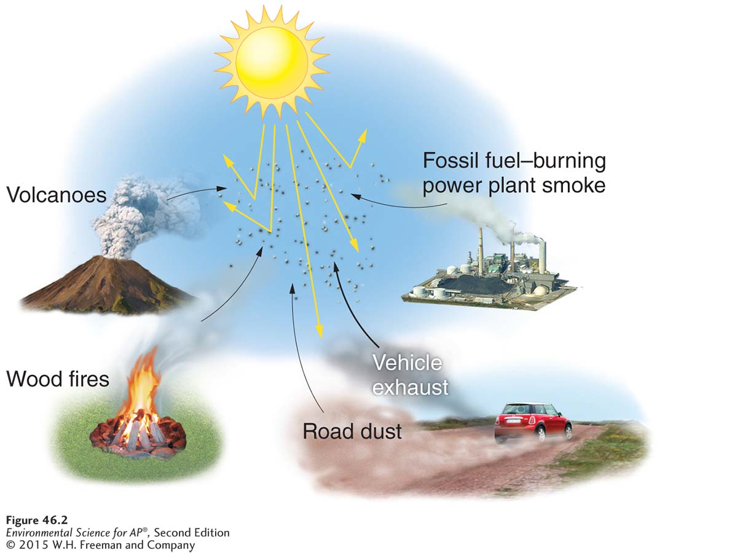
Classifying Pollutants
Particulate matter (PM) Solid or liquid particles suspended in air. Also known as Particulates; Particles.
The sources of particulate matter and its effect.
Particulate matter can be natural or anthropogenic. Particulate matter
in the atmosphere ranges considerably in size and can absorb or
scatter light, which creates a haze and reduces the light that reaches the surface of Earth.

Slide 8
Classifying Pollutants
Haze Reduced visibility.
Photochemical oxidant A class of air pollutants formed as a result of sunlight acting on compounds such as nitrogen oxides.
Ozone (O₃) A secondary pollutant made up of three oxygen atoms bound together.
Smog A type of air pollution that is a mixture of oxidants and particulate matter.
Photochemical smog Smog that is dominated by oxidants such as ozone. Also known as Los Angeles–type Smog; Brown smog.
Sulfurous smog Smog dominated by sulfur dioxide and sulfate compounds. Also known as London-type smog; Gray smog; Industrial smog.

Slide 9
Classifying Pollutants
Lead:
A gasoline additive, also found in oil, coal, and old paint.
Impairs central nervous system.
At low concentrations, can have measurable effects on learning and ability to concentrate.

Slide 10
Classifying Pollutants
Volatile organic compound (VOC) An organic compound that evaporates at typical atmospheric temperatures.
Formed by evaporation of fuels, solvents, paints, and improper combustion of fuels such as gasoline.
A precursor to ozone formation.

Slide 11
Primary and Secondary Pollutants
Primary pollutant A polluting compound that comes directly out of a smokestack, exhaust pipe, or natural emission source.
Examples include CO, CO₂, SO₂, NO_{x}, and most suspended particulate matter.

Slide 12
Primary and Secondary Pollutants
Secondary pollutant A primary pollutant that has undergone transformation in the presence of sunlight, water, oxygen, or other compounds.
Examples include O₃, sulfate, and nitrate.

Slide 13
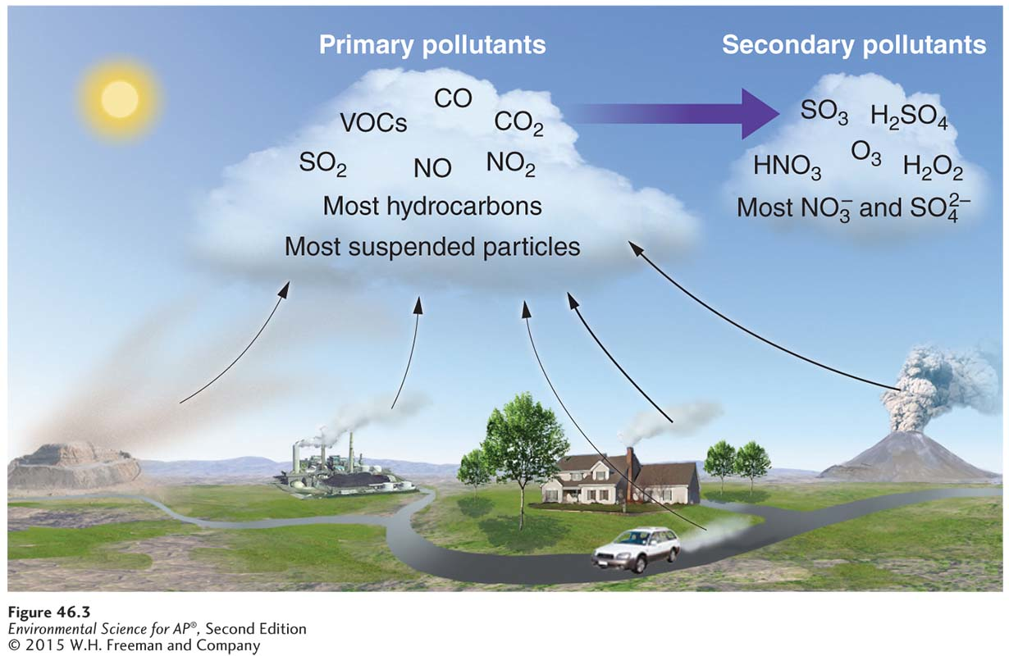
Primary and Secondary Pollutants
Primary and secondary air pollutants. The transformation from primary to secondary pollutant requires a number of factors
including sunlight, water (clouds), and the appropriate temperature.

Slide 14
Air pollution comes from both natural and human sources
Natural emissions of pollution include volcanoes, lightning, forest fires, and plants, both living and dead, all release compounds that can be classified as pollutants.
Anthropogenic sources include on-road vehicles, power plants, industrial processes, waste disposal (incinerator).

Slide 15
Anthropogenic Emissions
In the United States, emissions from human activity are monitored, regulated, and in many cases controlled.
Some anthropogenic sources are on-road vehicles, power plants, industrial processes, and incineration.
The Clean Air Act and its various amendments require that EPA establish standards to control pollutants that are harmful to “human health and welfare”.
Through the National Ambient Air Quality Standards (NAAQS) the EPA periodically specifies concentration limits for each air pollutant.

Slide 16
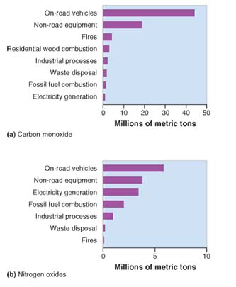
Anthropogenic Emissions, cont’d
Emission sources of criteria air pollutants for the United States. Recent EPA data show that on-road
vehicles, categorized as “transportation,” are the largest source of (a)carbon monoxide and (b)nitrogen oxides.

Slide 17
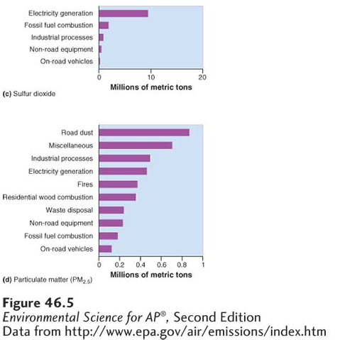
Anthropogenic Emissions
Emission sources of criteria air pollutants for the United States. The major source of
(c) anthropogenic sulfur dioxide is the generation of electricity, primarily from coal. Among the sources of (d) particulate matter are road dust, industrial processes, electricity generation, and natural and human-made fires.

Slide 18
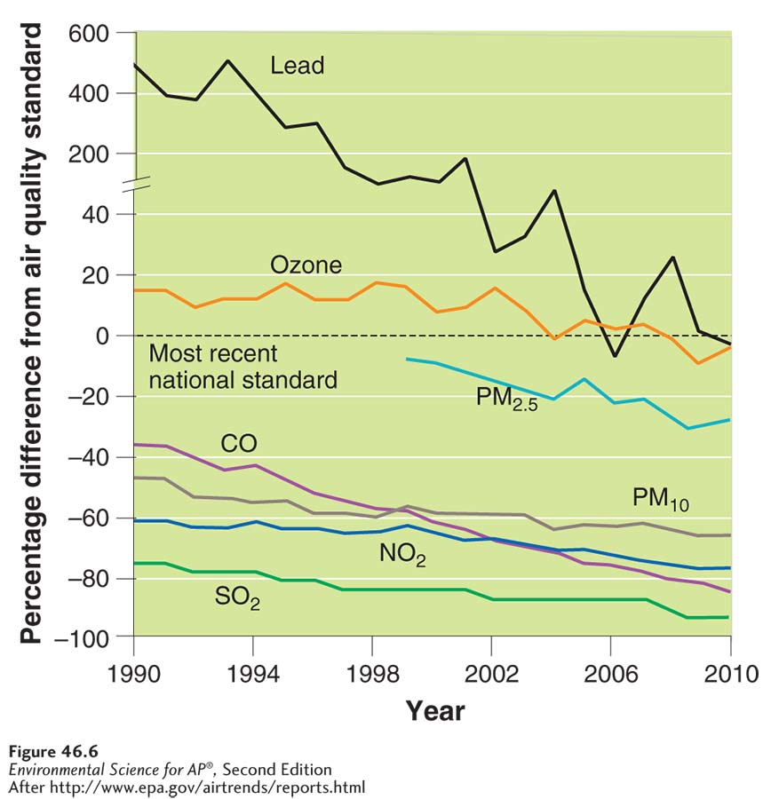
Anthropogenic Emissions
Criteria and other air pollutant
trends. Trends in the criteria air pollutants in the United States
between 1990 and 2010. All criteria air pollutants have decreased during this time period. The decrease for lead is the greatest.

Slide 19
Module 47 Photochemical Smog and Acid Rain
After reading this module, you should be able to
explain how photochemical smog forms and why it is still a problem in the United States.
describe how acid deposition forms and why it has improved in the United States and become worse elsewhere.

Slide 20
Photochemical smog remains an environmental problem in the United States
The formation of this photochemical smog is complex and still not well understood.
A number of pollutants are involved and they undergo a series of complex transformations in the atmosphere.

Slide 21
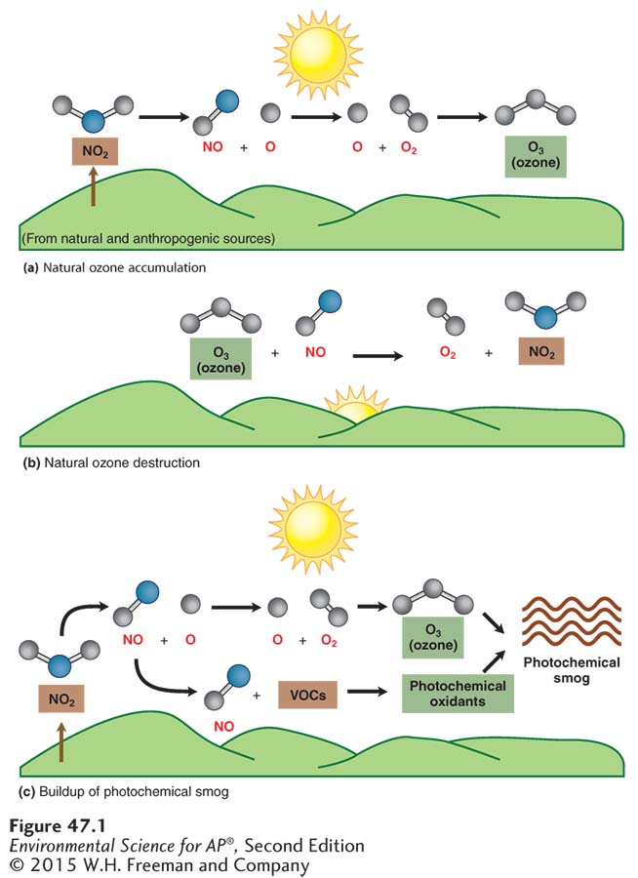
The Chemistry of Ozone and Photochemical Smog Formation
Tropospheric ozone and photochemical smog formation. (a) In the absence of VOCs, ozone will form during the daylight hours.
(b) After sunset, the ozone will break down. (c) In the presence of VOCs, ozone will form during the daylight hours. The VOCs combine with nitrogen oxides to form photochemical oxidants, which reduce the amount of ozone that will break down later and contribute to prolonged periods of photochemical smog.

Slide 22
Thermal Inversions
Thermal inversion A situation in which a relatively warm layer of air at mid-altitude covers a layer of cold, dense air below.
Inversion layer The layer of warm air that traps emissions in a thermal inversion.
The warm inversion layer traps emissions that then accumulate beneath it.
Thermal inversions that create pollution events are particularly common in some cities, where high concentration of vehicles exhaust and industrial emissions are easily trapped by the inversion layer.

Slide 23
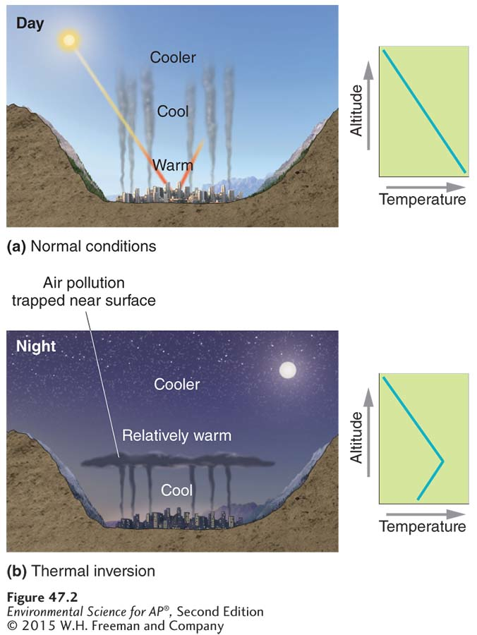
Thermal Inversions
A thermal inversion. (a) Under normal conditions, where temperatures decrease with increasing altitude, emissions rise into the atmosphere. (b) When a mid-altitude, relatively warm inversion layer blankets a cooler layer, emissions are trapped and accumulate.

Slide 24
Acid deposition has improved in the United States
Acid deposition occurs when nitrogen oxides and sulfur oxides are released into the atmosphere and combine with atmospheric oxygen and water. These form the secondary pollutants nitric acid and sulfuric acid.
The secondary pollutants further break down into nitrate and sulfate, and hydrogen ions (H+) which cause the acid in acid deposition.
Acid deposition has been reduced in the United States as a result of lower sulfur dioxide and nitrogen oxide emissions.

Slide 25
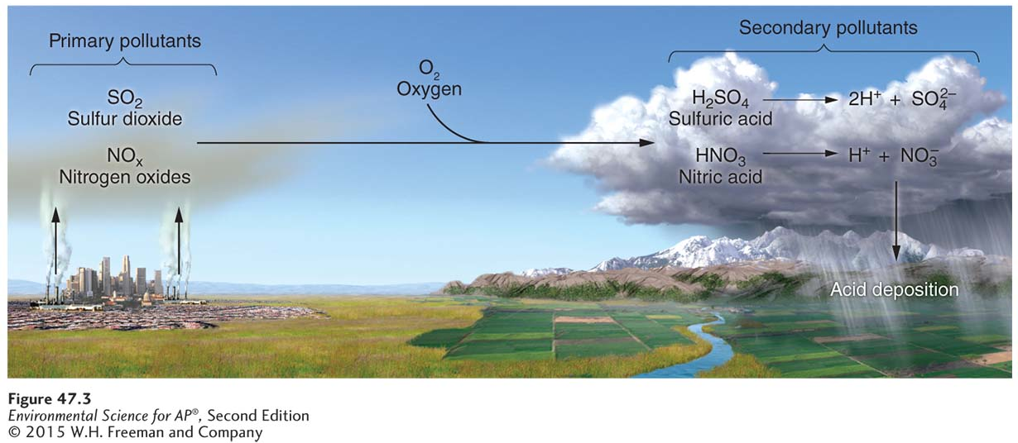
How Acid Deposition Forms and Travels
Formation of acid deposition. The primary pollutants sulfur dioxide and nitrogen oxides are precursors to acid deposition. After transformation to the secondary pollutants—sulfuric and nitric acid— dissociation occurs in the presence of water. The resulting ions—hydrogen, sulfate, and nitrate—cause the adverse ecosystem effects of acid deposition.

Slide 26
Effects of Acid Deposition
Acid deposition has many harmful effects:
Lowering the pH of lake water
Decreasing species diversity of aquatic organisms
Mobilizing metals that are found in soils and releasing them into surface waters
Damaging statues, monuments, and buildings

Slide 27
Module 48 Pollution Control Measures
After reading this module, you should be able to
explain strategies and techniques for controlling sulfur dioxide, nitrogen oxides, and particulate matter.
describe innovative pollution control measures.

Slide 28
Pollution control includes prevention, technology, and innovation
Ways to address air pollution:
Avoid emissions in the first place.
Use cleaner fuel.
Increase efficiency.
Control pollutants after combustion.

Slide 29
Pollution control includes prevention, technology, and innovation
Ways of controlling emissions:
Remove sulfur dioxide from coal by fluidized bed combustion.
Install catalytic converters on cars.
Use baghouse filters.
Use electrostatic precipitators.
Install scrubbers on smokestacks.

Slide 30
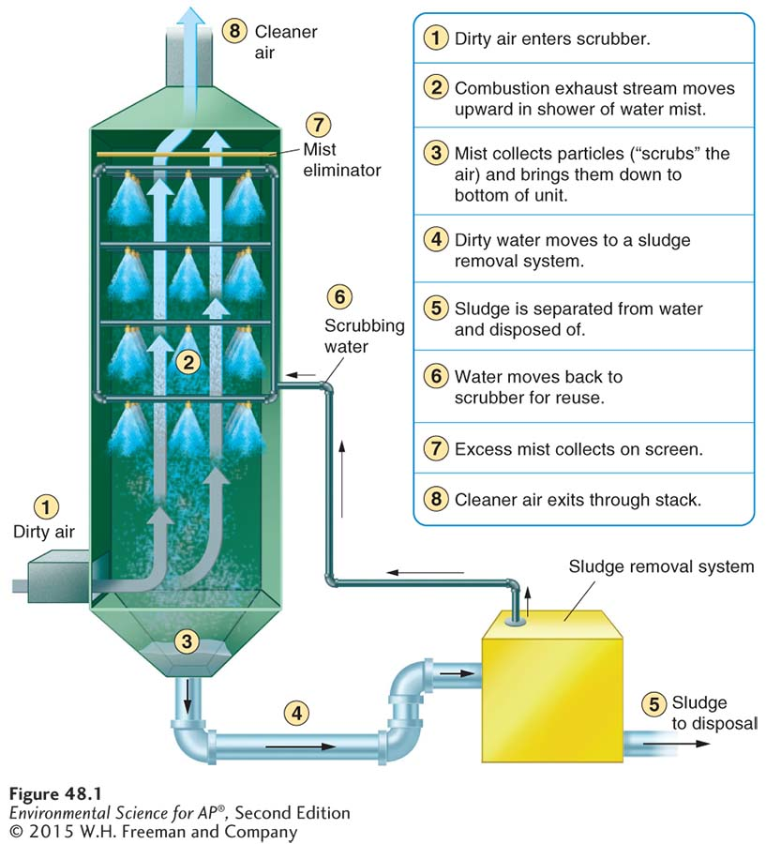
Control of Particulate Matter
The scrubber. In this air pollution control device, particles are “scrubbed” from the exhaust
stream by water droplets. A water-particle “sludge” is collected and processed for disposal.

Slide 31
Around the world people are implementing innovative pollution control measures
Municipalities have tried a number of strategies:
Reduce gasoline spilled at the pump, restrict evaporation of dry-cleaning fluids, and the use of lighter fluid.
Reduce use of wood-burning stoves and fireplaces.
Limit automobiles to every other day use or charge user fees for roads during heavy commute times.

Slide 32
Module 49 Stratospheric Ozone Depletion
After reading this module, you should be able to
explain the benefits of stratospheric ozone and how it forms.
describe the depletion of stratospheric ozone.
explain efforts to reduce ozone depletion.

Slide 33
Stratospheric ozone is beneficial to life on Earth
The stratospheric ozone layer exists roughly 45-60 kilometers above Earth.
Ozone has the ability to absorb ultraviolet radiation and protect life on Earth.
The ultraviolet (UV) spectrum is made up of three increasingly energetic ranges: UV-A UV-B, and UV-C.

Slide 34
Formation of Stratospheric Ozone
UV-C radiation breaks the molecular bond holding an oxygen molecule together:
O₂ + UV-C → O + O
A free oxygen atom (O) produced in the first reaction encounters an oxygen molecule, and they form ozone.
O + O₂ → O₃
Both UV-B and UV-C radiation can break a bond in this new ozone molecule:
O₃ + UV-B or UV-C → O₂ + O

Slide 35
Breakdown of Stratospheric Ozone
When chlorine is present (from CFCs), it can attach to an oxygen atom in an ozone molecule to form chlorine monoxide (ClO) and O₂:
O₃ + Cl → ClO + O₂
The chlorine monoxide molecule reacts with a free oxygen atom, which pulls the oxygen from the ClO to produce free chlorine again:
ClO + O → Cl + O₂

Slide 36
Breakdown of Stratospheric Ozone
A single chlorine atom can catalyze the breakdown of as many as 100,000 ozone molecules until finally one chlorine atom finds another and the process is stopped.
In the process, the ozone molecules are no longer available to absorb incoming UV-B radiation.
As a result, the UV-B radiation can reach Earth’s surface and cause harm to biological organisms.

Slide 37
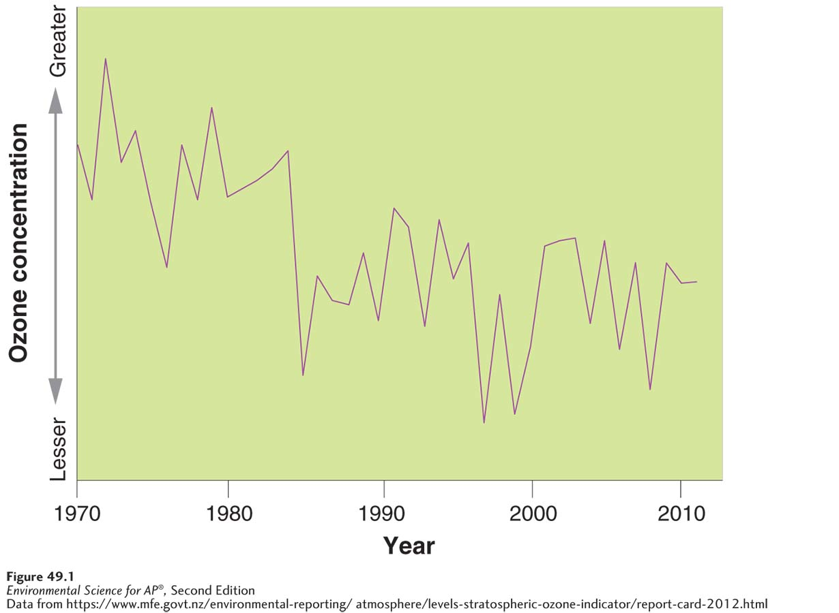
Depletion of the Ozone Layer
Stratospheric ozone concentration. This data for one area of Switzerland shows a generally decreasing trend from
1970 to 2011.

Slide 38
Module 50 Indoor Air Pollution
After reading this module you should be able to
explain how indoor air pollution differs in developing and developed countries.
describe the major indoor air pollutants and the risks associated with them.

Slide 39
Indoor air pollution is a significant hazard in developing and developed countries
Worldwide, approximately 4 million deaths each year are attributable to indoor air pollution.
Ninety percent of these deaths are in developing countries.
More than 50 percent are children.

Slide 40
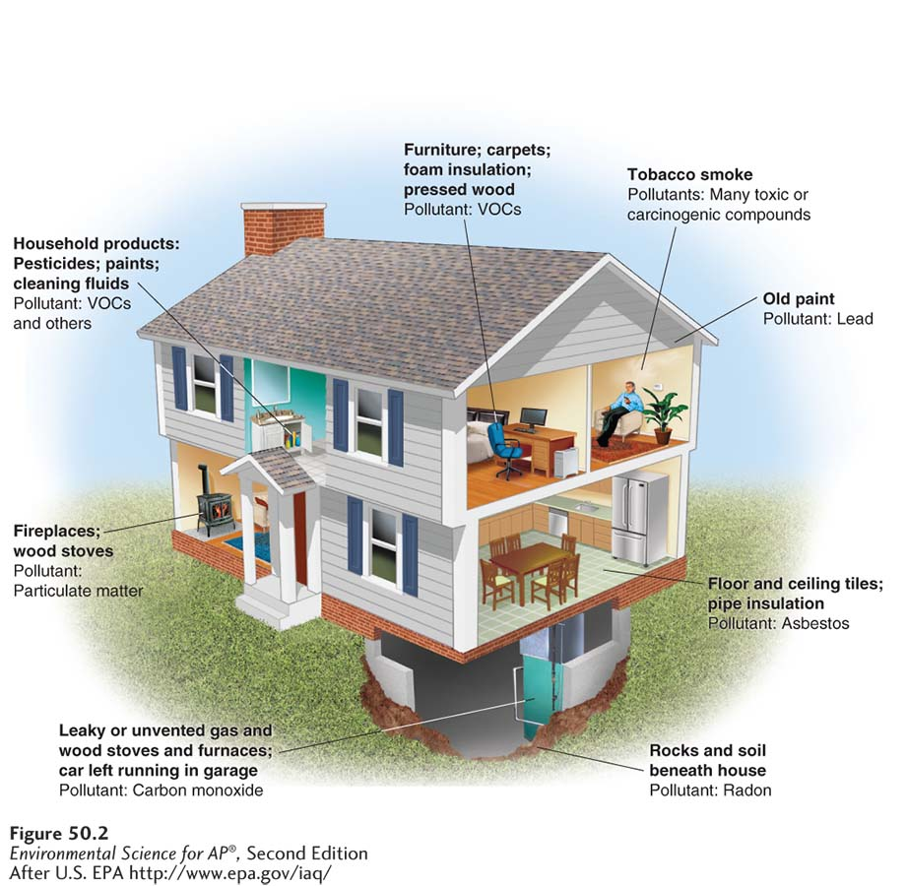
Indoor Air Pollution in Developed Countries
Some sources of indoor air pollution in the developed world.
A typical home in the United States may contain a variety of chemical compounds that could, under certain circumstances, be
considered indoor air pollutants.

Slide 41
Most indoor air pollutants differ from outdoor air pollutants
Indoor air pollutants include:
Carbon monoxide from malfunctioning heating equipment.
Asbestos A long thin fibrous silicate mineral with insulating properties, which can cause cancer when inhaled; formerly used as insulation in buildings.
Radon that seeps into homes through cracks in the foundation, groundwater, or rocks.
VOCs used in furniture, paint, and building materials.

Slide 42
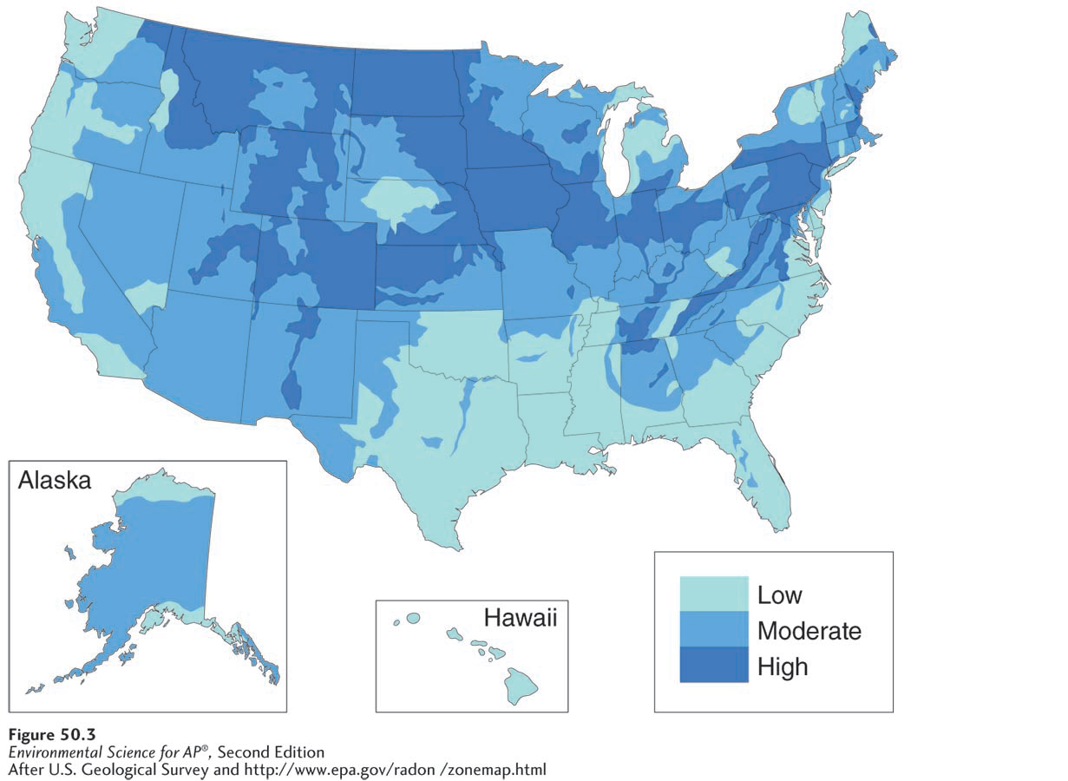
Radon
Potential radon exposure in the United States. Depending on the underlying bedrock and soils, the potential for exposure to radon exists in houses in certain parts of the United States.

Slide 43
VOCs in Home Products
Reasons for sick building syndrome:
Inadequate or faulty ventilation
Chemical contamination from indoor sources
Chemical contamination from outdoor sources
Biological contamination from outside or inside

