Slide 1
Chapter 17
Human Health and Environmental Risks
Friedland and Relyea Environmental Science for AP®, second edition
© 2015 W.H. Freeman and Company/BFW
AP® is a trademark registered and/or owned by the College Board®, which was not involved in the production of, and does not endorse, this product.

Slide 2
Module 56 Human Disease
After reading this module you should be able to
identify the different types of human diseases.
understand the risk factors for human chronic diseases.
discuss the historically important human diseases.
identify the major emergent infectious diseases.
discuss the future challenges for improving human health.

Slide 3
There are different types of human diseases
Disease Any impaired function of the body with a characteristic set of symptoms.
Infectious disease A disease caused by a pathogen.
Acute disease A disease that rapidly impairs the functioning of an organism.
Chronic disease A disease that slowly impairs the functioning of an organism.

Slide 4
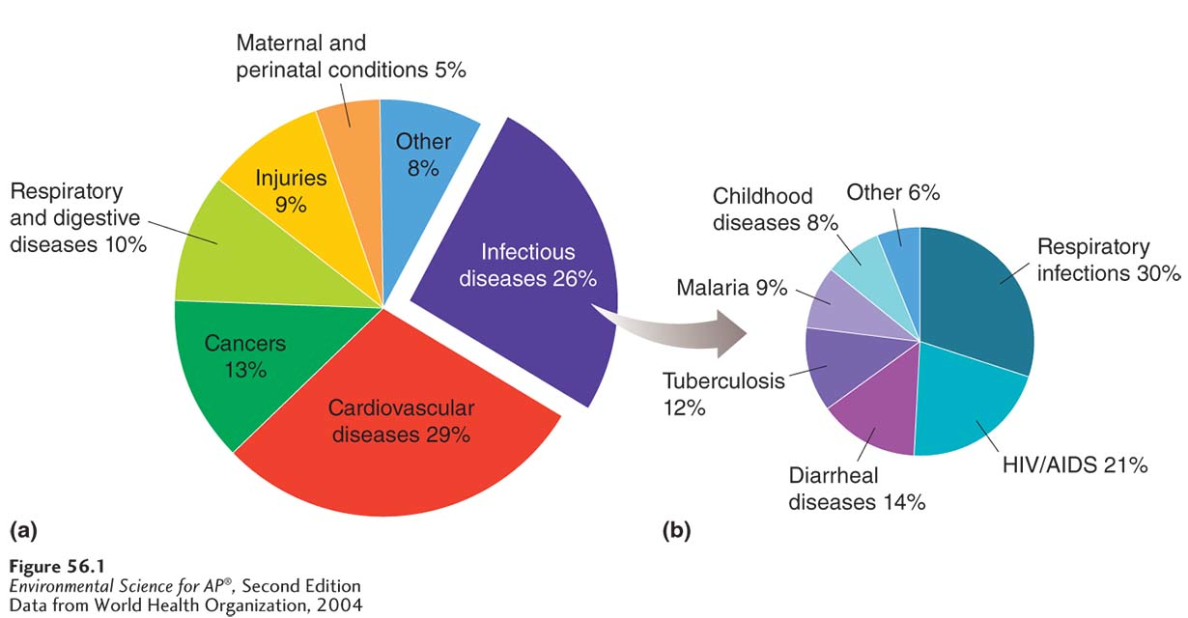
Types of Human Diseases
Leading causes of death in the world. (a) More than three-quarters of all world
deaths are caused by diseases, including respiratory and digestive diseases, various cancers, cardiovascular diseases, and infectious diseases. (b) Among the world’s deaths caused by infectious diseases, 94 percent are caused by only six types of diseases.

Slide 5
Numerous risk factors exist for chronic risk factors in humans
In low-income countries, the top risk factors leading to chronic disease are associated with poverty, including unsafe drinking water, poor sanitation, and malnutrition.
Risk factors for chronic disease in high-income countries include increased availability of tobacco, and a combination of less active lifestyles, poor nutrition, and overeating that leads to high blood pressure and obesity.

Slide 6
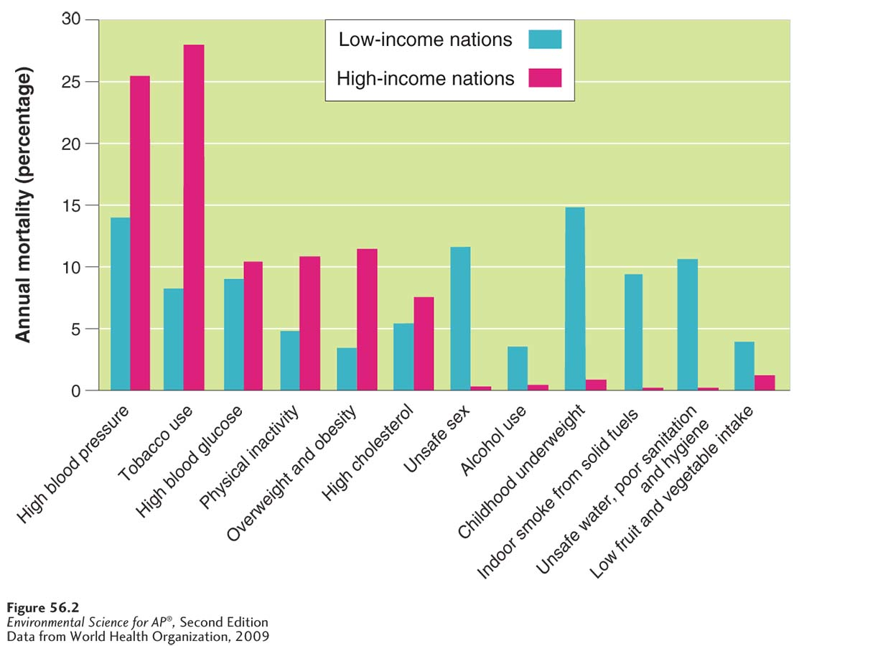
Chronic Risk Factors in Humans
Leading health risks in the world. If we consider all deaths that occur and separate them into different causes, we can examine which categories cause the highest percentage of all deaths. The leading health risks for low-income countries include issues related to low nutrition and poor sanitation. The leading risks for high-income countries include issues related to tobacco use, inactivity, obesity, and urban air pollution.

Slide 7
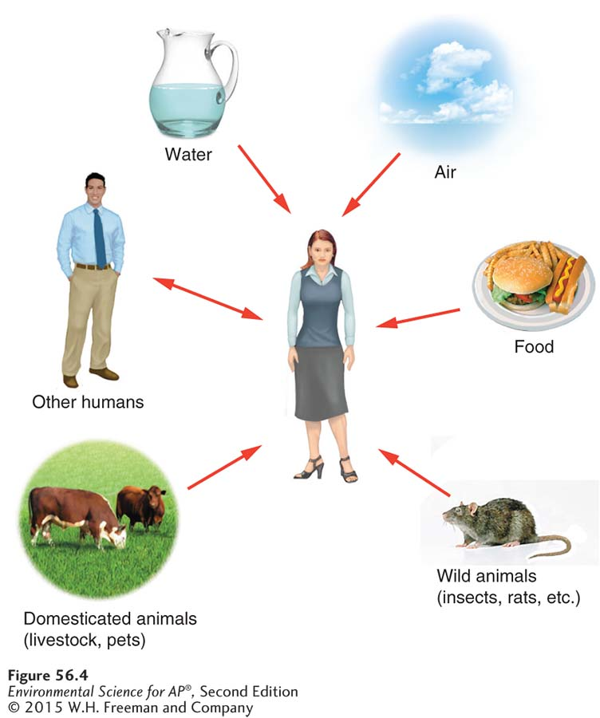
Some infectious diseases have been historically important
Environmental scientists are interested in diseases that have environmental causes, especially those caused by pathogens such as fungi, bacteria, and viruses.
Pathways of transmitting pathogens. Pathogens have evolved a wide variety of ways to infect humans.

Slide 8
Infectious Disease
Epidemic A situation in which a pathogen causes a rapid increase in disease.
Pandemic An epidemic that occurs over a large geographic region.
Plague An infectious disease caused by a bacterium (Yersinia pestis) that is carried by fleas.
Malaria An infectious disease caused by one of several species of protists in the genus Plasmodium.
Tuberculosis A highly contagious disease caused by the bacterium Mycobacterium tuberculosis that primarily infects the lungs.

Slide 9
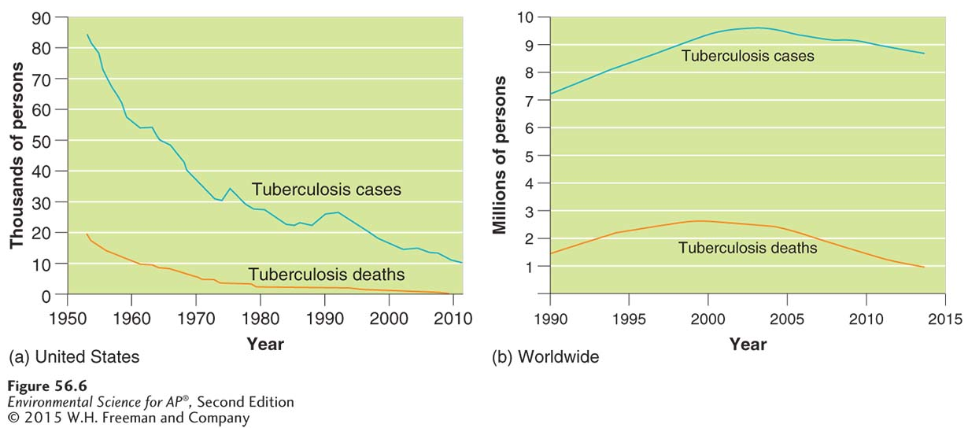
Tuberculosis
Tuberculosis cases and deaths. (a) Due to effective and available medicines,
tuberculosis has gone from being one of the most deadly diseases in the United States to a disease that rarely kills. (b) Worldwide, however, tuberculosis has continued to infect and kill millions of people, especially in low- and middle-income countries.

Slide 10
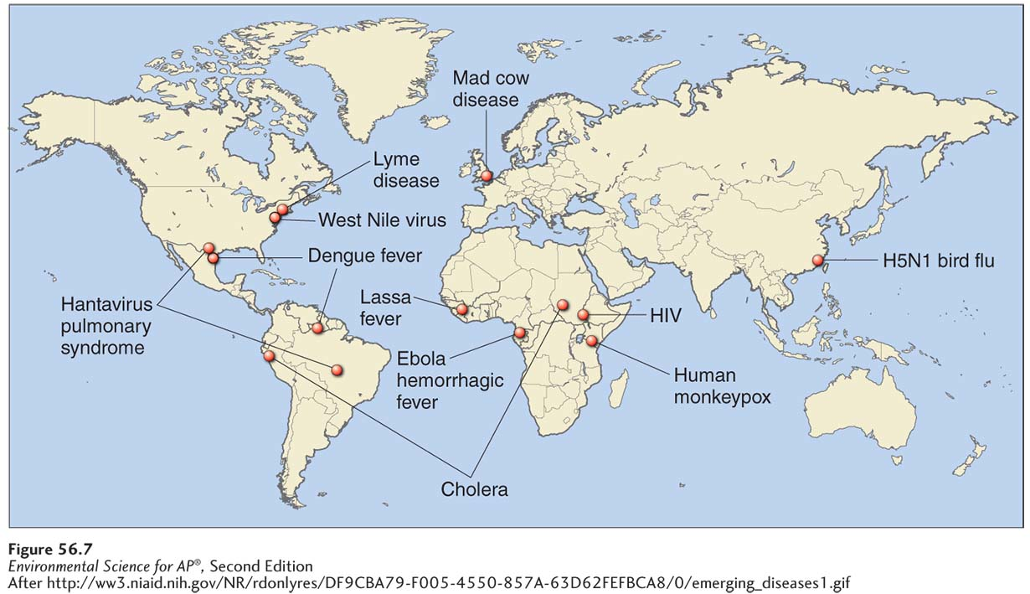
Emergent infectious diseases pose new risks to humans
Emergent infectious disease An infectious disease that has not been previously described or has not been common for at least 20 years.
The emergence of new diseases. Since the 1970s, new diseases, or diseases that have been rare for more than 20 years, have been appearing throughout the world at a rate of approximately one per year.

Slide 11
Emergent Infectious Diseases
Acquired Immune Deficiency Syndrome (AIDS)
An infectious disease caused by the human
immunodeficiency virus (HIV).
Human Immunodeficiency Virus (HIV) A type of virus that causes Acquired Immune Deficiency Syndrome (AIDS).
Ebola hemorrhagic fever An infectious disease with high death rates, caused by the Ebola virus.

Slide 12
Emergent Infectious Diseases
Mad cow disease A disease in which prions mutate into deadly pathogens and slowly damage a cow’s nervous system.
Prion A small, beneficial protein that occasionally mutates into a pathogen.
Swine flu A type of flu caused by the H1N1 virus.
Bird flu A type of flu caused by the H5N1 virus.

Slide 13
Emergent Infectious Diseases
Severe acute respiratory syndrome (SARS) A type of flu caused by a coronavirus.
West Nile virus A virus that lives in hundreds of species of birds and is transmitted among birds by mosquitoes.

Slide 14
Human health faces a number of future challenges
Low-income countries need improvements in nutrition, wider availability of clean drinking water, and proper sanitation.
High-income countries need to promote healthier lifestyle choices such as increased physical activity, a balanced diet, and limiting excess food consumption and tobacco use.
Education is needed everywhere to reduce the spread of diseases such as HIV and tuberculosis.

Slide 15
Module 57 Toxicology and Chemical Risks
After reading this module you should be able to
identify the major types of harmful chemicals.
explain how scientists determine the concentrations of chemicals that harm organisms.

Slide 16
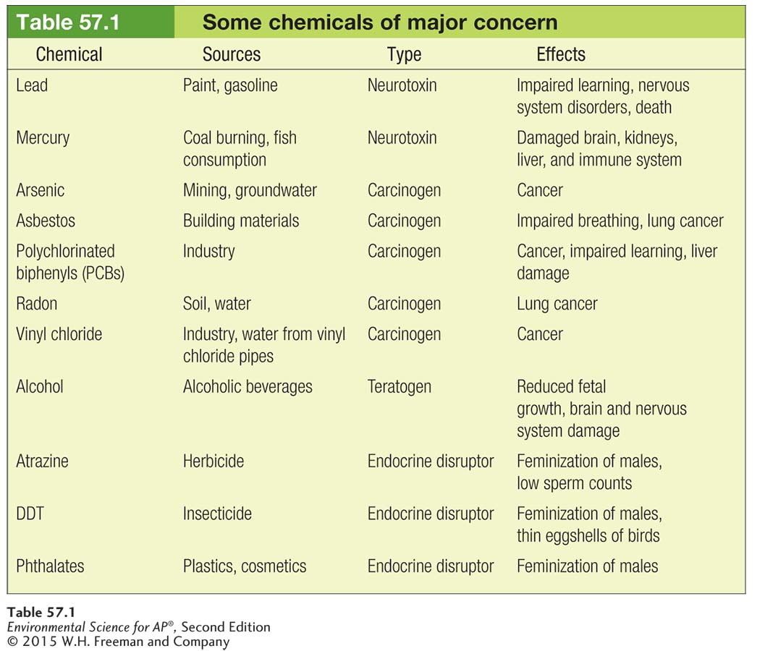
Many types of chemicals can harm organisms

Slide 17
Chemicals that Harm Organisms
Neurotoxin A chemical that disrupts the nervous systems of animals.
Carcinogen A chemical that causes cancer.
Mutagen A type of carcinogen that causes damage to the genetic material of a cell.

Slide 18
Chemicals that Harm Organisms
Teratogen A chemical that interferes with the normal development of embryos or fetuses.
Allergen A chemical that causes allergic reactions.
Endocrine disruptor A chemical that interferes with the normal functioning of hormones in an animal’s body.

Slide 19
Scientists can determine the concentrations of chemicals that harm organisms.
To assess the risk of a chemical, we need to know concentrations that cause harm.
There are three ways to determine the harmful concentration of a chemical:
Dose response studies
Prospective studies
Retrospective studies

Slide 20
Dose Response Studies
Dose-response study A study that exposes organisms to different amounts of a chemical and then observes a variety of possible responses, including mortality or changes in behavior or reproduction.
Acute study An experiment that exposes organisms to an environmental hazard for a short duration.
Chronic study An experiment that exposes organisms to an environmental hazard for a long duration.
LD50 The lethal dose of a chemical that kills 50 percent of the individuals in a dose-response study.

Slide 21
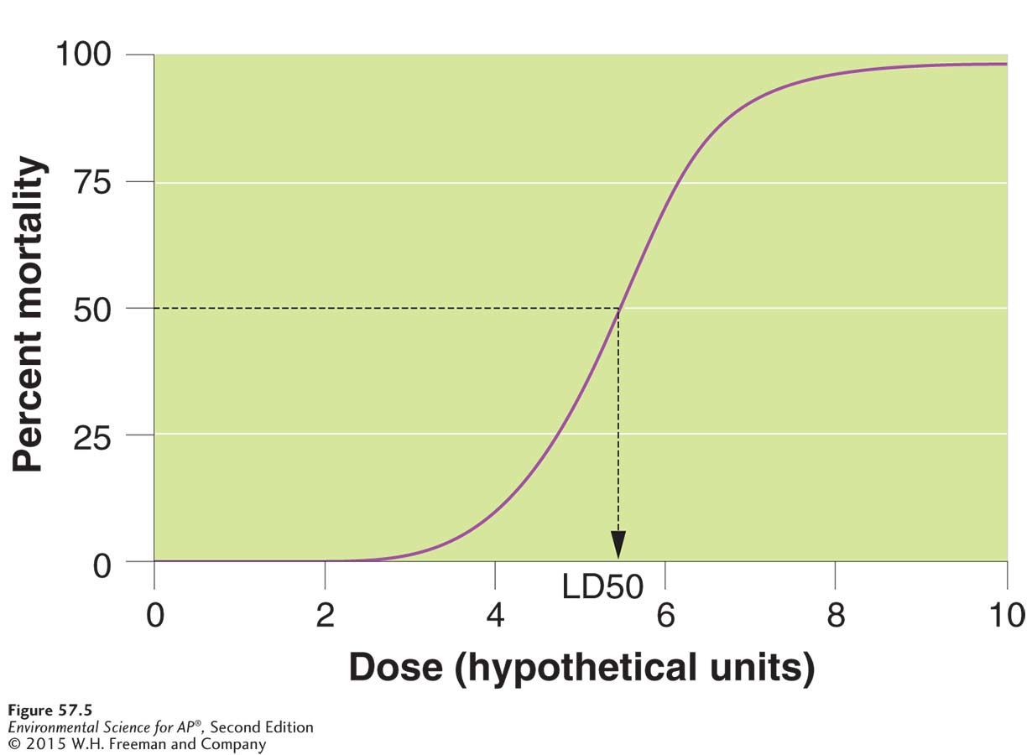
Dose Response Studies
LD50 studies. To determine the dose of a chemical that causes a 50 percent death rate, scientists expose animals to different doses of a chemical and determine what proportion of the animals die at each dose. Such an experiment typically produces an S-shaped curve.

Slide 22
Dose Response Studies
Sublethal effect The effect of an environmental hazard that is not lethal, but which may impair an organism’s behavior, physiology, or reproduction.
ED50 The effective dose of a chemical that causes 50 percent of the individuals in a dose-response study to display a harmful, but nonlethal, effect.

Slide 23
Retrospective versus Prospective Studies
Retrospective study A study that monitors people who have been exposed to an environmental hazard at some time in the past.
Prospective study A study that monitors people who might become exposed to harmful chemicals in the future.
Synergistic interaction A situation in which two risks together cause more harm than expected based on the separate effects of each risk alone.

Slide 24
Factors that Determine the Concentrations of Chemicals that Organisms Experience
To identify and understand the effects of chemical concentrations that organisms experience, we need to know something about how the chemicals behave in the environment.
Route of exposure The way in which an individual might come into contact with an environmental hazard.

Slide 25
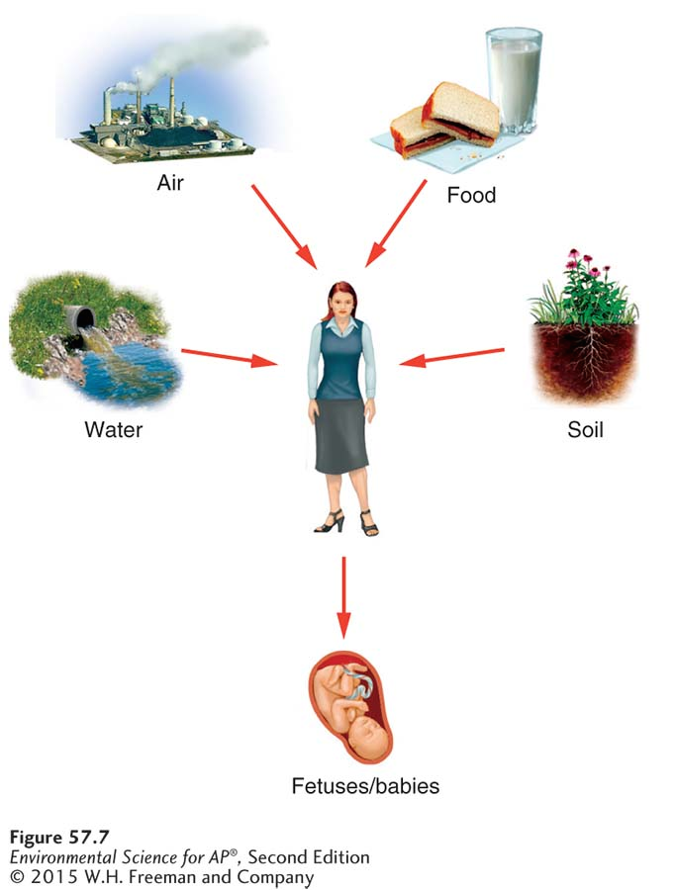
Routes of Exposure
Routes of exposure. Despite a multitude of potential routes of exposure to chemicals, most chemicals have a
limited number of major routes.

Slide 26
Solubility Of Chemicals, Bioaccumulation, and Biomagnifications
The movement of a chemical in the environment depends in part on its solubility.
Solubility How well a chemical dissolves in a liquid. A water-soluble chemical can be washed off surfaces, percolate into groundwater, and runoff into surface waters including rivers and lakes.
Fat soluble chemicals are not very soluble in water and are found in higher concentrations bound to soils, including the benthic soils that underlie bodies of water.

Slide 27
Solubility Of Chemicals, Bioaccumulation, and Biomagnifications
Bioaccumulation An increased concentration of a chemical within an organism over time.
Biomagnification The increase in chemical concentration in animal tissues as the chemical moves up the food chain.
Persistence The length of time a chemical remains in the environment.

Slide 28
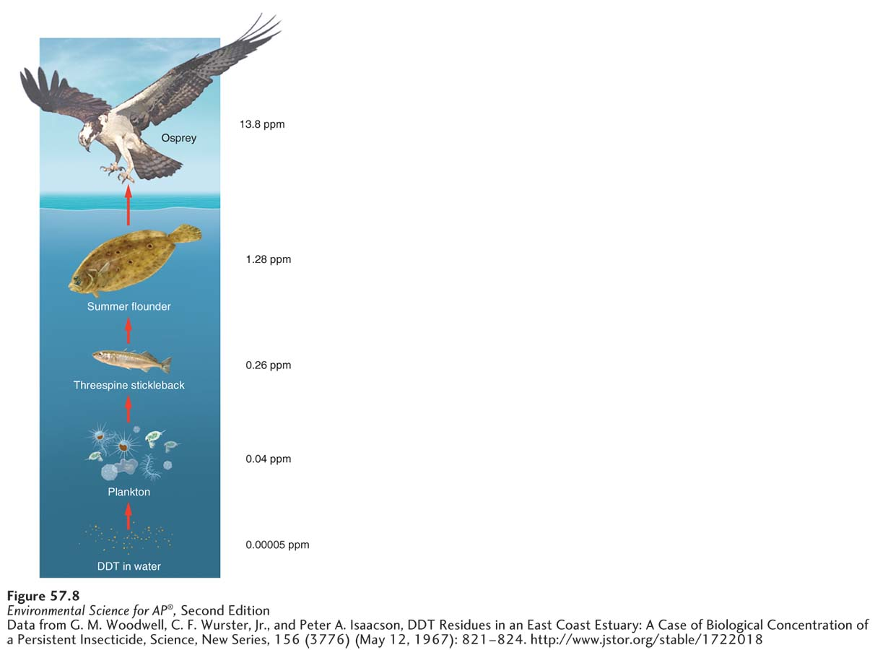
Bioaccumulation, and Biomagnification
The biomagnification of DDT. The initial exposure is primarily in a low trophic group such as the plankton in a lake. Consumption causes the upward movement of the chemical
where it is accumulated in the bodies at each trophic level. The combination of bioaccumulation at each trophic level and upward movement by consumption allows the concentration to magnify to the point where it can be substantially more concentrated in the
top predator than it was in the water.

Slide 29
Persistence

Slide 30
Module 58 Risk Analysis
After reading this module you should be able to
explain the processes of qualitative versus quantitative risk assessment.
understand how to determine the amount of risk that can be tolerated.
discuss how risk management balances potential harm against other factors.
contrast the innocent-until-proven-guilty principle and the precautionary principle.

Slide 31
Risk assessment estimates potential harm
Environmental hazard Anything in the environment that can potentially cause harm.
The process of risk analysis. Risk analysis involves risk assessment, risk acceptance, and risk management.

Slide 32
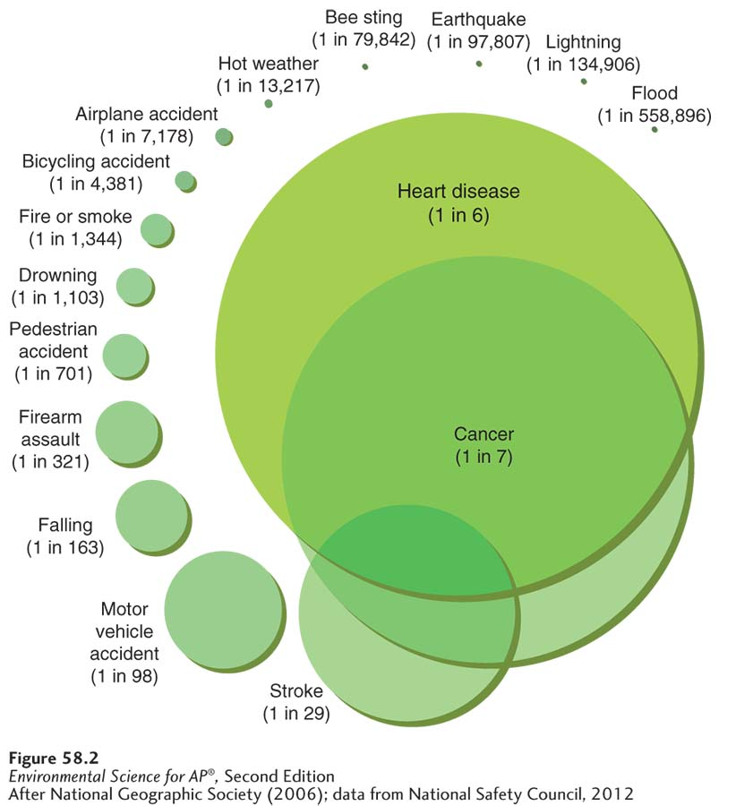
Risk Assessment
The probabilities of death in the United States. Some causes of death that people
perceive as having a high probability of occurring, such as dying in an airplane crash, actually have a low probability of occurring. In contrast, some causes of death that people rate as having a low probability of
occurring, such as dying from heart disease, actually have a very high probability of occurring.

Slide 33
Qualitative Risk Assessment
There are two types of risk assessment—qualitative and quantitative.
In a qualitative assessment, we make judgments that are based on our perceptions but that are not based on actual data.
Because our personal risk assessments are not quantitative, they often do not match the actual risk.

Slide 34
Quantitative Risk Assessment
A quantitative assessment uses actual data.
Risk = probability of being exposed to a hazard × probability of being harmed if exposed

Slide 35
Risk acceptance determines how much risk can be tolerated
Some people are willing to live with risk and others are not.
Even among those people who are willing to accept some risk, the precise amount of acceptable risk is open to heated disagreement.
Environmental scientists, economists, and others can help us weigh options as objectively as possible by providing accurate estimates of costs and benefits.

Slide 36
Worldwide standards of risk can be guided by two different philosophies
A key factor determining the type of chemical regulation is whether the regulations are guided by the innocent-until-proven-guilty principle or the precautionary principle.
Innocent-until-proven-guilty principle A principle based on the belief that a potential hazard should not be considered an actual hazard until the scientific data definitively demonstrate that it actually causes harm.
Precautionary principle A principle based on the belief that action should be taken against a plausible environmental hazard.

Slide 37
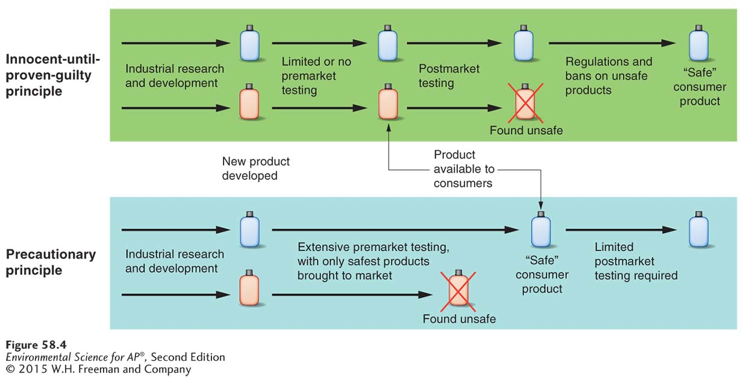
Philosophies of Risk Management
The two different approaches to managing risk. The innocent-until-proven-guilty
principle requires that researchers prove harm before the chemical is restricted or banned. The precautionary principle requires that when there is scientific evidence that demonstrates a plausible risk, the chemical must then be further tested to demonstrate it is safe before it can continue to be used.

Slide 38
International Agreements on Hazardous Chemicals
Stockholm Convention A 2001 agreement among 127 nations concerning 12 chemicals to be banned, phased out, or reduced.
REACH A 2007 agreement among the nations of the European Union about regulation of chemicals; the acronym stands for registration, evaluation, authorization, and restriction of chemicals.

