Slide 1
Chapter 18
Conservation of Biodiversity
Friedland and Relyea Environmental Science for AP®, second edition
© 2015 W.H. Freeman and Company/BFW
AP® is a trademark registered and/or owned by the College Board®, which was not involved in the production of, and does not endorse, this product.

Slide 2
Module 59 The Sixth Mass Extinction
After reading this module you should be able to
explain the global decline in the genetic diversity of wild species.
discuss the global decline in the genetic diversity of domesticated species.
identify the patterns of global decline in species diversity.
explain the values of ecosystems and the global declines in ecosystem function.

Slide 3
We are experiencing global declines in the genetic diversity of wild species
Scientists estimate that the world is currently experiencing approximately 50,000 species extinctions per year.
The United Nations Convention of Biological Diversity estimates that the current the rate of extinction is 1,000 times higher during the past 50 years than at any other time in human history.
Some declines in genetic diversity have natural causes.

Slide 4
Global Declines in the Genetic Diversity of Wild Species
High genetic diversity ensures that a wider range of genotypes is present.
Populations with low genetic diversity are prone to inbreeding depression which can cause the offspring to have a poor chance of survival and later reproduction.
High genetic diversity improves the probability of surviving future change in the environment.

Slide 5
We are also experiencing global declines in the genetic diversity of domesticated species
There are also major concerns about declining genetic variation in the domesticated species of crops and livestock on which humans depend.
In Europe half of the breeds of livestock that existed in 1900 are now extinct and 43 percent of those remaining are currently at serious risk of extinction.
Of the 200 breeds of domesticated animals that have been evaluated in North America, 80 percent of these breeds are either declining or are already facing extinction.
The nations of the world have recognized the problem of declining seed diversity and have responded by storing seed varieties in specially designed warehouses to preserve genetic diversity.

Slide 6
Species diversity has declined around the world
Threatened species According to the International Union for Conservation of Nature (IUCN), species that have a high risk of extinction in the future.
Near-threatened species Species that are very likely to become threatened in the future.
Least concern species Species that are widespread and abundant.

Slide 7
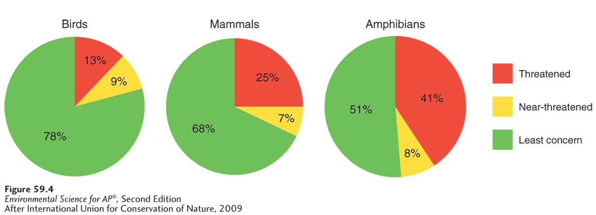
Declining Species Diversity
The decline of birds, mammals, and amphibians. Based on those species for which scientists have reliable data, 21 percent of birds, 32 percent of mammals, and 49 percent of amphibians are currently classified as threatened or near-threatened with extinction.

Slide 8
Ecosystem values and the global declines in ecosystem function
Intrinsic value Value independent of any benefit to humans.
Instrumental value Worth as an instrument or a tool that can be used to accomplish a goal.

Slide 9
Ecosystem Services
There are 5 categories of ecosystem services:
Provisions
Regulating services
Support systems
Resilience
Cultural services

Slide 10
Provisions
Provision A good that humans can use directly.
Examples of provisions include lumber, food crops, medicinal plants, natural rubber, and furs.
Of the top 150 prescription drugs sold in the United States, about 70 percent come from natural sources.

Slide 11
Regulating Services
Natural ecosystems help to regulate environmental conditions.
Natural ecosystems, such as tropical rainforests and oceans, remove carbon from the atmosphere.
Ecosystems also are important in regulating nutrient and hydrologic cycles.

Slide 12
Support Services
Natural ecosystems provide numerous support services such as pollination of food crops.
Ecosystems also provide natural pest control services because they provide habitat for predators that prey on agricultural pests.

Slide 13
Resilience
Resilience depends greatly on species diversity.
For example, several different species may perform similar functions in an ecosystem, but differ in their susceptibility to disturbance. If a pollutant kills one plant species that contains nitrogen-fixing bacteria, but not all plant species that contain nitrogen-fixing bacteria, the ecosystem can still continue to fix nitrogen.

Slide 14
Cultural Services
The awe-inspiring beauty of nature has instrumental value because it provides an aesthetic benefit for which people are willing to pay.
Similarly, scientific funding agencies may award grants to scientists for research that explores biodiversity with no promise of any economic gain.

Slide 15
The Decline of Ecosystem Services
Of 24 different ecosystem functions, 15 have been found to be declining or used at a rate that cannot be sustained.
If we want to improve ecosystem functions, we need to improve the fate of the species and ecosystems that provide these services.

Slide 16
Module 60 Causes of Declining Biodiversity
After reading this module you should be able to
discuss how habitat loss can lead to declines in species diversity.
explain how the movement of exotic species affects biodiversity.
describe how overharvesting causes declines in populations and species.
understand how pollution reduces populations and biodiversity.
identify how climate change affects species diversity.

Slide 17
Habitat loss is the major cause of declining species diversity
For most species the greatest cause of decline and extinction is habitat loss.
Most habitat loss is due to human development.
Species requiring such specialized habitats are particularly prone to population declines.
A species may decline in abundance or become extinct even without complete habitat destruction.

Slide 18
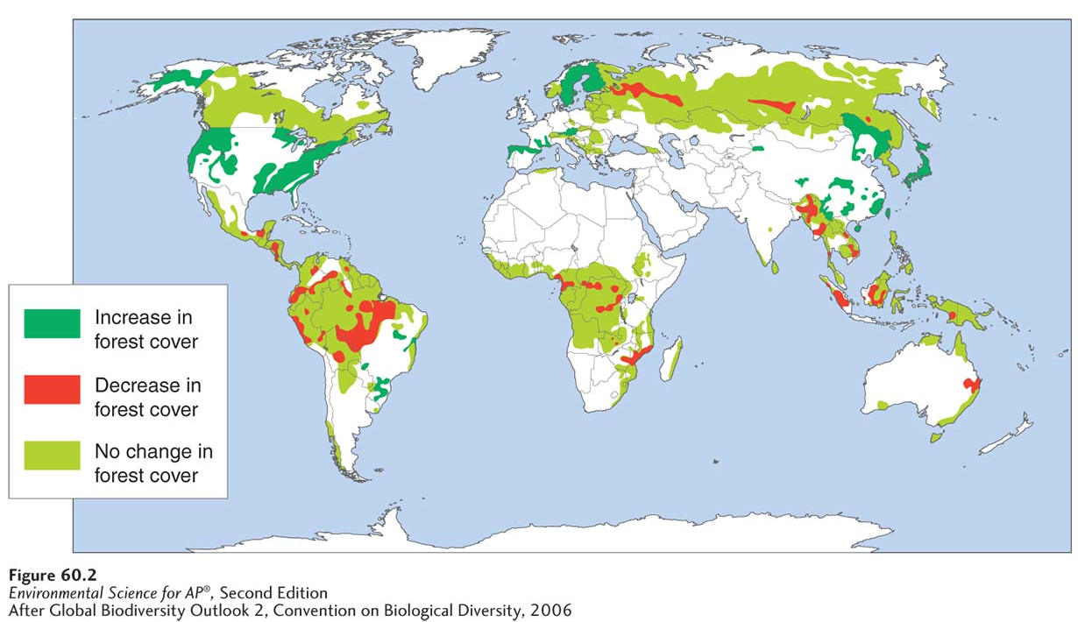
Habitat Loss
Changing forests. Some regions of the world experienced large declines in the amount of forested land from 1980 to 2000 while other regions have shown little change or have seen increases in forest cover.

Slide 19
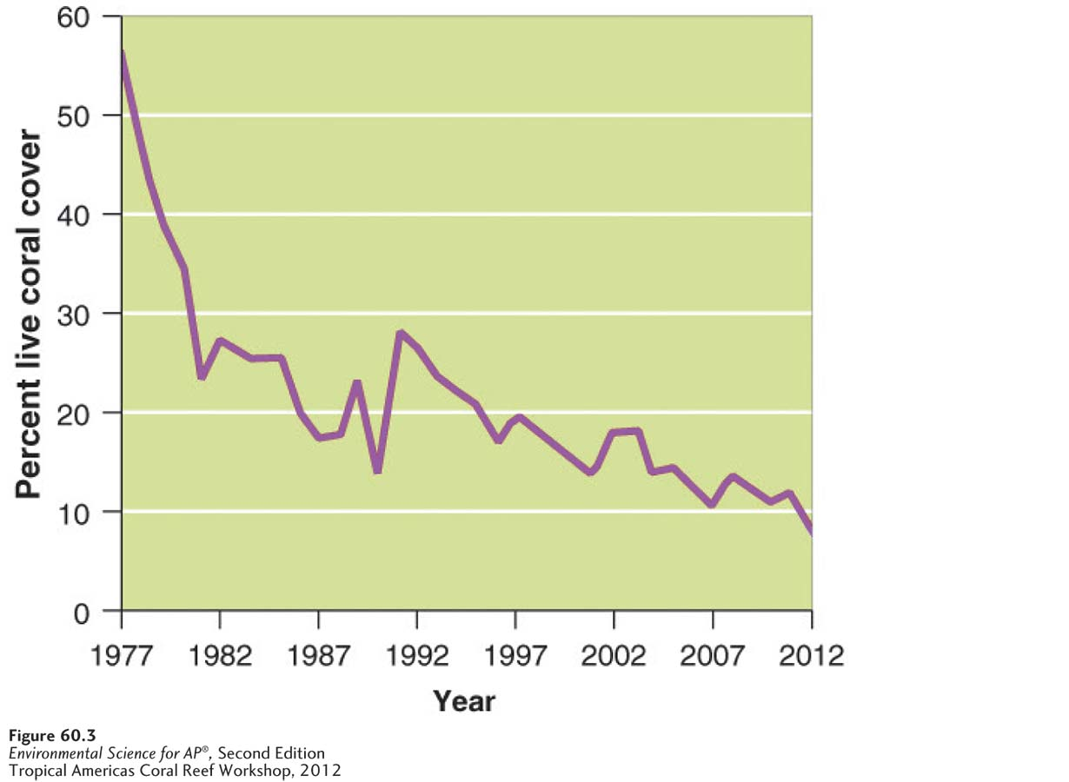
Habitat Loss
In marine systems, there has been a sharp decline in the amount of living coral in the Caribbean Sea.
Changing coral reefs. The percentage of coral that remains alive in coral reefs has declined sharply in the Caribbean from 1977 to 2012.

Slide 20
Exotic species are moving around the world
During the past several centuries, humans have frequently moved animals, plants, and pathogens around the world.
Native species Species that live in their historical range, typically where they have lived for thousands or millions of years.
Exotic species A species living outside its historical range. Also known as alien species.
Invasive species A species that spreads rapidly across large areas.
Around the world, invasive exotic species pose a serious threat to biodiversity by acting as predators, pathogens, or superior competitors to native species.

Slide 21
Overharvesting causes declines in populations and species
Hunting, fishing, and other forms of harvesting are the most direct human influences on wild populations of plants and animals.
Most species can be harvested to some degree, but a species is overharvested when individuals are removed at a rate faster than the population can replace them.
In the extreme, overharvesting of a species can cause extinction.

Slide 22
Plant and Animal Trade
The legal and illegal trade in plants and animals represents a serious threat to their ability of some species to persist in nature.
National and international laws help protect species.
Lacey Act A U.S. act that prohibits interstate shipping of all illegally harvested plants and animals.
Convention on International Trade in Endangered Species of Wild Fauna and Flora (CITES) A 1973 treaty formed to control the international trade of threatened plants and animals.
Red List A list of worldwide threatened species.

Slide 23
Pollution can have harmful effects of species
Threats to biodiversity come from toxic contaminants such as pesticides, heavy metals, acids, and oil spills.
Other contaminants, such as endocrine disrupters, can have nonlethal effects that prevent or inhibit reproduction.
Pollution sources that cause declines in biodiversity also include the release of nutrients that cause algal blooms and dead zones as well as thermal pollution that can make water bodies too warm for species to survive.

Slide 24
Climate change has the potential to affect species diversity
If climate change affects patterns of temperature and precipitation in different regions of the world, biodiversity may be threatened.
For example, in some regions, a species may be able to respond to warming temperatures and changes in precipitation by migrating to a place where the climate is well suited to the species niche. In other cases, this is not possible.

Slide 25
Module 61 Conservation of Biodiversity
After reading this module you should be able to
identify legislation that focuses on protecting single species.
discuss conservation efforts that focus on protecting entire ecosystems.

Slide 26
Conservation legislation often focuses on a single species
Marine Mammal Protection Act A 1972 U.S. act to protect declining populations of marine mammals.
Endangered species A species that is in danger of extinction within the foreseeable future throughout all or a significant portion of its range.
Threatened species According to U.S. legislation, any species that is likely to become an endangered species within the foreseeable future throughout all or a significant portion of its range.

Slide 27
Endangered Species Act
First passed in 1973, it authorizes the U.S. Fish and Wildlife Service to determine which species can be listed as threatened or endangered and prohibits the harming of these species.
Trading these species is also illegal.
The act also authorizes the government to purchase habitat that is critical to the species.

Slide 28
Convention on Biological Diversity
Convention on Biological Diversity An international treaty to help protect biodiversity.
The treaty has three objectives:
Conserve biodiversity
Use biodiversity sustainably
Share the benefits that emerge from the commercial use of genetic resources

Slide 29
Some conservation efforts focus on protecting entire ecosystems
Protecting entire ecosystems has been one of the major motivating factors in setting aside national parks and marine reserves.
In some cases, these areas were originally protected for their aesthetic beauty, but today they are also valued for their communities of organisms.
The amount of protected land has increased dramatically worldwide since 1960.

Slide 30
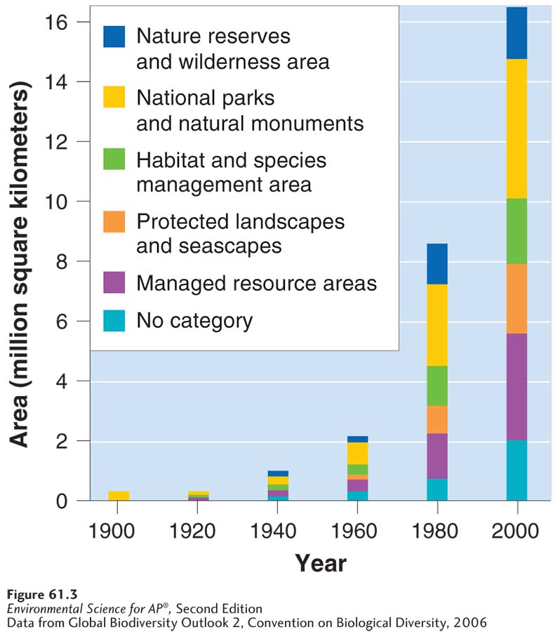
Protecting Entire Ecosystems
Changes in protected land. Since the 1960s, there has been a large increase in the amount of land that is under various types of protection throughout the world.

Slide 31
The Size, Shape, and Connectedness of Protected Areas
Although the theory of island biogeography was originally applied to oceanic islands, it has since been applied to islands of protected areas in the midst of less hospitable environments.
For example, it is less likely that species can travel among protected areas that are far apart. When a species has been lost from one ecosystem, it will be harder for individuals of that species from other ecosystems to recolonize it.
Conservationists must also consider metapopulations. A species is more likely to be protected from extinction if it can be rescued by dispersers from a neighboring population.
Edge habitat Habitat that occurs where two different communities come together, typically forming an abrupt transition, such as where a grassy field meets a forest.

Slide 32
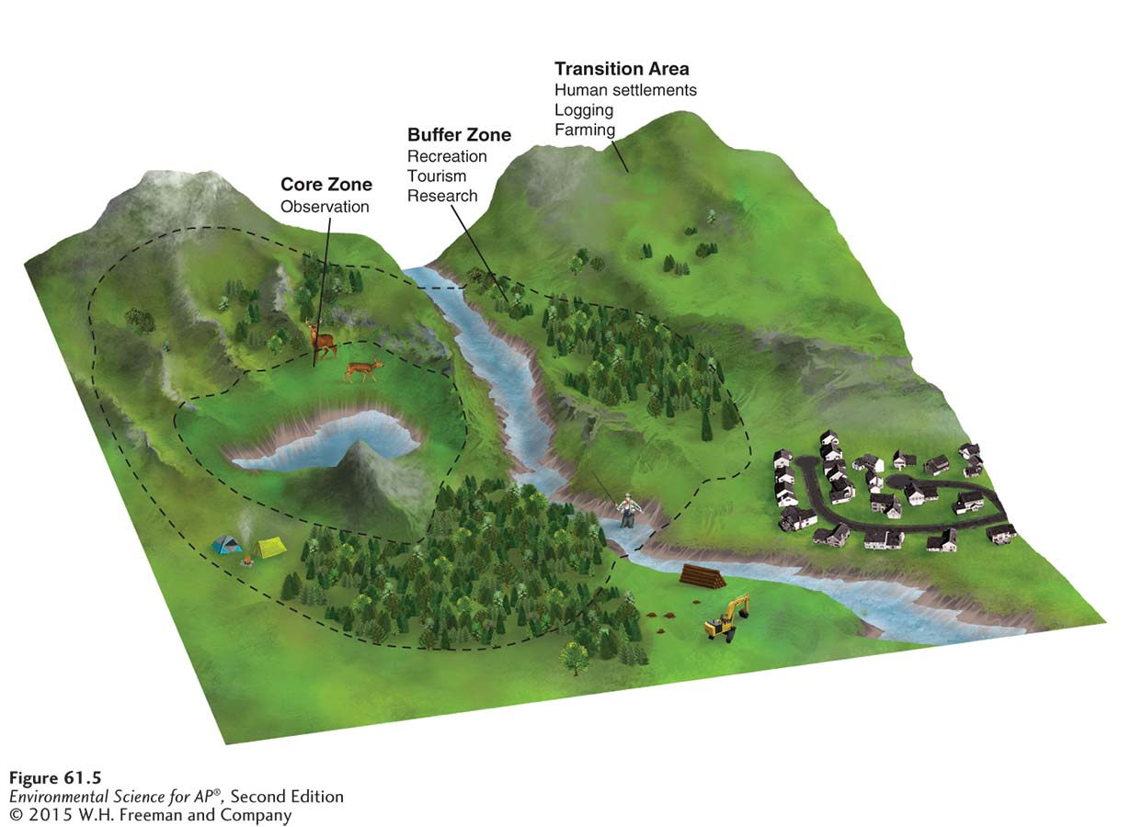
Biosphere Reserves
Biosphere reserve Protected area consisting of zones that vary in the amount of permissible human impact.
Biosphere reserve design. Biosphere reserves ideally consist of core areas that have minimal human impact and outer zones that have increasing levels of human impacts.

