Slide 1
Chapter 20
Sustainability, Economics, and Equity
Friedland and Relyea Environmental Science for AP®, second edition
© 2015 W.H. Freeman and Company/BFW
AP® is a trademark registered and/or owned by the College Board®, which was not involved in the production of, and does not endorse, this product.

Slide 2
Module 65 Sustainability and Economics
After reading this module you should be able to
explain why efforts to achieve sustainability must consider both sound environmental science and economic analysis.
environmental science and economic analysis.
describe how economic health depends on the availability of natural capital and basic human welfare.

Slide 3
Achieving sustainability requires both sound environmental science and economic analysis.
Well-being The status of being healthy, happy, and prosperous.
Economics The study of how humans allocate scarce resources in the production, distribution, and consumption of goods and services.

Slide 4
Supply, Demand, and the Market
A market occurs whenever people engage in trade.
In a market economy, the cost of a good is determined by supply and demand.
Price is the way that producers and consumers communicate the value of an item and allocate the scarce item.

Slide 5
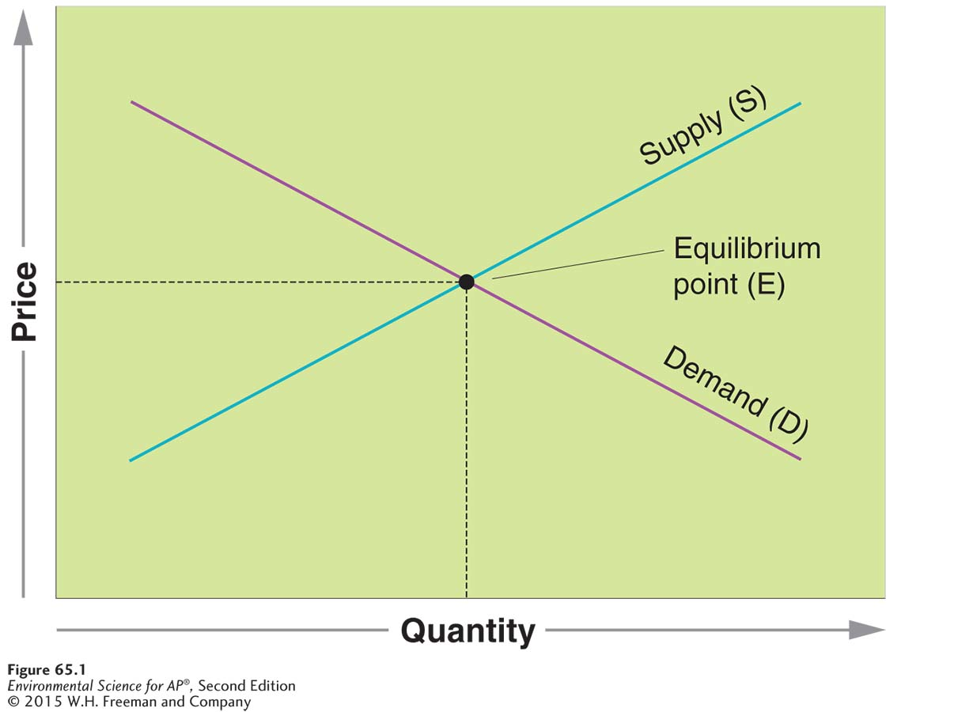
Supply, Demand, and the Market
Supply and demand with externalities. When the cost of emitting pollutants is included in
the price of a good, for any given quantity of items, the price increases. The supply curve
shifts from S to S₁. Since the law of demand states that when the price of a good goes up, demand falls, amount demanded falls, and the market reaches a new equilibrium, E₁.

Slide 6
Supply, Demand, and the Market
The intersection of the supply and demand curves determines the market equilibrium point for that item.
The supply curve shows how many units suppliers of a given product or service are willing to supply at a given price.
The demand curve (D) shows how much of a good consumers want to buy at a given price.
Factors that determine demand include income, price of the good, tastes, expectations, and the number of people who want the good.

Slide 7
Supply, Demand, and the Market
According to the laws of demand and supply, when the price of a good rises, the quantity demanded falls and when the price falls, demand rises.
When the price of a good rises, the quantity supplied of that good will rise and when the price of a good falls, the quantity of the good supplied will also fall.
However, the costs or impact of a good or service on people and the environment not included in the economic price of that good or service.

Slide 8
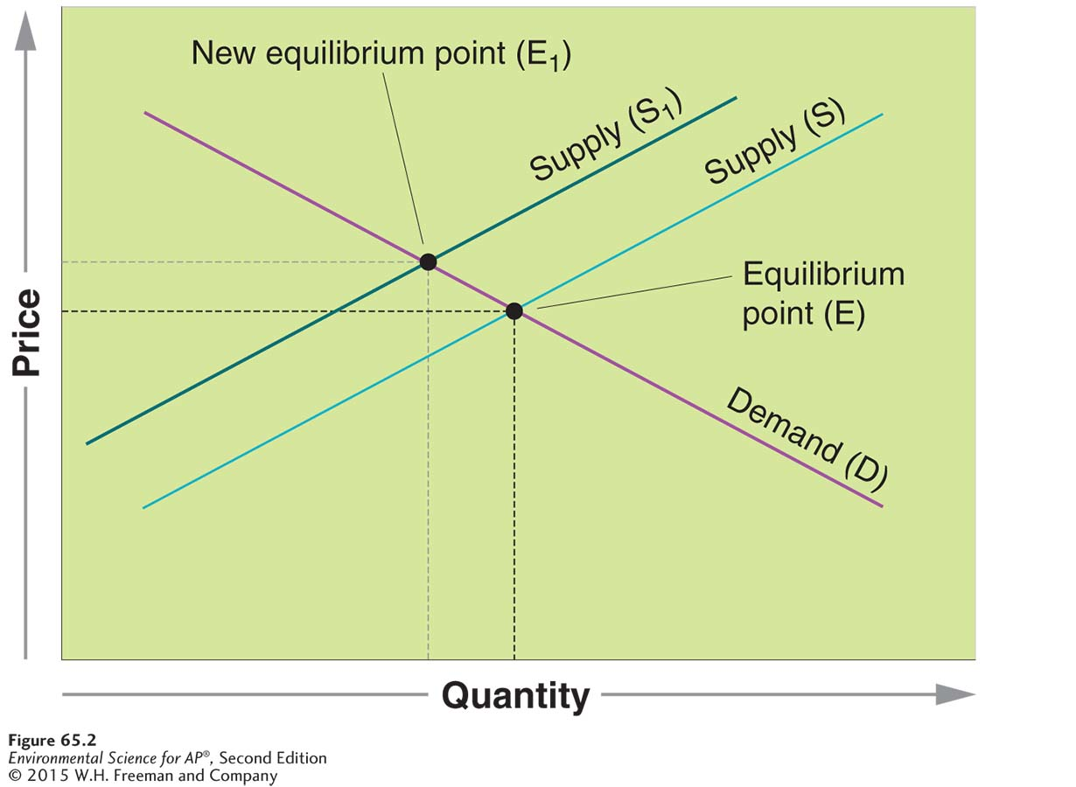
Supply, Demand, and the Market
When the cost of emitting pollutants is included in the price of a good, for any given quantity of items, the price increases.
Supply and demand with externalities. When
the cost of emitting pollutants is included in the price of a good, for any given quantity of items, the price increases. This causes the supply curve to shift to the left, from S to S₁. Since the law of demand states that when the price of a good goes up, demand falls, the amount demanded falls, and the market reaches a new equilibrium, E₁.

Slide 9
Measuring Wealth and Productivity
Gross domestic product (GDP) is the value of all products and services produced in a year in a given country. GDP does not reflect externalities such as pollution.
Genuine progress indicator (GPI) A measure of economic status that includes personal consumption, income distribution, levels of higher education, resource depletion, pollution, and the health of the population.

Slide 10
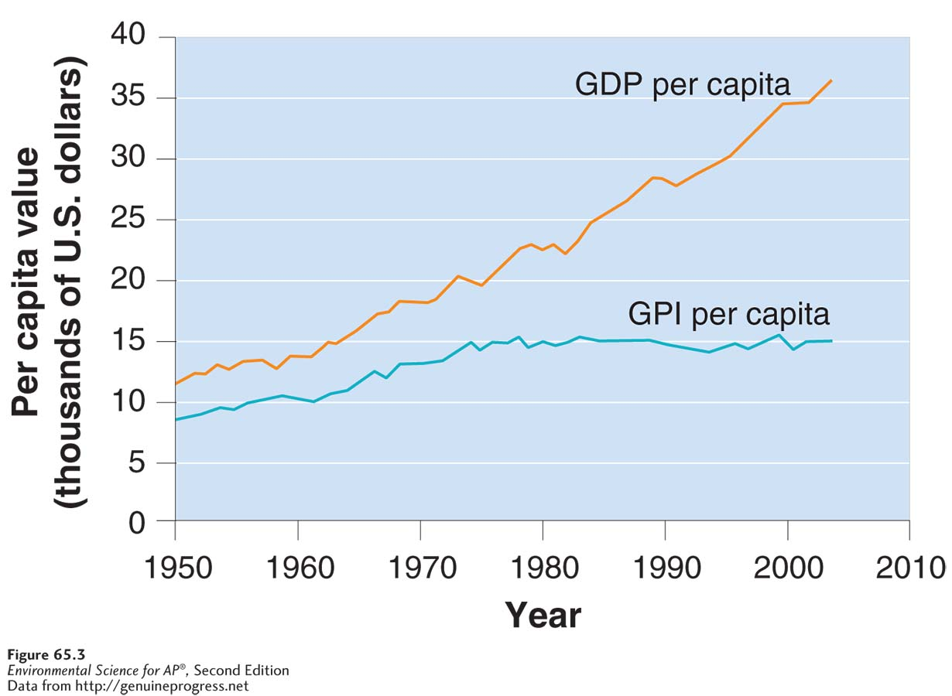
Measuring Wealth and Productivity
Genuine progress indicator versus gross domestic product, per capita, for the United States from 1950 to 2004. While gross domestic product measures the value of all products and services a country produces, the genuine progress indicator attempts to include the level
of education, personal consumption, income distribution, resource depletion, pollution, and the health of the population.

Slide 11
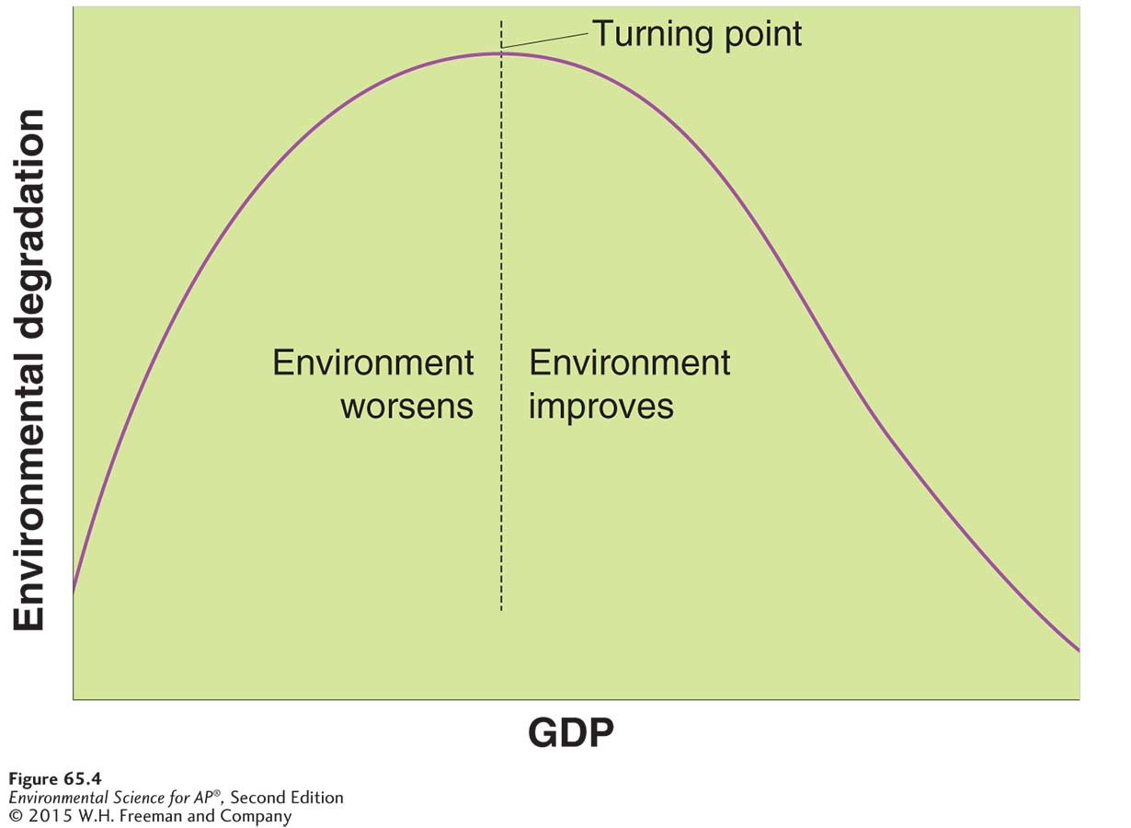
The Kuznets Curve
The Kuznets curve. This model suggests that as per capita income in a country increases, environmental degradation first increases and then decreases. In many respects, China is on the first part of this curve while the United States is on the second part of the curve.

Slide 12
The Kuznets Curve
Technology transfer The phenomenon of less developed countries adopting technological innovations developed in wealthy countries.
Leapfrogging The phenomenon of less developed countries using new technology without first using the precursor technology.

Slide 13
Economic health depends on the availability of natural capital and basic human welfare
Natural capital The resources of the planet, such as air, water, and minerals.
Human capital Human knowledge and abilities.
Manufactured capital All goods and services that humans produce.
Market failure When the economic system does not account for all costs.

Slide 14
Economic health depends on the availability of natural capital and basic human welfare
Environmental economics A subfield of economics that examines the costs and benefits of various policies and regulations that seek to regulate or limit air and water pollution and other causes of environmental degradation.
Ecological economics The study of economics as a component of ecological systems.
Valuation The practice of assigning monetary value to intangible benefits and natural capital.

Slide 15
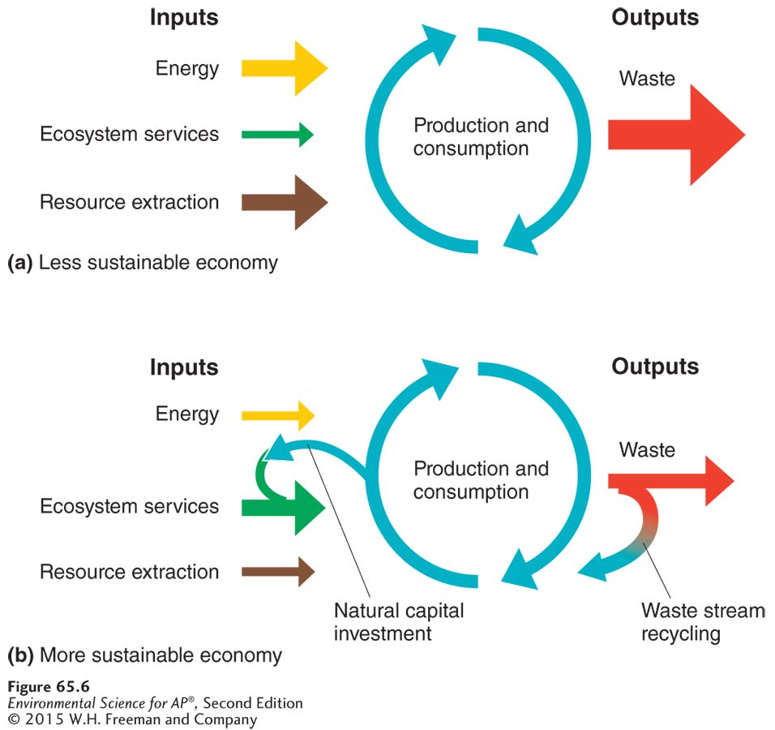
Sustainable Economic Systems
Systems diagrams of two economic systems. (a) A less sustainable
system, like our current economy, is based on
maximizing the utilization of resources and results
in a fairly large waste stream. (b) A more
sustainable system is based on greater use of
ecosystem services, less resource extraction, and
minimizing the waste stream.

Slide 16
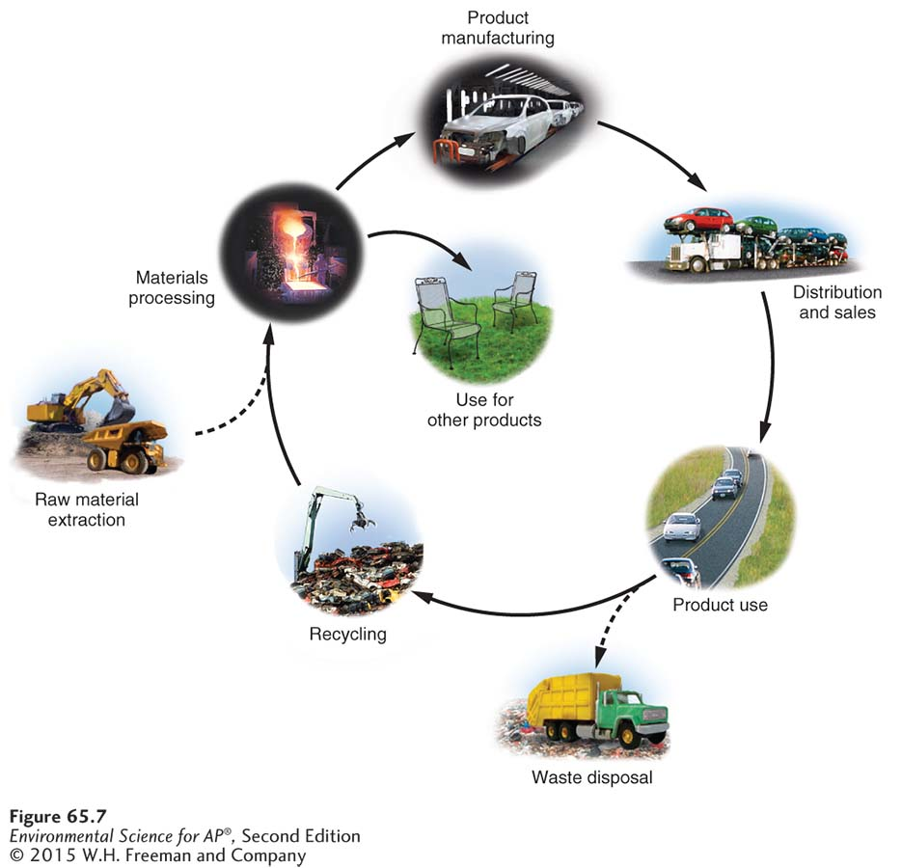
Sustainable Economic Systems
A cradle-to-cradle system for material use and waste recycling. The manufacture of automobiles serves as one example. Products made at a factory use recycled materials whenever possible. Products are designed and manufactured with the goal of recycling as much of the automobile as possible when its useful life is over. Energy costs in manufacturing, distribution, and use are all taken into consideration when designing the automobile and the distribution network.

Slide 17
Module 66 Regulations and Equity
After reading this module you should be able to
explain the role of agencies and regulations in efforts to protect our natural and human capital.
describe the approaches to measuring and achieving sustainability.
discuss the relationship among sustainability, poverty, personal action, and stewardship.

Slide 18
Agencies, laws, and regulations are designed to protect our natural and human capital
How people look at the world influences policy making.

Slide 19
Environmental Worldviews and Regulatory Approaches
Environmental worldview A worldview that encompasses how one thinks the world works; how one views one’s role in the world; and what one believes to be proper environmental behavior.
Anthropocentric worldview A worldview that focuses on human welfare and well-being.
Stewardship The careful and responsible management and care for Earth and its resources.
Biocentric worldview A worldview that holds that humans are just one of many species on Earth, all of which have equal intrinsic value.
Ecocentric worldview A worldview that places equal value on all living organisms and the ecosystems in which they live.

Slide 20
World Agencies
United Nations (UN) A global institution dedicated to promoting dialogue among countries with the goal of maintaining world peace.
United Nations Environment Programme (UNEP) A program of the United Nations responsible for gathering environmental information, conducting research, and assessing environmental problems.
World Bank A global institution that provides technical and financial assistance to developing countries with the objectives of reducing poverty and promoting growth, especially in the poorest countries.

Slide 21
World Agencies
World Health Organization (WHO) A global institution dedicated to the improvement of human health by monitoring and assessing health trends and providing medical advice to countries.
United Nations Development Programme (UNDP) An international program that works in 166 countries around the world to advocate change that will help people obtain a better life through development.

Slide 22
U.S. Agencies
Environmental Protection Agency (EPA) The U.S. organization that oversees all governmental efforts related to the environment, including science, research, assessment, and education.
Occupational Safety and Health Administration (OSHA) An agency of the U.S. Department of Labor, responsible for the enforcement of health and safety regulations.
Department of Energy (DOE) The U.S. organization that advances the energy and economic security of the United States.

Slide 23
There are several approaches to measuring and achieving sustainability
Human development index (HDI) A measurement index that combines three basic measures of human status: life expectancy; knowledge and education.
Human poverty index (HPI) A measurement index developed by the United Nations to investigate the proportion of a population suffering from deprivation in a country with a high HDI.

Slide 24
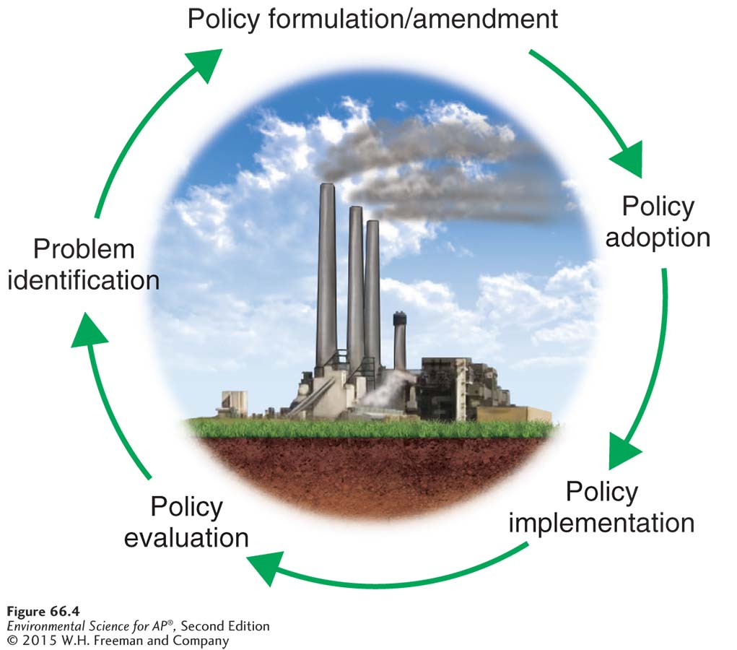
The Policy Process in the United States
The environmental policy cycle. After an environmental problem is identified, environmental policy is formulated or modified. After a policy is adopted and implemented, it is evaluated and, if necessary, adjustments to the policy are made.

Slide 25
Legislative Approaches to Encourage Sustainability
Command-and-control approach A strategy for pollution control that involves regulations and enforcement mechanisms.
Incentive-based approach A strategy for pollution control that constructs financial and other incentives for lowering emissions based on profits and benefits.
Green tax A tax placed on environmentally harmful activities or emissions in an attempt to internalize some of the externalities that may be involved in the life cycle of those activities or products.
Triple bottom line An approach to sustainability that considers three factors—economic, environmental, and social—when making decisions about business, the economy, and development.

Slide 26
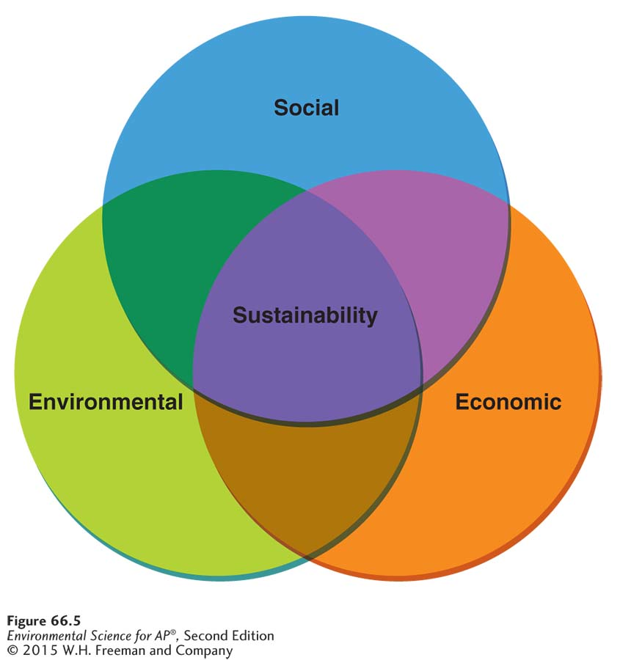
Legislative Approaches to Encourage Sustainability
The triple bottom line. Sustainability is believed to be achievable at the intersection of the social, economic,
and environmental factors that influence most development endeavors.

Slide 27
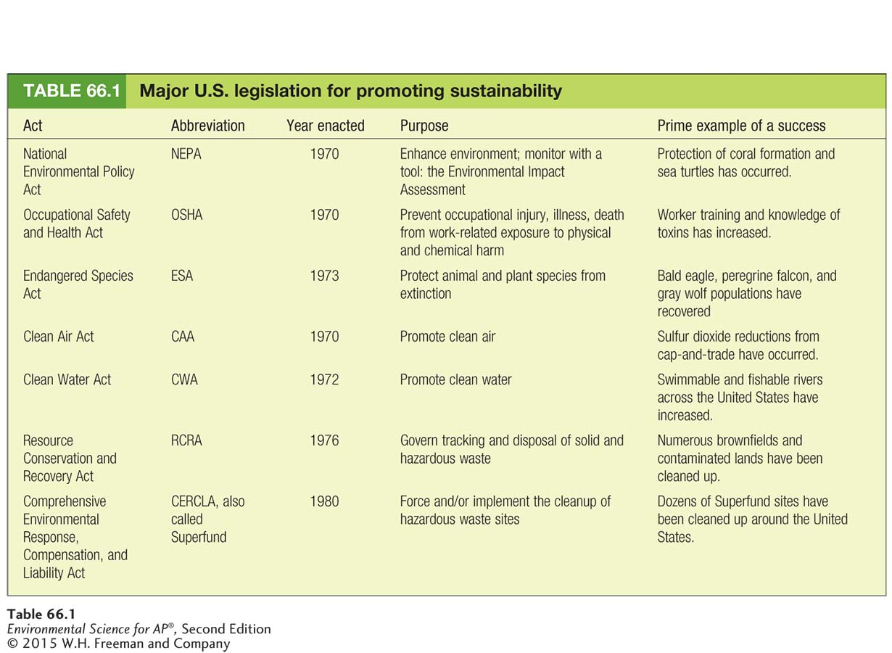
U.S. Policies for Promoting Sustainability

Slide 28
Two major challenges of our time are reducing poverty and stewarding the environment
Millennium Development Goals:
Eradicate extreme poverty and hunger
Achieve universal primary education
Promote gender equality and empower women
Reduce child mortality
Improve maternal health
Combat HIV/AIDS, malaria, and other diseases
Ensure environmental sustainability
Develop a global partnership for development

Slide 29
Environmental Justice
The inequitable distribution of pollution and of environmental degradation with their adverse effects on humans and ecosystems.
People that are of lower incomes and minorities that have a disproportionate exposure to environmental hazards.

