Slide 1
Ch. 6 Integumentary system

Slide 2
Integumentary system
The skin and its various structures make up the integumentary system.
Protects body tissues
Regulates body Temp.
Supports sensory receptors
Two or more kinds of tissues grouped together and performing specialized functions constitutes an organ.

Slide 3
Skin and its tissues
Composed of several tissue types
Maintains homeostasis
Protective covering
Retards water loss
Regulates body temperature
Houses sensory receptors
Contains immune system cells
Synthesizes chemicals
Excretes small amounts of wastes

Slide 4
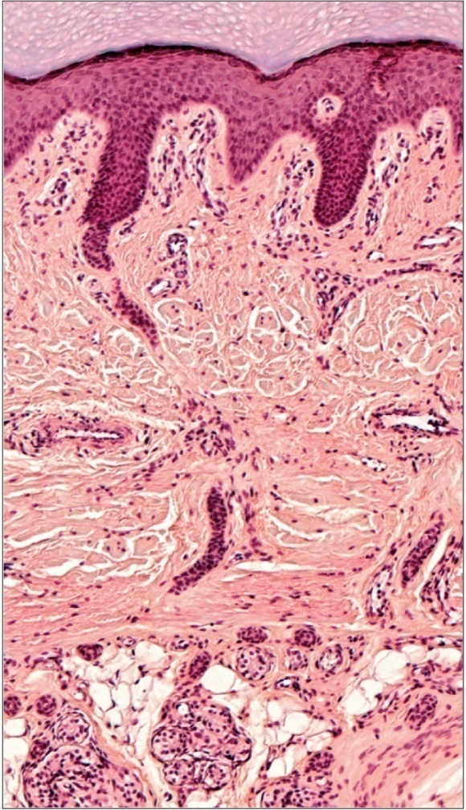
Skin Cells
Help produce Vitamin D needed for normal bone and tooth development
Some cells (keratinocytes) produce substances that simulate development of some white blood cells
Stratified
squamous
epithelium
Dense irregular
connective
tissue
Adipose tissue

Slide 5
Layers of skin
Epidermis
Dermis
Subcutaneous layer
AKA hypodermis
Beneath dermis
Some also call it the superficial fascia
Some consider it not part of the skin

Slide 6
epidermis
Stratified squamous epithelium
Lacks blood vessels
Keratinized- cells harden due to keratin protein (tough fibrous, waterproof) being stored in cells
Thickest on palms and soles (0.8-1.4mm)

Slide 7
epidermis
Melanocytes provide melanin
Rests on basement membrane
There are five (5) layers of the epidermis:
Stratum corneum
Stratum lucidum
Stratum granulosum
Stratum spinosum
Stratum basale

Slide 8
epidermis
Stratum corneum- outermost layer, many layers of dead keritinized cells
Stratum lucidum- 2nd layer in palms and soles, clear cells hardly visible may be lacking in thin epidermis, cells change shape and pushed toward surface
Stratum granulosum- 2nd layer, beneath stratum corneum, contains shruken fibers of keratin

Slide 9
epidermis
Stratum spinosum- 3rd layer, contains developing fibers of keratin and cells become flattened
Stratum basale- Deepest layer above basement membrane
close to blood vessels so cells grow and divide
contains melanocytes (produce melanin, which is a dark pigment that produce skin color and helps absorb UV rays)

Slide 10
Epidermis Influences
Heredity and environment determine skin color
Genetic Factors
Varying amounts of melanin
Varying size of melanin granules
Albinos lack melanin
Physiological Factors
Dilation of dermal blood vessels
Constriction of dermal blood vessels
Accumulation of carotene
Jaundice (Yellowing of skin meaning liver malfunction)
Environmental Factors
Sunlight
UV light from sunlamps
X-rays
Darkens melanin

Slide 11
dermis
On average 1.0-2.0mm thick
Contains dermal papillae
Binds epidermis to underlying tissues
Irregular dense connective tissue
Muscle cells
Nerve cell processes
Specialized sensory receptors
Glands
Blood vessels
Hair follicles

Slide 12
dermis
There are actually two (2) layers to the dermis
Papillary layer
Thin
Superficial
Dermal papillae found here
Areolar tissue
Reticular layer
80% of dermis
dense irregular tissue (tough collagen and elastic fibers)

Slide 13
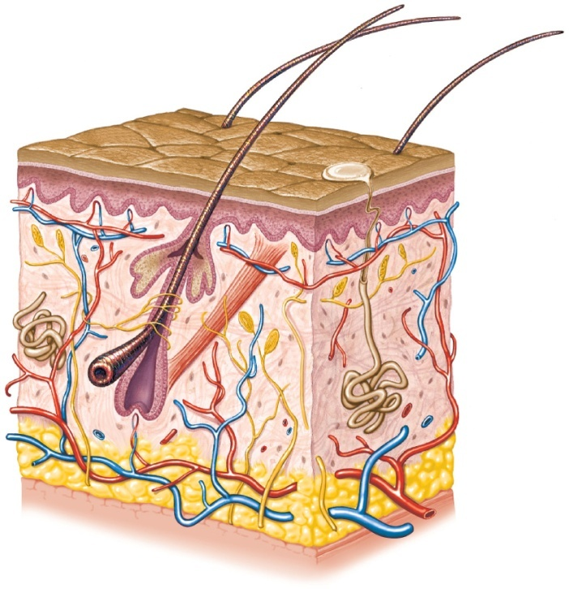
Subcutaneous layer
AKA hypodermis
Loose connective tissue and adipose tissue present
Insulates
Major blood vessels are present
Epidermis
Dermis
Subcutaneous
layer

Slide 14
Skin accessories
Accessory structures of the skin originate from the epidermis and include:
Hair follicles
Nails
Skin glands

Slide 15
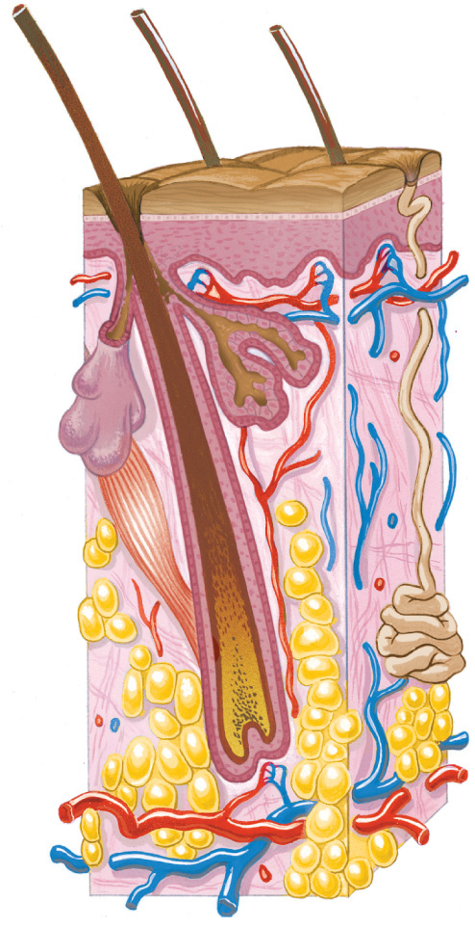
Skin accessories
Hair Follicles:
Tube-like depression
Extends into dermis
Hair develops from dead epidermal cells
Three parts:
Hair root
Hair shaft
Hair bulb/Hair papilla
Eumelanin (dark hair) and pheomelanin (light hair)
Arrector pili muscle- smooth muscle that control hair movement
Hair shaft
Arrector pili
muscle
Hair root
(keratinized
cells)
Hair follicle
Hair papilla

Slide 16
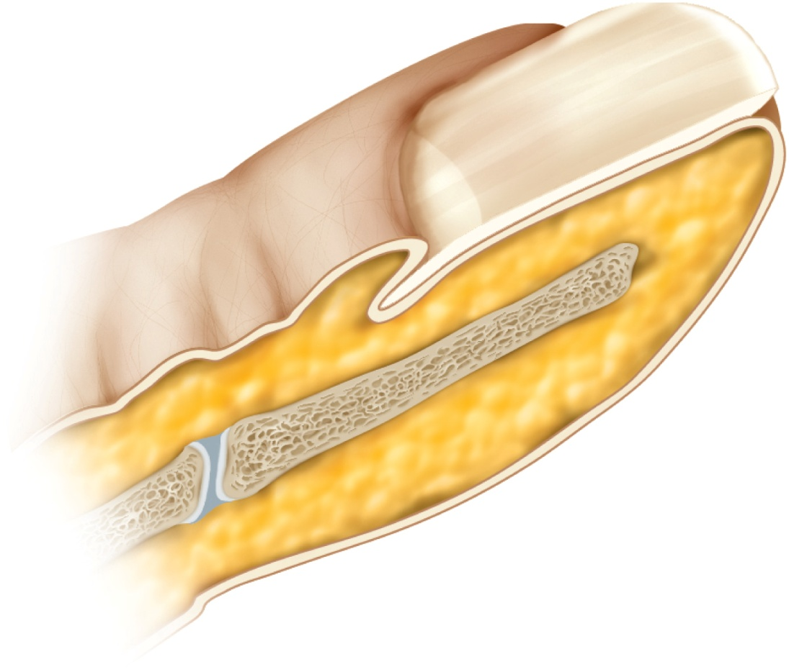
Skin accessories
Lunula
Nail bed
Nail plate
Nails:
Made of three parts:
Nail plate
Nail bed
Lunula
Epithelial cells divide at lunula, become keratinized and become part of the nail plate

Slide 17
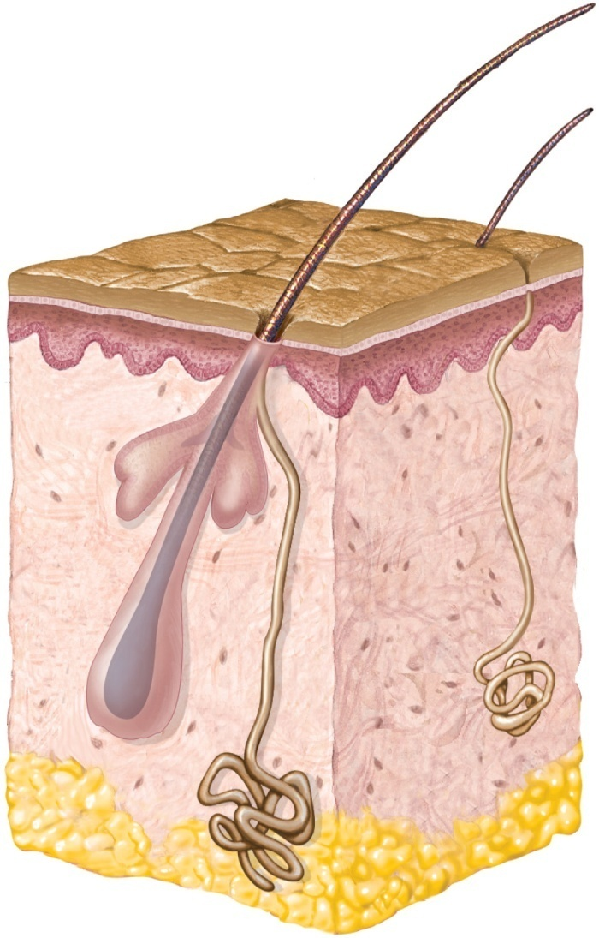
Skin accessories
Sebaceous glands:
Usually associated with hair follicles
Holocrine glands (glands that release entire cells)
Secrete sebum (oil)
Keeps skin and hair soft, pliable, and waterproof
Acne results from excess sebum secretion
Absent on palms and soles
Sebaceous
gland

Slide 18
Skin accessories
Sweat glands:
Aka sudoriferous glands
Widespread in skin
Ball shaped coil
Originates in deeper dermis or superficial subcutaneous layer
Eccrine glands (most numerous, work entire life, respond to increase in body temp. due to Environment and physical activity and open to pores)
Eccrine
sweat
gland

Slide 19
Skin accessories
Sweat glands:
Apocrine glands (active at puberty, causes scent, respond to pain, emotion and sexual arousal and open to hair follicles)
Ceruminous glands (secrete ear wax and found in ear)
Mammary glands (secrete milk and found in breasts)
Apocrine
sweat
gland

Slide 20
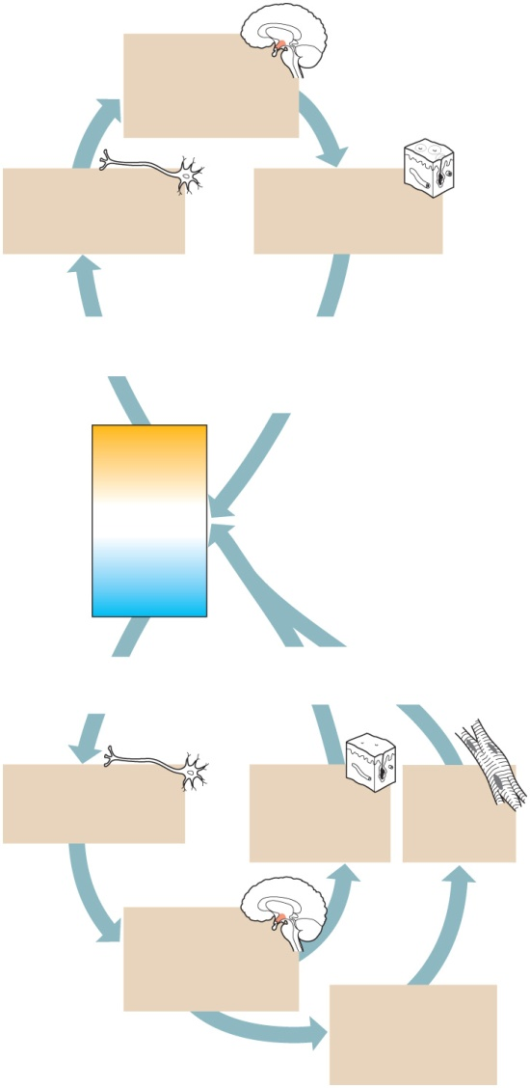
Body Temp Regulation
Control center
Hypothalamus
detects the deviation
from the set point and
signals effector organs.
Receptors
Thermoreceptors
send signals to the
control center.
Effectors
Dermal blood vessels
dilate and sweat glands
secrete.
Body temp regulation is controlled by negative feedback
Hypothermia – abnormally low body temperature (frostbite)
Hyperthermia – abnormally high body temperature
(Heat stress and heat stroke
Stimulus
Body temperature rises
above normal.
Response
Body heat is
lost to surroundings,
temperature drops toward
normal.
too high
Normal body
temperature
37°C (98.6°F)
too low
Stimulus
Body temperature
drops below normal.
Response
Body heat is conserved,
temperature rises toward normal.
Receptors
Thermoreceptors
send signals to the
control center.
Effectors
Dermal blood
vessels constrict
and sweat glands
remain inactive.
Effectors
Dermal blood
vessels constrict
and sweat glands
remain inactive.
Control center
Hypothalamus
detects the deviation
from the set point and
signals effector organs.
If body temperature
continues to drop,
control center signals
muscles to contract
involuntarily.

Slide 21
Healing of wounds
Inflammation is a normal response to injury or stress.
Blood vessels in affected tissues dilate and become more permeable, allowing fluids to leak into the damaged tissues.
Inflamed skin may become:
Reddened
Swollen
Warm
Painful

Slide 22
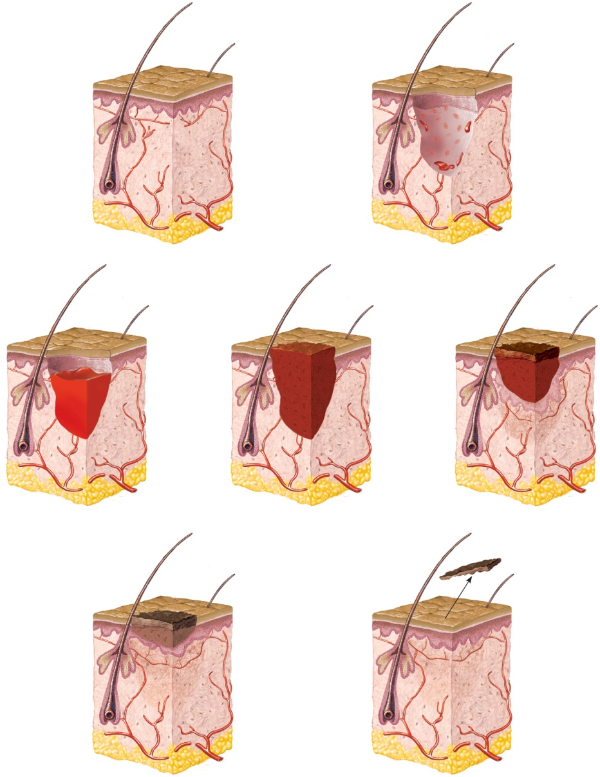
Healing of wounds
Site of injury
Blood cells
(a)
(b)
Scab
Blood
clot
(c)
(d)
(e)
Scab
Scar
tissue
Scar
tissue
Fibroblasts
(f)
(g)

Slide 23
Changes in skin during lifespan
Melanin production slows
Hair thins
Number of hair follicles decreases
Nail growth becomes impaired
Sensory receptors decline
Body temperature unable to be controlled
Diminished ability to activate Vitamin D
Skin becomes scaly
Age spots appear
Epidermis thins
Dermis becomes reduced
Loss of fat
Wrinkling
Sagging
Sebaceous glands secrete less oil

