Slide 1
Ch. 10 Nervous System basic Structure and Function

Slide 2
INTRODUCTION
Nervous system:
network of cells that sense and respond to stimuli in ways that maintain homeostasis
EXAMPLES
detects changes in the internal or external environment.
controls the movement of muscles.
regulates secretion.
integrates information from several sources and uses it to respond appropriately

Slide 3
INTRODUCTION
Nervous system composed of 3 things:
Neural tissue
Neurons- cell that send and receive bioelectric and chemical signals
Neuroglia- specialized cells that support neurons and maintain homeostasis of the nervous system.
Blood vessels
Connective tissue

Slide 4
INTRODUCTION
Organs of the nervous system are divided:
Central Nervous System (CNS)- Brain and spinal cord
Peripheral Nervous System (PNS)- nerves that connect the central nervous system to other body parts

Slide 5
INTRODUCTION
Synapse: Functional connection between the axon of one neuron and a receptor cell/neuron
Impulses: bioelectric signals that travels down the axon & allow neurons to communicate with other neurons & cells
Neurotransmitter: chemical that a axon secretes into a synapse

Slide 6
General functions
There are three types of general nervous system functions:
Sensory functions
Integrative Functions
Motor functions

Slide 7
General functions
Sensory functions:
Carried out by sensory receptors at the ends of neurons in the PNS
Sensory receptors monitor internal and environmental changes
Examples include light and sound intensities, temp, and O₂ concentration

Slide 8
General functions
Integrative functions:
Carried out by CNS
Signals from PNS are integrated with CNS to create sensations, adding memory or helping produce thoughts
After integration conscious or subconscious decisions are made/acted upon through motor functions

Slide 9
General functions
Motor functions:
Motor impulses stimulate effectors (glands, muscles) to respond.
The motor portion of the PNS that carries out voluntary activities is the somatic nervous system
The motor portion of the PNS that carries out involuntary activities is the autonomic nervous system

Slide 10
Cells of the Nervous system
Neurons are specialized to react to physical and chemical changes in their surroundings
Neurons have 3 main parts:
Dendrites-many branch like cytoplasmic extensions coming off the cell body that receive input
Axon- nerve fiber that conducts an impulse away from a neuron cell body; only has one
Cell body- main “Cell” portion of a neuron, contains nucleus.

Slide 11
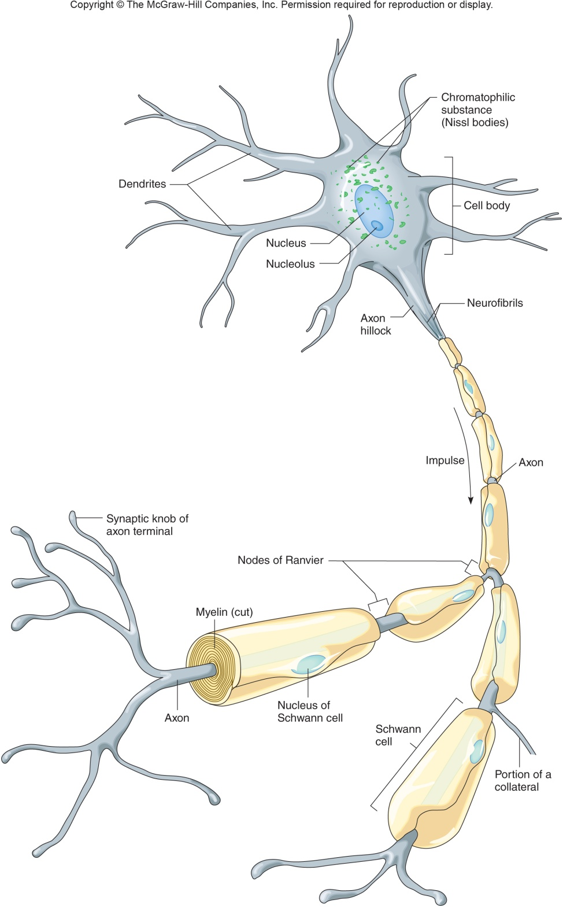
Cells of the Nervous system

Slide 12
Cells of the Nervous system
Other parts of Neurons:
Neurofibrils: fine cytoplasmic threads that extend into and support the axon
Chromatophillic substances (Nissl bodies): membranous packets of rough ER in the cytoplasm
Axon Terminal: end extensions of the axon, away from the cell body
Synaptic knobs are at the end of axon terminals and secrete neurotransmitters

Slide 13
Cells of the Nervous system
Other parts of Neurons:

Slide 14
Cells of the Nervous system
Other parts of Neurons:
Schwann cells: neuroglia(other type of nerve cell) that surrounds an axon of a peripheral nerve, forming myelin and neurilemma; Found in PNS
Myelin: lipids that form sheathlike covering around nerve axons
White matter: myelinated axons
Gray matter: Unmyelinated axons
Neurilemma: part of the Schwann cell outside the myelin sheath

Slide 15
Cells of the Nervous system
Other parts of Neurons:

Slide 16
Cells of the Nervous system
Other parts of Neurons:
Nodes of Ranvier: Gaps or interruptions in the myelin sheath
Oligodendrocytes: neuroglia that produce myelin in the brain and spinal cord (CNS)
Synaptic cleft: narrow space between the cells at a synapse

Slide 17
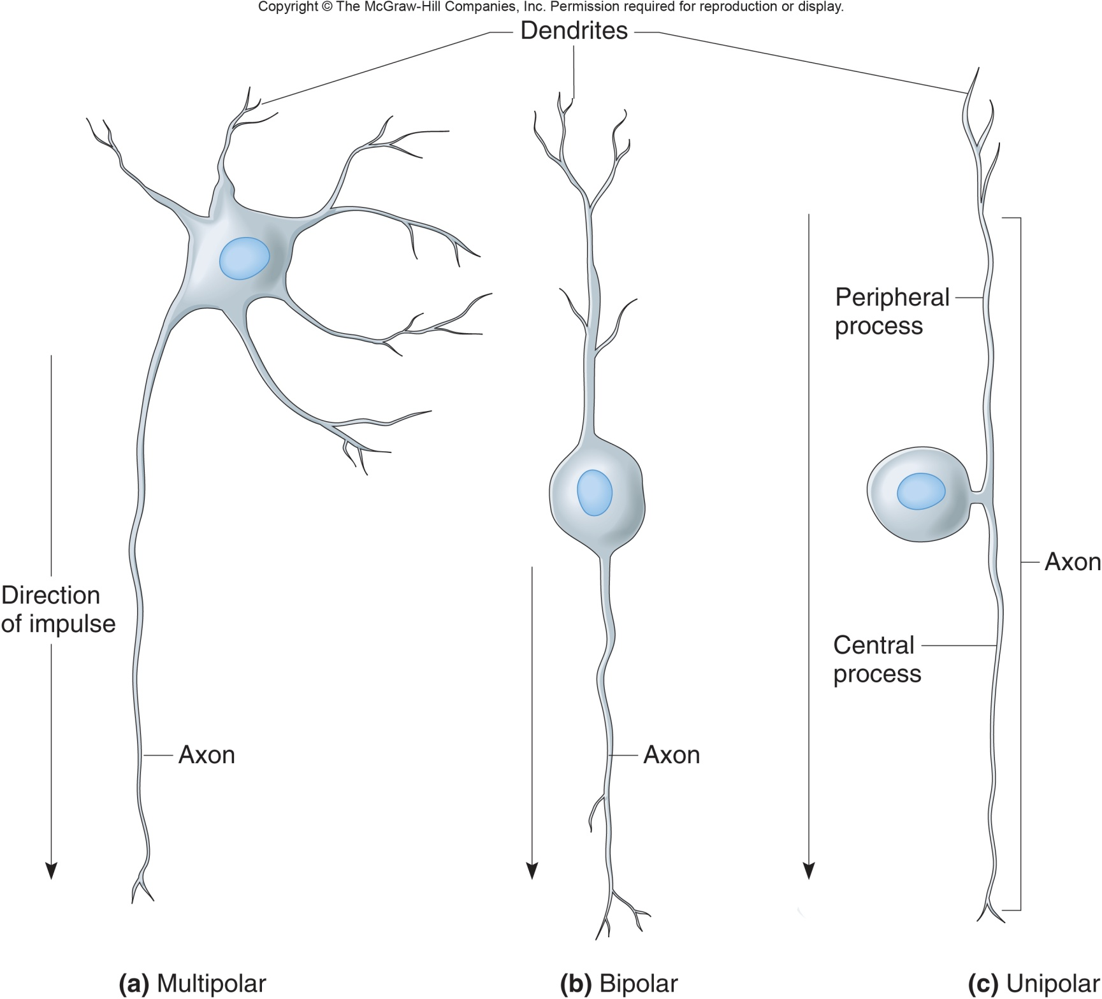
Classification of Cells of the Nervous system
There are three main types of neurons (structure):
Multipolar
Bipolar
Unipolar
Ganglia: cell bodies of some unipolar neurons group together

Slide 18
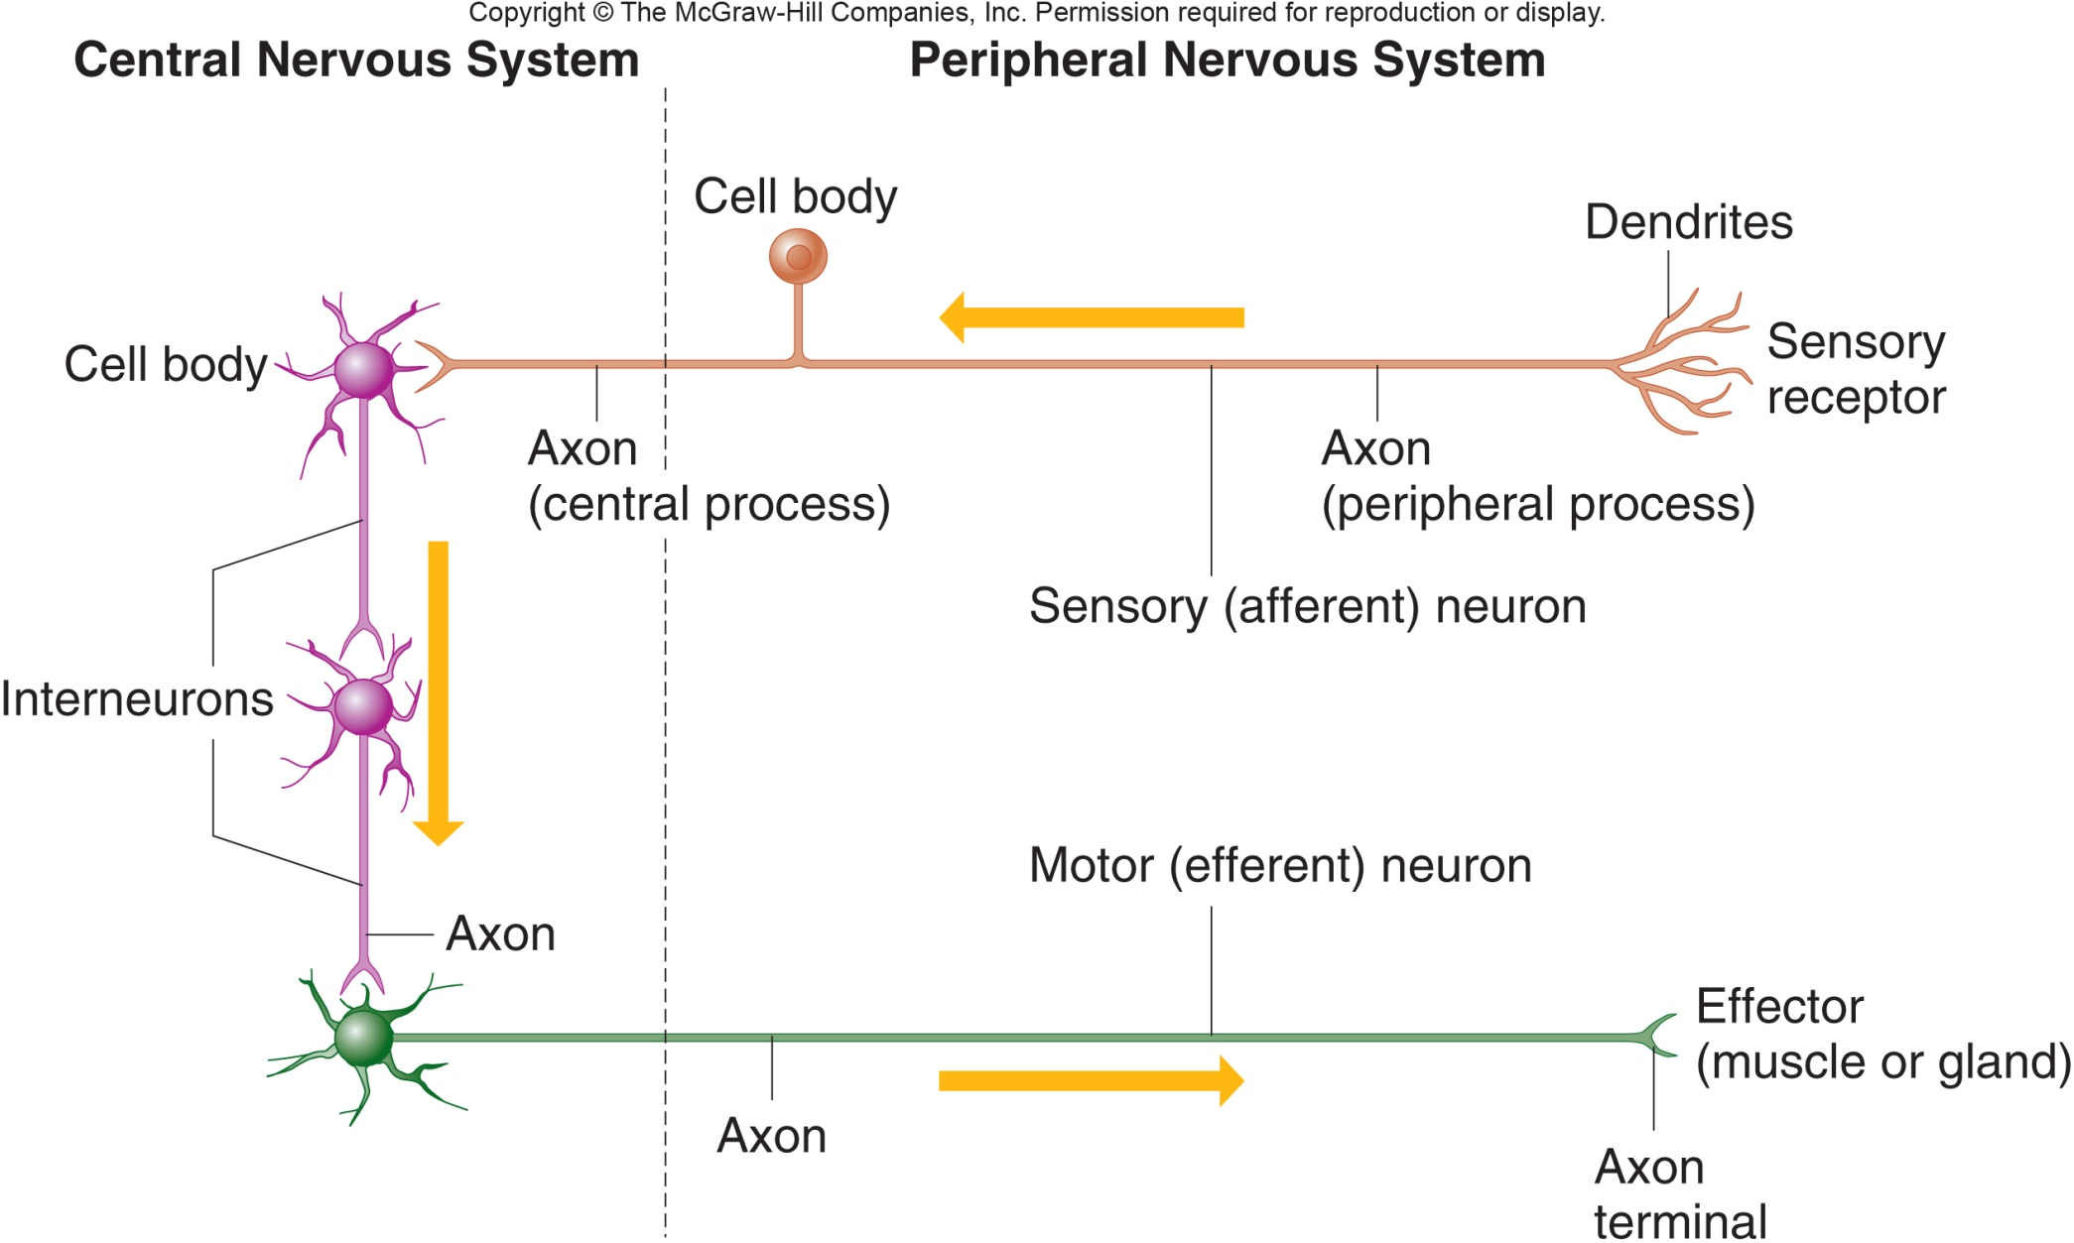
Classification of Cells of the Nervous system
There are three main types of neurons (Function):
Sensory neurons
Interneurons
Motor Neurons
*Yellow arrow in figure represents impulse

Slide 19
Classification of Cells of the Nervous system
Neuroglia of the CNS:
Astrocytes- major component of the blood-brain barrier; aids in structural support and maintains homeostasis B/W blood vessels and neurons
Oligodendrocytes: form myelin sheaths in brain and spinal cord
Microglia: Immune protection
Ependyma: from layer which substance diffuse through B/W brain/spinal cord and cerebrospinal fluid

Slide 20
Classification of Cells of the Nervous system

Slide 21
Classification of Cells of the Nervous system
Neuroglia of the PNS:
Schwann cells: Speed up neurotransmissions
Satellite cells: support ganglia in the PNS

Slide 22
Synapse
Presynaptic neuron sends impulse to synapse
Postsynaptic neuron receives input at synapse
Synaptic transmission: impulse in presynaptic neuron stimulates or inhibits the postsynaptic cell, one way process carried out by neurotransmitters.
*Transmitting a nerve impulse from one neuron to another involves a nerve impulse stimulating a presynaptic axon to release a neurotransmitter into a synaptic cleft.

Slide 23
Cell Membrane potential
A cell membrane is usually charged or polarized.
Polarization: is due to the inside of the cell membrane being negatively charged (more negative ions) as compared to the outside (more positive ions).
Membrane potential: stored electrical energy across a membrane due to the unequal distribution of charges

Slide 24
Cell Membrane potential
Resting potential: membrane potential of a resting/polarized neuron (not actively sending impulses)
-70 millivolts
Different stimuli influence mem. Potential which causes impulses
Hyperpolarized- membrane potential gets more negative than resting potential
Depolarized- membrane becomes more positive than resting potential; Caused by inflow of Na⁺ ions

Slide 25
Cell Membrane potential
Threshold potential: level of potential at which an action potential is triggered in a neuron (-55 mv)
Action potential: Sequence of electrical changes in the axon of a neuron exposed to a stimulus that exceeds threshold.
An action potential occurs when the local (resting) potential reaches threshold level.
An action potential is triggered if excitatory postsynaptic potential (EPSP) overpower inhibitory postsynaptic potential (IPSP).

Slide 26
Cell Membrane potential

Slide 27
Cell Membrane potential
A stimulus either causes an action potential or it doesn't. This is called an all-or-none response.
Refractory period: a fraction of a second when the axon becomes unresponsive to normal threshold stimulus; membrane is restoring resting potential
Absolute refractory period: no stimulus of any strength will trigger a new action potential. 1/2,500 second
Relative refractory period: Resting potential restores; intense stimuli spark action potential.

Slide 28
Cell Membrane potential
Saltatory Conduction: Impulses jump from node to node along axon.
Conduction on myelinated axons is many times faster than conductions on unmyelinated axons.
Myelin sheaths act as insulators that cause impulses to jump form nodes of Ranvier.

Slide 29
Cell Membrane potential

Slide 30
Neurotransmitters

