Slide 1
Nervous System II Division of the Nervous system

Slide 2
Introduction
The central nervous system (CNS) consists of the brain and spinal cord.
The brain oversees sensation, and perception, movement, and thinking
The brainstem connects the brain and the spinal cord, allowing communication between the two.
The spinal cord provides communication between the CNS and the peripheral nervous system (PNS).

Slide 4
Meninges
Bone and protective membranes called meninges surround the brain and spinal cord.
The meninges consist of dura mater (1st ), arachnoid mater (2nd )and pia mater (3rd)
Cerebrospinal fluid occupies the space between the arachnoid and pia mater. And is clear and watery.

Slide 5
Ventricles and cerebrospinal fluid
Ventricles: connecting cavities in the cerebral hemispheres and brainstem.
They are filled with cerebrospinal fluid.
Cerebrospinal fluid (CSF):
Helps maintain a stable ion concentration in the CNS
Provides a pathway for blood waste
Helps clear waste from brain tissue

Slide 6
Ventricles and cerebrospinal fluid
CSF circulates through the ventricles and is reabsorbed into the blood of the dural sinuses
Choroid plexuses: Found in the walls of ventricles and secrete CSF
Ependymal Cells: regulate the composition of the CSF, found in choroid plexuses.

Slide 7
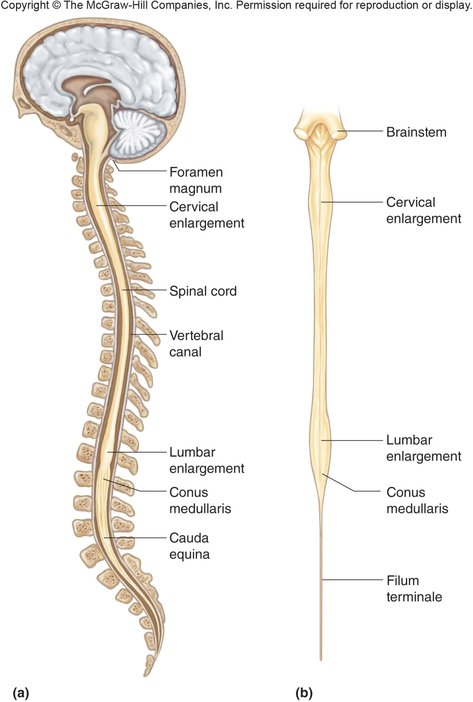
Spinal Cord
The spinal cord is a nerve column that extends from the brain into the vertebral canal and ends between the first and second lumbar vertebrae

Slide 8
Spinal Cord
Structure of the spinal cord:
The spinal cord is composed of thirty-one segments, each of which gives rise to a pair of spinal nerves.
It is characterized by:
a cervical enlargement
a lumber enlargement
two deep longitudinal grooves that divide it into right and left halves
Spinal cord has four main regions: cervical thoracic, lumbar and sacral

Slide 9
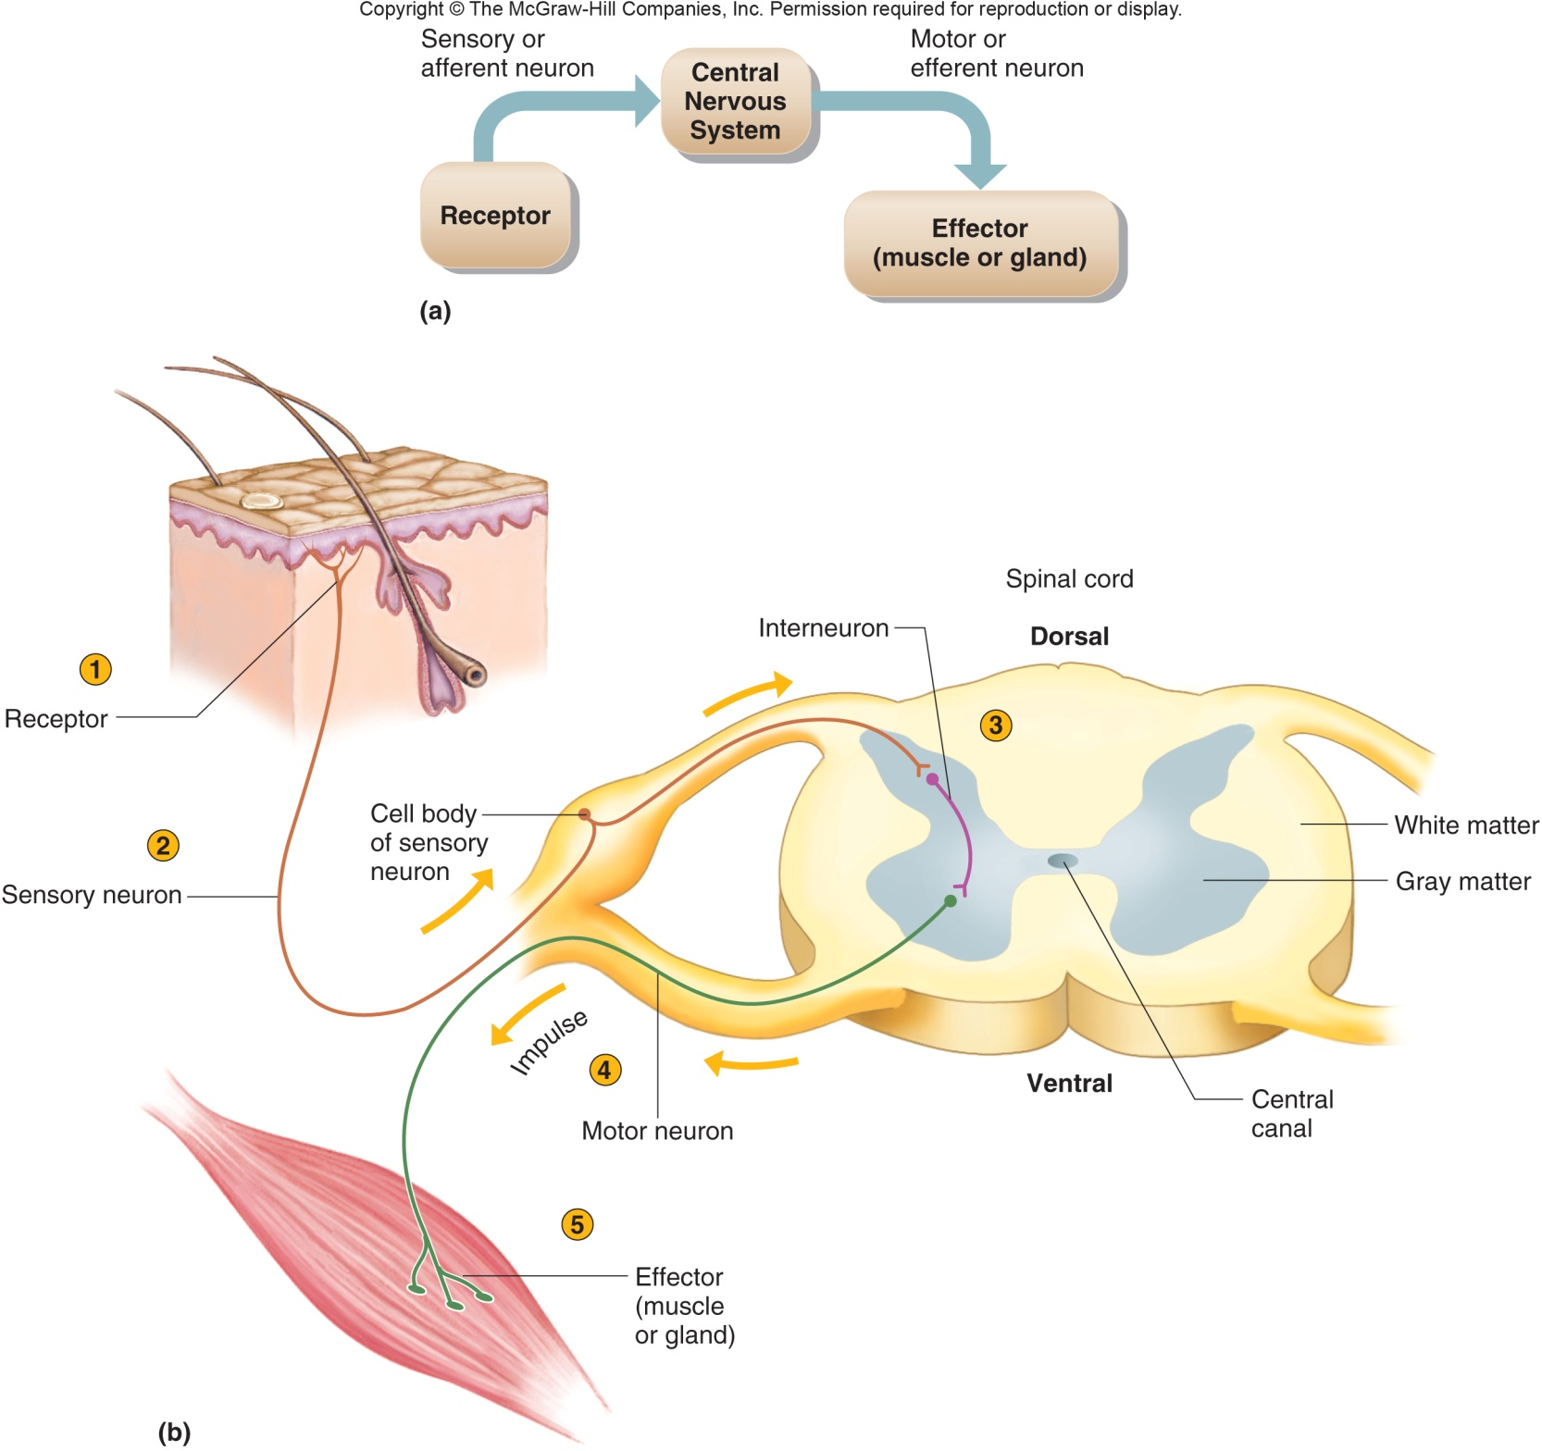
Spinal Cord
White matter surrounds a central core of gray matter
The white matter is composed of bundles of myelinated fibers

Slide 10
Spinal Cord
Functions of the spinal cord:
The spinal cord is the center for spinal reflexes.
Reflexes are automatic, subconscious responses to changes
The component of the autonomic reflex arc that detects a change in stimulus is the sensory receptor
The help maintain homeostasis
Knee-jerk reflex only uses two neurons (monosynaptic which are the quickest ). Other reflexes involve more neurons
Withdrawal reflexes are protective

Slide 12
Spinal Cord
Functions of the spinal cord:
The spinal cord is a two-way communication system between the brain and structures outside the nervous system.
Ascending tracts carry sensory impulses to the brain; Descending tracts carry motor impulses to muscles and glands
Many of the fibers in the ascending and descending tracts cross over in the spinal cord or brain

Slide 13
Brain
Brain: Largest and most complex part of the nervous system.
Contains nerve centers associated with sensations
Issues motor commands
carries on higher mental functions

Slide 14
Brain
Brain development:
Brain structure reflects the way it forms
The brain develops from a neural tube with three cavities
Forebrain
Midbrain
Hindbrain
The cavities persist as ventricles and the walls give rise to structural and functional regions

Slide 16
Brain structure
Use figure 11.15

Slide 17
Brain
Cerebrum: provide higher brain functions such as thought, reasoning, interpretation of sensory input, control of voluntary muscles and memory storage
Cerebral cortex has sensory, association and motor areas
The function of the cerebral association areas is
to analyze sensory experiences.
memory
to interpret sensations.
reasoning and judgment.

Slide 18
Brain
Cerebrum
Consists of two hemispheres which contain lobes
Lobes:
Frontal- Contains primary motor cortex, cognitive thought
Parietal- interpret sense info from skin (cutaneous), taste
Temporal-interpretation of auditory patterns
Occipital –responsible for vision
Insula- not visible on the surface of the brain, transmit sense info with appropriate emotions, Hard to study with surface electrodes

Slide 19
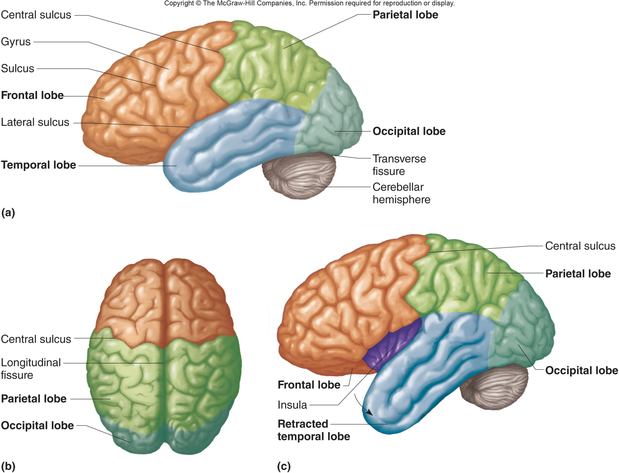

Slide 20
Brain
Cerebrum
Consists of two hemispheres which contain lobes
Central sulcus: separates frontal and parietal lobes
Corpus callosum: is a band of commissural fibers that connects the right cerebral hemisphere to the left cerebral hemisphere.
The right and left cerebral hemispheres are separated from each other by the longitudinal fissure

Slide 21
Brain
Cerebellum: Part of the brain that coordinates voluntary muscular movements is the
control skeletal muscles to maintain balance
control of posture, locomotion, and fine motor coordination.
Separated from cerebrum by transverse fissure

Slide 22
Brain
Diencephalon: includes the thalamus and hypothalamus
Thalamus is a major portion of the diencephalon and relays incoming sensory impulses to cerebral cortex
Hypothalamus: controls homeostasis
Regulation of body temperature “thermostat”
Control of hunger
Production of hormones
Control of thirst

Slide 23
Brain
Diencephalon:
Limbic system produces emotional feelings and modifies behavior, interprets smell

Slide 24
Brain
Brainstem: Extends from base of the brain to spinal cord, made of:
Midbrain- contains reflex centers associated with eye and head movement
Pons- Transmit impulses between the cerebrum and other parts of the nervous system
Medulla oblongata- Continuous w/spinal cord, transmits all ascending and descending impulses and contains vital reflex centers involved w/ cardiovascular and respiratory systems

Slide 25
Brainstem

Slide 26
Brain
Brainstem: Extends from base of the brain to spinal cord, made of:
Reticular formation-
Maintains alertness and attention
responsible for sleep/wake cycle

Slide 27
Peripheral Nervous system
Structure of Peripheral Nerves:
The epineurium outermost layer of connective tissue that bundles fascicles into nerves.
The endoneurium is a small amount of connective tissue that surrounds individual axons and their Schwann cells.

Slide 28
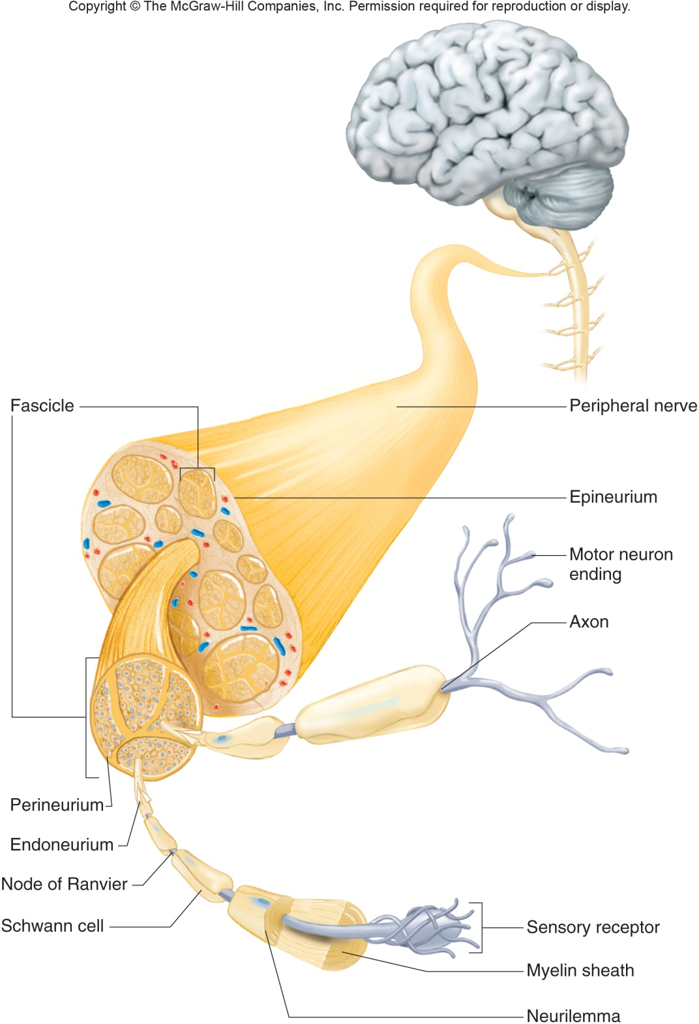
Peripheral Nervous system
Structure of Peripheral Nerves:

Slide 29
Peripheral Nervous system
Cranial Nerves: Originate from the brain and communicate with other body parts
There are 12 pairs of cranial nerves and 31 pairs of spinal nerves.
The Roman numerals assigned to each cranial nerve reflect the sequence from anterior to posterior in which they emerge from the brain.
Vagus Nerve: cranial nerve which acts to innervate the thoracic and abdominal organs. Only one to leave had/neck area

Slide 30
Peripheral Nervous system
Cranial Nerves:
Abducens nerves: are involved in eye movement.
Facial expression is regulated by the facial nerve.
Mixed nerve: consists of both afferent (sensory) and efferent (motor) fibers.
Vestibulocochlear (VIII): cranial nerves is exclusively sensory, controls hearing and equillibrium

Slide 31
Peripheral Nervous system
Cranial Nerves:
Other important cranial nerves:
Olfactory – smell, most anterior
Oculomotor – eye movement
Trochlear – eye movement
Glossopharyngeal – muscles for swallowing
Vagus – sensory and motor for internal organs
Hypoglossal –tongue movement for speaking, chewing and swallowing
Vestibulocochlear – hearing and balance
Optic- Sensory for vision

Slide 32
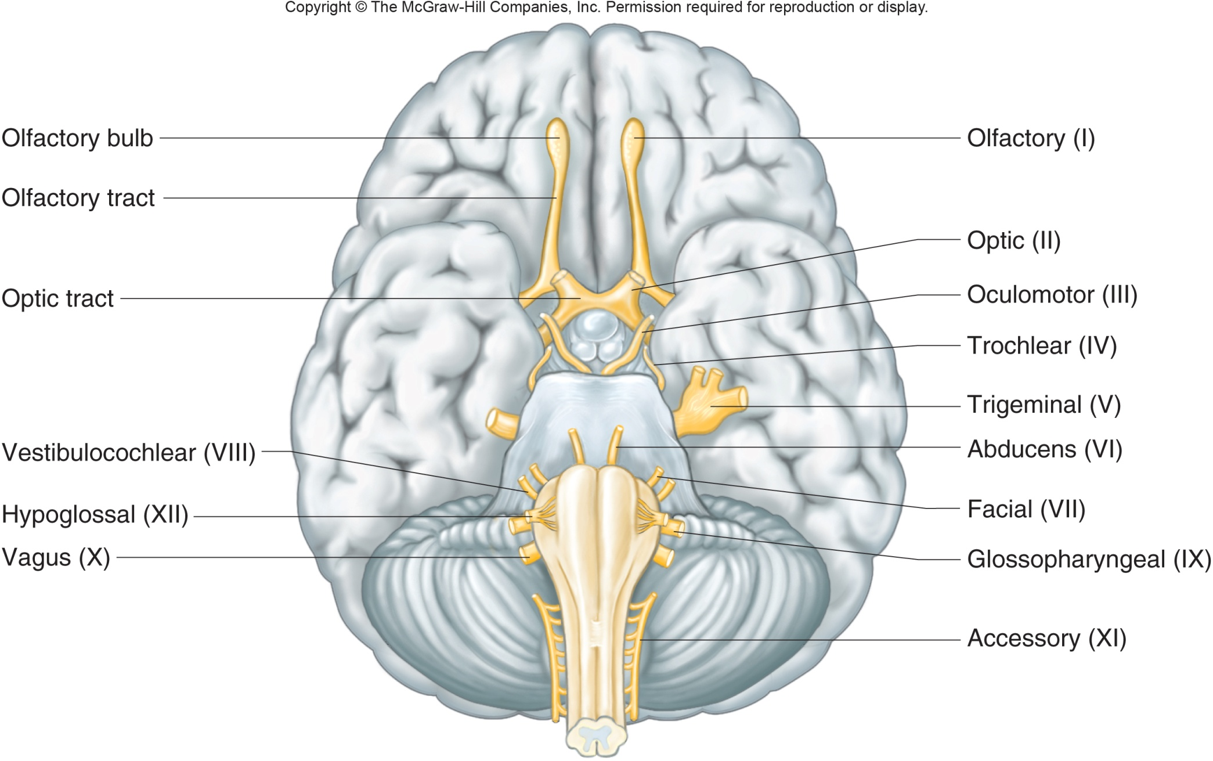
Fig. 11.25

Slide 33
Peripheral Nervous system
Spinal Nerves: Originate from the spinal cord and communicate with other body parts
Ventral root of a spinal nerve contains only motor fibers.
The sensory root of a spinal nerve is also referred to as the dorsal root.

Slide 34
Peripheral Nervous system
Spinal Nerves:
The brachial plexus: Nerves found deep within the shoulders and the arm pits.
supplies nerves that function to contract muscles of the arm and forearm

Slide 35
Autonomic Nervous system
Autonomic Nervous = involuntary control
Effectors controlled by the autonomic nervous system:
cardiac muscle
glands
smooth muscle in blood vessels
smooth muscle in the digestive system
Two main Branches:
Sympathetic: is often referred to as the emergency system and stimulates the body in times of stress and crisis.
Parasympathetic: Normal system; operates under ordinary and restful conditions.

