Slide 1
Ch. 7 Skeletal system

Slide 2
Skeletal System-Function
Provides structure and support for softer tissues
Provides points of attachment for muscles
House blood-producing cells
Stores inorganic salts

Slide 3
Skeletal System-Structure
Bones are the organs of the skeletal system
Human skeleton initially cartilages and fibrous membranes
Hyaline cartilage is the most abundant cartilage
By age 25 the skeleton is completely hardened
206 bones make up the adult skeleton (20% of body mass)
80 bones of the axial skeleton
126 bones of the appendicular skeleton

Slide 4
Bones- Classification
Long Bones- long w/expanded ends
Femur
Short Bones-cube like w/ roughly equal legnths and widths
Bones of wrist and ankles
Sesamoid (round) Bones- special type of short bone, ussually small and nodular and embeded in a tendon adjacent to a joint, where the tendon is compressed
Kneecap (patella)

Slide 5
Bones- Classification
Flat Bones- plate like w/broad surfaces
Ribs, scapulae, some bones in skull
Irregular Bones- variety of shapes, most are connected to serval other bones
Vertebrae, many facial bones

Slide 7
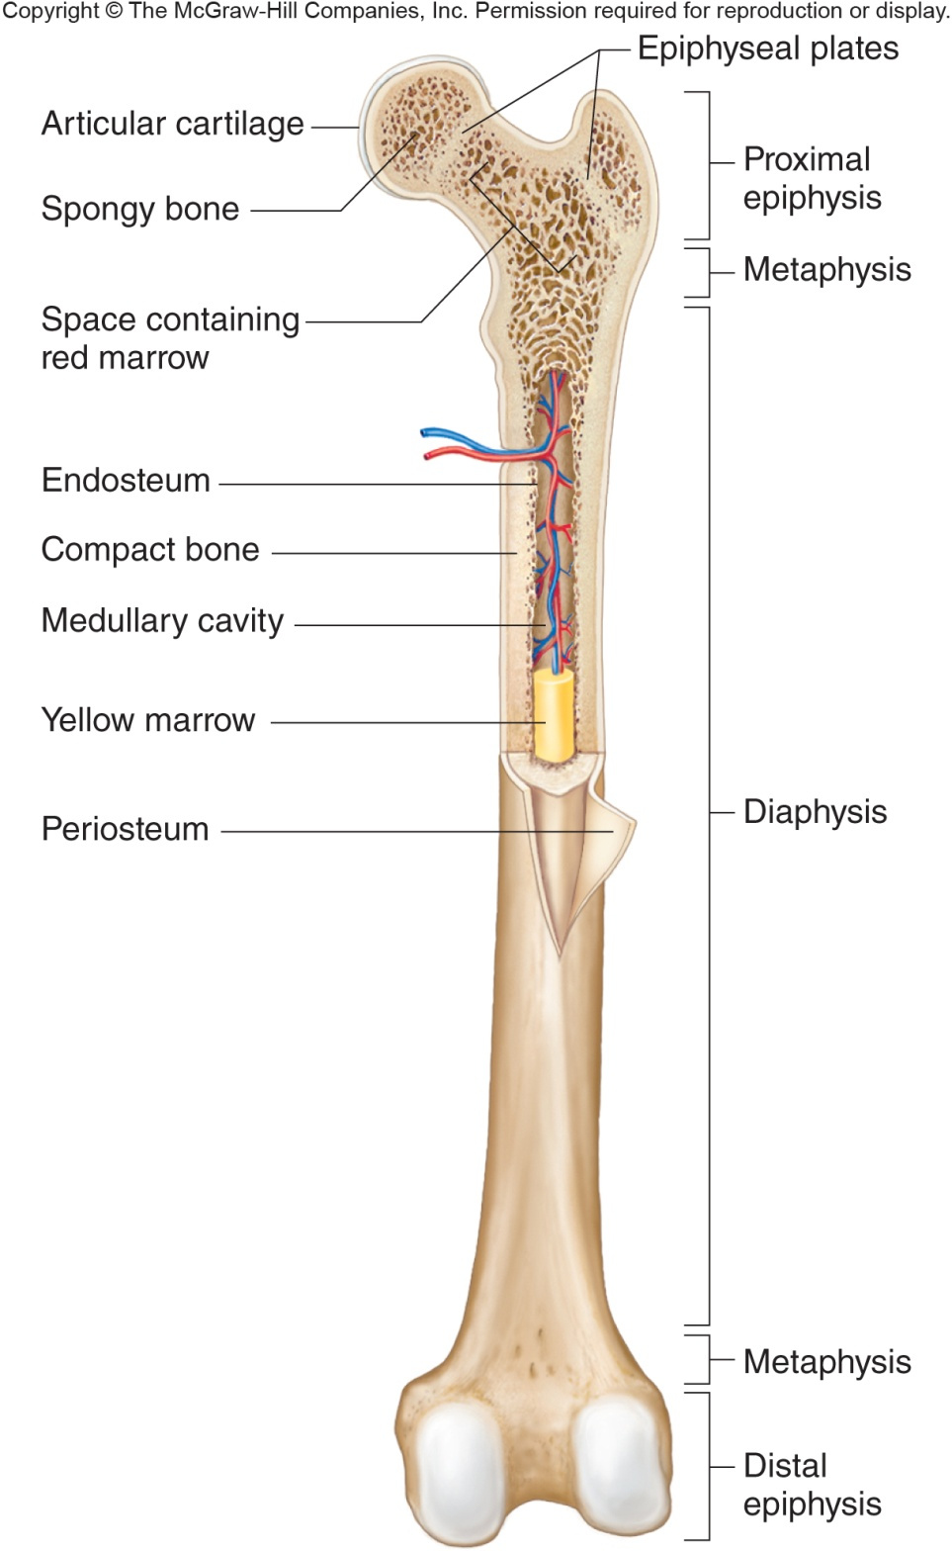
Parts of long bones
Epiphysis- expanded portion of long bone that forms a joint w/ another bone, mainly composed of spongy bone
Distal
Proximal
Diaphysis- shaft of the bone mainly composed of compact bone
Metaphysis- widening part of the bone between the epiphysis and the diaphysis
Compact bone- dense tightly packed tissue , extracellular matrix with no gaps, located in diaphysis
Spongy bone- consists of bars and plates separated by irregular spaces

Slide 8
Parts of long bones
Articular cartilage- hyaline cartilage on the end of bones
Periosteum- tough, dense connective tissue on the outer surface of the bone, helps form and repair bone tissue
Endosteum- tissue lining the medullary cavity in bone
Medullary cavity- cavity containing marrow within the diaphysis of long bone
Trabeculae- branching boney plates within spongy bone

Slide 9
Parts of long bones
Bone marrow- soft connective tissue in bones that contains stem cells for blood cell formation
Red marrow- red blood cells, white blood cells and platelets form here
Yellow marrow- stores fat and does not produce blood cells

Slide 10
Microscopic Bone- Compact
Bone cells are called osteocytes
Osteocytes transport nutrients and wastes
Found in tiny bony chambers forming circles around central canals – Lacunae
Central canals (Haversian canals)- contains blood vessels and nerve cells
The extracellular matrix of bone is largely collagen and inorganic salts
Collagen gives bone resilience
Inorganic salts make bone hard

Slide 11
Microscopic Bone- Compact
Canaliculi- A passageway connecting neighboring osteocytes in an osteon. Osteocytes use transport waste and nutrients
Osteon- the osteocytes and layers of extracellular matrix circle and cluster around a central canal to form an entire cylinder shaped unit/structure
Perforating canals (Volkman’s canals)- connect central canals horizontally, and allow to communicate with surface of the bone and medullary cavity

Slide 12
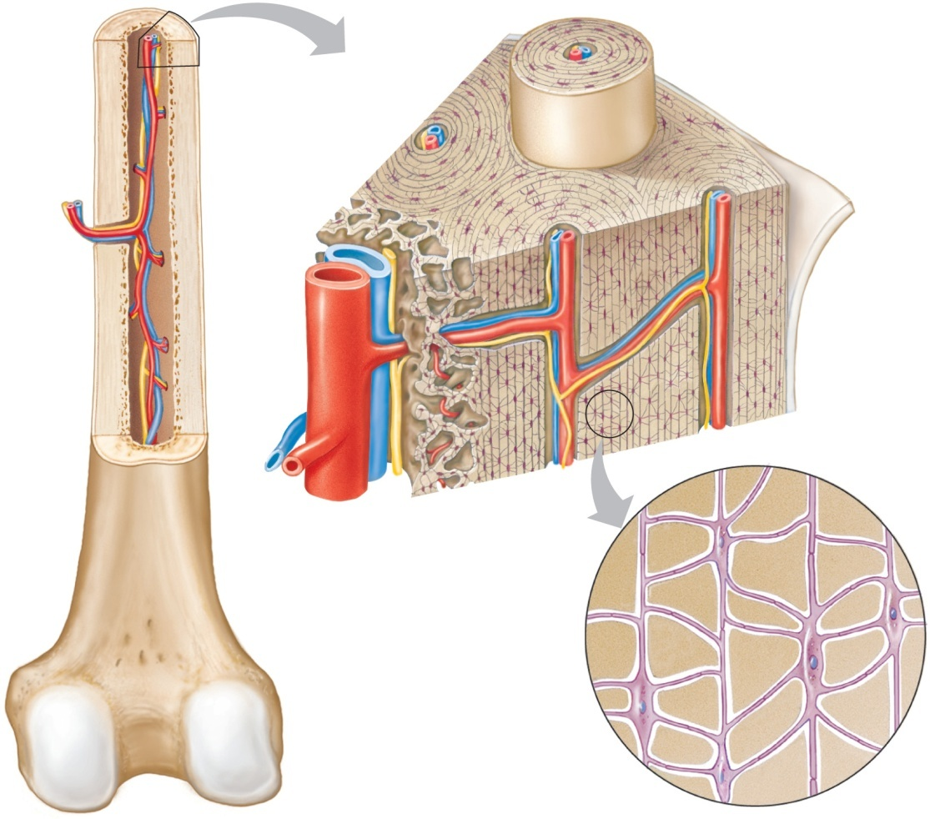
Microscopic Bone- Compact

Slide 13
Microscopic Bone- Spongy
Composed of Osteocytes and extracellular matrix
Bone cells do not aggregate around central canals, cells found in trabeculae
Receive nutrients from substances diffusing into the canaliculi that lead to the surfaces of trabeculae

Slide 14
Bone Development and Growth
Parts of the skeletal system begin to develop during the first few weeks of prenatal development and continue to grow into adulthood
Bones replace existing connective tissue in one of two ways:
As intramembranous bones
As endochondral bones

Slide 15
Bone Development and Growth
Intramembranous Bones
These bones originate within sheetlike layers of connective tissues
They are the broad, flat bones
Skull bones, clavicles, sternum and some facial bones are known as intramembranous bones
Intramembranous ossification- process of replacing connective tissue to form intramembranous bone

Slide 16
Bone Development and Growth
Intramembranous ossification:
Sheets of relatively undifferentiated connective tissue appear at sites of future bones
Partially differentiated connective tissue cells collect around blood vessels in these layers
Connective tissue cells further differentiate into osteoblasts, which deposit spongy bone
Osteoblasts- bone forming cells that deposit boney matrix around themselves

Slide 17
Bone Development and Growth
Intramembranous ossification:
Osteoblasts become osteocytes when boney matrix completely surrounds them
Connective tissue on the surface of each developing structure forms a periosteum
Osteoblasts on the inside of the periosteum deposit compact bone over the spongey bone

Slide 18
Bone Development and Growth
Endochondral Bones
Bones begin as hyaline cartilage
Form models for future bones
These are most bones of the skeleton
Endochondral ossification: process of forming endochondral bones from hyaline cartilage

Slide 19
Bone Development and Growth
Endochondral ossification:
Masses of hyaline cartilage form models for future bones
Cartilage tissue breaks down. Periosteum develops
Blood vessels and differentiating osteoblasts from the periosteum invade the disintegrating tissue

Slide 20
Bone Development and Growth
Endochondral ossification:
Osteoblasts form spongy bone in the space occupied by cartilage
Osteoblasts beneath the periosteum deposit a thin layer of compact bone
Osteoblasts become osteocytes when bony matrix completely surrounds them

Slide 21
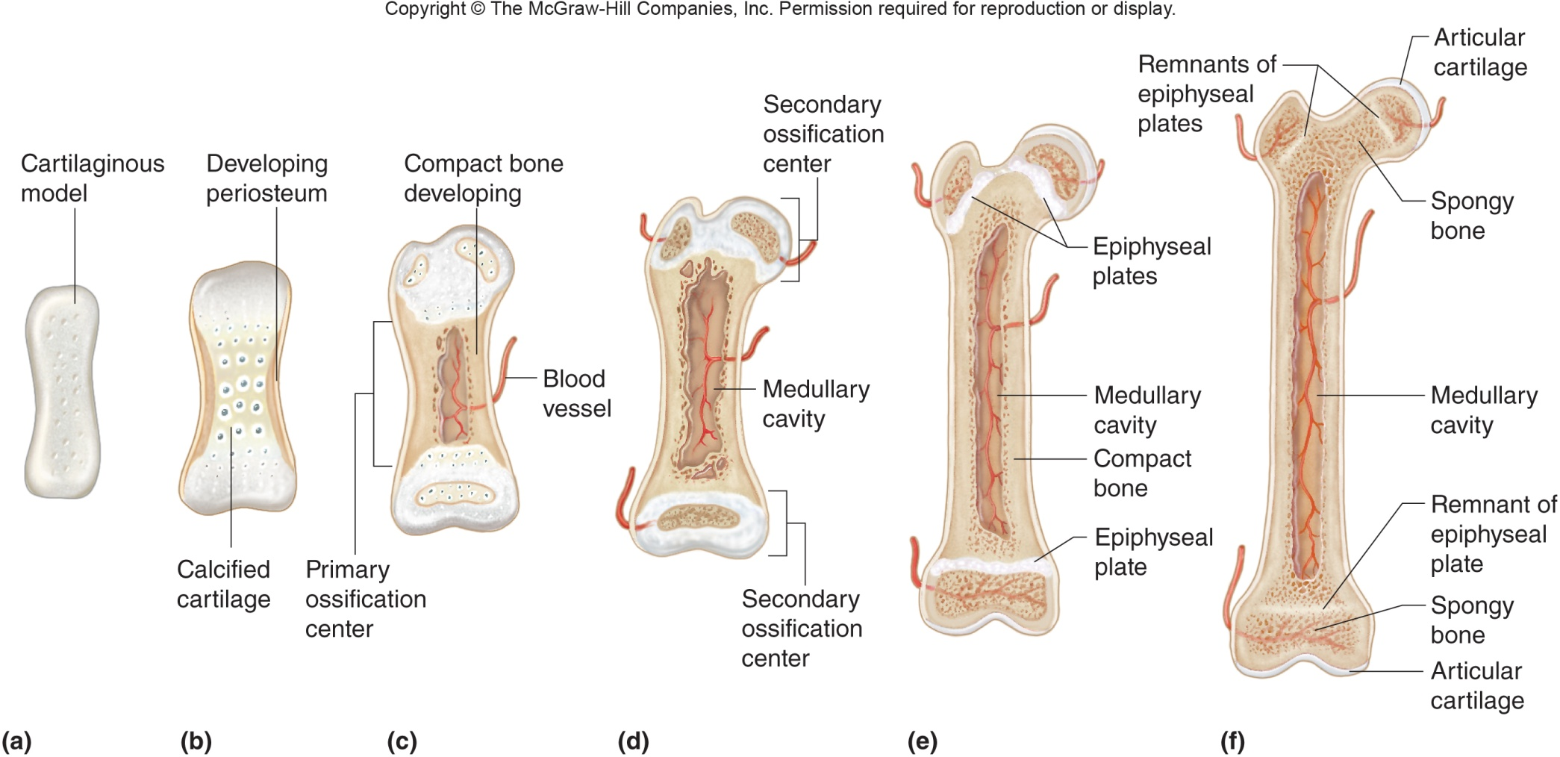
Bone Development and Growth
Endochondral ossification:
Primary ossification center- starts at diaphysis
Secondary ossification center- starts at epiphysis
Epiphyseal plate- band of cartilage that separates two ossification centers

Slide 22
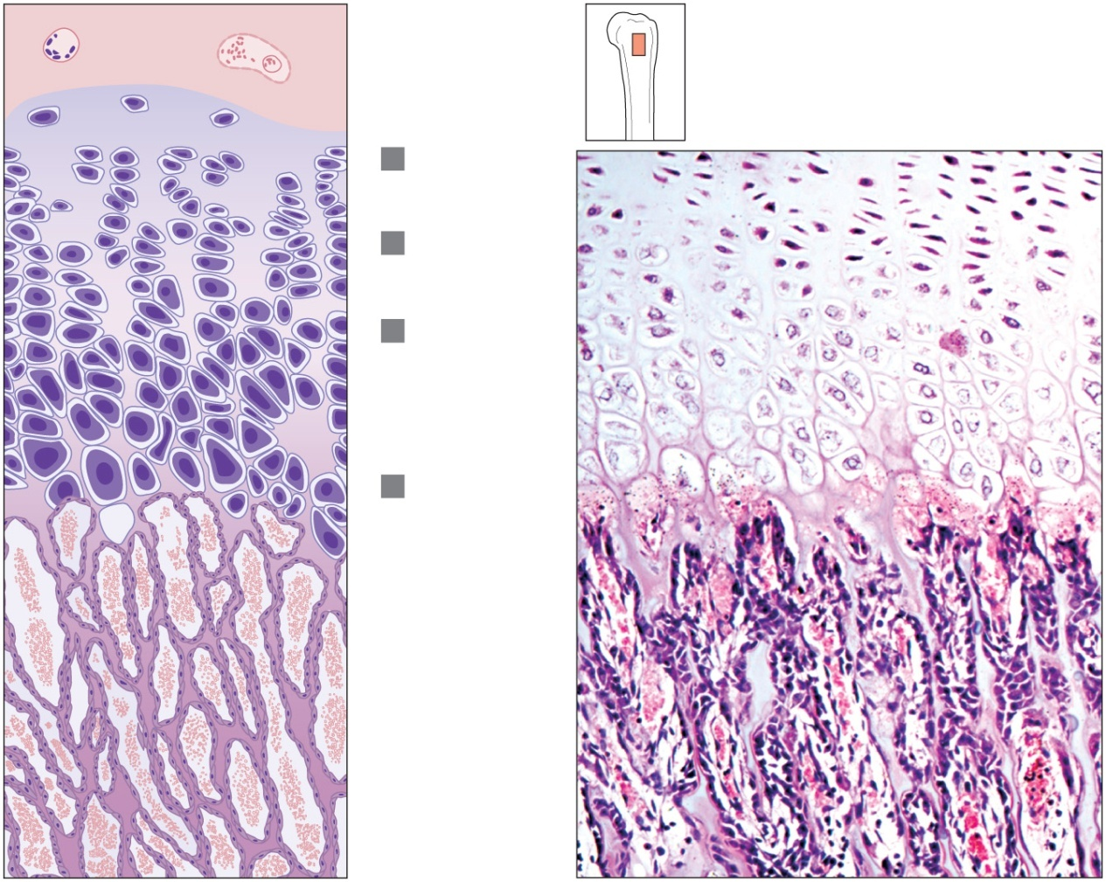
Growth at Epiphyseal Plate
First layer of cells
Zone of Resting cells
Closest to the end of epiphysis
Anchors epiphyseal plate to epiphysis
Second layer of cells
Zone of Proliferating Cartilage
Many rows of young cells
Undergoing mitosis
Bone tissue
of epiphysis
1
Zone of
resting
cartilage
2
Zone of
proliferating
cartilage
3
Zone of
hypertrophic
cartilage
4
Zone of
calcified
cartilage
Ossified
bone of
diaphysis
(a)
(b)

Slide 23
Growth at Epiphyseal Plate
Third layer of cells
Zone of hypertrophic cartilage
Older cells
Left behind when new cells appear
Cells enlarging and becoming calcified
Fourth layer of cells
Zone of calcified Cartilage
Thin
Dead cells
Calcified extracellular matrix
Bone tissue
of epiphysis
1
Zone of
resting
cartilage
2
Zone of
proliferating
cartilage
3
Zone of
hypertrophic
cartilage
4
Zone of
calcified
cartilage
Ossified
bone of
diaphysis
(a)
(b)

Slide 24
Growth at Epiphyseal Plate
Osteoclasts:
Multi nucleated cells that dissolve calcified cartilage matrix
Secrete acid to dissolve inorganic components and use enzymes to to breakdown organic components
Can also phagocytize components of boney matrix
After osteoclasts remove excess cellular matrix osteoblasts move in to replace with bone tissue.

Slide 25
Homeostasis of Bone
Bone remodeling-occurs throughout life as osteoclasts resorb bone tissue and osteoblasts replace the bone
Occurs on the surfaces of the endosteum and periosteum
Remodeling of spongy bone is quicker than compact bone
Helps to replace about 10%=20% of Skelton each year

Slide 26
Factors Affecting Bone Development, Growth and Repair
Deficiency of Vitamin A – retards bone development
Deficiency of Vitamin C – results in fragile bones
Deficiency of Vitamin D – rickets, osteomalacia (softening and defromed bones due to calcium lack of calcium in bones)
Insufficient Growth Hormone – dwarfism

Slide 27
Factors Affecting Bone Development, Growth and Repair
Excessive Growth Hormone – gigantism, acromegaly (hands feet and jaw enlarge)
Insufficient Thyroid Hormone – delays bone growth
Sex Hormones – promote bone formation; stimulate ossification of epiphyseal plates
Physical Stress – stimulates bone growth

Slide 28
Functions of Bone
Support, Movement & Protection
Gives shape to head, etc.
Supports body’s weight
Protects lungs, etc.
Bones and muscles interact
When limbs or body parts move
Inorganic Salt Storage
Calcium
Phosphate
Magnesium
Sodium
Potassium
Blood Cell Formation
Also known as hematopoiesis
Occurs in the red bone marrow

