Slide 1
Joints

Slide 2
Intro to Joints
Are known as articulations
Functional junctions between bones
Bind parts of skeletal system together
Make bone growth possible
Permit parts of the skeleton to change shape during childbirth
Enable body to move in response to skeletal muscle contraction

Slide 3
Intro to Joints
Joints classified structurally by the type of tissue that binds the bones together are:
fibrous, cartilaginous, and synovial.
Joints can also be grouped according to the degree of movement possible at the bony junctions.
Immovable joints are called synarthrotic.
Slightly movable joints are called amphiarthrotic.
Freely movable joints are called diarthrotic.

Slide 4
Fibrous joints
Fibrous joints have dense connective containing many collagenous fibers holding them together.
The three types of fibrous joints are:
syndesmosis, suture, and gomphosis.

Slide 5
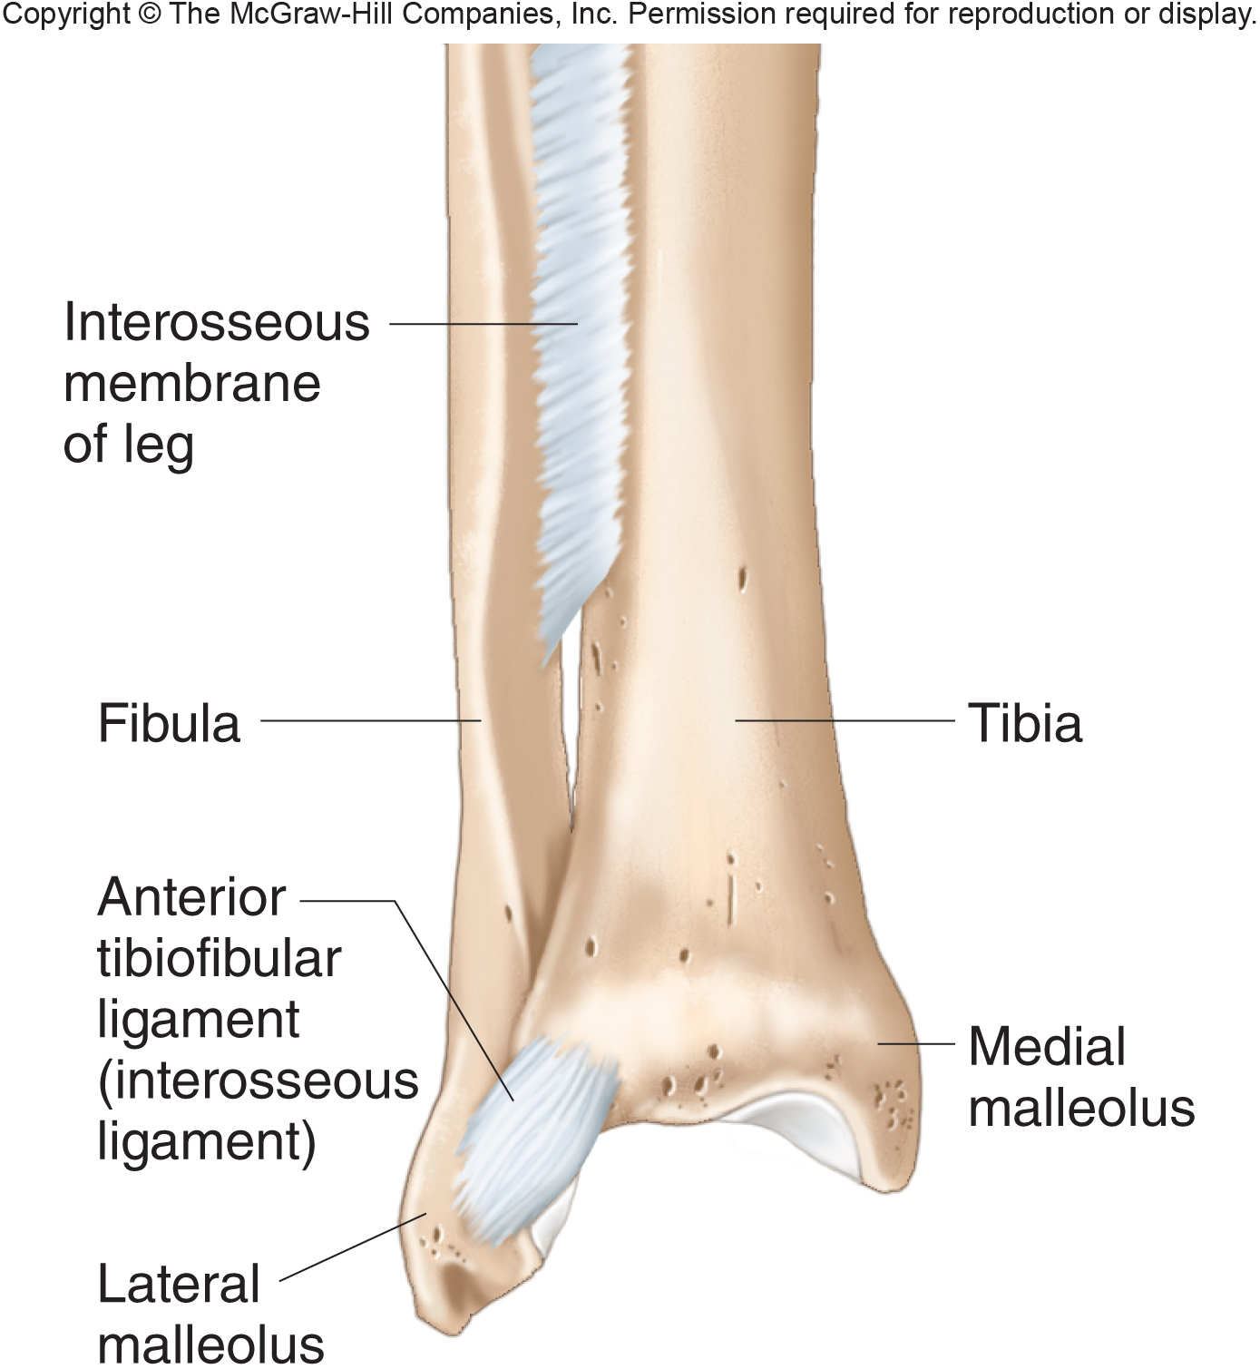
Fibrous joints
Syndesmosis: bones are bound by a sheet of fibrous connective tissue (interosseous membrane) or bundle of fibrous connective tissue (interosseous ligament).
An example of a syndesmosis is between the tibia and fibula.
syndesmosis =
amphiarthrotic.

Slide 6
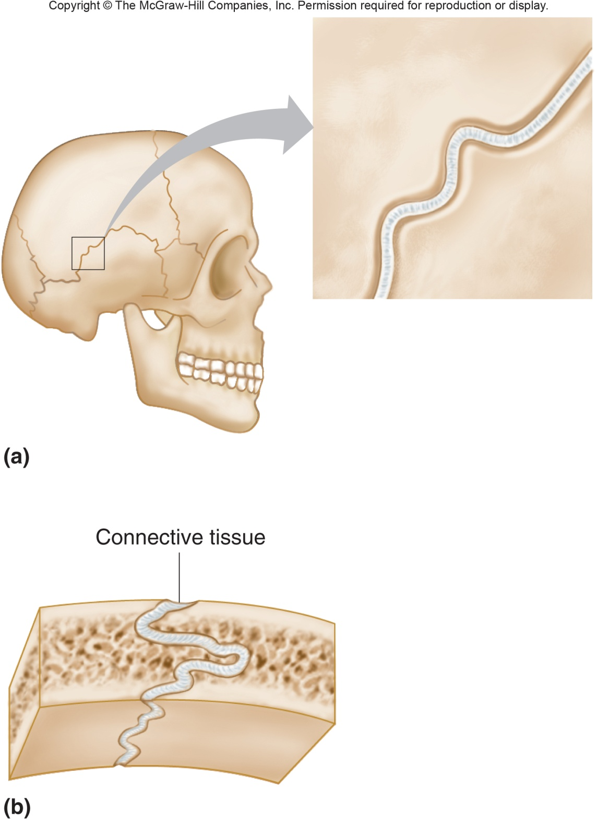
Fibrous joints
Sutures are only between flat bones of the skull.
A sutural ligament is a thin layer of dense connective tissue that joins flat bones of the skull together.
Fontanels allow the skull to change shape slightly during childbirth.
An example of a suture is the parietal suture.
Sutures = synarthrotic.

Slide 7
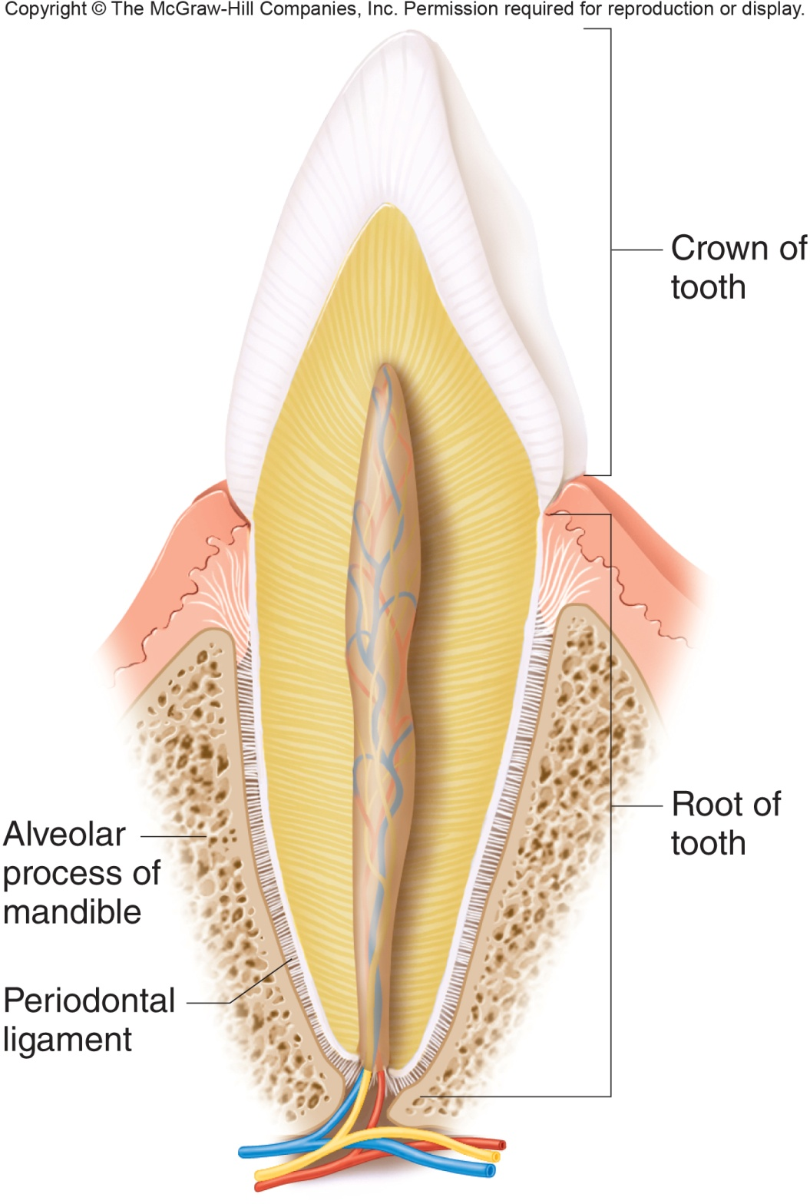
Fibrous joints
Gomphosis is a joint formed by the union of a cone-shaped bony process in a bony socket.
An example of a gomphosis is a tooth in a socket.
A periodontal ligament is a structure that firmly attaches a tooth to the jaw.
Gomphosis = synarthrotic

Slide 8
Cartilaginous joints
Bones of cartilaginous joints are joined by hyaline cartilage or fibrocartilage.
Two types of cartilaginous joints are:
synchondroses, and symphyses.

Slide 9
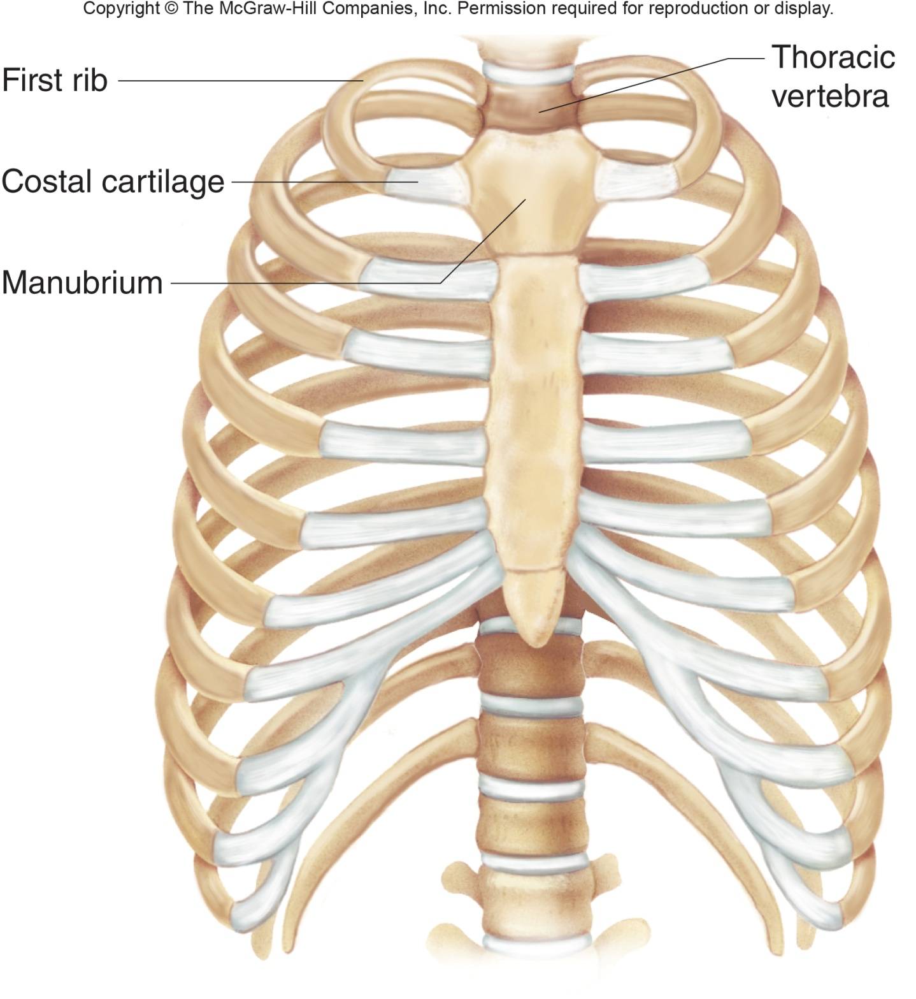
Cartilaginous joints
Synchondrosis, bands of hyaline cartilage unite bones.
Many synchondrosis are temporary structures and disappear during growth.
Two examples of synchondrosis are epiphyseal plates and the joint between the first rib and manubrium.
Synchondrosis = synarthrotic.

Slide 10
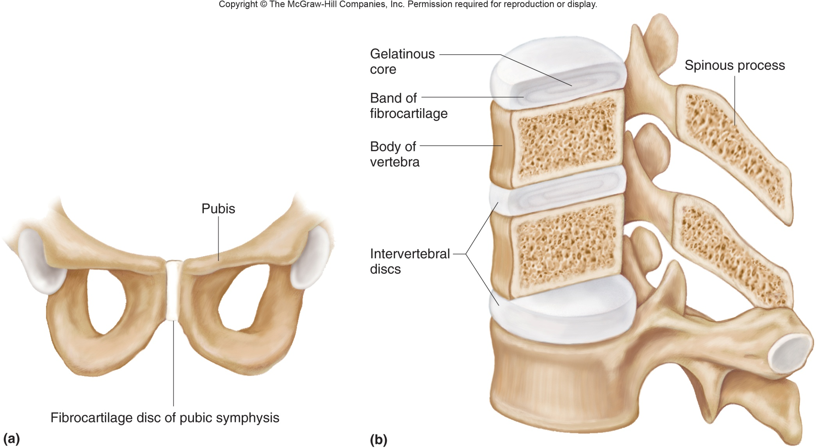
Cartilaginous joints
Symphysis: the articular surfaces of bones are covered with a thin layer of hyaline cartilage and the cartilage is attached to a pad of springy fibrocartilage.
Two examples of symphysis are the symphysis pubis and intervertebral joints
Symphysis = amphiarthrotic

Slide 11
Synovial Joints
Most joints are synovial.
Synovial joints = diarthrotic.
Synovial joints consist of articular cartilage, a joint capsule, and a synovial membrane.

Slide 12
Synovial Joints
General Structure of a Synovial Joint
Articular cartilage is a thin layer of hyaline cartilage that covers the ends of bones.
The joint capsule holds together the bones of a synovial joint.
The outer layer of the joint capsule consists of dense connective tissue.

Slide 13
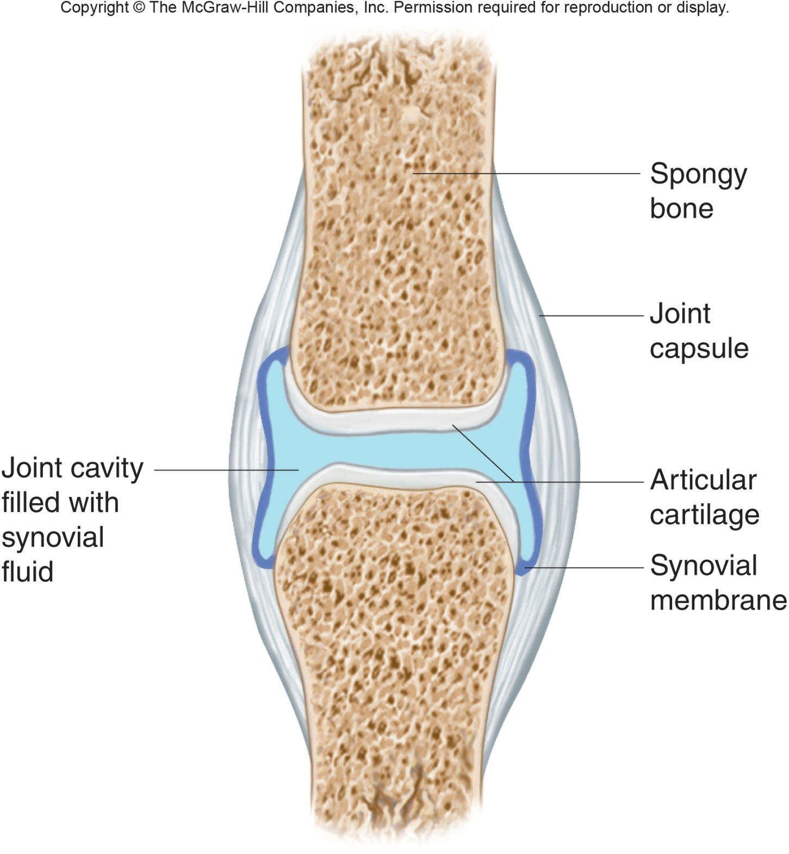
Synovial Joints
General Structure of a Synovial Joint
Ligaments reinforce the joint capsule.
The inner layer of the joint capsule consists of a synovial membrane.
The synovial membrane is a shiny, vascular layer of loose connective tissue.

Slide 14
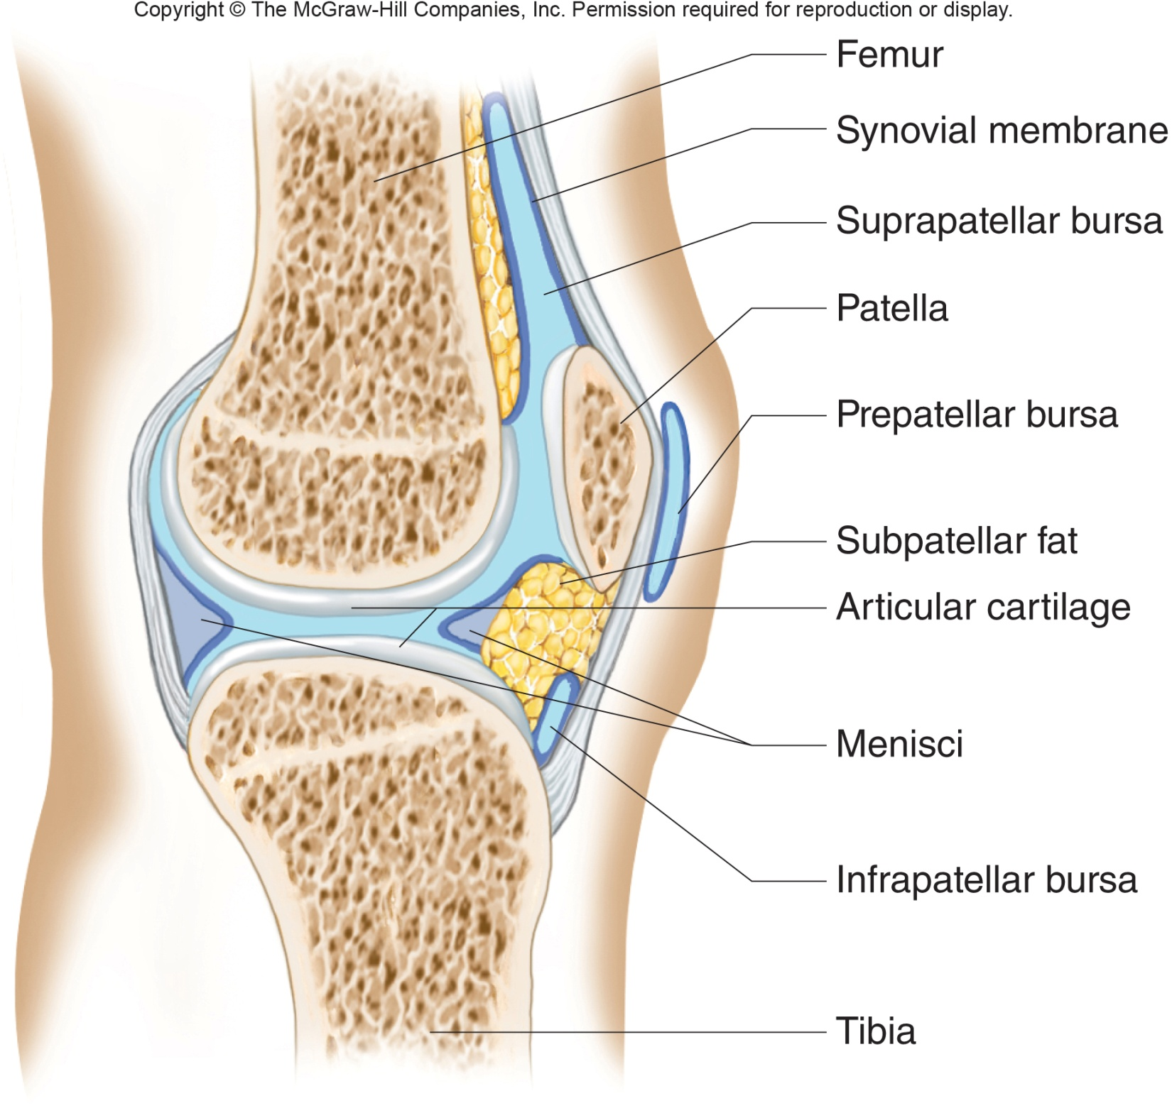
Synovial Joints
General Structure of a Synovial Joint
Synovial fluid comes from the synovial membrane.
The synovial membrane secretes synovial fluid and also stores adipose tissue to form movable fatty pads with the joint.
Synovial fluid is like uncooked egg white and functions to lubricate the cartilaginous surfaces within the joint.

Slide 15
Synovial Joints
General Structure of a Synovial Joint
Bursae are fluid filled sacs associated with synovial joints.
located between the skin and underlying bony prominences.
Bursae function to cushion and aid the movement of tendons that glide over bony parts or over other tendons.
The names of bursae reflect locations.
Menisci - discs of fibrocartilage.
Menisci function to cushion articulating surfaces.

Slide 16
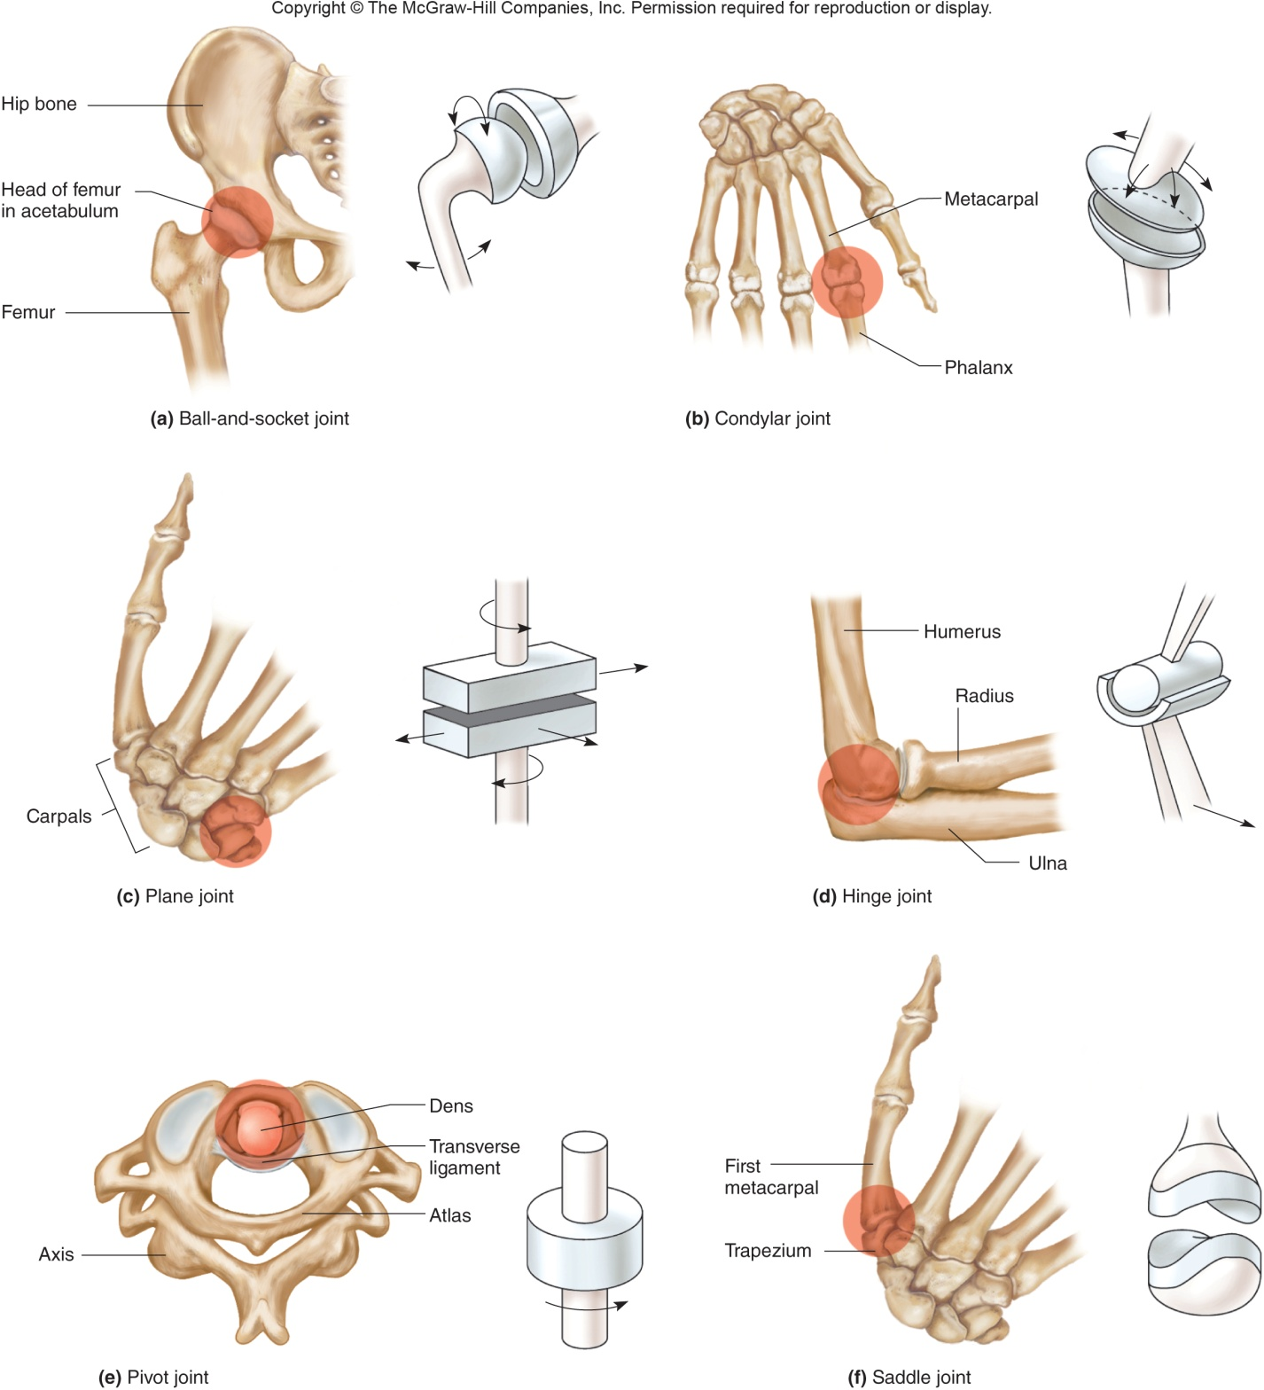
Synovial Joints
Types of a Synovial Joint
The six major types of synovial joints are ball-and-socket, condylar, plane, hinge, pivot, and saddle.

Slide 17
Synovial Joints
Types of a Synovial Joint
A ball-and-socket joint consists of a bone with a globular head that articulates with a cup-shaped cavity of another bone.
A ball-and-socket joint allows a wider range of motion than any other type of joint.
Examples of ball-and-socket joints: hip joint and shoulder joint.

Slide 18
Synovial Joints
Types of a Synovial Joint
The structure of a condylar joint is an ovoid condyle of one bone fitting into the elliptical cavity of another bone.
Example of a condylar joint: between the metacarpals and phalanges.
Plane joints have articulating surfaces that are nearly flat or slightly curved.
Examples of plane joints: joints within the wrists and ankles.

Slide 19
Synovial Joints
Types of a Synovial Joint
The structure of a hinge joint is a convex surface of one bone fitting into the concave surface of another bone. One way movement.
Example of a hinge joint: elbow joint.
The structure of a saddle joint is a convex and concave surface of one bone articulating with a concave and convex surface of another bone. Multi plane movement.
Example of a saddle joint is the joint between the trapezium and the metacarpal of the thumb

Slide 20
Synovial Joints
Types of a Synovial Joint
The structure of a pivot joint is a cylindrical surface of one bone rotating within a ring formed of bone and a ligament.
Examples of pivot joints:
joint formed between the proximal ends of the radius and ulna
joint between the dens of the axis and ring of the atlas.

Slide 21
Synovial Joints
Joint movements (Refer to figures 8.11 &8.12 pg. 277-278)
An insertion of a muscle is its movable end.
The origin of a muscle is its fixed end.
Flexion is bending of a body part.
Extension is straightening of a body part.
Hyperextension is excess extension of a body part beyond the anatomical position.

Slide 22
Synovial Joints
Joint movements (Refer to figures 8.11 &8.12 pg. 277-278)
Dorsiflexion is movement at ankle that brings the foot closer to the shin.
Plantar flexion is movement at ankle that brings the foot farther from the shin.
Abduction is moving a part away from the midline of the body.
Adduction is moving a part toward the midline of the body.

Slide 23
Synovial Joints
Joint movements (Refer to figures 8.11 &8.12 pg. 277-278)
Circumduction is moving a body part in a circular path.
Supination is turning the palm of the hand up.
Pronation is turning the palm of the hand down.
Eversion is turning the foot laterally with the sole flattening.
Rotation is moving a body part around an axis; also known as twisting.

Slide 24
Synovial Joints
Joint movements (Refer to figures 8.11 &8.12 pg. 277-278)
Inversion is turning the foot medially with the sole raising.
Protraction is moving a body part forward.
Retraction is moving a body part backward.
Elevation is raising a body part.
Depression is lowering a body part.

Slide 25
Synovial Joints
Example of synovial joints
Shoulder joint
Hip Joint
Elbow joint
Knee joint
*Be able to classify the joint type for each joint and know main structures contained, not specific names

Slide 26
Life span changes
Changes in collagen lie behind joint stiffness.
The fibrous joints are the first to change.
Synchondroses that connect epiphyses to diaphyses in long bones disappear as the skeleton grows.

Slide 27
Life span changes
Ligaments lose their elasticity as collagen fibers become more tightly cross-linked.
In the intervertebral discs, less water diminishes the flexibility of the vertebral column and impairs the ability of the discs to absorb shocks.
Loss of function of synovial joints begins in the third decade of life.

