Slide 1
Ch. 9 Muscles

Slide 2
Introduction
All movements require muscle
Muscular actions also provide muscle tone, propel body fluids and food, generate the heartbeat, and distribute heat.
Three types of muscle are:
Skeletal
Smooth
Cardiac

Slide 3
Structure of skeletal Muscle Connective Tissue
A skeletal muscle is composed of skeletal muscle tissue, nervous tissue, blood, and connective tissues
Fascia is dense connective tissue that separates individual skeletal muscles.
A tendon is a cordlike structure that consists of dense connective tissue. Tendons connect a muscle to a bone.
An aponeurosis is a sheet-like structure composed of dense connective tissue

Slide 4
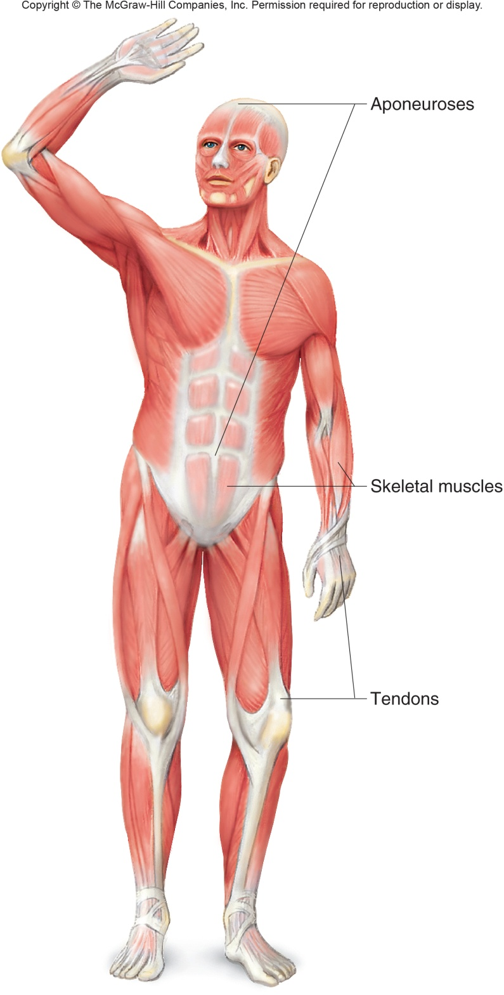

Slide 5
Structure of Skeletal Muscle Connective Tissue
Epimysium is a layer of connective tissue that closely surrounds a skeletal muscle.
Perimysium is connective tissue that separates muscles into fascicles.
A fascicle is a section of a muscle.
Endomysium is connective tissue that surrounds individual muscle cells.

Slide 6
Structure of Skeletal Muscle Connective Tissue
Deep fascia is fascia that surrounds or penetrates muscles.
Subcutaneous fascia is fascia just beneath the skin.
Subserous fascia is a connective tissue layer of the serous membranes covering organs in various body cavities and lining those cavities.

Slide 7
Structure of Skeletal Muscle Muscle Fibers
A skeletal muscle fiber is a single muscle cell.
The sarcolemma is the cell membrane of a muscle cell.
The sarcoplasm is the cytoplasm of a muscle cell.
The sarcoplasm contains many small nuclei, mitochondria, and myofibrils.

Slide 8
Structure of Skeletal Muscle Muscle Fibers
Myofibrils are threadlike structures and are located in the sarcoplasm.
Myofibrils play a fundamental role in the muscle contraction mechanism.
Thick myofilaments are composed of myosin.
Thin myofilaments are composed of actin.

Slide 9
Structure of Skeletal Muscle Muscle Fibers
Myofibrils are threadlike structures and are located in the sarcoplasm.
Myofibrils play a fundamental role in the muscle contraction mechanism.
Thick myofilaments are composed of myosin.
Thin myofilaments are composed of actin.
The organization of myofilaments produces the alternating light and dark striation characteristic of skeletal muscles.

Slide 10
Structure of Skeletal Muscle Muscle Fibers
A sarcomere is a repeating pattern of a myofibril.
Myofibrils may be thought of as sarcomeres joined end to end.
Sarcomere is the functional unit of muscle
Myofibril is the contractile thread that extends the length of the muscle fiber

Slide 11
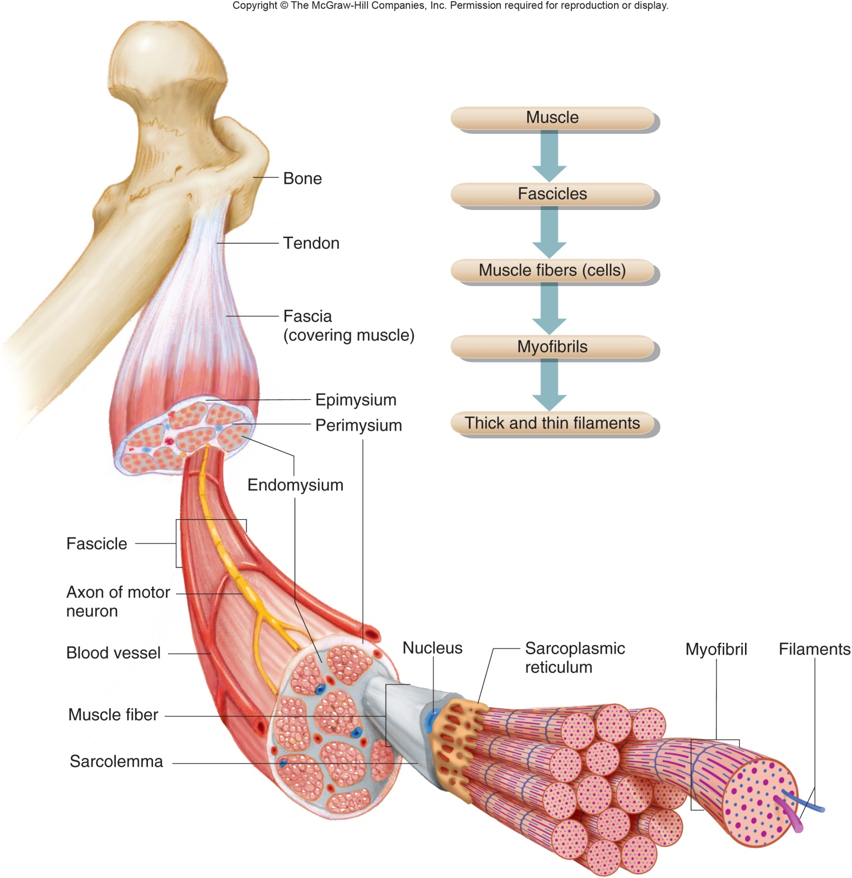
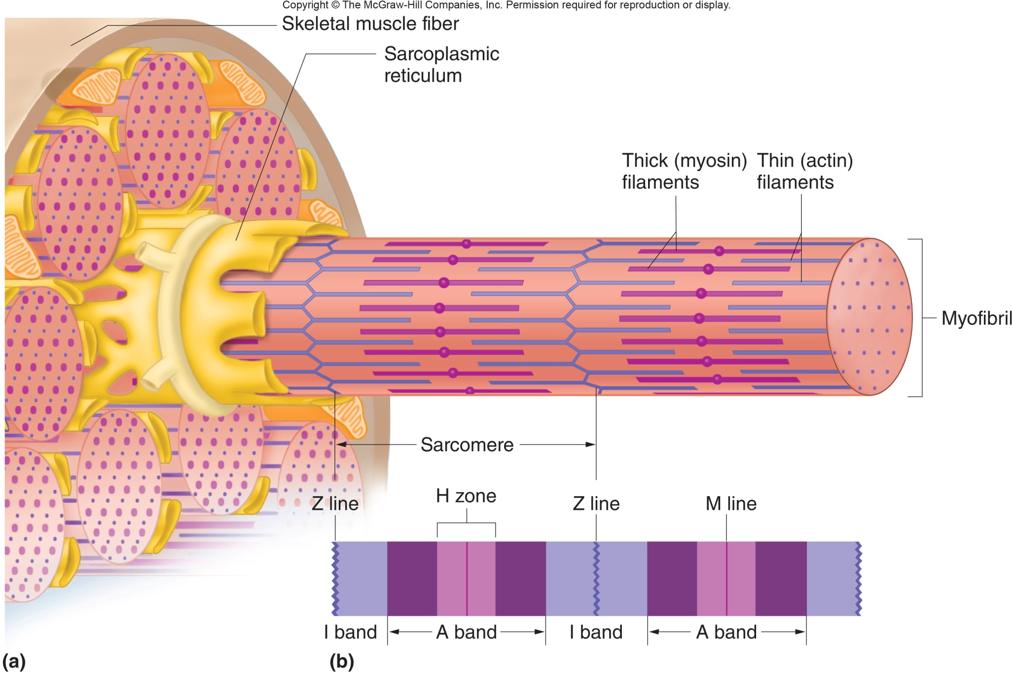
Fig. 9.2

Slide 12
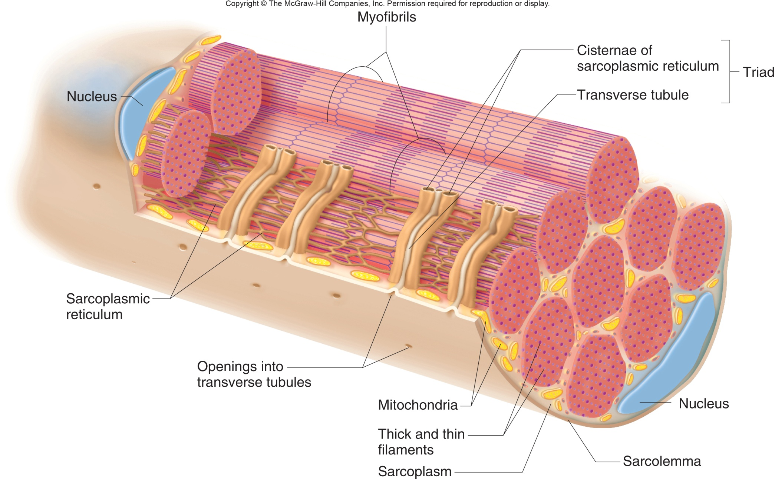

Slide 13
Skeletal Muscle Contraction-Neuromuscular Junction
Each skeletal muscle is functionally connected to an axon of a motor neuron.
Motor neurons stimulate muscle fibers to contract by conducting electrical impulses called action potentials
A neuromuscular junction is the site where an axon and muscle fiber meet.
A motor unit is a motor neuron and the muscle fibers it controls.

Slide 14
Skeletal Muscle Contraction-Neuromuscular Junction
A synaptic cleft separates the membranes of the neuron and the membrane of the muscle fiber.
Synaptic vesicles store neurotransmitters.
The functional connection between a neuron and a skeletal muscle fiber is a synaptic cleft

Slide 15
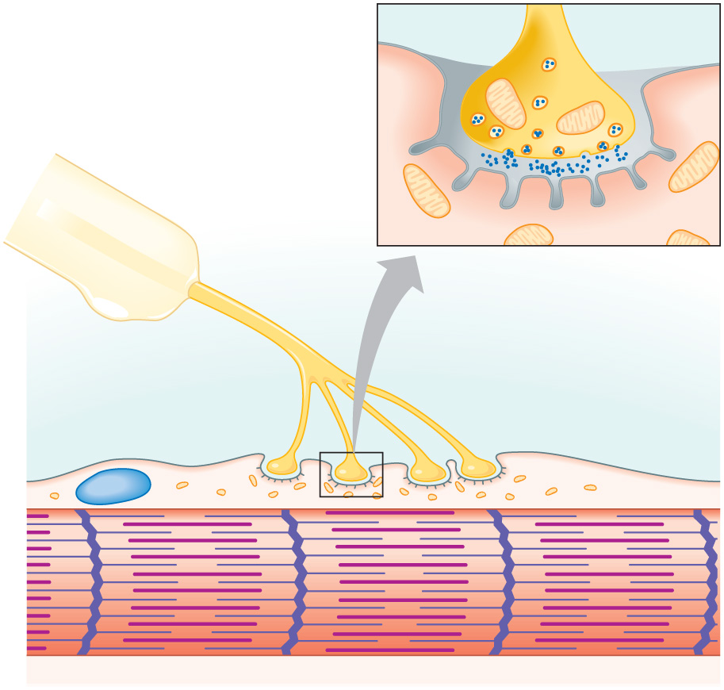
Skeletal Muscle Contraction-Neuromuscular Junction
Synaptic
vesicles
Mitochondria
Motor
neuron axon
Acetylcholine
Synaptic
cleft
Folded
sarcolemma
Axon branches
Motor
end plate
Muscle fiber
nucleus
Myofibril of
muscle fiber

Slide 16
Skeletal Muscle Contraction-Stimulus for contraction
Acetylcholine( ACh) is the neurotransmitter that motor neurons use to control skeletal muscle.
Acetylcholine:
is the neurotransmitter at the neuromuscular junction.
is broken down by acetylcholinesterase.
binds to receptors on the muscle cell membrane.
causes an influx of sodium ions into the muscle cell when bound to its receptor.
In response to an action potential ACh is released and stimulates the muscle fiber

Slide 17
Skeletal Muscle Contraction-Excitation contraction coupling
The sarcoplasmic reticulum has a high concentration of calcium.
A muscle impulse signals the sarcoplasmic reticulum to release calcium ions
Calcium ions bind to troponin, causing the tropomyosin to shift and expose active sites on the actin for myosin binding
Cross-bridges form between myosin and actin, and actin filaments move inward, shortening the sarcomere

Slide 18
Skeletal Muscle Contraction-Excitation contraction coupling (1-3)

Slide 19
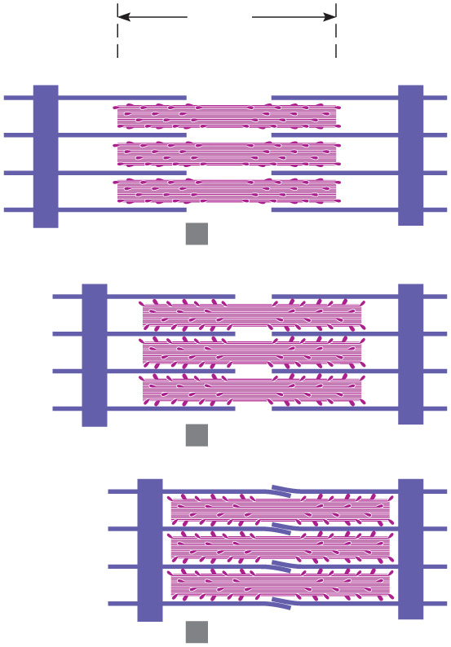
Skeletal Muscle Contraction-Sliding Filament Model
According to the sliding filament model, when sarcomeres shorten, the thick and thin filaments slide past one another.
Z line
A band
Z line
Thin
filaments
1
Relaxed
Thick
filaments
2
Contracting

Slide 20
Skeletal Muscle Contraction-Cross bridge cycling
A myosin head can attach to an actin binding site to form a cross bridge.
This pulls on the actin filament
The myosin head can then release the actin and attach to another active site binding site farther down the actin filament and pull again.
The breakdown of ATP releases energy that provides the repetition of the cross bridge cycle

Slide 21
Skeletal Muscle Contraction-Cross bridge cycling (3-6)

Slide 22
Skeletal Muscle Contraction-Relaxation
Acetycholinesterase breaksdown ACh, which prevents a single nerve impulse from continuously stimulating a muscle fiber.
Muscle fiber relaxes when calcium ions are transported back into the sarcoplasmic reticulum through active transport
Cross bridges break and do not reform causing the muscle to relax

Slide 23
Skeletal Muscle Contraction

Slide 24
Skeletal Muscle Contraction-Energy
ATP supplies energy for muscle contraction and relaxation
Creatine phosphate is an energy source available to generate ATP from ADP.
Creatine phosphate includes a high energy phosphate bond.
As ATP is decomposed to ADP, the energy from creatine phosphate is transferred back to ADP to produce ATP.
After creatine phosphate is used, a muscle cell must depend on cellular respiration of glucose to synthesize ATP.

Slide 25
Skeletal Muscle Contraction-Oxygen supply
Aerobic respiration requires oxygen and yields lots of ATP
Anaerobic respiration does NOT require oxygen and yields few ATP
Lactic acid starts to fill your muscles when the body switches from aerobic to anaerobic respiration
Myoglobin in muscle cells temporarily stores some oxygen

Slide 26
Skeletal Muscle Contraction-Oxygen Debt
Lactic acid threshold is the shift in cellular respiration from aerobic to anerobic respiration.
Lactic acid is carried by the blood to the liver and the liver cells can convert lactic acid to glucose.
Oxygen debt is the amount of oxygen liver cells require to use the accumulated lactic acid to produce glucose or gylcogen and to restore supplies of ATP and creatine phosphate

Slide 27
Skeletal Muscle Contraction-Muscle Fatigue
Fatigue is the condition in which a muscle fiber cannot contract.
Fatigue occurs when muscle cell pH decreases
A cramp is a sustained, painful, involuntary muscle contraction.

Slide 28
Skeletal Muscle Contraction-Muscle Fatigue
Fatigue is the condition in which a muscle fiber cannot contract.
Fatigue occurs when muscle cell pH decreases
A cramp is a sustained, painful, involuntary muscle contraction.
Due to temporary deficit of ATP

Slide 29
Skeletal Muscle Contraction-Muscle Fatigue
Fatigue is the condition in which a muscle fiber cannot contract.
Fatigue occurs when muscle cell pH decreases
A cramp is a sustained, painful, involuntary muscle contraction.
Due to temporary deficit of ATP

Slide 30
Skeletal Muscle Contraction-Recording Muscle contraction
A twitch is the result of a single muscle contraction
An isotonic contraction is a type of contraction that produces movement of a body part.
An example of an isotonic contraction is walking.
An isometric contraction is a contraction in which muscle tension increases but no movements of body parts are produced.
An example of an isometric contraction is standing.

Slide 31
Skeletal Muscle Contraction-Recording Muscle contraction
Muscle tone is a continuous state of partial muscle contraction and helps to maintain posture
At increasing intensities of stimulation other motor units are recruited until the muscle contracts with maximal tension.
Lifting heavier thing=recruit more muscle fibers

Slide 32
Other types of Muscle
Smooth muscle and cardiac muscle are the two other types of muscle
Both are involuntary
Smooth: compared to skeletal muscle fibers, smooth muscle fibers are shorter, and they have single nuclei.
located in the walls of hollow organs except for the heart, in the irises and the walls of blood vessels.
Cardiac: Posses striations like skeletal, has a branched structure and contains intercalated discs to hold muscle cells together
Found in the heart

