Slide 1
Ecology

Slide 2
What is ecology?
Ecology is the study of how organisms react with one another and their environment.

Slide 3
Environmental Factors
Biotic factors are living factors in an organism’s environment.
What might some of these be?

Slide 4
Environmental Factors
Abiotic factors are nonliving factors in an organism’s environment
What might some of these be?

Slide 5
Terms to know
Species: group of organisms capable of interbreeding and producing fertile offspring
Population: group of organisms from the same species in the same place at the same time.
Community: a group of populations in the same place at the same time.

Slide 6
Examples
red squirrel- species
A bunch of red squirrels living in the forest behind your house- population
A bunch of red squirrels, coyotes, wood peckers and salamanders living in the forest behind your house- community

Slide 7
What do communities create?
Ecosystem: community and all of the abiotic factors that affect it.
Biome: a large group of ecosystems that share the same climate and have similar types of communities

Slide 8
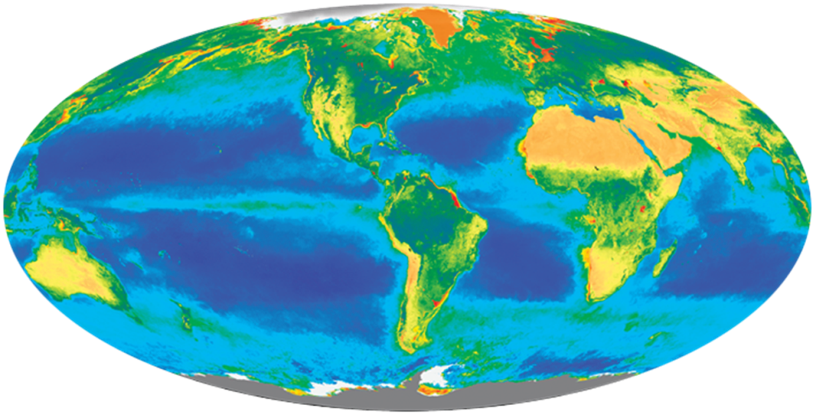
Biosphere
A thin layer around Earth that supports life
Extends a few km above and below the earth’s surface
Includes all biomes

Slide 9
Classifying Organisms
Consumers: organisms that must consume (eat) food to get their energy.
Producer: organisms that make their food to get energy.
Decomposer: organisms that eat dead or decaying organisms for energy.

Slide 10
Classifying Organisms
Herbivores: organisms that consume plants for energy.
Omnivore: organisms that consume plants and other animals for energy.
Carnivore: organisms that consume other animals for energy.

Slide 11
“Fitting in” in the ecosystem
Habitat- place where an organism lives
Mr. Carter’s habitat during the school day is him science classroom.
Niche-role or job, of an organism in the ecosystem.
EX. Mr. Carter’s role in the school is to teach you about science.

Slide 12
Symbiosis
Symbiosis is the interactions between two different species.
Mutualism: is an interaction between two species in which both species benefit
Commensalism: interaction between two species in which one species benefits and the other neither benefits nor is harmed
Parasitism: interaction between two species in which one species benefits while the other is harmed.

Slide 13
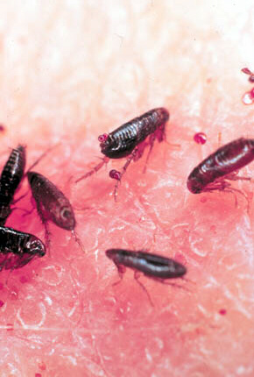
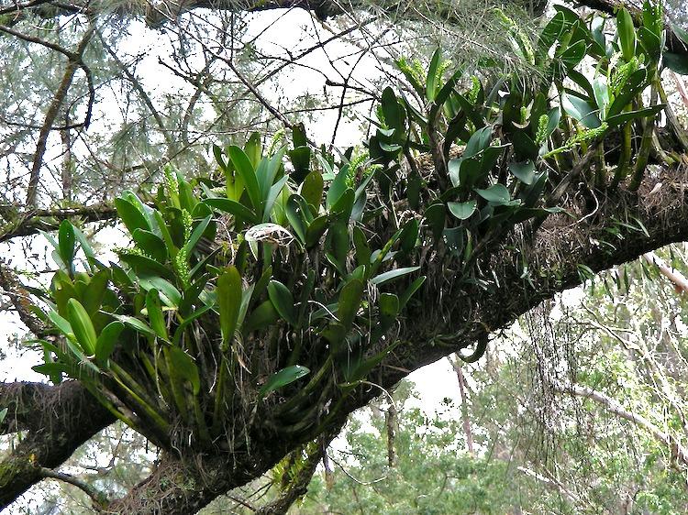

Slide 14
Competition
Competition: when two species compete (try to get) the same resource. Examples of resources that are competed for include food, shelter, habitat and mates.
Native species: a species that is naturally found in an ecosystem
Invasive species: a non native species. A species that has been introduced into an ecosystem different from where that species is naturally from.

Slide 16
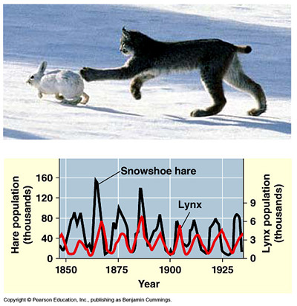
Predation
Predation—one organism captures and feeds on another organism
Predator—one that does the killing
Prey—one that is the food

Slide 17
Characteristics of population
Population Density- number of organisms in a population that occupy a definite area.
Ex. MI-175 people/square mile;
U.S.- 88 people/square mile
Limiting Factors- any abiotic or biotic factors that limits the number of organisms in a population.
What might some of these be?

Slide 18
Characteristics of population
Carrying capacity- the largest number of organisms of a species that an environment can support and maintain for a long period of time.
What are some limiting factors that have an influence on carrying capacity?

Slide 19
Changing ecosystems
Succession- when ecosystems change naturally over time.
Pioneer Species- First species to start inhabiting an area after change has occurred. (Ex. lichens)
Ecosystems can change naturally(succession) or can be altered by humans.
Human intervention can sometimes restore a ecosystem that has been damaged by nature or humans.

Slide 20
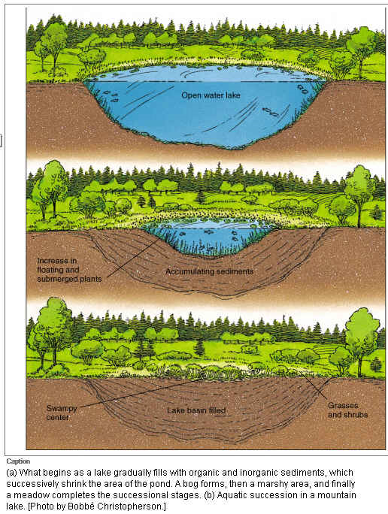
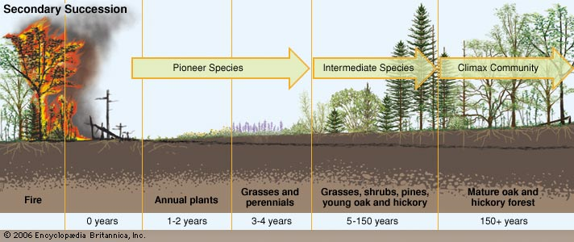
Changing ecosystems

Slide 21
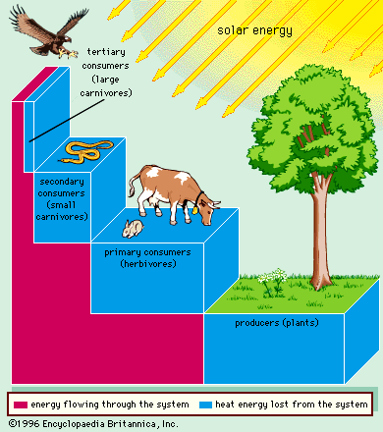
Energy Flow in Ecosystems
Law of conservation of energy- energy is conserved, it can NOT be created or destroyed, it is just converted from one form to the other.

Slide 22
Energy Flow in Ecosystems

Slide 23
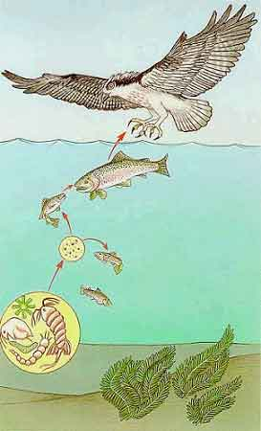
Energy Flow in Ecosystems
Food chains: A simple model that shows how energy flows through an ecosystem

Slide 24
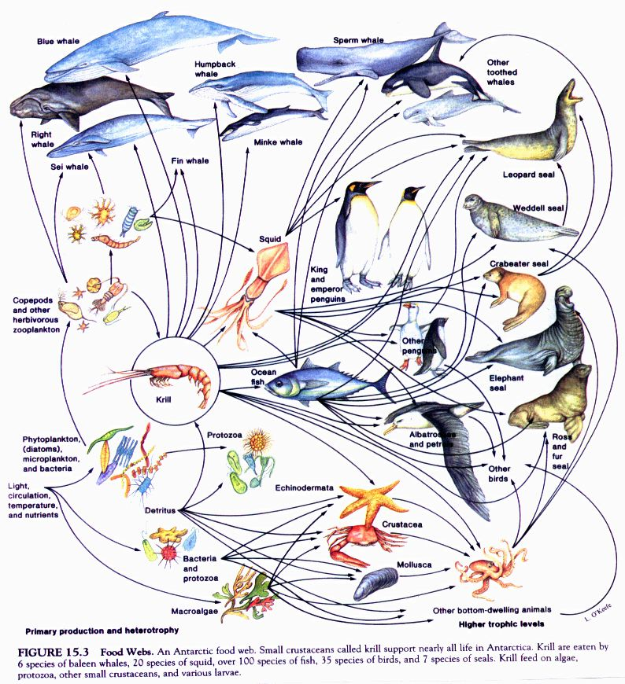
Energy Flow in Ecosystems
Food webs: A model representing the many interconnected food chains and pathways in which energy flows.

Slide 25
Environmental Concerns in Ecosystems
Biomagnification: refers to the accumulation of substances, such as pesticides, or other chemicals in an organism.

Slide 26
Environmental Concerns in Ecosystems
Habitat destruction:
Human impacts and natural disasters
Runoff: Leads to coastal dead zones, eutrophication and general poisoning.
Dead zones and eutrophication are the result of extreme algae growth and then die off. Bacteria decomposing algae use up all dissolved oxygen in the water. NO OXYGEN= NO LIFE
Fossil Fuel Pollution: Acid rain, increased green house gases and environmental contamination
Resource use and abuse: overfishing/hunting, littering/dumps, deforestation.

Slide 27
Nutrient Cycles
Cycling matter maintains homeostasis in the environment.
3 cycles to investigate:
1. Water cycle
2. Carbon cycle
3. Nitrogen cycle

Slide 28
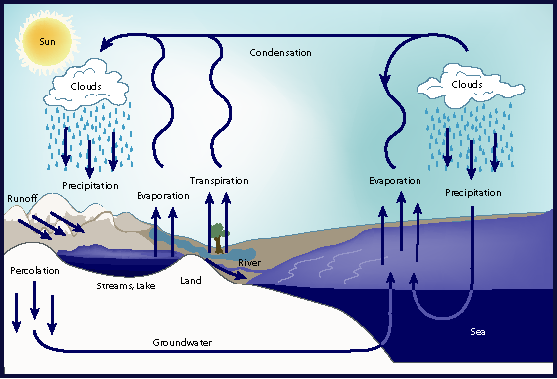
Water Cycle
Evaporation, transpiration, condensation, precipitation, runoff

Slide 29
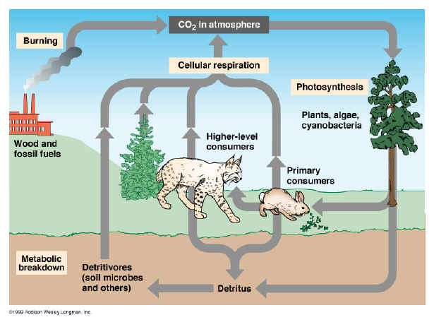
Carbon Cycle
Photosynthesis and respiration cycle carbon and oxygen through the environment

Slide 30
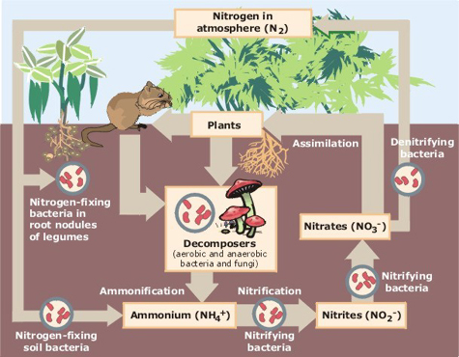
Nitrogen Cycle
Atmospheric nitrogen (N2) makes up nearly 78%-80% of air.
Organisms can not use it in that form.
Lightning and bacteria convert nitrogen into usable forms.

