Slide 1
Endocrine
Function:
Produces hormones that communicate between cells.
Structure:
Hormones, Pituitary gland, hypothalamus, adrenal glands, thyroid gland, ovaries and testies

Slide 2
Endocrine
Hormones: are chemical messengers that are secreted directly into the blood
Steroid and Non-steroid
Pituitary gland: Pea sized. Secretes a wide variety of hormones, many of which control other endocrine glands
Hypothalamus: In Brain. Provides a link between the nervous and endocrine systems. Produces hormones that directly regulate body processes

Slide 3
Endocrine
Adrenal glands: Located above the kidneys. Secretes hormones which helps the body deal with stress, helps regulate the balance of minerals in the body and secretes fight-or-flight hormones such as adrenaline.
Thyroid gland: large gland in the neck. Thyroid hormones increase the rate of metabolism in cells throughout the body.
Ovaries: secrete the female sex hormone estrogen
Testes: secrete the male sex hormone testosterone

Slide 4
Reproductive
Function:
Produces gametes (sex cells) and sex hormones
Structure:
Female: uterus; vagina; fallopian tubes; ovaries
Male: penis; testes; seminal vesicles

Slide 5
Reproductive
Female:
Uterus: Muscular organ shaped like an upside-down pear. During birth, contractions of the muscular walls of the uterus push the baby out of the body
Vagina: Tube-like structure about 3.5 inches long. Receives sperm during sexual intercourse, and it provides a passageway for a baby to leave the mother’s body during birth
Fallopian tubes: Tubes that allows eggs to move towards the uterus
Ovaries: Small, egg-shaped organs that lie on either side of the uterus. They produce eggs and secrete estrogen

Slide 6
Reproductive
Male:
Penis: External genital organ, secretes urine and semen
Testes: Located in scrotum just behind the penis. Produce sperm and secrete testosterone.
Seminal vesicles: Ducts that transport sperm from the epididymis to the urethra in the penis

Slide 7
Respiratory
Function:
Brings air to sites where gas exchange can occur between the blood and cells around the body or blood and air in the lungs.
Structure:
Trachea, larynx, pharynx, lungs

Slide 8
Respiratory
Trachea: Wide pipe; allows air to enter and leave the lungs
Larynx: Voice box, located just above your wind pipe
Pharynx: Passage between nasal cavity, oral cavity and trachea
Lungs: Sac like structure that expand to fill with air
Contain tree branch like structures and specialized structures called alveoli for gas exchange.
Diaphragm: Large Muscle that pulls on chest cavity to make it expand

Slide 9
Urinary
Function:
Removes extra water, salts, and waste products from blood and body
Controls pH; controls water and salt balance.
Structure:
Kidneys, urinary bladder and urethra

Slide 10
Urinary
Kidneys: pair of bean-shaped organs just above the waist. Functions to produce hormones, absorbing minerals, and filtering blood and producing urine.
Functional unit of the kidney, that removes waste from the blood is the nephron
Urinary bladder: hollow, sac-like organ that stores urine
Urethra: muscular tube that carries urine out of the body

Slide 11
Nervous
Function:
Collects, transfers and processes information
Structure:
Brain, spinal cord and neurons

Slide 12
Nervous
Two Structural Divisions-
Central Nervous System (CNS)
Brain and Spinal Cord
Peripheral Nervous System (PNS)
Nerves that connect all parts of the body to the brain
Two Motor Divisions-
Autonomic Nervous System (ANS)
Conducts nerve impulses from CNS to organs and glands
Somatic Nervous System (SNS)
Conducts nerve impulses from CNS to muscles (Voluntary control)

Slide 13
Nervous
Brain: most complex organ of the human body and the control center of the nervous system.
Controls such mental processes as reasoning, imagination, memory, and language. Interprets information from the senses. Controls basic physical processes such as breathing and heartbeat.
Spinal cord: a thin, tubular bundle of nervous tissue that extends from the brainstem and continues down the center of the back to the pelvis.
Serves as an information superhighway, passing messages from the body to the brain and from the brain to the body.
Neurons: structural and functional units of the nervous system. They transmit electrical signals, called nerve impulses (electrical impulses)

Slide 14
Immune
Function:
Defends against diseases
Structure:
Bone marrow, spleen and white blood cells

Slide 15
Immune
Pathogens: disease-causing agents

Slide 16
Immune
Bone marrow: soft connective tissue in bones that contains stem cells for blood cell formation
Red marrow- red blood cells, white blood cells and platelets form here
Yellow marrow- stores fat and does not produce blood cells
Spleen: creates red blood cells and store large amounts of red an white blood cells
White blood cells: (leukocytes) are involved in protecting the body against both infectious disease and foreign invaders
Many different kinds:
B cells: releases antibodies and assists activation of T cells
T cells: killer cells that attack and kill diseases

Slide 17
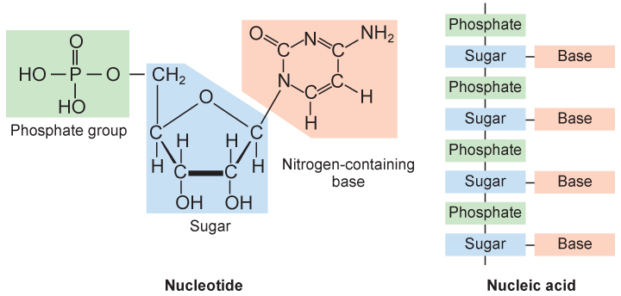
DNA Structure=Proteins
Nucleic Acids made of smaller repeating molecules called nucleotides.
Store, transmit, and express hereditary/genetic information(instructions to make proteins).
Nucleotides molecules composed of carbon, nitrogen, oxygen, phosphorus, and hydrogen atoms arranged in three groups shown below.

Slide 18
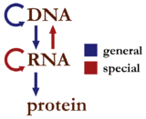
DNA Structure=Proteins
Central Dogma: an explanation of the flow of genetic information within a biological system
Genetic info. stored in DNA codes for proteins
Genes are segments of DNA that code for proteins
Genes can be turned off due a number of things like environmental conditions, pharmaceuticals, hormones and other genes

Slide 19
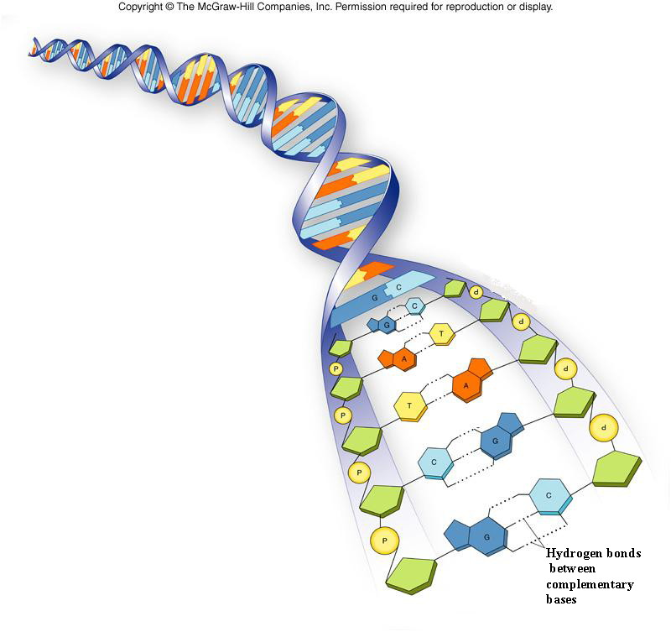
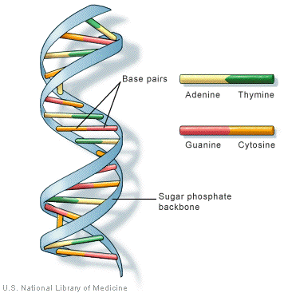
DNA Structure
DNA is called a double helix and often is compared to a twisted ladder.
Rails of the ladder are represented by the alternating: deoxyribose sugar and phosphate.
There are 4 nitrogen bases:
cytosine (C)
guanine (G)
thymine(T)
adenine(A)
The four bases pair up to make the “steps” on the “ladder”
C-G, A-T

Slide 20
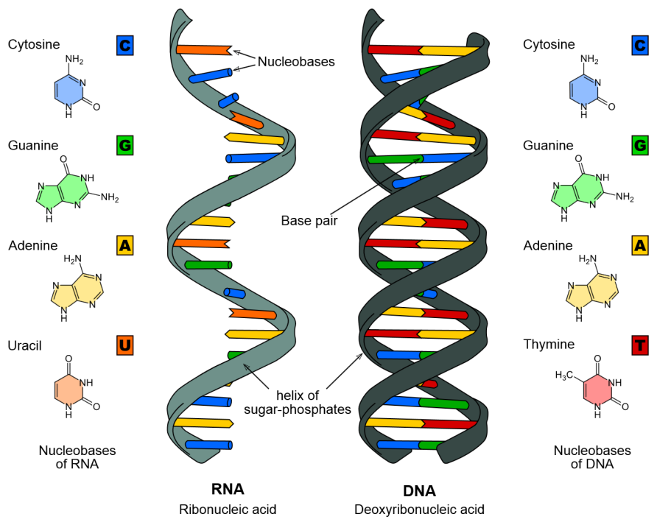
RNA Structure
RNA is usually a single helix or single stranded.
Sides are represented by the alternating: ribose sugar and phosphate.
There are 4 nitrogen bases:
cytosine (C)
guanine (G)
Uracil (U)
adenine(A)
The four bases pair up DNA when RNA is made and other RNA to make proteins
C-G, A-U

Slide 21
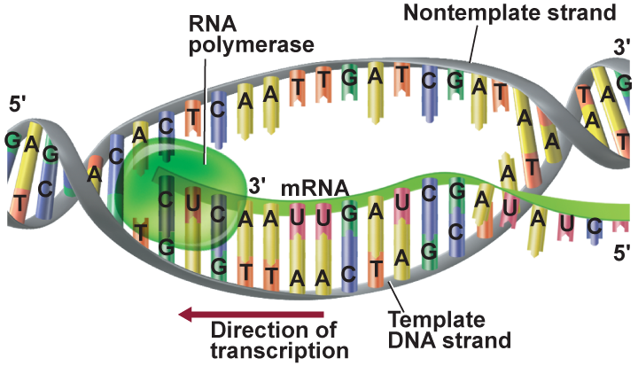
DNA Structure=Proteins
The base pair code in DNA is used to make RNA in a process called transcription.
In RNA thymine is replaced with uracil (T’s are swapped out with U’s) when RNA is synthesized.

Slide 22
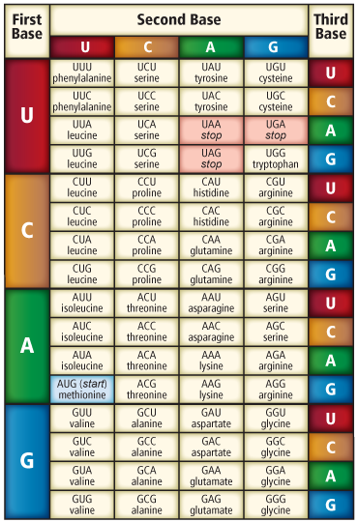
DNA Structure=Proteins
The base code in RNA is used to make polypeptides (chains of amino acids) during a process called translation.
RNA base code is separated into groups of three called codons. Each codon codes for an amino acid.
Polypeptides are eventually turned into proteins.

