Slide 1
How do organisms get energy from food?
Organisms get energy from food by breaking it down to glucose and breaking down glucose to create ATP during cellular respiration.

Slide 2
Cellular Respiration
Inputs: Glucose (sugar) and Oxygen
Outputs: Carbon dioxide, Water and Energy

Slide 3
Cellular Respiration
Cellular respiration occurs in three main parts.
1.Glycolysis- glucose is broken down into pyruvate molecules, 2ATP are produced
Aerobic respiration (requires oxygen)
2. Kreb’s Cycle- Pyruvate is broken down to produce CO₂ and 2 ATP
3. Electron Transport/ Phosphorylation- Oxygen is used and 32-34ATP and water are produced.
36-38 Total ATP Produced

Slide 4
Cellular Respiration
Cellular respiration can also occur without oxygen which is called anaerobic respiration.
2 types of anaerobic pathways that follow glycolysis:
Lactic acid fermentation
Pyruvate (input) is converted into Lactic Acid (output)
Alcohol fermentation
Pyruvate (input) is converted to Ethanol (output)
2ATP is produced in both versions of anaerobic respiration from glycolysis.

Slide 5
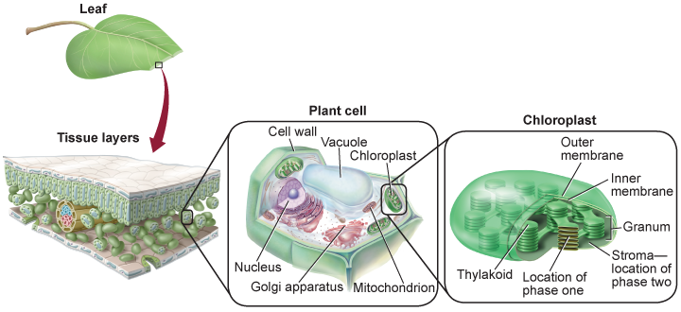
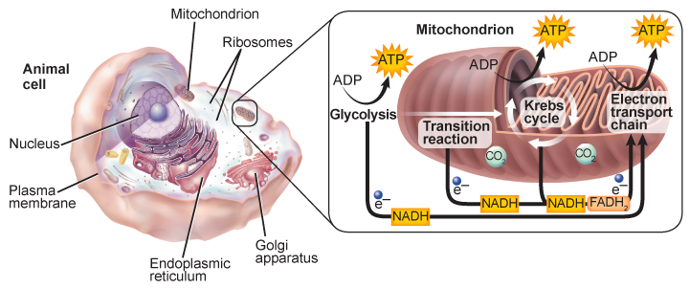
Where does it all happen in the cell?
Photosynthesis occurs in the chloroplasts of cells
Cellular respiration starts in the cytoplasm/cytosol (anaerobic) and then in the mitochondria (aerobic).

