Slide 1
Energy Flow and Matter Cycling in Ecosystems
Ecosystem: a unit of nature and the focus of study in ecology. It consists of all the biotic and abiotic factors in an area and their interactions.
Biotic factors are living factors in an organism’s environment.
Abiotic factors are nonliving factors in an organism’s environment

Slide 2
Energy Flow and Matter Cycling in Ecosystems
In terms of energy flow, ecosystems (earth) is considered to be an open system. This is because there is a consistent input of energy from the sun.
In terms of matter cycling, ecosystems (earth) is considered a closed system because there is not a consistent input of new matter. The matter (atoms) are constantly being recycled.

Slide 3
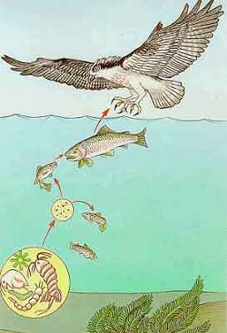
Energy Flow in Ecosystems
Food chains: A simple model that shows how energy flows through an ecosystem

Slide 4
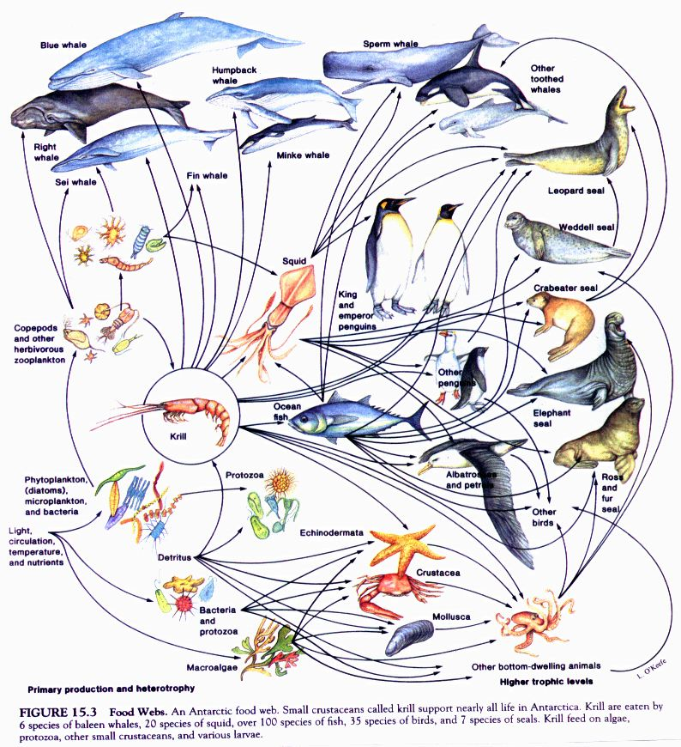
Energy Flow in Ecosystems
Food webs: A model representing the many interconnected food chains and pathways in which energy flows.

Slide 5
Energy Flow in Ecosystems
Trophic levels: The feeding positions in a food chain or web.

Slide 6
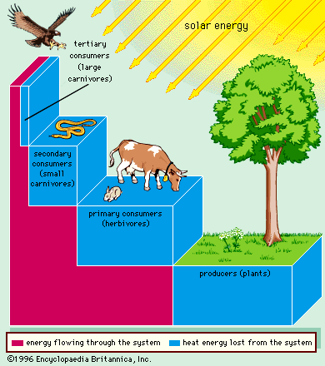
Energy Flow in Ecosystems
Law of conservation of energy- energy is conserved, it can NOT be created or destroyed, it is just converted from one form to the other.
Only about 10% of the energy that moves through the different trophic levels is transferred from organism to organism.
The other 90% is converted into heat and metabolism.

Slide 7
Matter Cycling in Ecosystems
Cycling matter maintains homeostasis in the environment.
3 cycles to investigate:
1. Water cycle
2. Carbon cycle
3. Nitrogen cycle

Slide 8
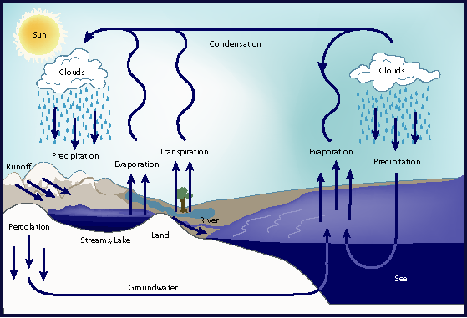
Matter Cycling in Ecosystems
Water Cycle: consists of evaporation, transpiration, condensation, precipitation, runoff

Slide 9
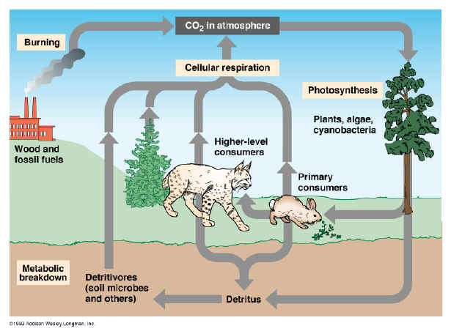
Matter Cycling in Ecosystems
Carbon Cycle: Photosynthesis and respiration cycle carbon and oxygen through the environment

Slide 10
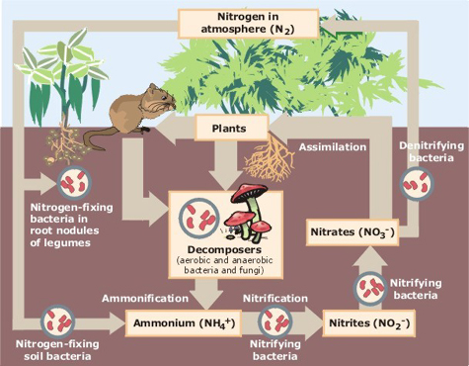
Matter Cycling in Ecosystems
Nitrogen Cycle: Atmospheric nitrogen (N2) makes up nearly 78%-80% of air.
Organisms can not use it in that form.
Lightning and bacteria convert nitrogen into usable forms.

