Slide 1
Interdependent Relationships in Ecosystems

Slide 2
Ecology & Ecosystems
Ecosystem: a unit of nature and the focus of study in ecology. It consists of all the biotic and abiotic factors in an area and their interactions.
Biotic factors are living factors in an organism’s environment.
Abiotic factors are nonliving factors in an organism’s environment
Ecology is the study of how organisms react with one another and their environment.

Slide 3
How Organisms in an Ecosystem are Organized
Species: group of organisms capable of interbreeding and producing fertile offspring
Population: group of organisms from the same species in the same place at the same time.
Community: a group of populations in the same place at the same time.

Slide 4
Examples
red squirrel- species
A bunch of red squirrels living in the forest behind your house- population
A bunch of red squirrels, coyotes, wood peckers and salamanders living in the forest behind your house- community

Slide 5
What do communities create?
Ecosystems and biomes.
Biome: a large group of ecosystems that share the same climate and have similar types of communities
Biosphere: A thin layer around Earth that supports life
Extends a few km above and below the earth’s surface
Includes all biomes

Slide 6
“Fitting in” in the Ecosystem
Habitat- place where an organism lives
E.g. Mr. Carter’s habitat during the school day is his science classroom.
Niche-role or job, of an organism in the ecosystem.
E.g. Mr. Carter’s role in the school is to teach you about science.

Slide 7
Interactions Between Organisms
Symbiosis is the interactions between two different species.
Mutualism: is an interaction between two species in which both species benefit
Commensalism: interaction between two species in which one species benefits and the other neither benefits nor is harmed
Parasitism: interaction between two species in which one species benefits while the other is harmed.

Slide 8
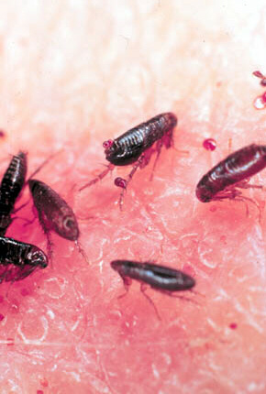
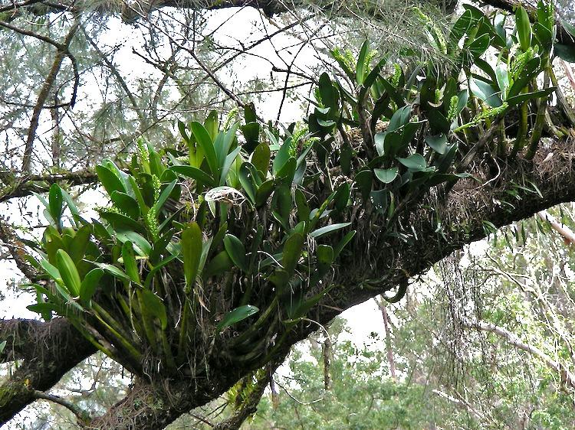
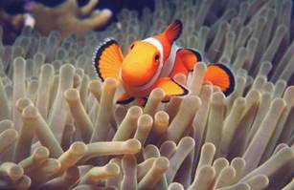
Interactions Between Organisms

Slide 9
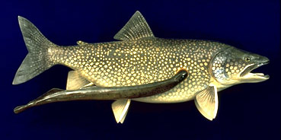
Competition
Competition: when two species compete (try to get) the same resource.
E.g. food, shelter, habitat and mates.
Native species: a species that is naturally found in an ecosystem
Invasive species: a non native species. A species that has been introduced into an ecosystem different from where that species is naturally from.

Slide 10
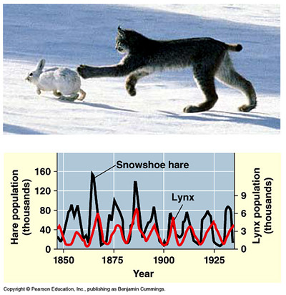
Predation
Predation—one organism captures and feeds on another organism
Predator—one that does the killing
Prey—one that is the food

Slide 11
Characteristics of population
Population Density- number of organisms in a population that occupy a definite area.
Ex. MI-175 people/square mile;
U.S.- 88 people/square mile
Limiting Factors- any abiotic or biotic factors that limits the number of organisms in a population.
What might some of these be?

Slide 12
Characteristics of population
Carrying capacity- the largest number of organisms of a species that an environment can support and maintain for a long period of time.
What are some limiting factors that have an influence on carrying capacity?

Slide 13
Changing ecosystems
Succession- when ecosystems change naturally over time.
Pioneer Species- First species to start inhabiting an area after change has occurred. (Ex. lichens)
Ecosystems can change naturally(succession) or can be altered by humans.
Human intervention can sometimes restore a ecosystem that has been damaged by nature or humans.

Slide 14
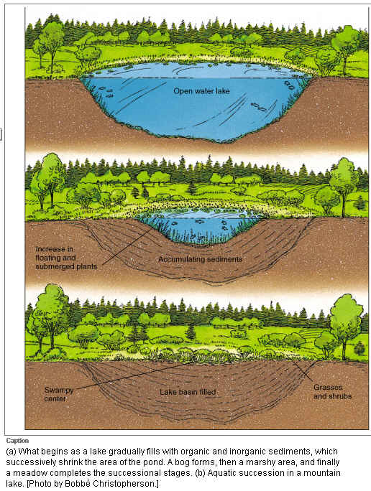
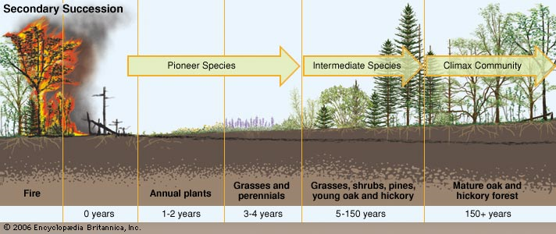
Changing ecosystems

Slide 15
Environmental Concerns in Ecosystems
Habitat destruction:
Human impacts and natural disasters
Runoff: Leads to coastal dead zones, eutrophication and general poisoning.
Dead zones and eutrophication are the result of extreme algae growth and then die off. Bacteria decomposing algae use up all dissolved oxygen in the water. NO OXYGEN= NO LIFE
Industrial Pollution: Acid rain, increased green house gases and environmental contamination
Resource use and abuse: overfishing/hunting, littering/dumps, deforestation, extraction of resources.

Slide 16
Environmental Concerns in Ecosystems
DDT was a pesticide used until the 1970’s and commonly ran off into water supplies. Eagles ingested the chemicals when they ate fish. The chemicals made the eagle eggs soft, so that when the eagles sat on their nests, they would crush their own eggs. This essentially stopped them from reproducing.
Biomagnification- The increase in chemical concentration in animal tissues as the chemical moves up the food chain.

