Slide 1
Chapter 4
Global Climates and Biomes
Friedland and Relyea Environmental Science for AP®, second edition ©2015 W.H. Freeman and Company/BFW
AP® is a trademark registered and/or owned by the College Board®, which was not involved in the production of, and does not endorse, this product.

Slide 2
Climates and Biomes
Climate The average weather that occurs in a given region over a long period of time.
Weather The short-term conditions of the atmosphere in a local area, which include temperature, humidity, clouds, precipitation, and wind speed.

Slide 3
Module 9 The Unequal Heating of Earth
After reading this module you should be able to
identify the five layers of the atmosphere.
discuss the factors that cause unequal heating of Earth.
describe how Earth’s tilt affects seasonal differences in temperatures.

Slide 4
Earth's atmosphere is composed of layers
Troposphere A layer of the atmosphere closest to the surface of Earth, extending up to approximately 16 km (10 miles).
Stratosphere The layer of the atmosphere above the troposphere, extending roughly 16 to 50 km (10–31 miles) above the surface of Earth.

Slide 5
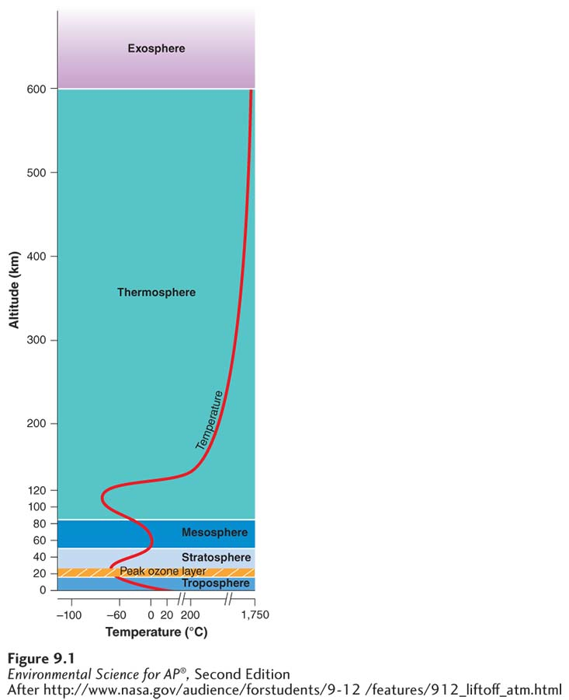
Earth’s Atmosphere
The layers of Earth’s atmosphere.
The troposphere is the atmospheric layer closest to Earth. Because the density of air decreases with altitude, the troposphere’s temperature also decreases with altitude. Temperature increases with altitude in the stratosphere because the Sun’s UV-B and UV-C rays warm the upper part of this layer. Temperatures in the thermosphere can reach 1,750°C (3,182°F).

Slide 6
The amount of solar energy reaching Earth varies with location
As the Sun's energy passes through the atmosphere and strikes land and water, it warms the surface of Earth. But this warming does not occur evenly across the planet because:
The angle at which the Sun's rays strike varies.
The amount of surface area over which the Sun's rays are distributed varies.
Some areas of Earth reflect more solar energy than others.
Albedo The percentage of incoming sunlight reflected from a surface.

Slide 7
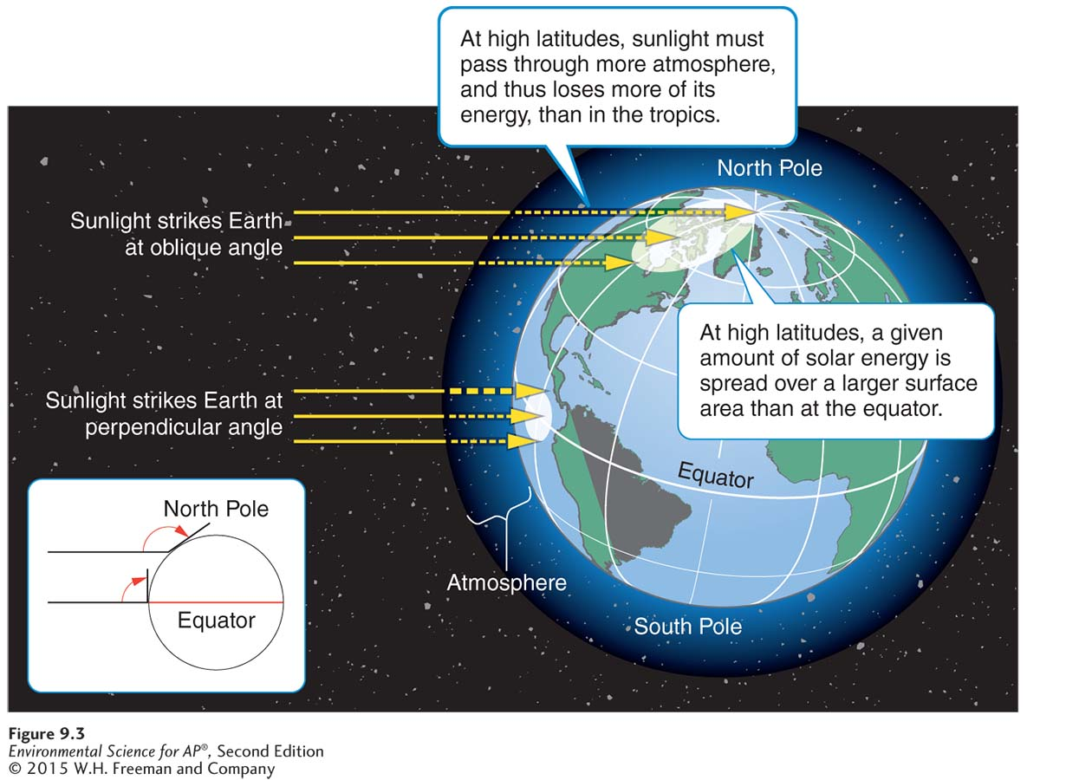
The Amount of Solar Energy Reaching Earth
Differential heating of Earth. Tropical regions near the equator receive more solar energy than mid-latitude and polar regions, where the Sun’s rays strike Earth’s surface at an oblique angle.

Slide 8
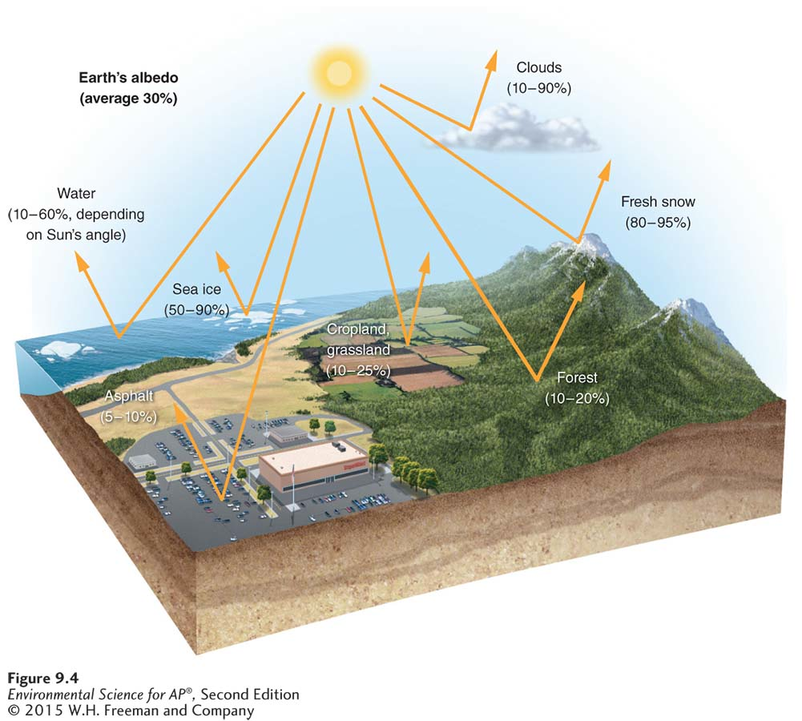
The Amount of Solar Energy Reaching Earth
Albedo. The albedo of a surface is the percentage of the incoming solar energy that it reflects. Snow and ice reflect much of the solar energy that they receive, but darker objects such as forests and asphalt paving reflect very little energy, which means that they absorb most of the solar energy that strikes them.

Slide 9
Earth's tilt causes seasonal changes in climate
The Earth's axis of rotation is tilted 23.5 ˚.
When the Northern Hemisphere is tilted toward the Sun, the Southern Hemisphere is tilted away from the Sun, and vice versa.

Slide 10
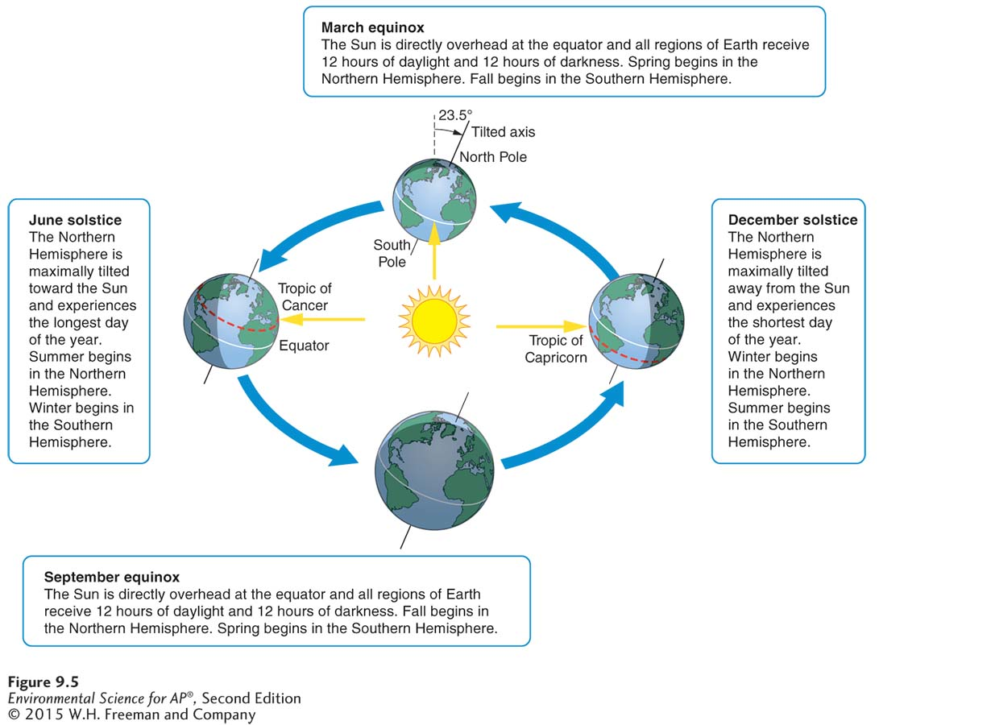
Earth's Tilt and the Seasons
Earth’s seasons. Because Earth’s axis of rotation is tilted 23.5°, the latitude that receives the most direct rays of the Sun and the most hours of daylight changes throughout the year
as Earth orbits the Sun. Thus Earth’s tilt produces predictable seasons. This diagram illustrates the pattern of seasons in the Northern Hemisphere.

Slide 11
Module 10 Air Currents
After reading this module you should be able to
explain how the properties of air affect the way it moves in the atmosphere.
identify the factors that drive atmospheric convection currents.
describe how Earth’s rotation affects the movement of air currents.
explain how the movement of air currents over mountain ranges affects climates.

Slide 12
Air has several important properties that determine how it circulates in the atmosphere
Saturation point The maximum amount of water vapor in the air at a given temperature.
Adiabatic cooling The cooling effect of reduced pressure on air as it rises higher in the atmosphere and expands.
Adiabatic heating The heating effect of increased pressure on air as it sinks toward the surface of Earth and decreases in volume.
Latent heat release The release of energy when water vapor in the atmosphere condenses into liquid water.

Slide 13
Atmospheric convection currents move air and moisture around the globe
Atmospheric convection current Global patterns of air movement that are initiated by the unequal heating of Earth.

Slide 14
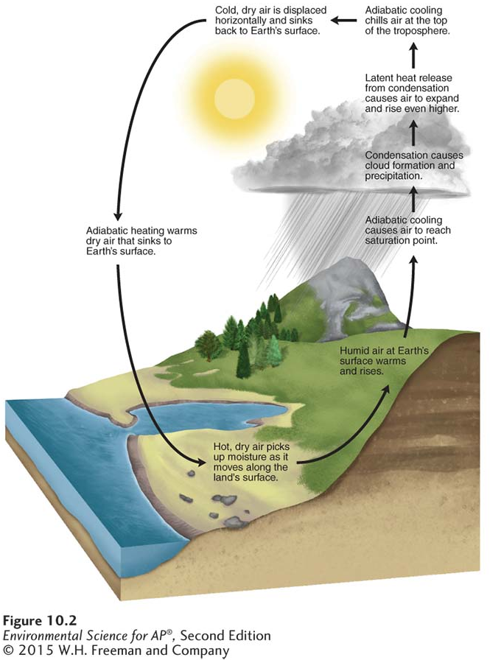
Atmospheric Convection Currents
Atmospheric currents.
Warming at Earth’s surface
causes air to rise up into the atmosphere where it
experiences lower pressures,
adiabatic cooling, and latent heat release. The cool air near the top of the atmosphere is then displaced horizontally before it sinks back to Earth. As it sinks,
the air experiences adiabatic
heating and then moves
horizontally along the surface of Earth to complete the cycle.

Slide 15
Atmospheric Convection Currents
Hadley cell A convection current in the atmosphere that cycles between the equator and 30° N and 30° S.
Intertropical convergence zone (ITCZ) The latitude that receives the most intense sunlight, which causes the ascending branches of the two Hadley cells to converge.
Polar cell A convection current in the atmosphere, formed by air that rises at 60° N and 60° S and sinks at the poles, 90° N and 90° S.
Ferrell cell A convection current in the atmosphere that lies between Hadley cells and polar cells.

Slide 16
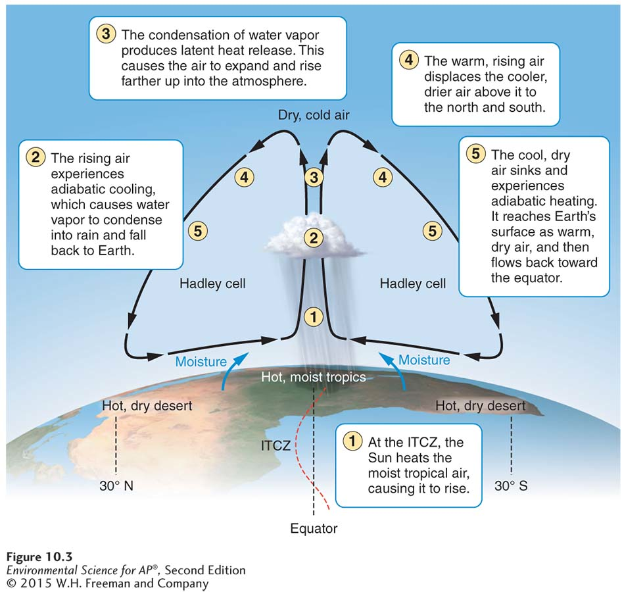
Atmospheric Convection Currents
Hadley cells. Hadley cells are atmospheric
convection currents that operate between the equator and 30° N
and 30° S. Solar energy warms humid air in the tropics. The warm air rises and eventually cools below its saturation point.
The water vapor it contains
condenses into clouds and
precipitation. The air, which now contains little moisture, sinks to Earth’s surface at approximately 30° N and 30° S. As the air descends, it is warmed by adiabatic heating. This descent
of hot, dry air causes desert
environments to develop at those latitudes.

Slide 17
Earth's rotation causes the Coriolis effect
As Earth rotates, its surface moves much faster at the equator than in mid-latitude and polar regions.
The faster rotation speeds found closer to the equator cause objects that are moving directly north or south to deflect.

Slide 18
The Coriolis Effect
Coriolis effect The deflection of an object’s path due to the rotation of Earth.
The prevailing winds of the world are produced by a combination of atmospheric convection currents and the Coriolis effect.

Slide 19
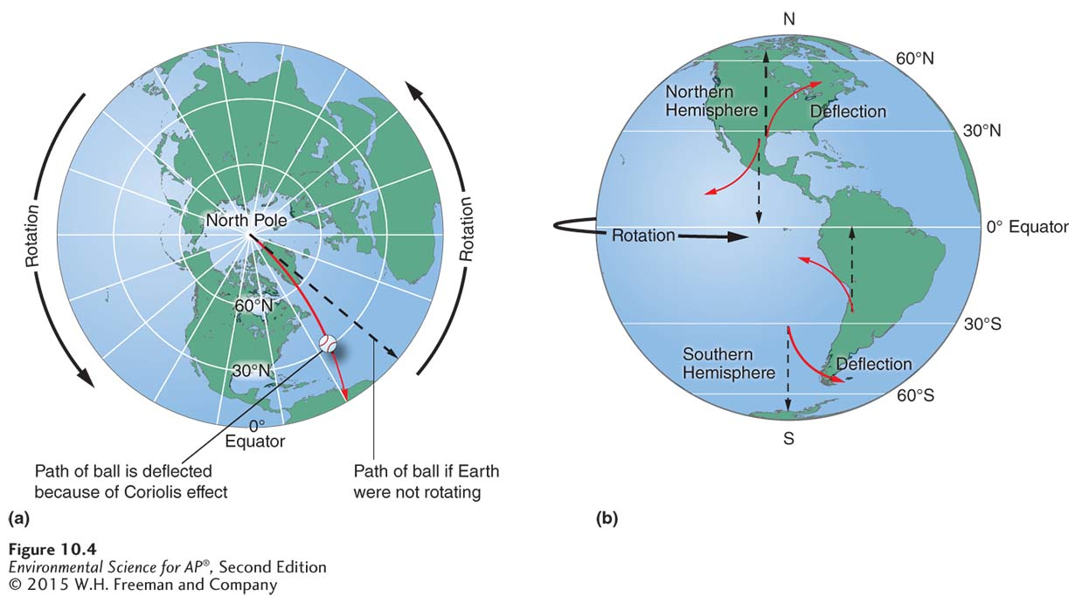
The Coriolis Effect
The Coriolis effect. (a) A ball thrown from the North Pole toward the equator would be deflected to the west by the Coriolis effect. (b) The different rotation speeds of Earth at different latitudes cause a deflection in the paths of traveling objects.

Slide 20
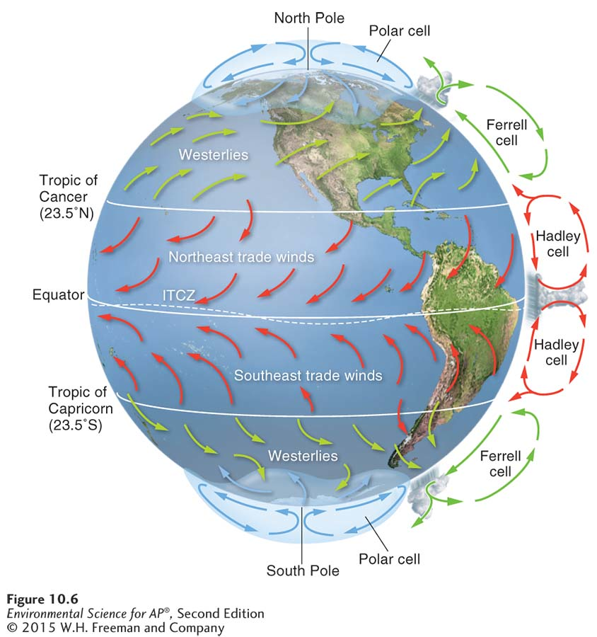
The Coriolis Effect
Prevailing wind patterns. Prevailing wind patterns around the world are produced by a combination of
atmospheric convection currents and the Coriolis effect.

Slide 21
Rain shadows cause mountains to be dry on one side
Rain shadow A region with dry conditions found on the leeward side of a mountain range as a result of humid winds from the ocean causing precipitation on the windward side.

Slide 22
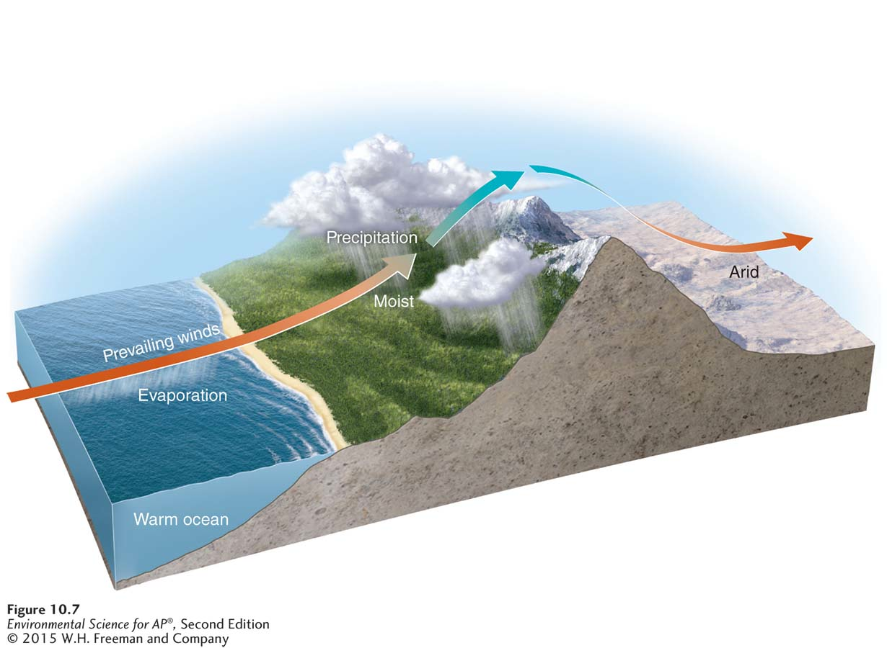
Rain Shadows
Rain shadow. Rain shadows occur where humid winds blowing inland from the ocean meet a mountain range. On the windward (wind-facing) side of the mountains, air rises and cools, and large amounts of water vapor condense to form clouds and precipitation. On the leeward side of the mountains, cold, dry air descends, warms via adiabatic heating, and causes much drier conditions.

Slide 23
Rain Shadows
Air moving inland from the ocean contains a large amount of water vapor. When it meets the windward side of a mountain range (the side facing the wind), it rises and begins to experience adiabatic cooling.
Because water vapor condenses as air cools, clouds form and precipitation falls.
The presence of the mountain range causes large amounts of precipitation to fall on its windward side.
The cold, dry air then travels to the other side of the mountain range (the leeward side), where it descends and experiences higher pressures, which cause adiabatic heating.
This air is now warm and dry and produces arid conditions on the leeward side forming the region called a rain shadow.

Slide 24
Module 11 Ocean Currents
After reading this module you should be able to
describe the patterns of surface ocean circulation.
explain the mixing of surface and deep ocean waters from thermohaline circulation.
identify the causes and consequences of the El Niño–Southern Oscillation.

Slide 25
Surface ocean currents move warm and cold water around the globe
Ocean currents are driven by a combination of temperature, gravity, prevailing winds, the Coriolis effect, and the locations of continents.
Warm water, like warm air, expands and rises.
Gyre A large-scale pattern of water circulation that moves clockwise in the Northern Hemisphere and counterclockwise in the Southern Hemisphere.

Slide 26
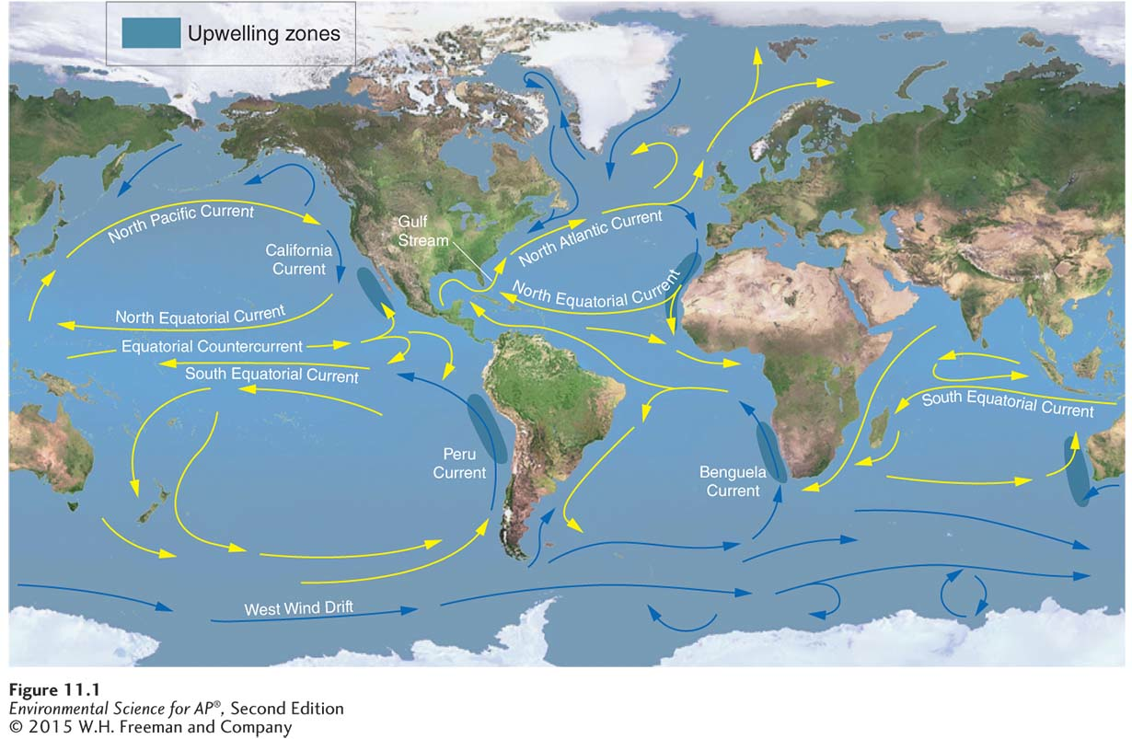
Ocean Currents
Oceanic circulation patterns. Oceanic circulation patterns are the result of differential heating, gravity, prevailing winds, the Coriolis effect, and the locations of continents. Each of the five major ocean basins contains a gyre driven by the trade winds in the tropics and the westerlies at mid-latitudes. The result is a clockwise circulation pattern in the Northern Hemisphere and a counterclockwise circulation pattern in the Southern Hemisphere. Along the west coasts of many continents, currents diverge and cause the upwelling of deeper and more fertile water.

Slide 27
Ocean Currents
Upwelling The upward movement of ocean water toward the surface as a result of diverging currents.
This upward movement of water brings nutrients from the ocean bottom that supports the large populations of producers, which in turn support large populations of fish.

Slide 28
Deep water currents circulate ocean water over long time periods
Thermohaline circulation An oceanic circulation pattern that drives the mixing of surface water and deep water.
Scientists believe this process is crucial for moving heat and nutrients around the globe.
Thermohaline circulation appears to be driven by surface waters that contain unusually large amounts of salt.

Slide 29
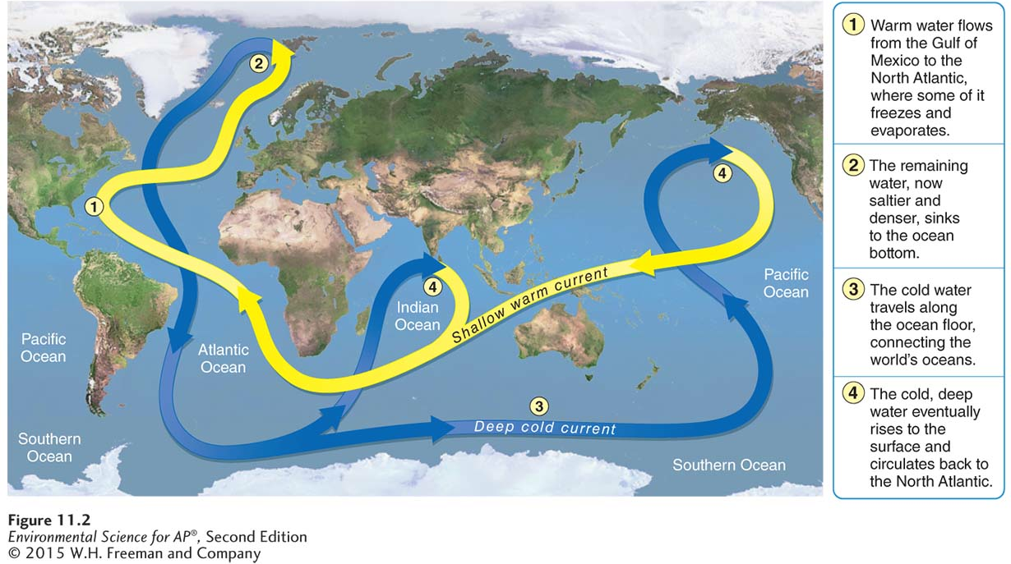
Thermohaline Circulation
Thermohaline circulation. The sinking of dense, salty water in the North Atlantic drives a deep, cold current that moves slowly around the world.

Slide 30
Deep ocean currents circulate ocean water over long time periods
Some of the water that flows from the Gulf of Mexico to the North Atlantic freezes or evaporates, and the salt that remains behind increases the salt concentration of the water.
This cold, salty water is relatively dense, so it sinks to the bottom of the ocean, mixing with deeper ocean waters.
These two processes create the movement necessary to drive a deep, cold current that slowly moves past Antarctica and northward to the northern Pacific Ocean.

Slide 31
The El-Niño Southern Oscillation is caused by a shift in ocean currents
El Niño–Southern Oscillation (ENSO) A reversal of wind and water currents in the South Pacific.

Slide 32
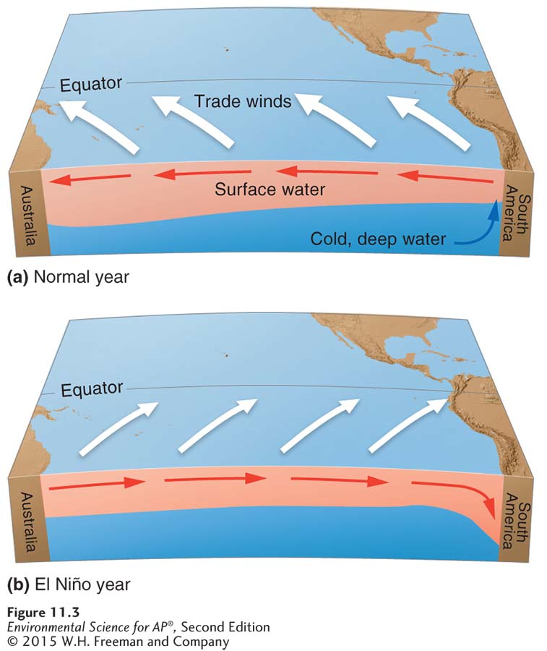
The El-Niño Southern Oscillation
Every 3 to 7 years, the interaction of the Earth's atmosphere and ocean cause surface currents in the tropical Pacific Ocean to reverse direction.
The El Niño–Southern Oscillation. (a) In a normal year, trade winds push warm surface waters away from the coast of South America and promote the upwelling of water from the ocean bottom. (b) In an El Niño year, trade winds weaken or reverse direction, so warm waters build up along the west coast of Peru.

Slide 33
The El-Niño Southern Oscillation
First, the trade winds near South America weaken.
This weakening allows warm equatorial water from the western Pacific to move eastward toward the west coast of South America.
The movement of warm water and air toward South America suppresses upwelling off the coast of Peru and decreases productivity there, reducing fish populations near the coast.
These periodic changes in wind and ocean currents are collectively called the El-Niño Southern Oscillation, or ENSO.

