Slide 1
Chapter 8
Earth Systems
Friedland and Relyea Environmental Science for AP®, second edition ©2015 W.H. Freeman and Company/BFW
AP® is a trademark registered and/or owned by the College Board®, which was not involved in the production of, and does not endorse, this product.

Slide 2
Module 24 Mineral Resources and Geology
After reading this module you should be able to
describe the formation of Earth and the distribution of critical elements on Earth.
define the theory of plate tectonics and discuss its relevance to the study of the environment.
describe the rock cycle and discuss its importance in environmental science.

Slide 3
The availability of Earth's resources was determined when the planet was formed
The distribution of chemicals, minerals, and ores around the world is in part a function of the processes that occurred during the formation of Earth.

Slide 4
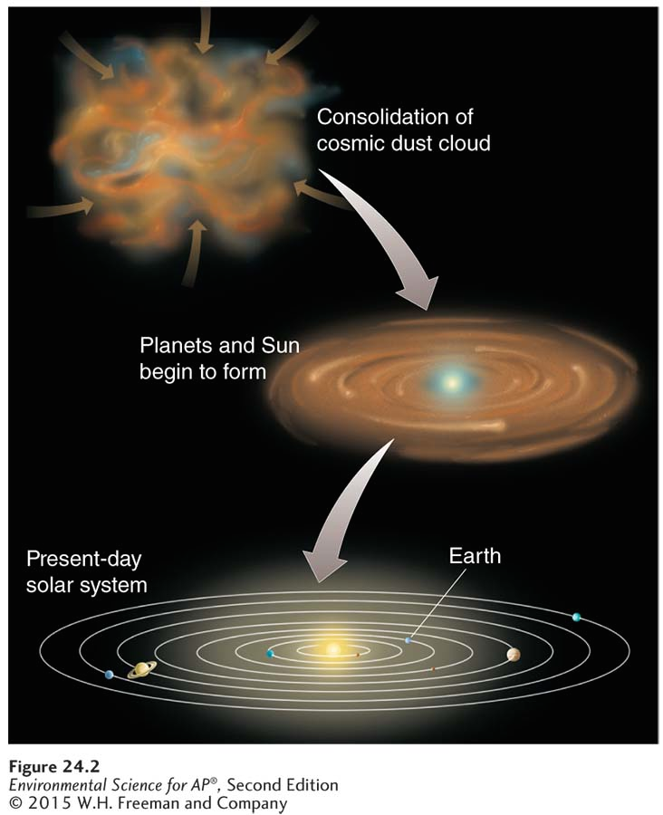
The Formation and Structure of Earth
Formation of Earth and the solar system.
The processes that formed Earth 4.6 billion years ago determined the distribution and abundance of elements and minerals today.

Slide 5
The Formation and Structure of Earth
Earth is characterized by distinct vertical zonation.
Core The innermost zone of Earth’s interior, composed mostly of iron and nickel. It includes a liquid outer layer and a solid inner layer.
Mantle The layer of Earth above the core, containing magma.
Magma Molten rock.
Asthenosphere The layer of Earth located in the outer part of the mantle, composed of semi-molten rock.
Lithosphere The outermost layer of Earth, including the mantle and crust.
Crust In geology, the chemically distinct outermost layer of the lithosphere.

Slide 6
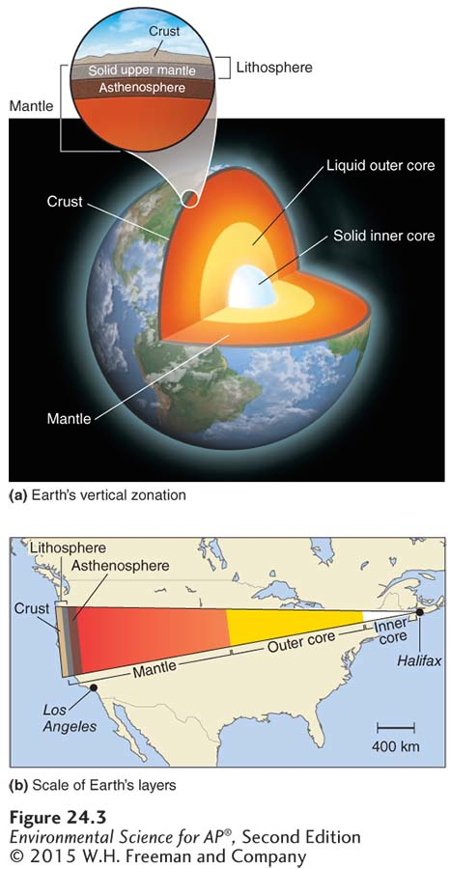
The Formation and Structure of Earth
Earth’s layers. (a) Earth is composed of concentric layers. (b) If we were to slice a wedge from Earth, it would cover the width of the United States.

Slide 7
Hot Spots
The high temperature of Earth's outer core and mantle is thought to be the result of radioactive decay of various isotopes.
The heat causes plumes of hot magma to well upward from the mantle and produce hot spots.
Hot spot In geology, a place where molten material from Earth’s mantle reaches the lithosphere.

Slide 8
The theory of plate tectonics describes the movement of the lithosphere
Plate tectonics The theory that the lithosphere of Earth is divided into plates, most of which are in constant motion.
Tectonic cycle The sum of the processes that build up and break down the lithosphere.
The theory of plate tectonics is a unifying theory in geology and earth sciences because it relates to so many aspects of the earth sciences.

Slide 9
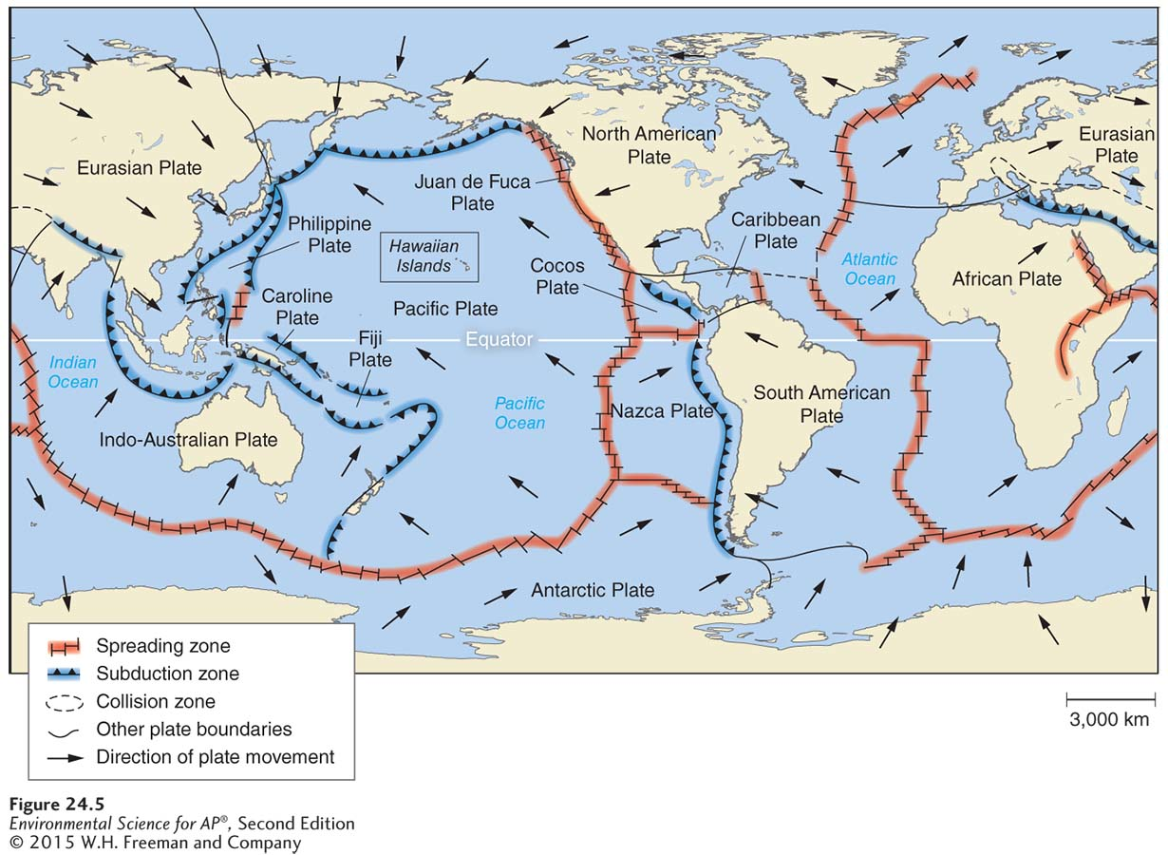
Plate Movement
Tectonic plates. Earth is covered with tectonic plates, most of which are in constant
motion. The arrows indicate the direction of plate movement. New lithosphere is added at spreading zones and older lithosphere is recycled into the mantle at subduction zones.

Slide 10
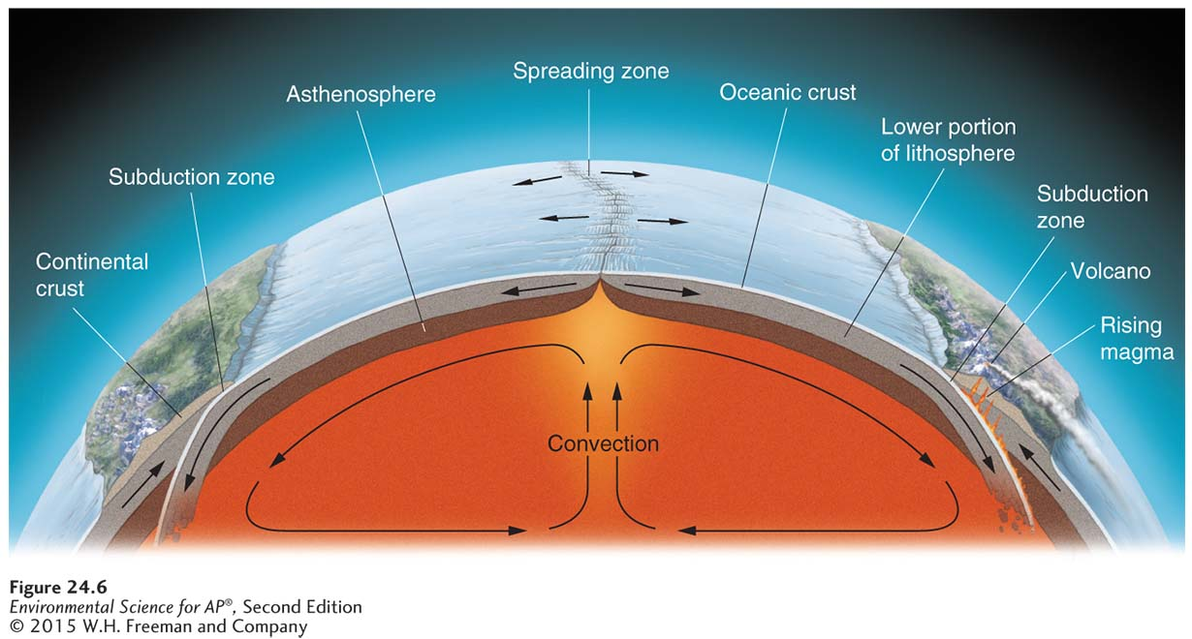
Plate Movement
Convection and plate movement. Convection in the mantle causes oceanic plates to spread apart as new rock rises to the surface at spreading zones. Where oceanic and continental plate margins come together, older oceanic crust is subducted.

Slide 11
Consequences of Plate Movement
Subduction The process of one crustal plate passing under another.
Volcano A vent in the surface of Earth that emits ash, gases, or molten lava.

Slide 12
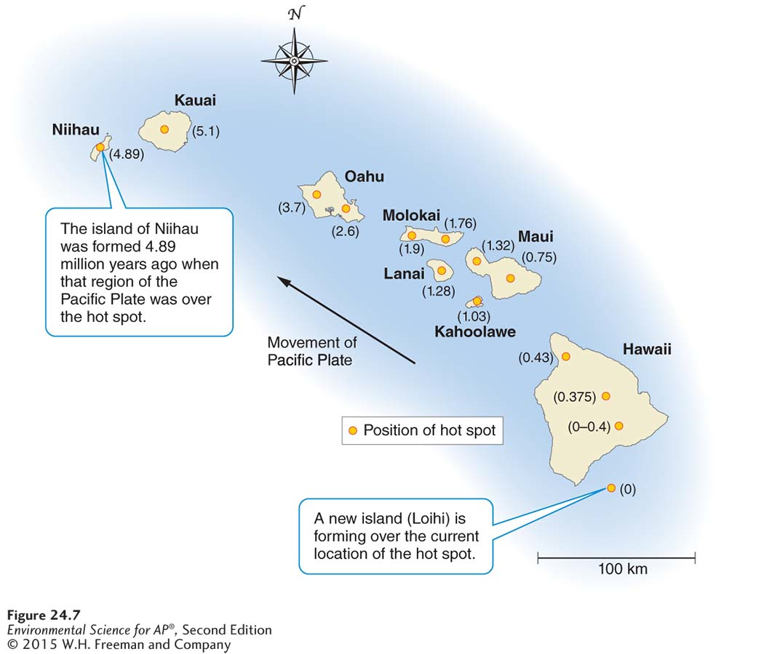
Consequences of Plate Movement
Plate movement over a hot
spot. The Hawaiian Islands were formed by volcanic eruptions as the Pacific Plate traveled over a geologic hot spot. The chain of inactive volcanoes to the northwest of Hawaii shows that
those locations used to be over the hot spot. Numbers indicate how long ago each area was located over the hot spot (in millions of years).

Slide 13
Types of Plate Contact
Divergent plate boundary An area beneath the ocean where tectonic plates move away from each other.
Seafloor spreading The formation of new ocean crust as a result of magma pushing upward and outward from Earth’s mantle to the surface.
Convergent plate boundary An area where plates move toward one another and collide.
Transform fault boundary An area where tectonic plates move sideways past each other.

Slide 14
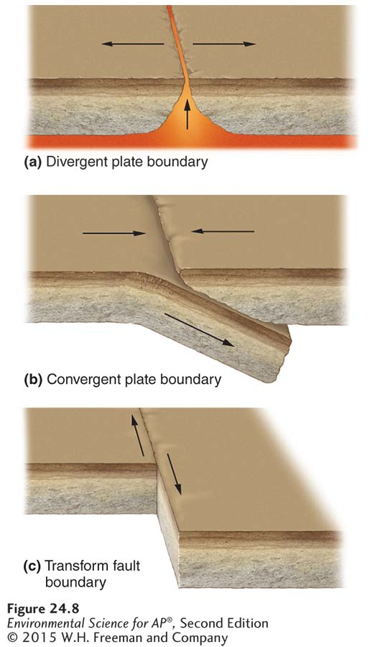
Types of Plate Contact
Types of plate boundaries.
(a) At divergent plate boundaries, plates move apart. (b) At convergent plate boundaries, plates collide.
(c) At transform fault boundaries, plates slide past each other.

Slide 15
Types of Plate Contact
Fault A fracture in rock caused by a movement of Earth’s crust.
Seismic activity The frequency and intensity of earthquakes experienced over time.
Fault zone A large expanse of rock where a fault has occurred.

Slide 16
Faults, Earthquakes, and Volcanoes
Earthquake The sudden movement of Earth’s crust caused by a release of potential energy along a geologic fault and usually causing a vibration or trembling at Earth’s surface.
Epicenter The exact point on the surface of Earth directly above the location where rock ruptures during an earthquake.
Richter scale A scale that measures the largest ground movement that occurs during an earthquake.
The Richter scale increases by a factor of 10, so an earthquake of 7 is 10 times greater than an earthquake of 6.

Slide 17
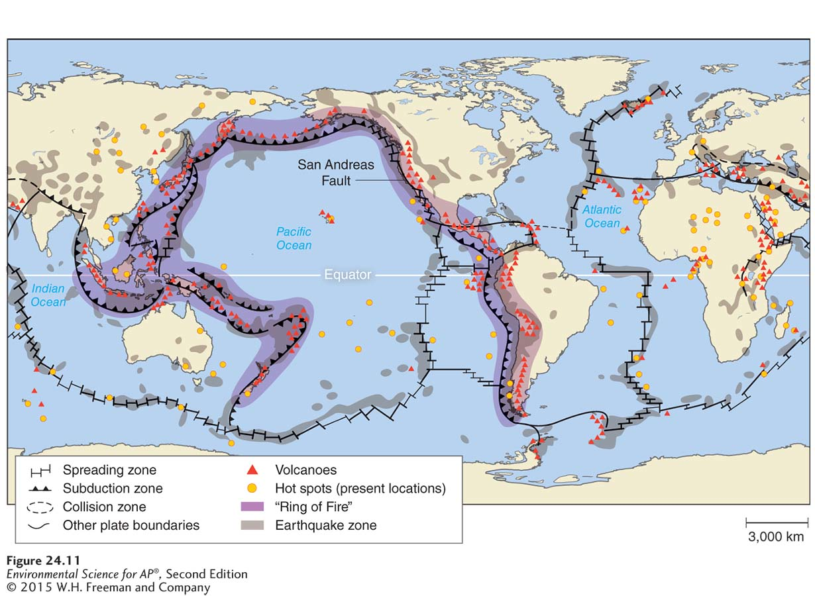
Faults, Earthquakes, and Volcanoes
Locations of earthquakes and volcanoes. A “Ring of Fire” circles the Pacific Ocean
along plate boundaries. Other zones of seismic and volcanic activity, including hot spots, are also shown on this map.

Slide 18
The rock cycle recycles scarce minerals and elements
Rock cycle The geologic cycle governing the constant formation, alteration, and destruction of rock material that results from tectonics, weathering, and erosion, among other processes.
The rock cycle is the slowest of all Earth's cycles.

Slide 19
The Rock Cycle
There are three major ways in which rocks at Earth's surface can form. This leads to three types of rock:
Directly from molten magma (igneous)
Compression of sediments (sedimentary)
Exposure to high temperatures and pressures (metamorphic)

Slide 20
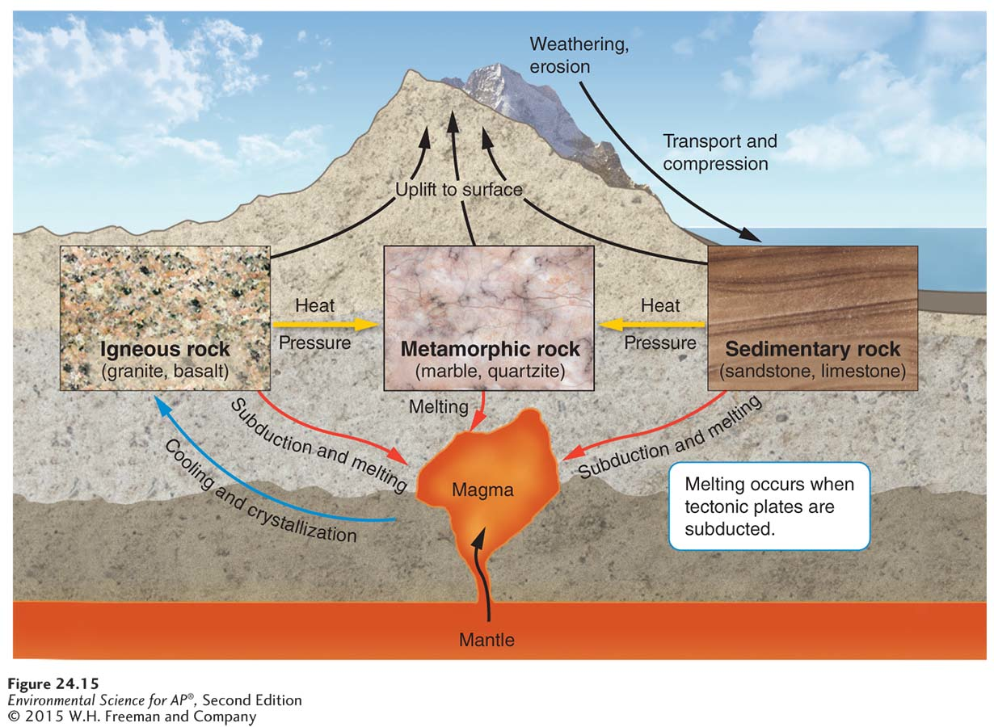
The Rock Cycle
The rock cycle. The rock cycle slowly but continuously forms new rock and breaks down
old rock. Three types of rock are created in the rock cycle: Igneous rock is formed from magma; sedimentary rock is formed by the compression of sedimentary materials; and metamorphic rock is created when rocks are subjected to high temperatures and pressures.

Slide 21
Igneous Rocks
Igneous rock Rock formed directly from magma.
Intrusive igneous rock Igneous rock that forms when magma rises up and cools in a place underground.
Extrusive igneous rock Rock that forms when magma cools above the surface of Earth.
Fracture In geology, a crack that occurs in rock as it cools.

Slide 22
Sedimentary Rock
Sedimentary rock Rock that forms when sediments such as muds, sands, or gravels are compressed by overlying sediments.
Sedimentary rocks hold the fossil record that provides a window into our past.

Slide 23
Metamorphic Rocks
Metamorphic rock Rock that forms when sedimentary rock, igneous rock, or other metamorphic rock is subjected to high temperature and pressure.
Metamorphic rock has been important as a building material throughout human history because it is structurally strong and visually attractive.

