Slide 1
Module 12 Terrestrial Biomes
After reading this module you should be able to
explain how we define terrestrial biomes.
interpret climate diagrams.
identify the nine terrestrial biomes.

Slide 2
Terrestrial biomes are defined by dominant plant growth forms
Terrestrial biome A geographic region categorized by a particular combination of average annual temperature, annual precipitation, and distinctive plant growth forms on land.
Aquatic biome An aquatic region characterized by a particular combination of salinity, depth, and water flow.

Slide 3
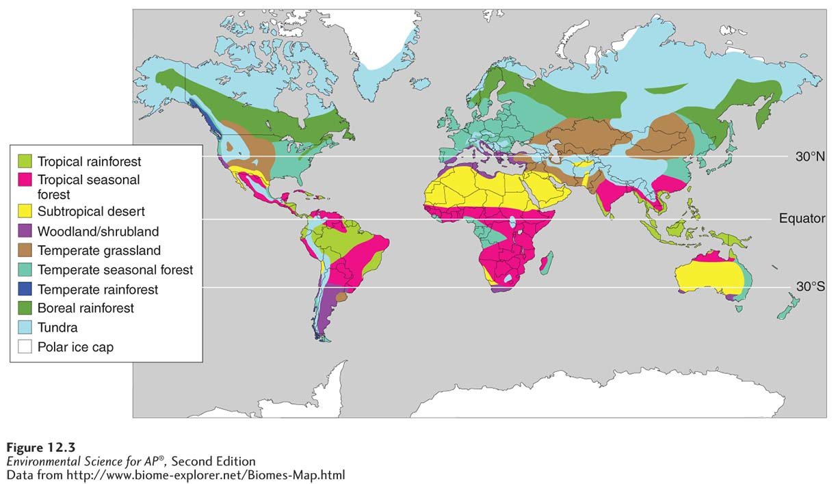
Terrestrial Biomes
Biomes. Biomes are categorized by particular combinations of average annual temperature and annual precipitation.

Slide 4
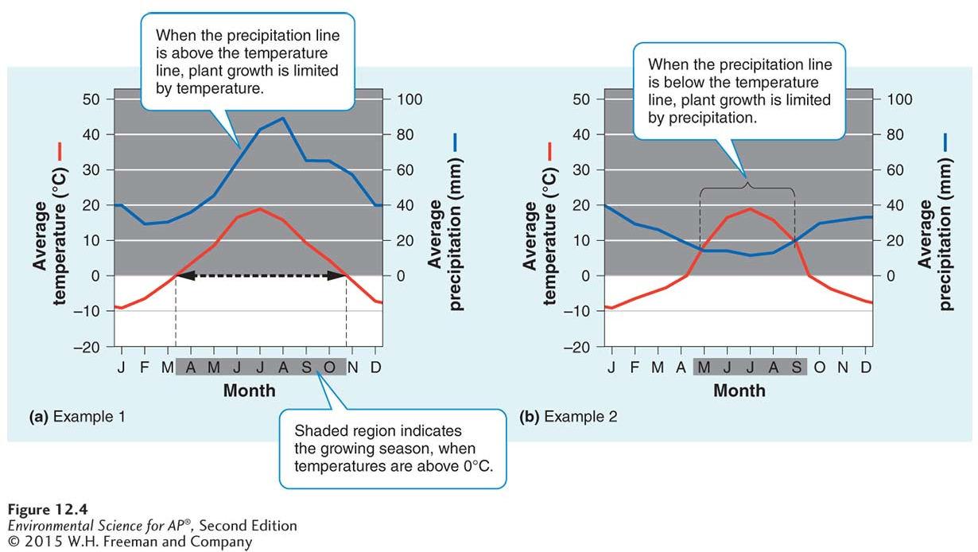
Climate diagrams illustrate patterns of annual temperature and precipitation
Climate diagrams. Climate diagrams display monthly temperature and precipitation
values, which help determine the productivity of a biome.

Slide 5
Terrestrial biomes range from tundra to tropical forests
There are nine terrestrial biomes:
Tundra
Boreal Forest
Temperate rainforest
Temperate seasonal forest
Woodland/shrubland
Temperate grassland/cold desert
Tropical rainforest
Tropical seasonal forest/ savanna
Subtropical desert

Slide 6
Tundra
Tundra A cold and treeless biome with low-growing vegetation.
In winter, the soil is completely frozen.
The tundra's growing season is very short, usually only about 4 months during summer.
The underlying subsoil, is permafrost.
Permafrost An impermeable, permanently frozen layer of soil.

Slide 7
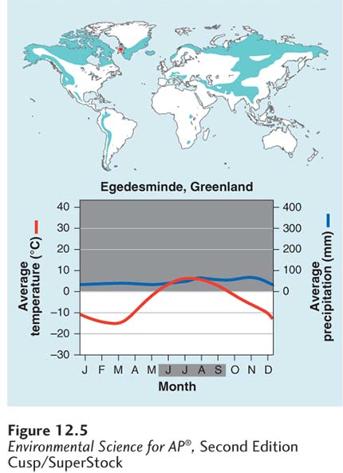
Tundra
Tundra biome. The tundra is cold and treeless, with low-growing vegetation.

Slide 8
Boreal Forest
Boreal forest A forest biome made up primarily of coniferous evergreen trees that can tolerate cold winters and short growing seasons.
Boreal forests are found between about 50˚ and 60˚ N in Europe, Russia and North America.
This subarctic biome has a very cold climate, and plant growth is more constrained by temperature than precipitation.
The soil is nutrient-poor due to slow decomposition.

Slide 9
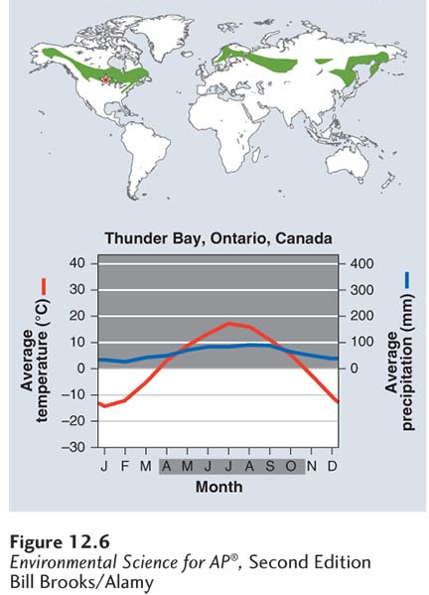
Boreal Forest
Boreal forest biome. Boreal forests are made
up primarily of coniferous evergreen trees that can tolerate cold winters and short growing seasons.

Slide 10
Temperate Rainforest
Temperate rainforest A coastal biome typified by moderate temperatures and high precipitation.
Coastal biome found along the west coast of North America from northern California to Alaska, in southern Chile, on the west coast of New Zealand, and on the island of Tasmania.
Ocean currents moderate temperature fluctuations and provide a source of water vapor.
Nearly 12-month growing season where winters are rainy and summers are foggy.
Mild temperatures and high precipitation support growth of very large trees.

Slide 11
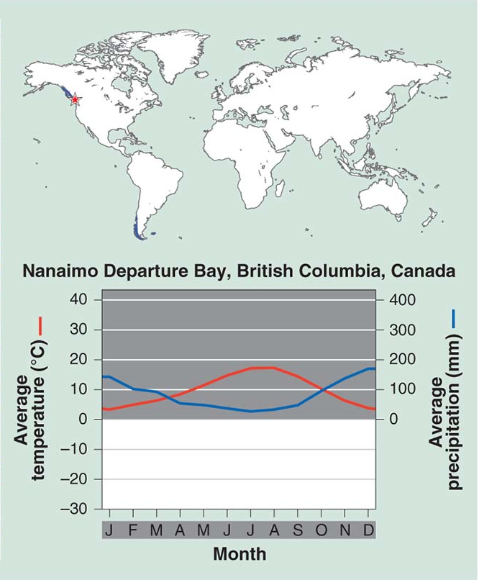
Temperate Rainforest
Temperate rainforest biome.
Temperate rainforests have moderate mean annual temperatures and high precipitation that supports the growth of very large trees.

Slide 12
Temperate Seasonal Forest
Temperate seasonal forest A biome with warm summers and cold winters with over 1 m (39 inches) of precipitation annually.
Receives over 1 m (39 inches) of precipitation annually.
Found in the eastern United States, Japan, China, Europe, Chile and eastern Australia.
Dominated by broadleaf deciduous trees such as beech, male, oak and hickory.
Warmer summer temperatures favor decomposition; soils generally contain more nutrients than those of boreal forests.

Slide 13
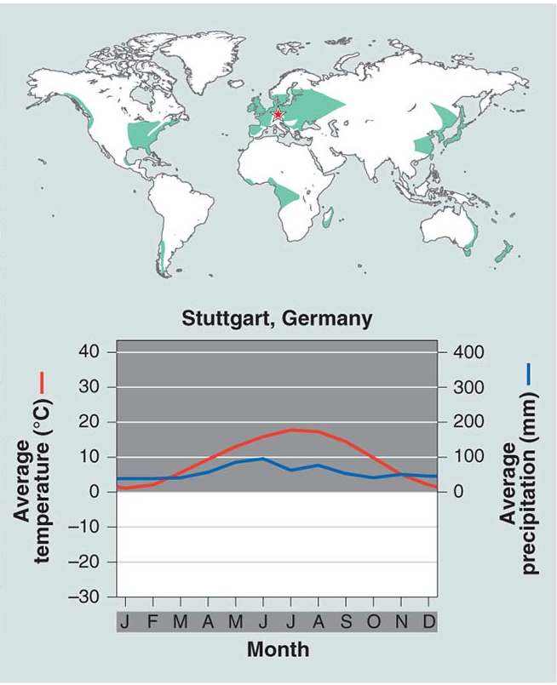
Temperate Seasonal Forest
Temperate seasonal forest biome.
Temperate seasonal forest
biomes have moderate
mean annual temperatures
and moderate amounts of
precipitation that support
broadleaf deciduous trees such as beech, maple, oak, and hickory.

Slide 14
Woodland/Shrubland
Woodland/shrubland A biome characterized by hot, dry summers and mild, rainy winters.
Found on the coast of southern California, southern Australia, southern Africa and in the area surrounding the Mediterranean Sea.
There is a 12-month growing season, but plant growth is constrained by low precipitation in summer and by relatively low temperatures in winter.
Wildfires are common and plants of this biome are well adapted to both fire and drought.

Slide 15
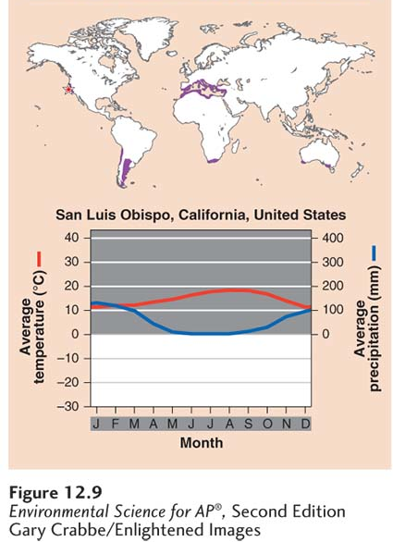
Woodland/Shrubland
Woodland/shrubland biome.
The woodland/shrubland biome is characterized by hot, dry summers and mild, rainy winters.

Slide 16
Temperate Grassland/Cold Desert
Temperate grassland/cold desert A biome characterized by cold, harsh winters, and hot, dry summers.
Lowest average annual precipitation of any temperate biome.
Found in the Great Plains of North America, in South America, and in central Asia and eastern Europe.
Plant growth constrained by both insufficient precipitation in summer and cold temperatures in winter.
Plants include grasses and non woody flowering plants well-adapted to wildfires and frequent grazing by animals.

Slide 17
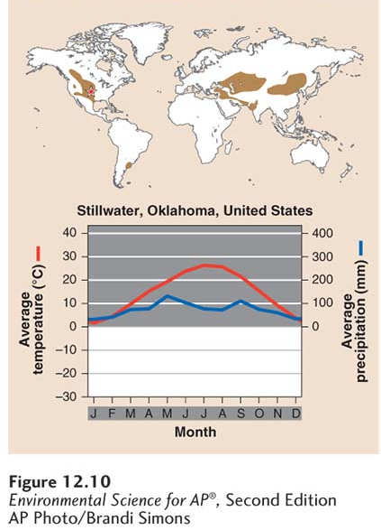
Temperate Grassland/Cold Desert
Temperate grassland/cold desert biome.
The temperate grassland/cold desert biome has cold, harsh winters and hot, dry, summers that support grasses and nonwoody flowering plants.

Slide 18
Tropical Rainforest
Tropical rainforest A warm and wet biome found between 20° N and 20° S of the equator, with little seasonal temperature variation and high precipitation.
Average annual temperatures exceed 20˚C.
Found in Central and South America, Africa, Southeast Asia, and northeastern Australia.
Precipitation occurs frequently; warm and wet with little temperature variation.
Contain more biodiversity per hectare than any other terrestrial biome; contain up to two-thirds of Earth's terrestrial species.

Slide 19
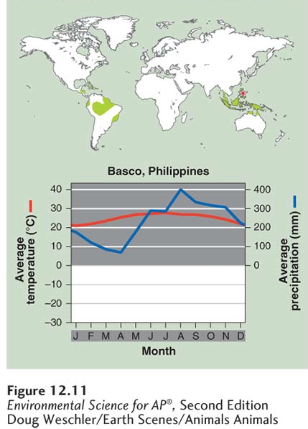
Tropical Rainforest
Tropical rainforest biome.
Tropical rainforests
are warm and wet, with little seasonal temperature variation. These forests are highly productive with several distinctive layers of
vegetation.

Slide 20
Tropical Seasonal Forest/ Savanna
Tropical seasonal forest/savanna A biome marked by warm temperatures and distinct wet and dry seasons.
Tropical seasonal forests are common in much of Central America, on the Atlantic coast of South America, in southern Asia, in northwestern Australia, and in sub-Saharan Africa.
Soil in this biome is fairly fertile and can be farmed due to high decomposition rates, but the low amount of precipitation constrains plants from using the soil nutrients that are released.
Grasses and scattered deciduous trees are common.

Slide 21
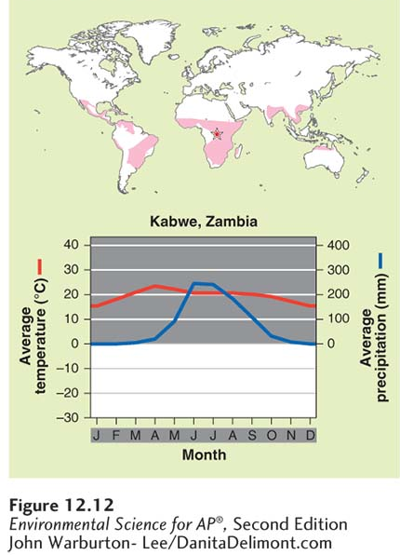
Tropical Seasonal Forest/ Savanna
Tropical seasonal forest/savanna biome.
Tropical seasonal forest and savannas have warm
temperatures and distinct wet and dry seasons. Vegetation ranges from dense stands of shrubs and trees to relatively open landscapes dominated by grasses and scattered deciduous trees.

Slide 22
Subtropical Desert
Subtropical desert A biome prevailing at approximately 30° N and 30° S, with hot temperatures, extremely dry conditions, and sparse vegetation.
The Mojave Desert in the southwestern United States, the Sahara in Africa, the Arabian Desert of the Middle East and the Great Victoria Desert of Australia are all subtropical deserts.
Cacti, euphorbs and succulent plants are well adapted to this biome.

Slide 23
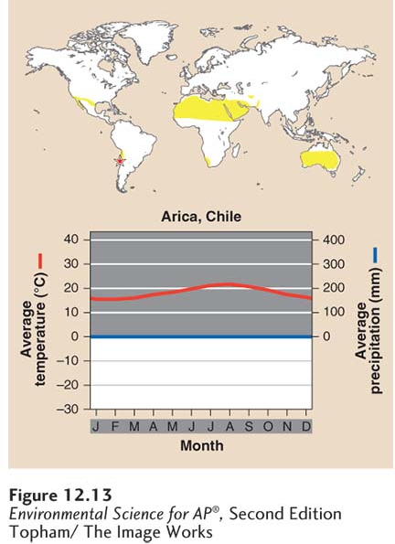
Subtropical Desert
Subtropical desert biome. Subtropical deserts have hot temperatures, extremely dry conditions, and sparse
vegetation.

Slide 24
Module 13 Aquatic Biomes
After reading this module you should be able to
identify the major freshwater biomes.
identify the major marine biomes.

Slide 25
Freshwater biomes have low salinity
Freshwater biomes include:
Streams and rivers
Lakes and ponds
Freshwater wetlands

Slide 26
Streams and Rivers
Flowing fresh water that may originate from underground springs or as runoff from rain or melting snow.
Streams are typically narrow and carry relatively small amounts of water where rivers are usually wider and carry larger amounts of water.

Slide 27
Lakes and Ponds
Lakes and ponds contain standing water, at least some of which is too deep to support emergent vegetation.
Lakes are larger than ponds but there is no clear point at which a pond is considered large enough to be called a lake.
Littoral zone The shallow zone of soil and water in lakes and ponds where most algae and emergent plants grow.
Limnetic zone A zone of open water in lakes and ponds.
Phytoplankton Floating algae.
Profundal zone A region of water where sunlight does not reach, below the limnetic zone in very deep lakes.
Benthic zone The muddy bottom of a lake, pond, or ocean.

Slide 28
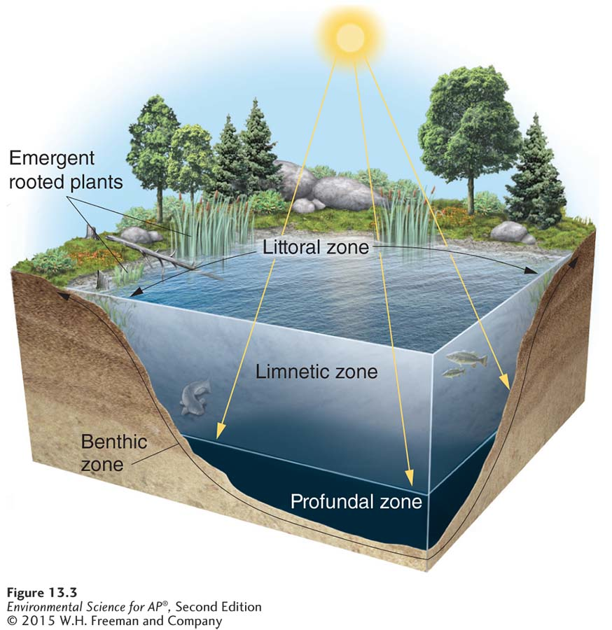
Lakes and Ponds
Lake zones. The littoral zone consists of shallow
water with emerging, rooted plants whereas the limnetic zone is the deeper water where plants do not emerge. The deepest water, where oxygen can be limiting because little sunlight penetrates to allow
photosynthesis by producers, is the profundal zone. The sediments
that lie beneath the littoral, limnetic, and profundal zones constitute the benthic zone.

Slide 29
Lakes and Ponds
Lakes are classified by their level of primary productivity.
Oligotrophic Describes a lake with a low level of productivity.
Mesotrophic Describes a lake with a moderate level of productivity.
Eutrophic Describes a lake with a high level of productivity.

Slide 30
Freshwater Wetlands
Freshwater wetlands An aquatic biome that is submerged or saturated by water for at least part of each year, but shallow enough to support emergent vegetation.
Freshwater wetlands are among the most productive biomes on Earth.

Slide 31
Marine biomes have high salinity
There are five marine biomes:
Salt marsh
Mangrove swamp
Intertidal zone
Coral reefs
Open ocean

Slide 32
Salt Marsh
Salt marsh A marsh containing nonwoody emergent vegetation, found along the coast in temperate climates.
Found along the coast in temperate climates.
The salt marsh is one of the most productive biomes in the world.

Slide 33
Mangrove Swamp
Mangrove swamp A swamp that occurs along tropical and subtropical coasts, and contains salt tolerant trees with roots submerged in water.
Mangrove trees are salt tolerant and help protect the coastlines from erosion and storm damage.

Slide 34
Intertidal Zone
Intertidal zone The narrow band of coastline between the levels of high tide and low tide.
Waves that crash onto the shore in this biome can make it a challenge for organisms to hold on and not get washed away.

Slide 35
Coral Reefs
Coral reef The most diverse marine biome on Earth, found in warm, shallow waters beyond the shoreline.
Earth's most diverse marine biome even though coral reefs are found in water that is relatively poor in nutrients and food.
Coral bleaching A phenomenon in which algae inside corals die, causing the corals to turn white.

Slide 36
Open Ocean
Open ocean Deep ocean water, located away from the shoreline where sunlight can no longer reach the ocean bottom.
Photic zone The upper layer of ocean water in the ocean that receives enough sunlight for photosynthesis.
Aphotic zone The deeper layer of ocean water that lacks sufficient sunlight for photosynthesis.
Chemosynthesis A process used by some bacteria in the ocean to generate energy with methane and hydrogen sulfide.

Slide 37
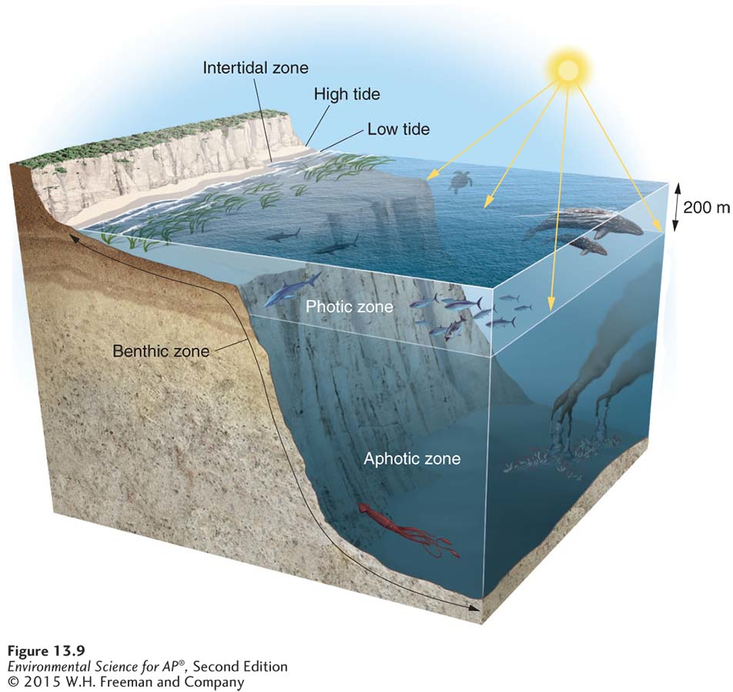
Open Ocean
The open ocean. The open ocean can be separated into several distinct zones.

