Slide 1
Module 25 Weathering and Soil Science
After reading this module, you should be able to
understand how weathering and erosion occur and how they contribute to element cycling and soil formation.
explain how soil forms and describe its characteristics.
describe how humans extract elements and minerals and the social and environmental consequences of these activities.

Slide 2
The processes of weathering and erosion contribute to the recycling of the elements
When rock is exposed at Earth's surface, it begins to break down through the processes of weathering and erosion.

Slide 3
Weathering
Physical weathering The mechanical breakdown of rocks and minerals.
Chemical weathering The breakdown of rocks and minerals by chemical reactions, the dissolving of chemical elements from rocks, or both.
Acid precipitation Precipitation high in sulfuric acid and nitric acid from reactions between water vapor and sulfur and nitrogen oxides in the atmosphere. Also known as Acid rain.

Slide 4
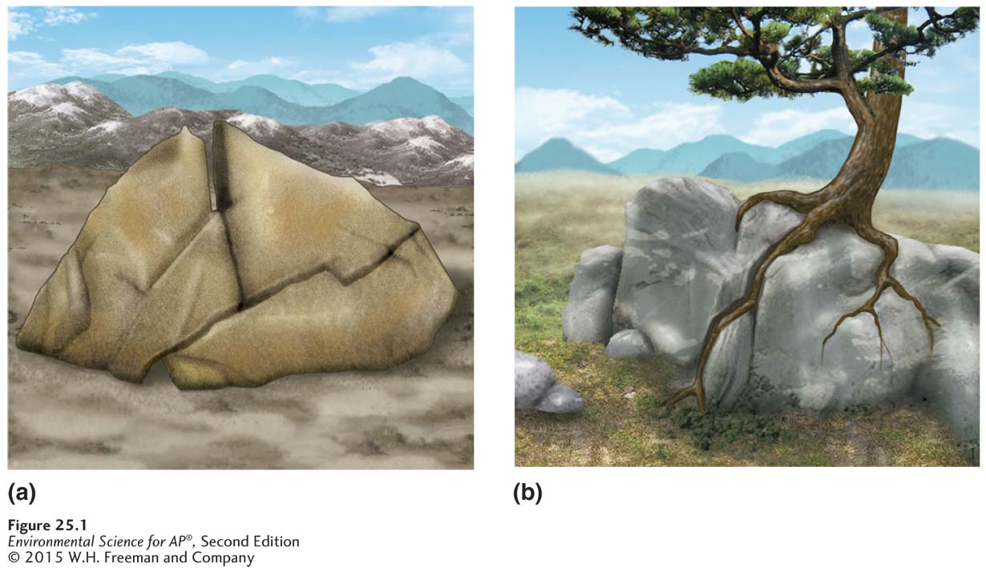
Weathering
Physical weathering. (a) Water can work its way into cracks in rock, where it can wash
away loose material. When the water freezes and expands, it can widen the cracks. (b) Growing plant roots can force rock sections apart.

Slide 5
Erosion
Erosion The physical removal of rock fragments from a landscape or ecosystem.
Erosion is usually the result of two processes:
Wind, water and ice move materials downslope.
Living organisms burrow under the soil.

Slide 6
Soil links the rock cycle and the biosphere
Soil serves many functions:
A medium for plant growth
A filter for water
A habitat for living organisms
A filter for pollutants

Slide 7
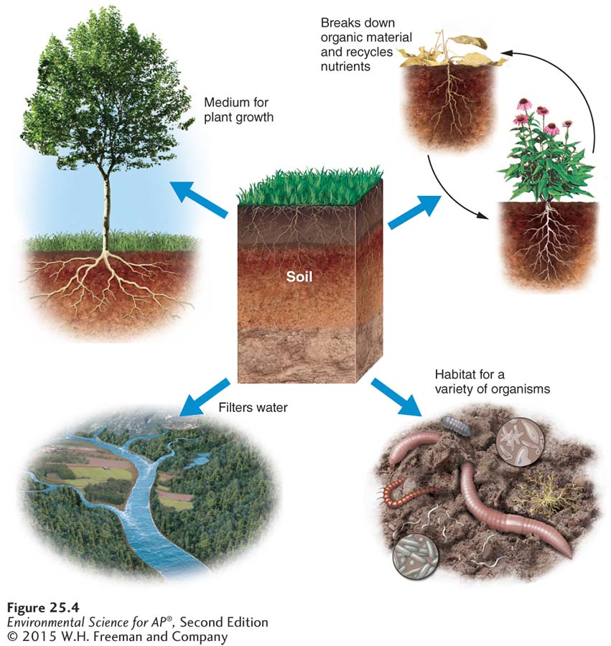
Soil links the rock cycle and the biosphere
Ecosystem services provided by soil.
Soil serves as a medium for plant growth, as a habitat for other organisms, and as a recycling system for organic wastes. Soil also helps to filter and purify water.

Slide 8
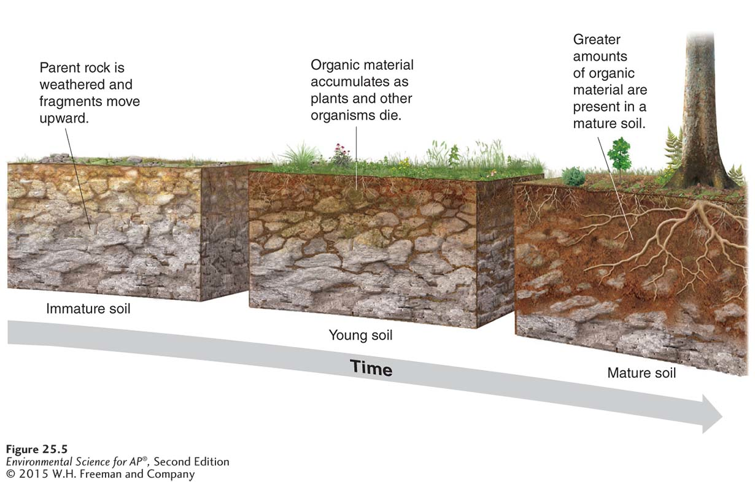
The Formation of Soil
Soil formation. Soil is a mixture of organic and inorganic matter. The breakdown of rock and primary minerals from the parent material provides the inorganic matter. The organic matter comes from organisms and their wastes.

Slide 9
The Formation of Soil
Five factors determine the properties of soil:
Parent material The rock material from which the inorganic components of a soil are derived.
Climate
Topography
Organisms
Time
Soil degradation The loss of some or all of a soil’s ability to support plant growth.

Slide 10
Soil Horizons
Horizon A horizontal layer in a soil defined by distinctive physical features such as texture and color.

Slide 11
Soil Horizons
There are five soil horizons:
O horizon The organic horizon at the surface of many soils, composed of organic detritus in various stages of decomposition.
A horizon Frequently the top layer of soil, a zone of organic material and minerals that have been mixed together. Also known as Topsoil.
E horizon A zone of leaching, or eluviation, found in some acidic soils under the O horizon or, less often, the A horizon.
B horizon A soil horizon composed primarily of mineral material with very little organic matter.
C horizon The least-weathered soil horizon, which always occurs beneath the B horizon and is similar to the parent material.

Slide 12
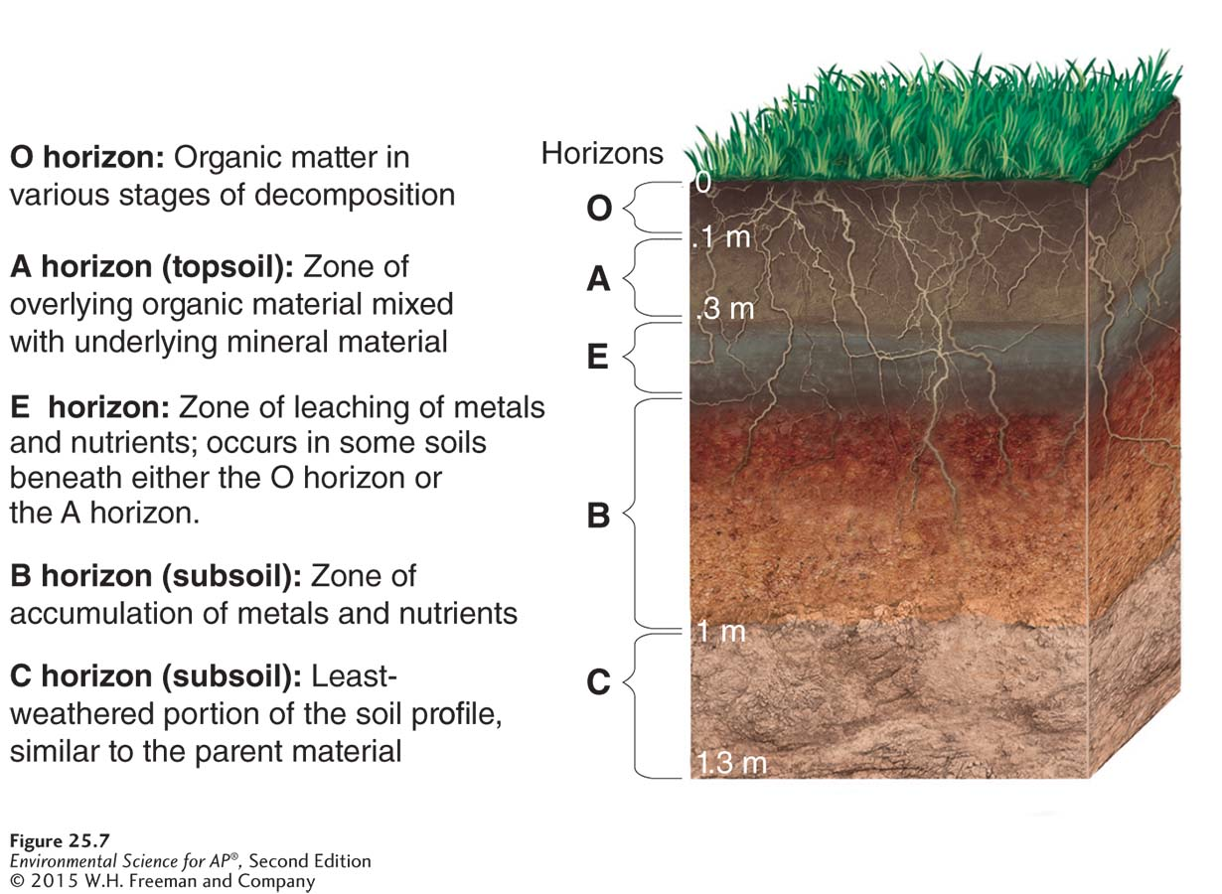
Soil Horizons
Soil horizons. All soils have horizons, or layers, which vary depending on soil-forming factors such as climate, organisms, and parent material. Most soils have either an O or A horizon and usually not both. Some soils that have an O horizon also have an E horizon.

Slide 13
Properties of Soil
There are three properties of soil:
Physical
Chemical
Biological

Slide 14
Properties of Soil
The physical properties of soil refer to physical characteristics such as size and weight.
The texture of a soil is determined by its percentage of sand, silt, and clay.
Soil permeability depends on its texture.

Slide 15
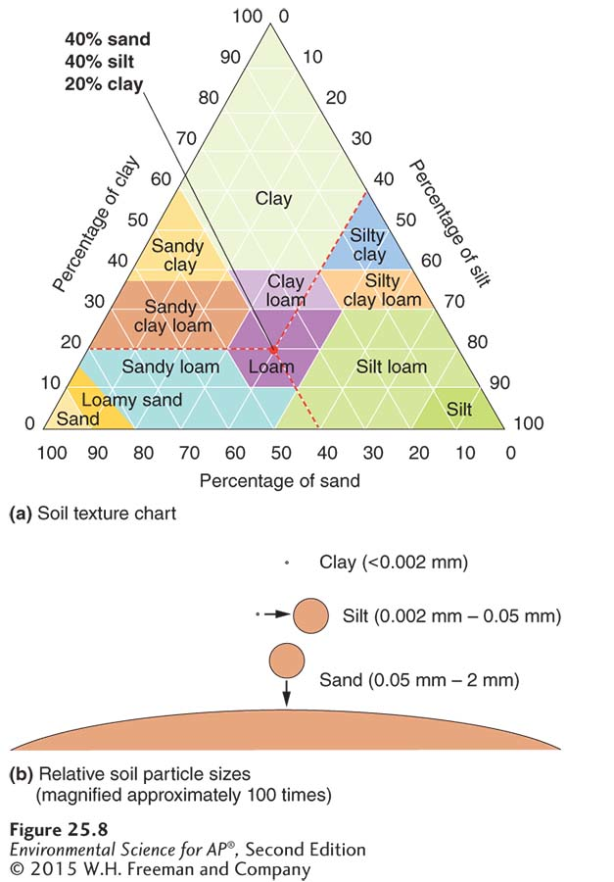
Properties of Soil
Soil properties. (a) Soils consist of a mixture of clay, silt, and sand. The relative proportions of these particles determine the texture of the soil.
(b) The relative sizes of sand, silt, and clay.

Slide 16
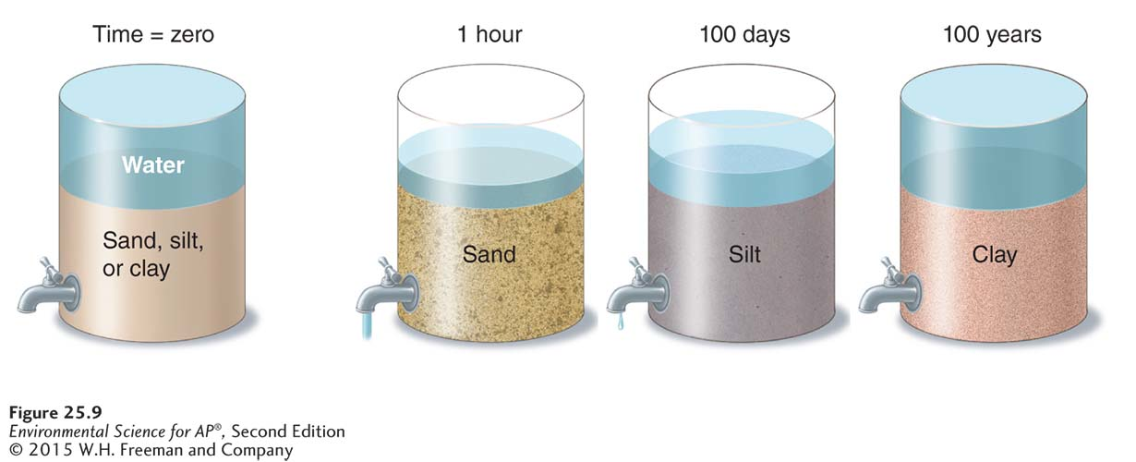
Properties of Soil
Soil permeability. The permeability of soil depends on its texture. Sand, with its large, loosely packed particles, drains quickly. Clay drains much more slowly.

Slide 17
Properties of Soil
The chemical properties of soil help determine how a soil functions.
Cation exchange capacity (CEC) The ability of a particular soil to absorb and release cations.
Base saturation The proportion of soil bases to soil acids, expressed as a percentage.

Slide 18
Properties of Soil
The biological properties of soil refer to the activities of the many organisms living in soil.
Three groups of organisms account for most of the biological activity in soil:
Fungi
Bacteria
Protozoans

Slide 19
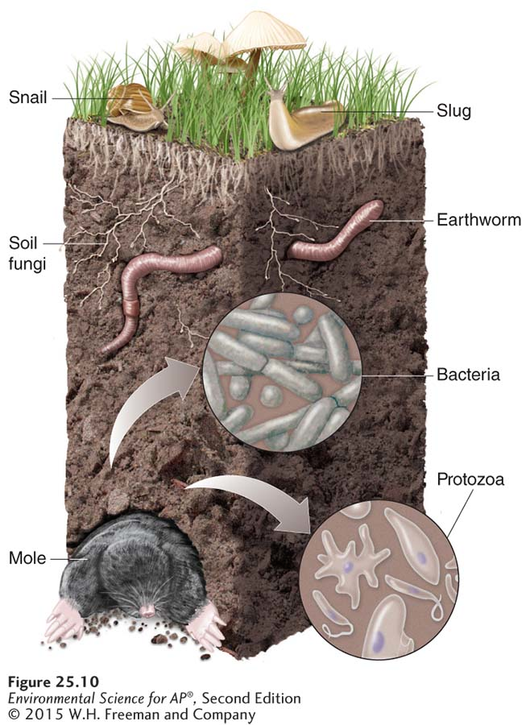
Properties of Soil
Soil organisms. Bacteria, fungi, and protozoans account for 80 to 90 percent of soil organisms. Also present are snails, slugs, insects, earthworms, and rodents.

Slide 20
The distribution of minerals on Earth has social and environmental consequences
Rock and minerals are finite resources.
Some resources are abundant but others are rare.

Slide 21
Abundance of Ores and Metals
Crustal abundance The average concentration of an element in Earth’s crust.
Ore A concentrated accumulation of minerals from which economically valuable materials can be extracted.
Metal An element with properties that allow it to conduct electricity and heat energy, and to perform other important functions.
Reserve In resource management, the known quantity of a resource that can be economically recovered.

Slide 22
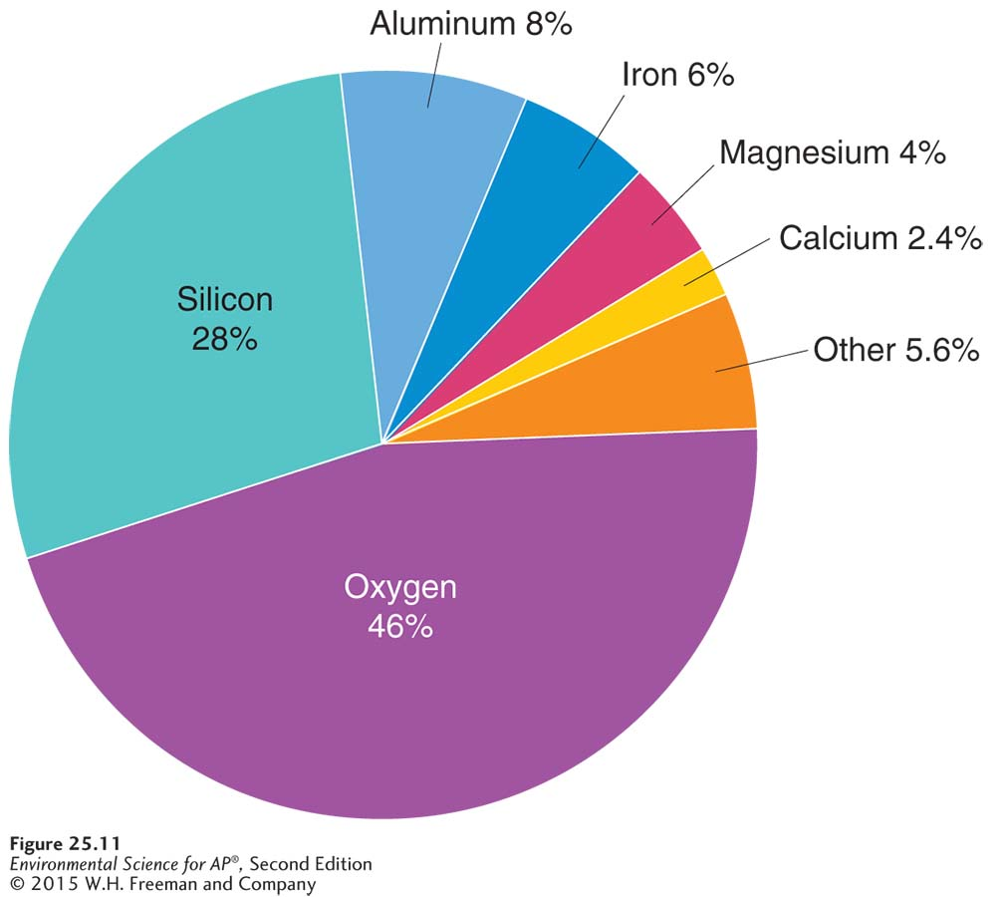
Abundance of Ores and Metals
Elemental composition of Earth’s crust. Oxygen is the most abundant element in the crust. Silicon, aluminum, and iron are the next three most abundant elements.

Slide 23
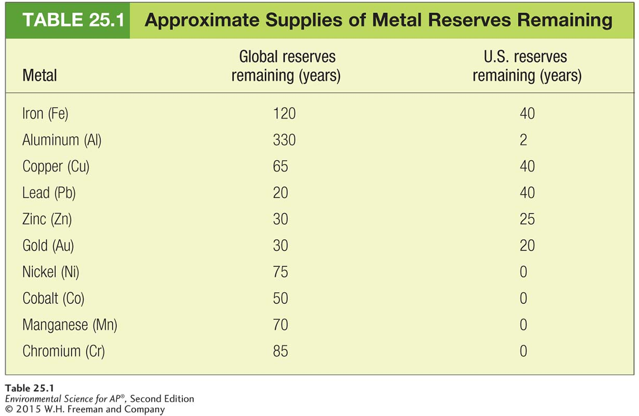
Abundance of Ores and Metals

Slide 24
Mining Techniques
Mining can be on the surface or below the surface.
Surface mining includes:
Strip mining
Open-pit mining
Mountaintop removal
Placer mining

Slide 25
Surface Mining Techniques
Strip mining The removal of strips of soil and rock to expose ore.
Mining spoils Unwanted waste material created during mining. Also known as Tailings.
Open-pit mining A mining technique that uses a large visible pit or hole in the ground.
Mountaintop removal A mining technique in which the entire top of a mountain is removed with explosives.
Placer mining The process of looking for minerals, metals, and precious stones in river sediments.

Slide 26
Subsurface Mining Techniques
Subsurface mining Mining techniques used when the desired resource is more than 100 m (328 feet) below the surface of Earth.
Coal, diamonds, and gold are some of the materials extracted by subsurface mining.

Slide 27
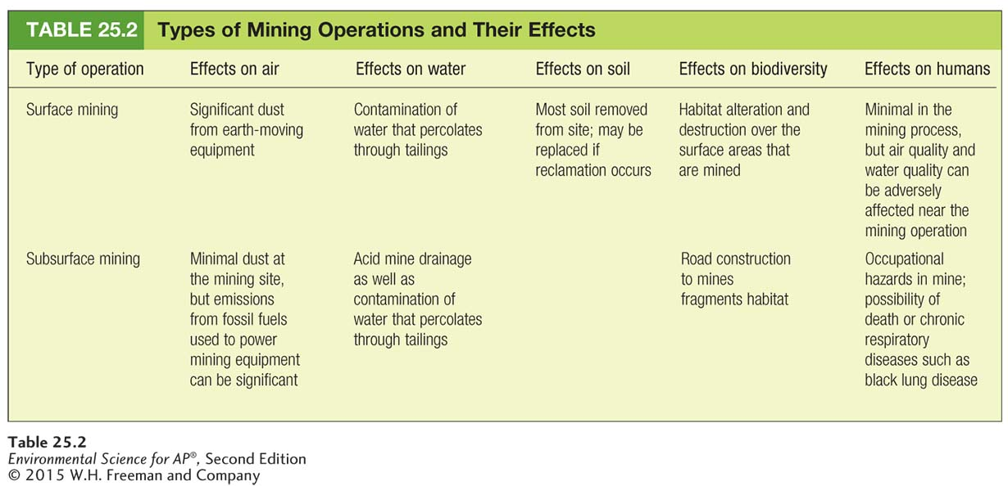
The Environment and Safety

