Slide 1
Matter and Energy in Organisms and Ecosystems

Slide 2
What is Energy?
Energy- The ability to do work (change to take place) or transfer heat;
Thermodynamics- the study of the flow and transformation of energy in the universe.
First law—energy can be converted from one form to another, but it cannot be created nor destroyed.
Second law—energy cannot be converted without the loss of usable energy.

Slide 3
Different kinds of Energy
2 General Types:
1. Kinetic energy The energy of motion.
2. Potential energy Stored energy that has not been released.

Slide 4
Different kinds of Energy
Specific types of energy:
Electromagnetic radiation A form of energy emitted by the Sun that includes, but is not limited to, visible light, ultraviolet light, and infrared energy. (light energy)
Chemical energy Potential energy stored in chemical bonds in compounds, E.g. food.
Mechanical energy Can be either kinetic energy (energy of motion) or potential energy (stored energy of position) E.g. Sound.
Thermal Energy Heat energy

Slide 5
How Do Organisms Get Energy?
All organisms get there energy from food!
Autotrophs Organisms that make their own food. E.g. Plants, algae
Heterotrophs Organisms that need to ingest food to obtain energy. E.g. Wolves, ants, cows
Chemotroph Use inorganic substances (chemicals & gases) for source of energy. E.g. Bacteria on thermal vents of the ocean floor

Slide 6
How Do Organisms Get Energy?
Which is which?

Slide 7
Autotrophs and Energy
Photosynthesis light energy from the sun is converted to chemical energy for use by the cell

Slide 8
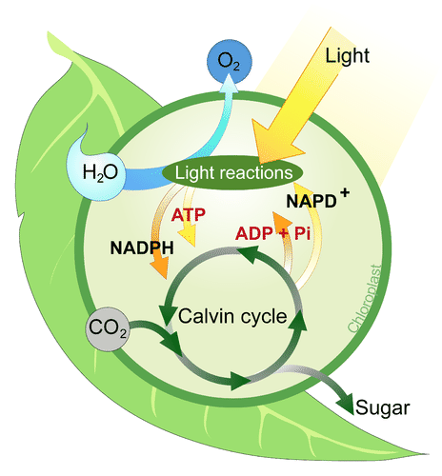
Photosynthesis
Inputs: Carbon dioxide, Water and Light
Outputs: Glucose (sugar) and Oxygen

Slide 9
Photosynthesis and the Plant
Leaves are used to absorb light energy
Roots are used for the up take of water
Most of the plants chemical energy conversion takes place in the stem/trunk of the plant

