Slide 1
Food, Molecules and Energy
Other types of lipids include steroids (E.g. cholesterol), saturated and unsaturated fats:

Slide 2
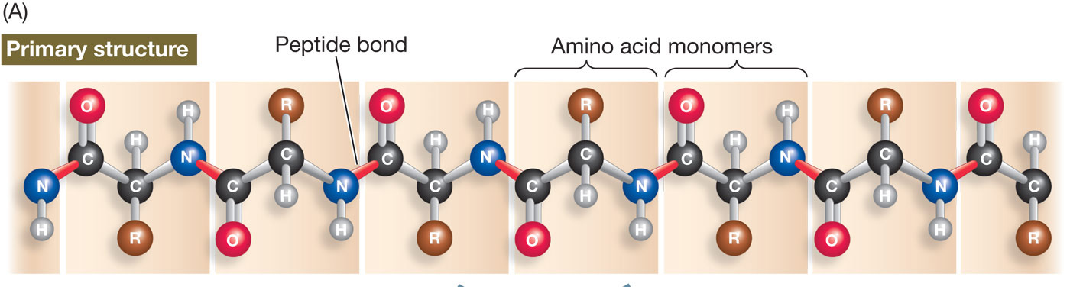
Food, Molecules and Energy
3. Proteins Molecule made of small carbon molecules called amino acids.
Amino acids Small molecules that are made of carbon, nitrogen, oxygen, hydrogen, and sometimes sulfur.
Polypeptides Large chains of amino acids(polymers). Functional proteins are made up of one or more polypeptides.

Slide 3
Food, Molecules and Energy
Proteins have many functions:
Enzymes—catalytic molecules(speed up chemical reactions)
Defensive proteins (E.g., antibodies)
Hormonal & regulatory proteins control physiological processes
Receptor proteins receive and respond to molecular signals
Storage proteins store amino acids
Structural proteins physical stability and movement to cells
Transport proteins carry substances (e.g., hemoglobin)
Genetic regulatory proteins
regulate when, how, and to what extent a gene is expressed

Slide 4
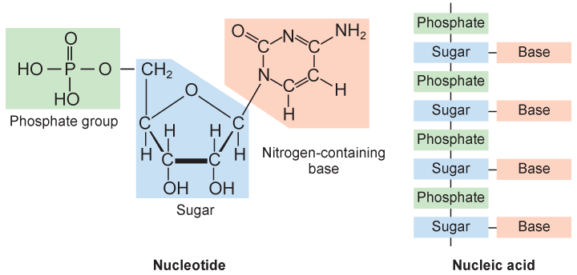
Food, Molecules and Energy
4. Nucleic Acids made of smaller repeating molecules called nucleotides. Store, transmit, and express hereditary/genetic information(instructions to make proteins).
Nucleotides molecules composed of carbon, nitrogen, oxygen, phosphorus, and hydrogen atoms.

Slide 5
Food, Molecules and Energy
2 Types of Nucleic Acids:

